Slide 1








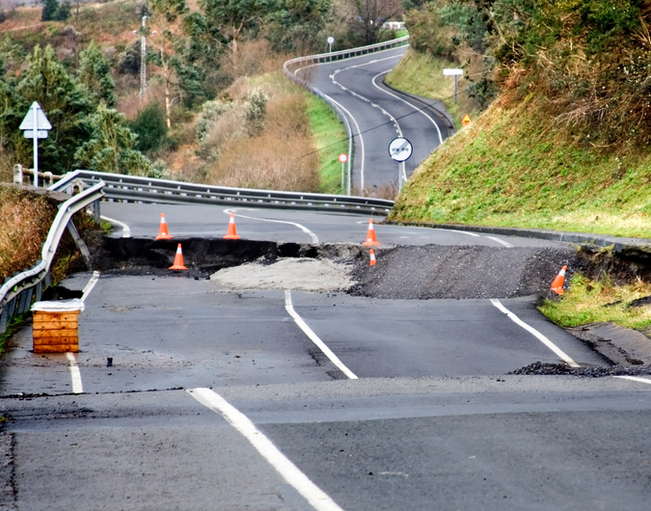

The Opportunities & Obstacles in Insuring
Non-Tangible Assets
Workshop C7 – Marc Davis, Roy Bauman, Tom Keist

Slide 2
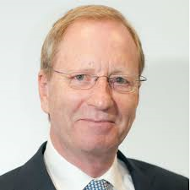

An Introduction from John Hurrell and Clive Clarke
“The opportunities& threats facing our members have never been greater or more profound.
We are seeing risk move ever higher up board agendas which is opening new doors for our members.
But at the same time, conventional property and casualty insurance is struggling to maintain its strategic relevance……
……as companies transform their business models”

Slide 3
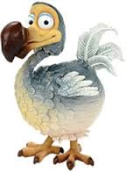
AIRMIC study – keeping the industry relevant
74% The Risk management profession must undergo significant change
82% Risk and how it is managed will become more regular agenda item
82% Risk management value will increase over next 3 years
51% See loss of reputation as their #1 risk

Slide 4
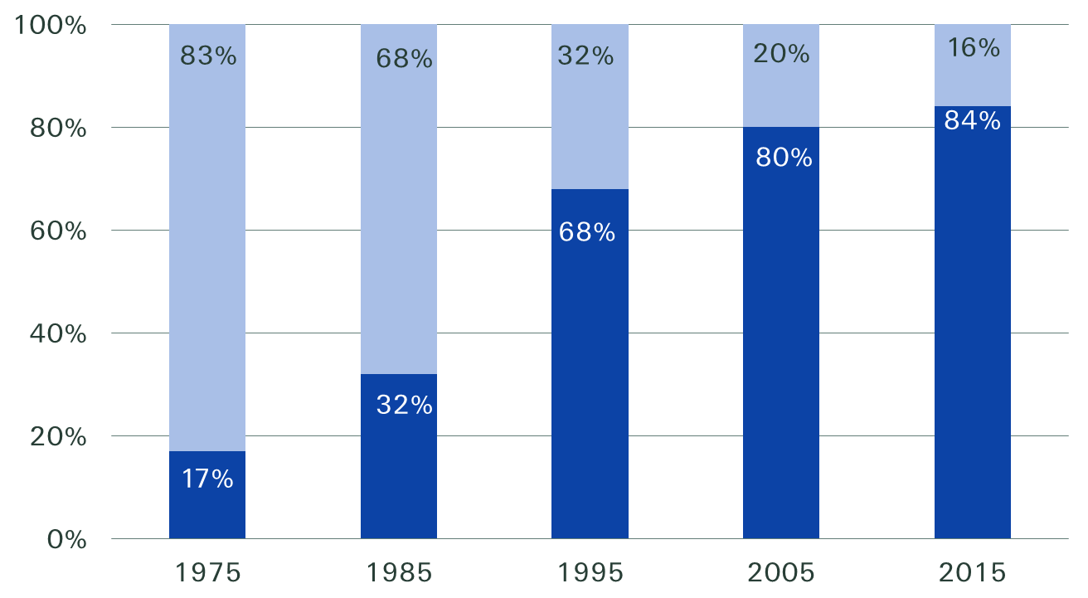
Two interesting observations … # 1
Components of S&P 500 market value
Source: Ocean Tomo, LLC. January 1, 2015
Uber, the world’s largest taxi company, owns no vehicles.
Facebook, the world’s most popular media owner, creates no content.
Alibaba, the most valuable retailer, has no inventory and .
Airbnb, the world’s largest accommodation provider, owns no real estate.
Source: “The Battle Is For The Customer Interface”, by Tom Goodwin of Havas Media on Tech Crunch Network.

Slide 5
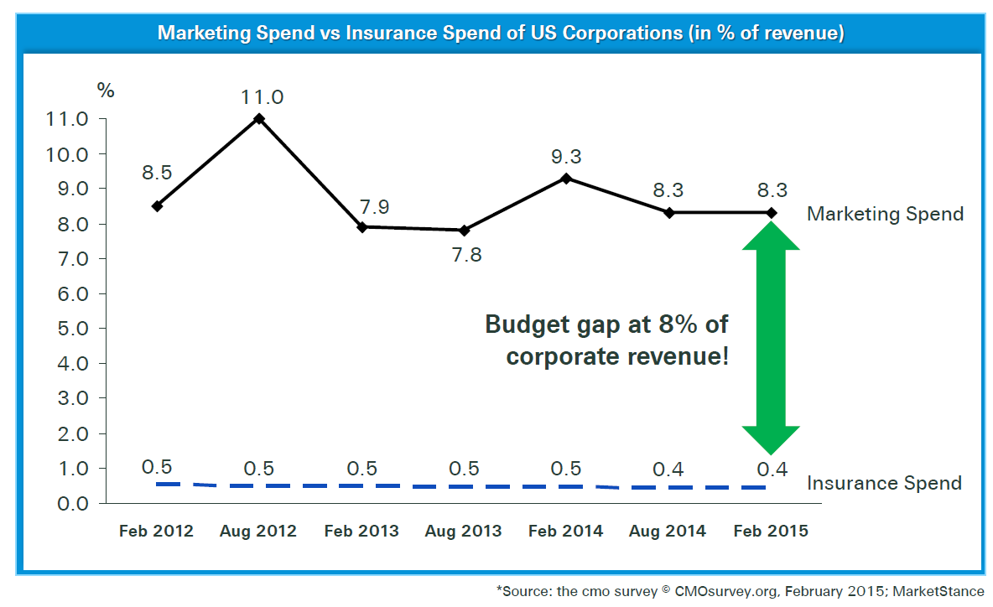
…….#2
Marketing spend vs Insurance spend of US corporations (in % of revenue)
Source: Ocean Tomo, LLC. January 1, 2015
Growthsurance™ is a Swiss Re Corporate Solutions trademark, which we registered in 2015.
It stands for a concept whereby we help our clients to achieve growth by managing the risks involved in their business development initiatives.
Source: The cmo survey, CMOsurvey.org. February 2015

Slide 6
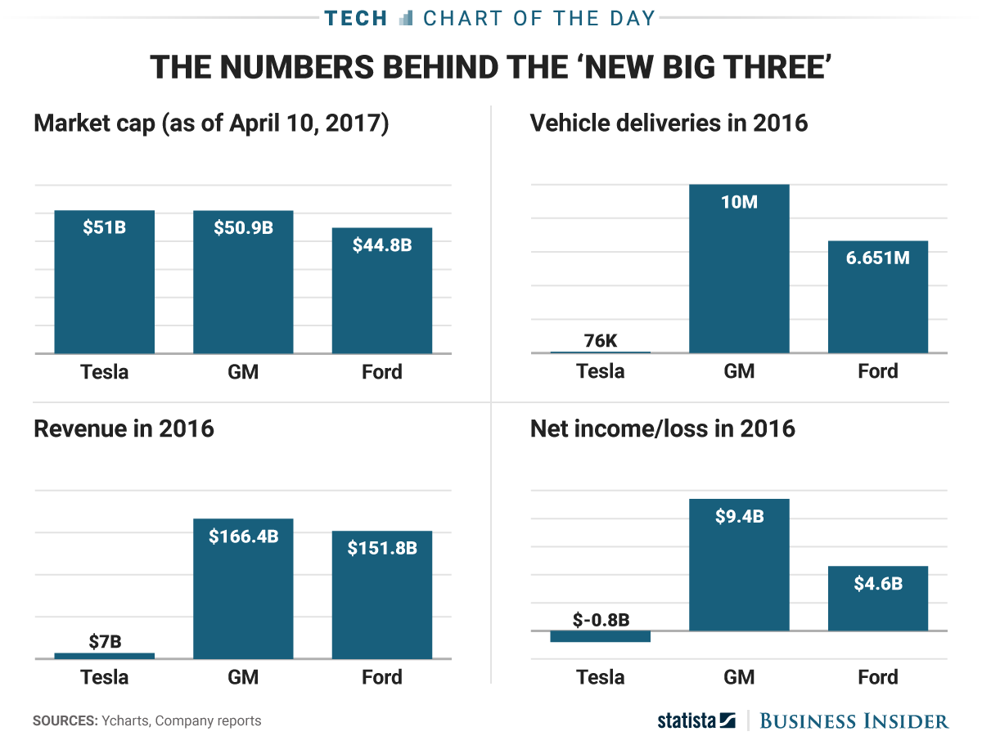
The New Reality – future potential rather than fundamentals
with thanks to UK Business Insider

Slide 7
… and emerging risks …
1
Business interruption
incl. supply chain disruption and vulnerability
2
Market developments
volatility, new entrants, M&A, market stagnation
3
Cyber risks
IoT, cyber attacks, cyber crime, IT failure, data breaches
4
Natural catastrophes
5
Regulatory uncertainty
BEPS, protectionism, sanctions
6
Macroeconomic developments
austerity, deflation, inflation, commodity prices
7
Fire, explosions
8
Political risks and violence
war, terrorism, populism, changing political landscape
9
Loss of reputation and brand value
1
0
New technologies
3 D printing, internet of things, AI, drones, etc.
Sources: Allianz Risk Barometer 2017; FERMA: European Risk and Insurance Report 2016; Marsh: Global Geopolitical Risk Concerns for Businesses in 2017; Swiss Re: Sonar; Willis Towers Watson: What risks will emerge in 2017
Notes:
Growth in insurance will come from the OTC segment, in particular innovative risk transfer solutions.

Slide 8




… require new approaches
Areas
Applications
Needs
Growthsurance TM
Insurance for sales promotions
Reimbursement for adverse weather
Product outage
Over-redemption
Promoting a product or sales campaign
Revenue protection
Non Physical Damage BI
NatCat / Weather
Regulatory actions
Terror
Pandemic
Negative Press
Protection of a (critical) business plan
Protection against sensitive revenue fall
Parametric Solutions
NatCat exposed assets
Weather exposed assets
Objective triggers using big data and/or 3rd party indices
Simplified claim determination
Avoid loss adjusters and complex loss investigation
Ensure immediate cash after a loss
Parametric Solutions
Captive protections
Fronting for the Captive
Capital relieve solutions
Captive alternatives
Setting up an efficient self insurance concept
Increase efficiency of running a captive
Captive Solutions
Notes:
Growth in insurance will come from the OTC segment, in particular innovative risk transfer solutions.

Slide 9
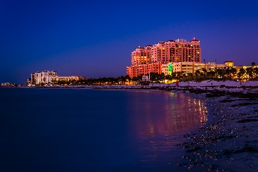
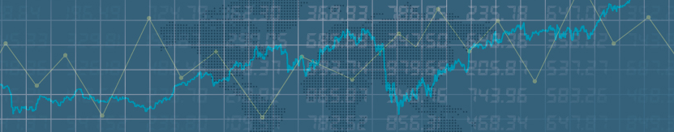

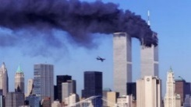
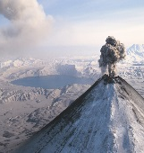
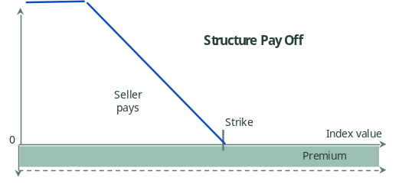
Loss of attraction / widespread travel disruption p&l protection
  Hotel chain owned by a private equity investor is concerned about drop in revenue per available room (RevPAR), a key metric in the industry
RevPAR Index by 3rd party
  Key perils identified are terrorism, pandemic and widespread travel disruption
  Cover pays up to 75m if RevPAR index provided by a 3rd party falls below threshold, following occurrence of named perils (formulaic pay-out based on index)
Pandemic
Terrorism
Pay Off
Widespread travel disruption

Slide 10

Go-to market approach to support client’s core business growthsuranceTM
  The policyholder, a utility company, offers their clients a “payment holiday” in case they are affected by an earthquake or flood event
  Utility company uses insurance as an added benefit to the product to attract new customers. Marketing instrument to differentiate policyholder’s offering
  Directly supports future income growth. Expense is an acquisition cost not a cost of risk
  Parametric, i.e. no proof of direct physical loss required

Slide 11
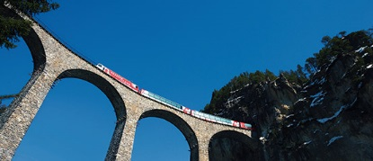


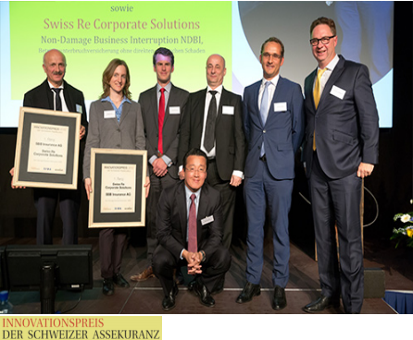
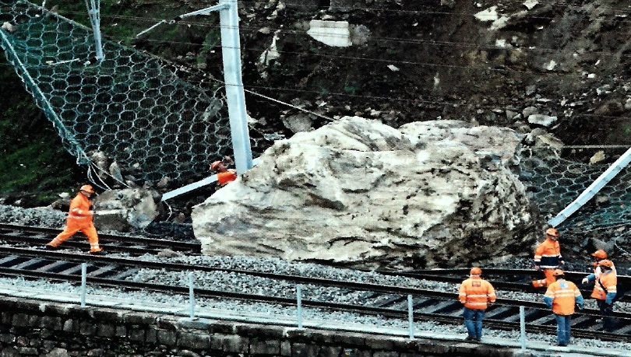
Non-physical damage business interruption p&l protection
  Railways are exposed to risk of business interruption without a damage to its physical property
  Broad cover protects the income statement against several "black swan" type of events. Key perils identified are Cyber, Nat Cat and Regulation
  Cover pays up to 50m (indemnity). Complements the traditional PDBI policy. Costing is entirely based on comprehensive exposure and scenario analysis as well as actuarial modelling
Cyber
“Grounding”
Nat Cat

Slide 12


Expansion plan / adverse publicity p&l protection
  Company has a very successful product and aims to expand its business globally
  Cover protects revenues related to this specific product or product category
  Covers loss of profit and fixed costs in case of drop in sales following adverse publicity specifically relating to the named product or the product category
  Definition of adverse publicity, trigger and pay out are based on in-depths analysis of negative publicity exposure, product type and historical revenue figures

Slide 13
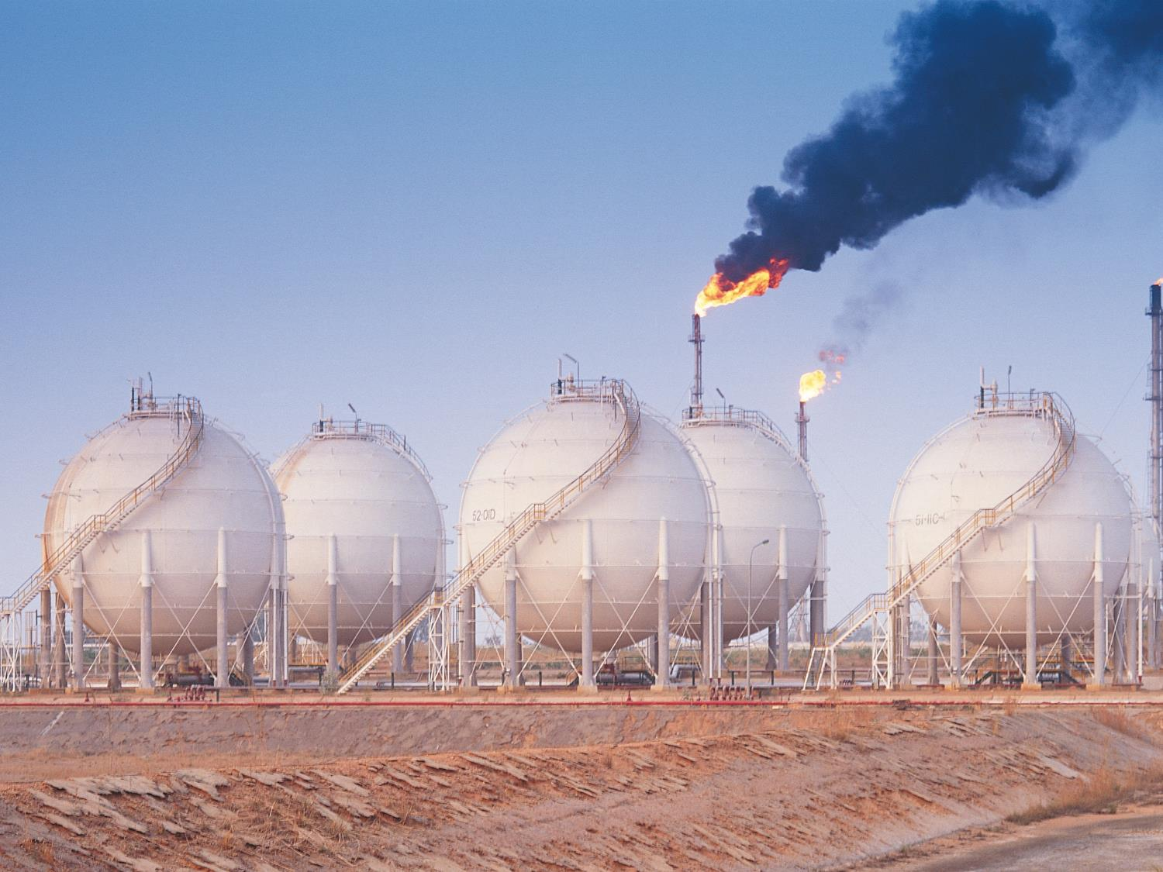

Supplier failure / contingent price hedge p&l protection
  Optimised hedging; protect low margin trading business from rare but potentially large losses due to supplier failure (force majeure)
  Underlying property is not the policyholder's
  Combination of property all risk and traded commodity price risk. Integrated cover combining two risks, i.e. force majeure event at supplier's facilities and traded gas price

Slide 14


Epidemic failure / bathtub cover growthsuranceTM
  Provision of smart metering data to energy suppliers / utilities. The business case rests crucially on the functioning of the meters installed. The meters come with a product warranty by the producer and an extended warranty from an insurer. This addresses the risk of "normal" expected failure rates
  This still leaves the business case exposed to widespread failure of meters substantially in excess of "normal" expected failure rates
  Operator's Extra Expense insurance covers the financial risk of widespread, "epidemic" failure of meters, primarily the extra expense related to the replacement of the meters rather than the cost of the meters themselves

Slide 15
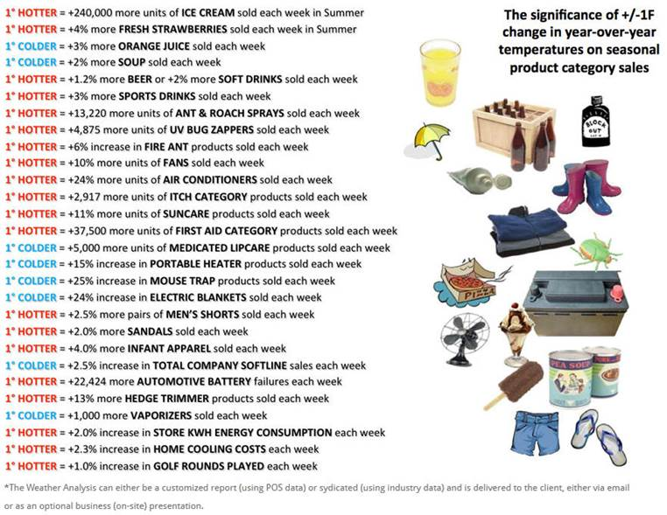
What’s the board concerned about?

Slide 16

Threat or Opportunity ?
OR

Slide 17

“Is … growth over?”¹ … "Not a chance. It's just being held back by our ability to process all the new ideas fast enough.“²
¹R. J. Gordon, "Is US economic growth over? Faltering innovation confronts the six headwinds." CEPR Policy Insight No. 63
²E. Brynjolfsson, A. MacAfee; The Second Machine Age
Notes:
Growth in insurance will come from the OTC segment, in particular innovative risk transfer solutions.

Slide 18
Legal notice
©2017 Swiss Re. All rights reserved. You are not permitted to create any modifications
or derivative works of this presentation or to use it for commercial or other public purposes
without the prior written permission of Swiss Re.
The information and opinions contained in the presentation are provided as at the date of
the presentation and are subject to change without notice. Although the information used
was taken from reliable sources, Swiss Re does not accept any responsibility for the accuracy
or comprehensiveness of the details given. All liability for the accuracy and completeness
thereof or for any damage or loss resulting from the use of the information contained in this
presentation is expressly excluded. Under no circumstances shall Swiss Re or its Group
companies be liable for any financial or consequential loss relating to this presentation.

