Slide 1
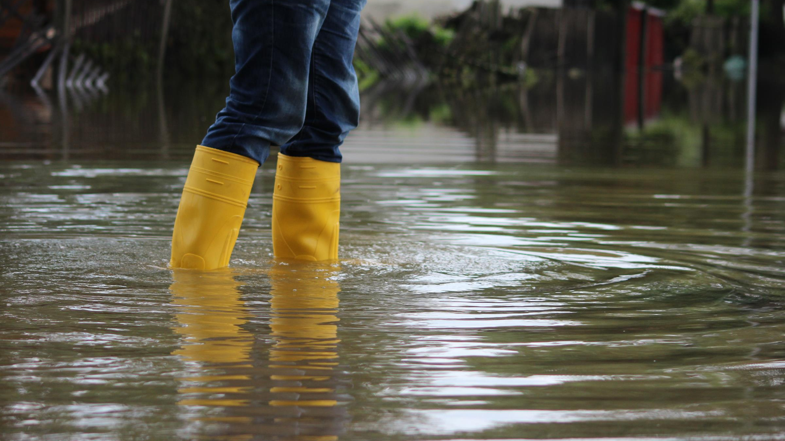

Environmental Challenges Shaping our World
Robert Muir-Wood
Chief Research Officer

Slide 2
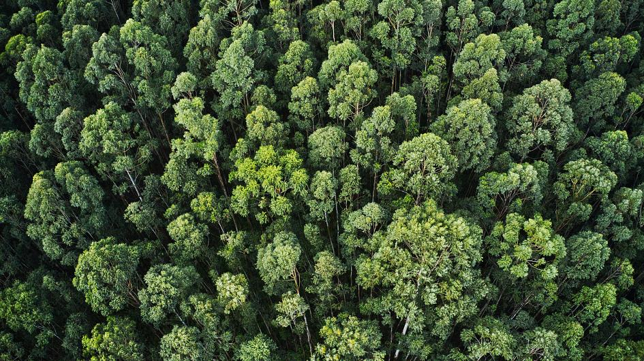
It all starts with trees

Slide 3
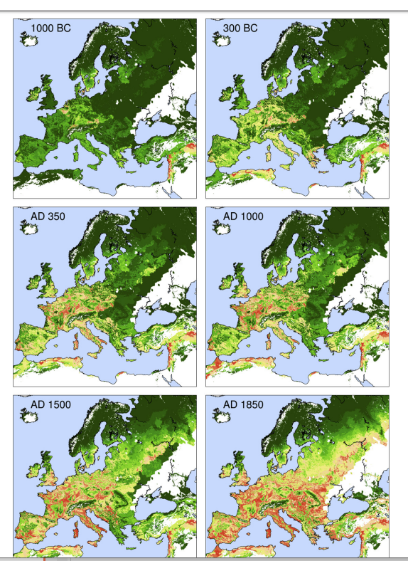
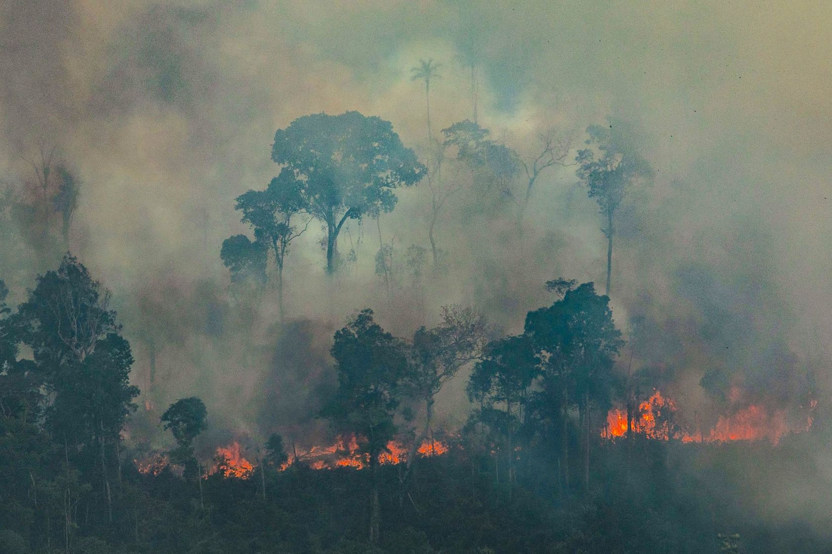
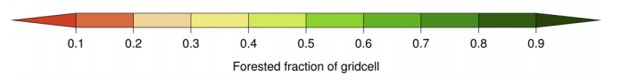
http://citeseerx.ist.psu.edu/viewdoc/download?doi=10.1.1.546.4645&rep=rep1&type=pdf

Slide 4
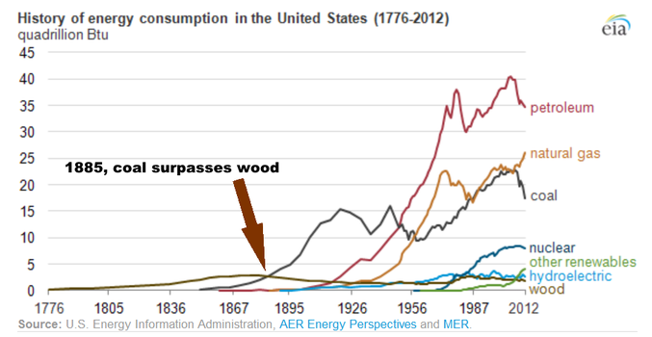

Slide 5
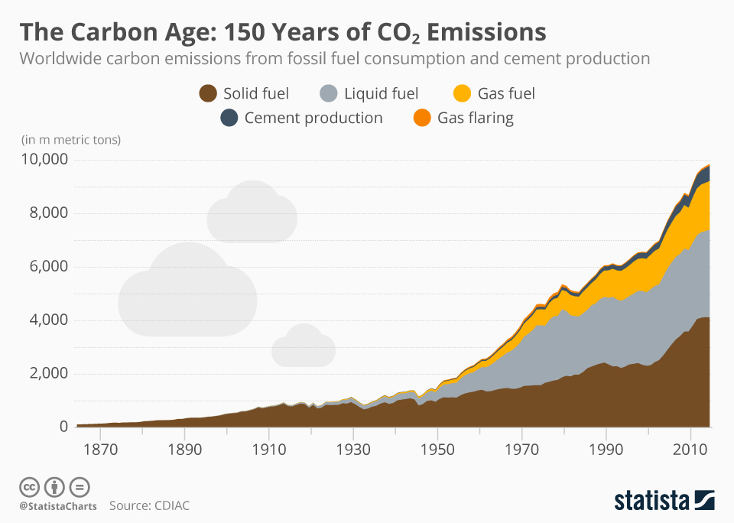

Slide 6
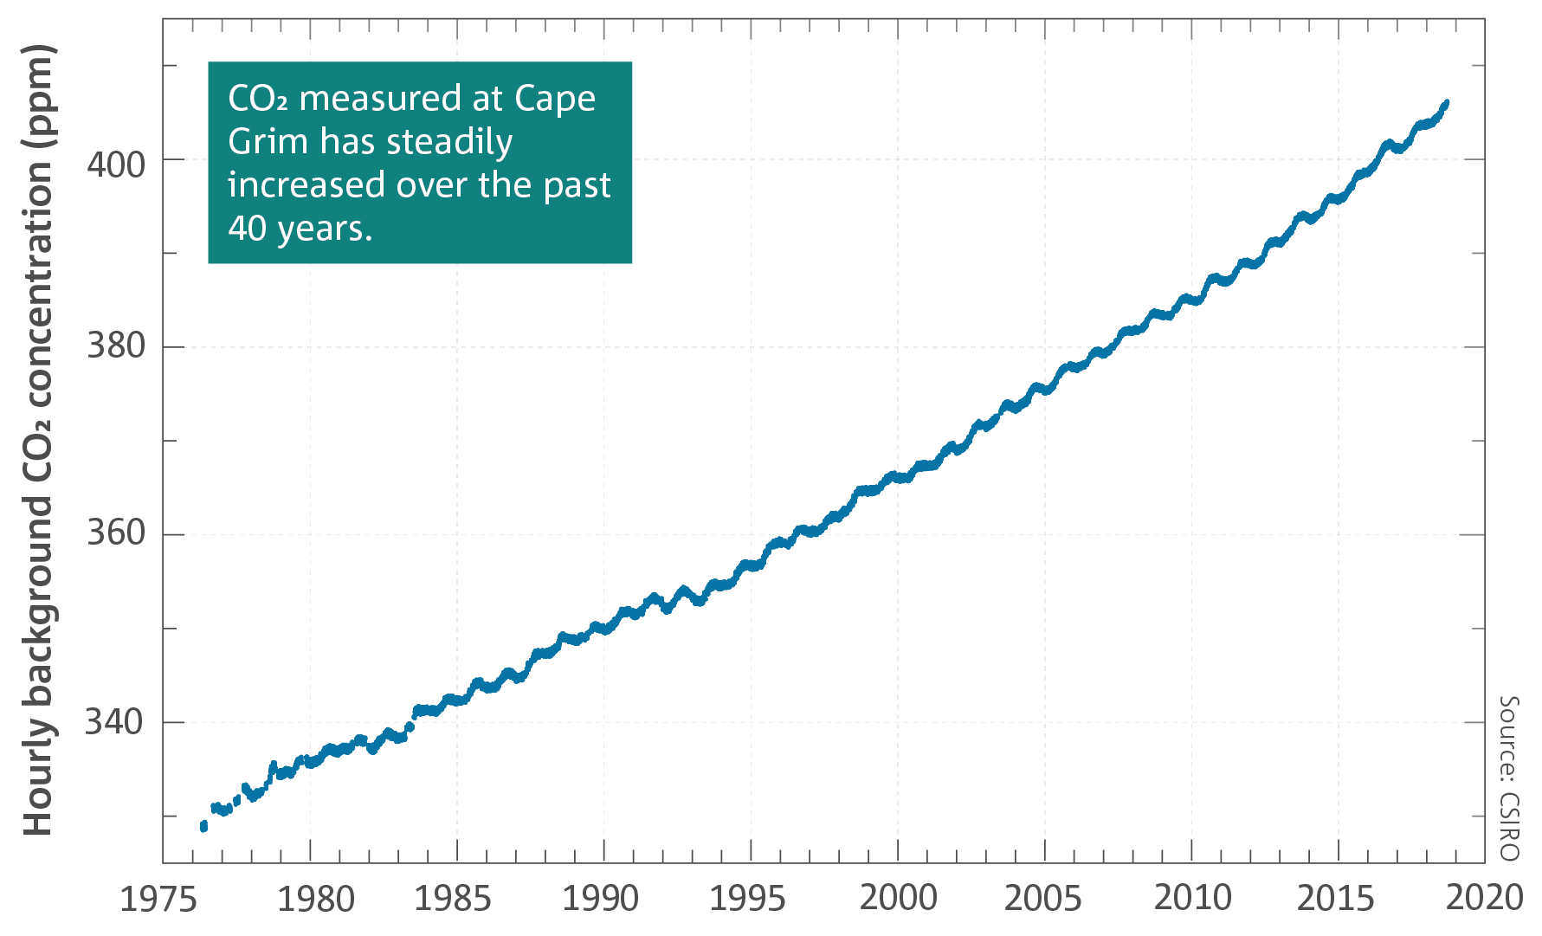

Slide 7
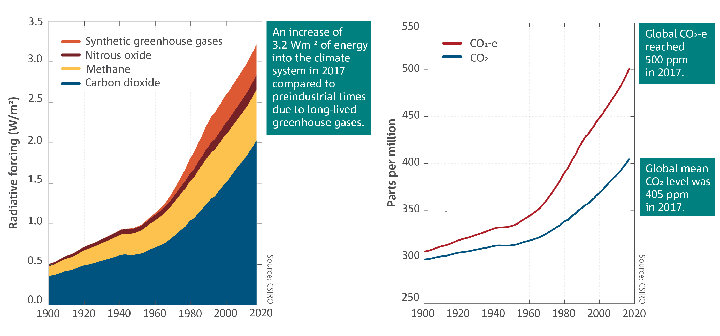

Slide 8
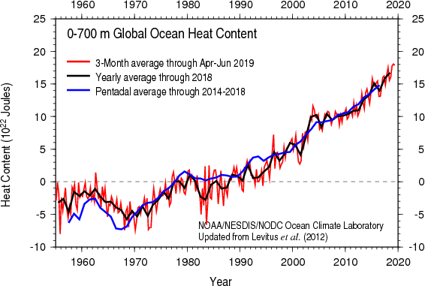
1 Zettajoule = 10E21joules

Slide 9
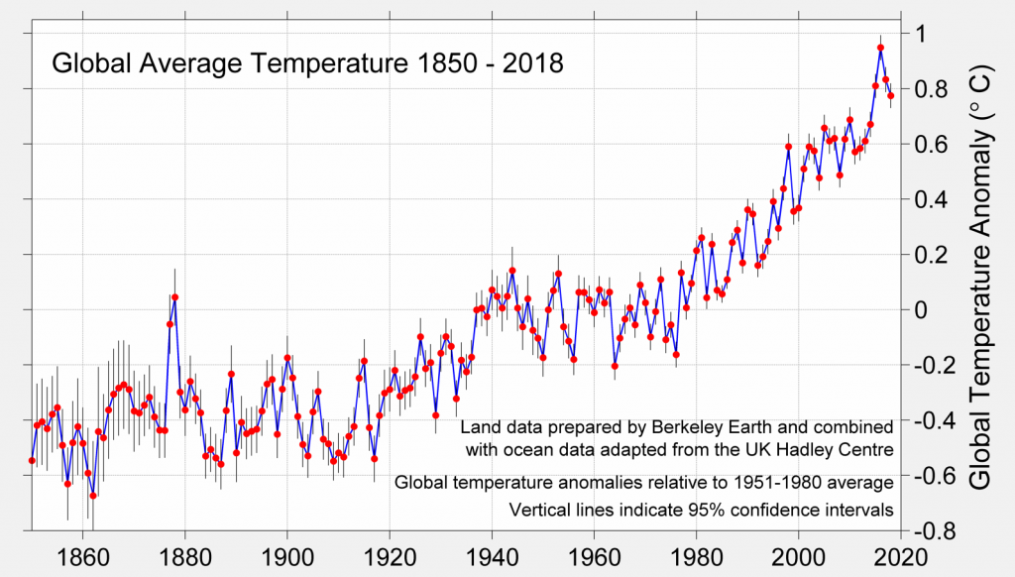

Slide 10
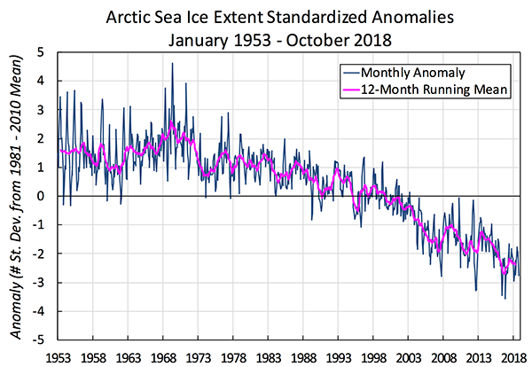

Slide 11
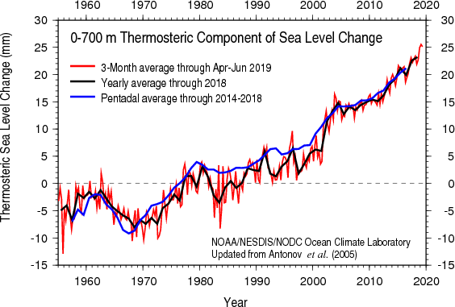
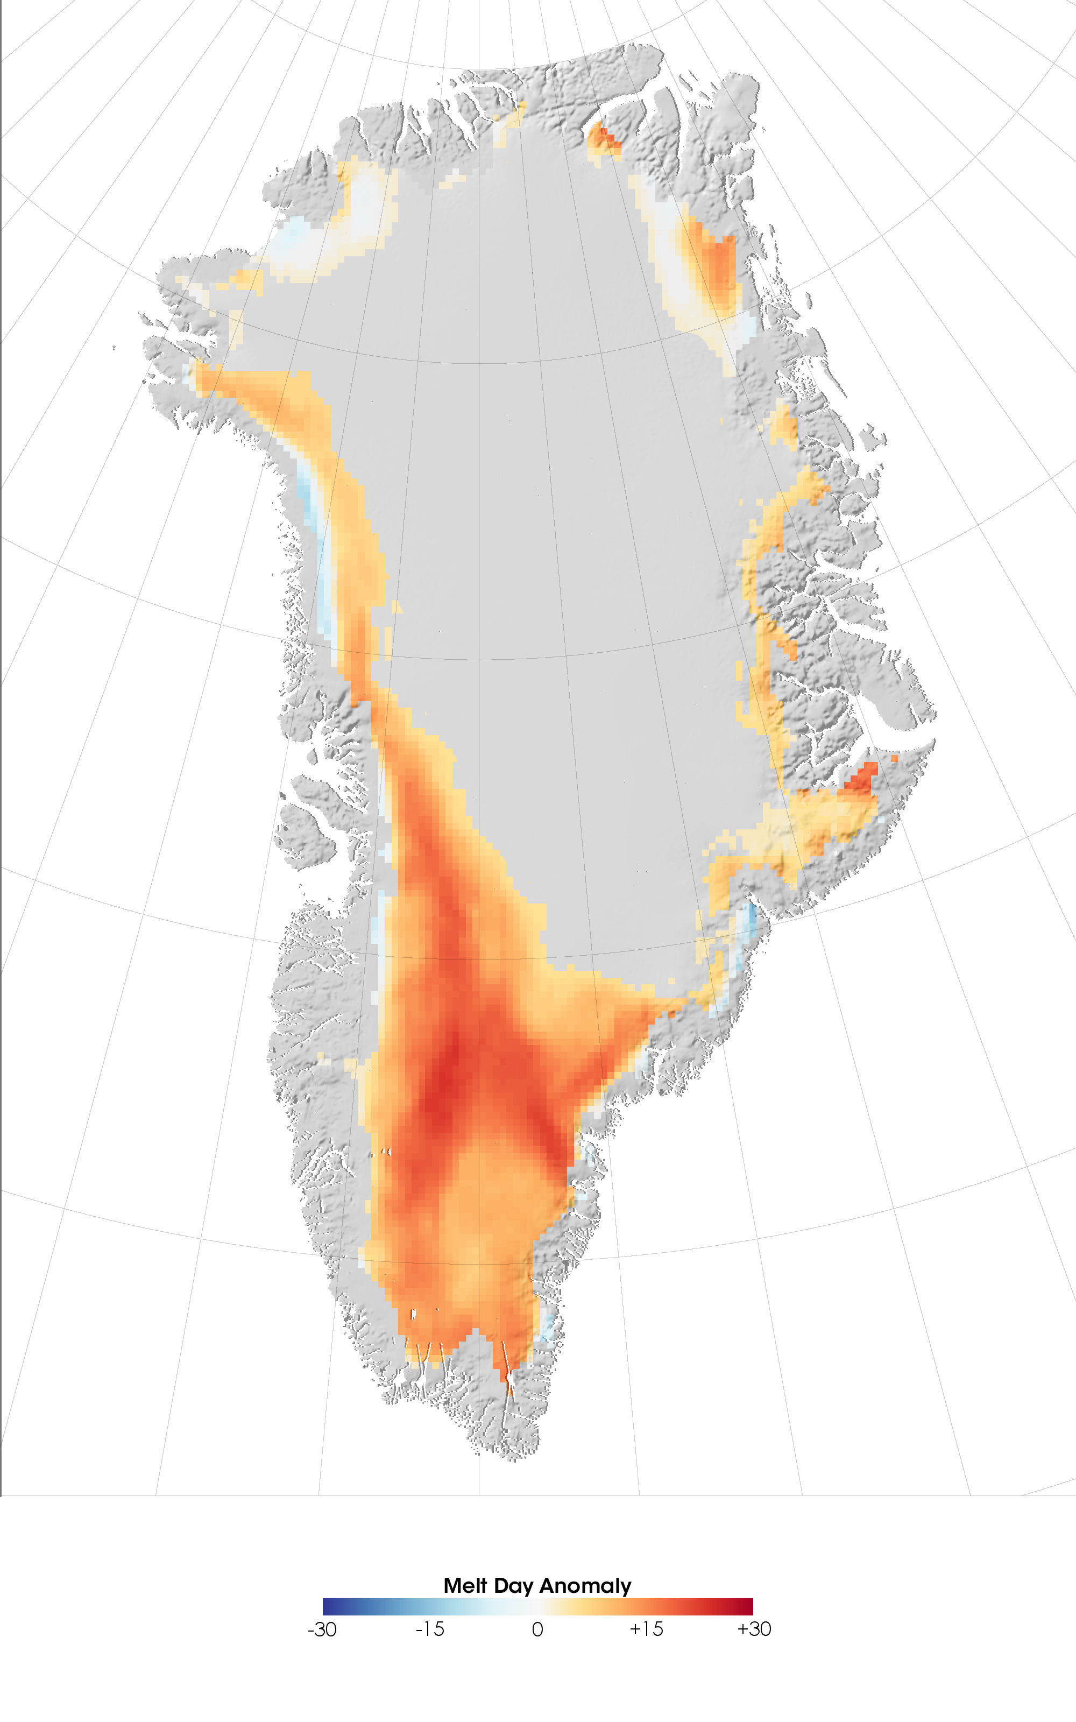
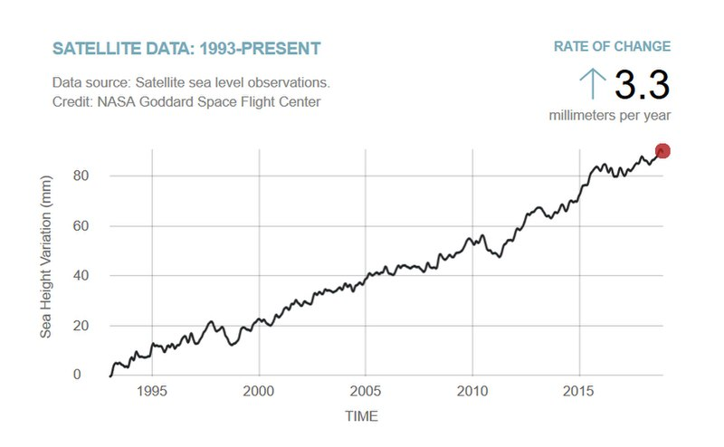
Drivers of sea-level Rise

Slide 12


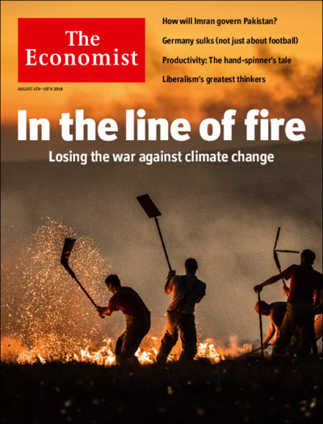
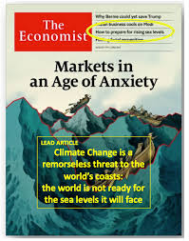


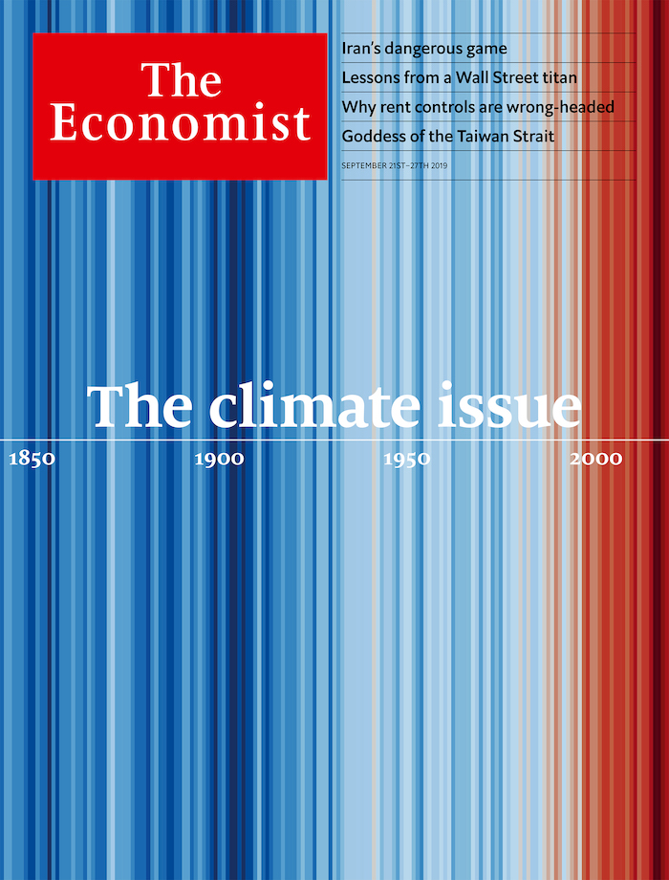


Slide 13

The consequences of climate change
Physical
Systemic
Supply Chain Disruption
Infrastructure Failures
Flood
Wildfire
Acute
Sea-Level Rise
Desertification
Impoverishment
Migration
Chronic

Slide 14
Implications of the Risk horizon on the hazard
Expanded
uncertainty
Infrastructure 50 year view
Hazard
Facilities 20 year view
Insurance 1-5 year view
historical average = static view
1990
2000
2010
2020
2030
2040
2050
2060
2019
Each horizon gives a different perspective

Slide 15
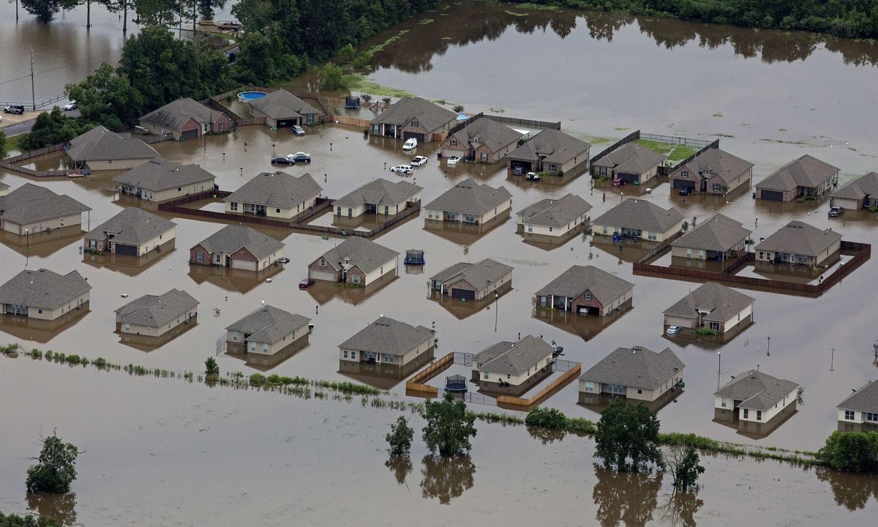
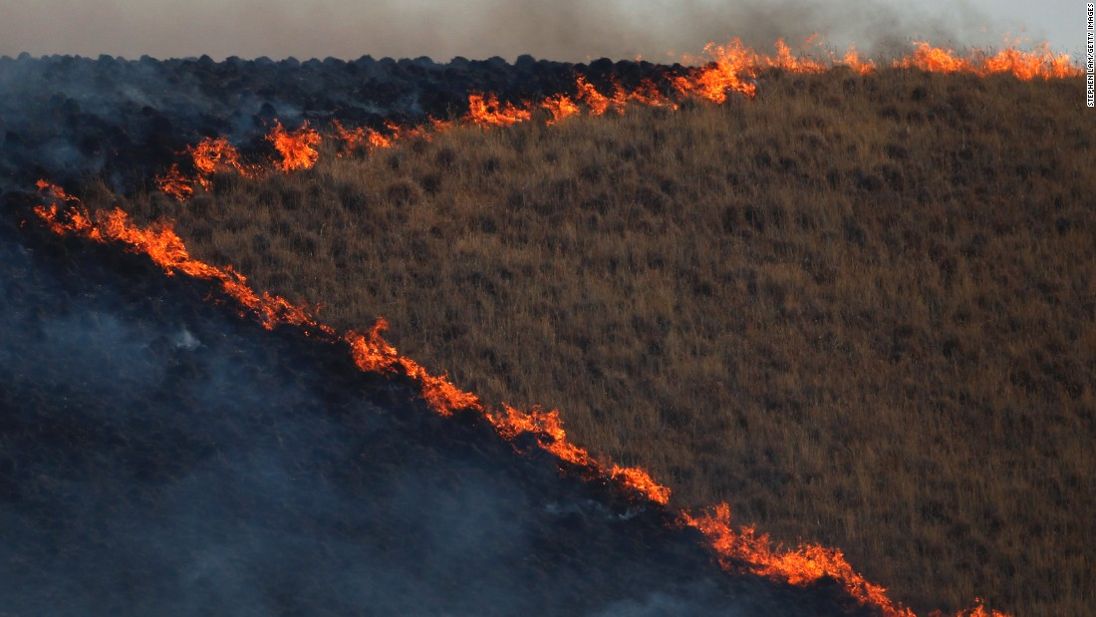
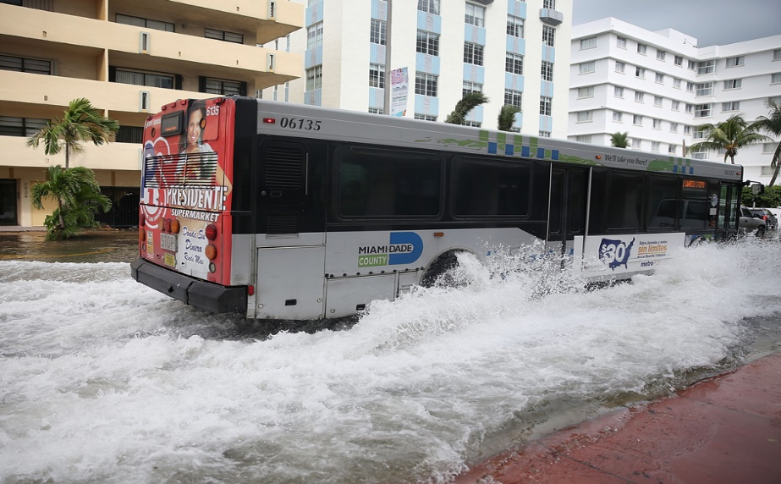
The future is already here – if you know where to look!
Southern Louisiana:
California:
Florida:
Sea-level rise on steroids
Questions around what can be protected
Trends for de-urbanization
‘Whiplash’ climate and fire accelerants
Astronomical v climate sources of flooding
Balancing response to ordinary and extreme flooding

Slide 16
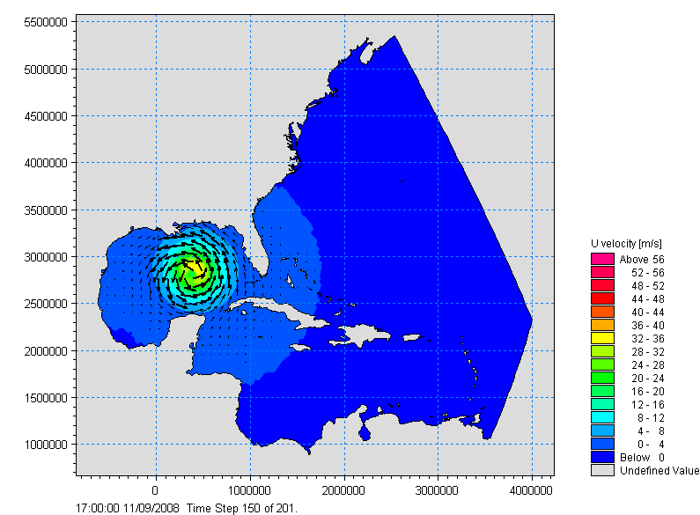
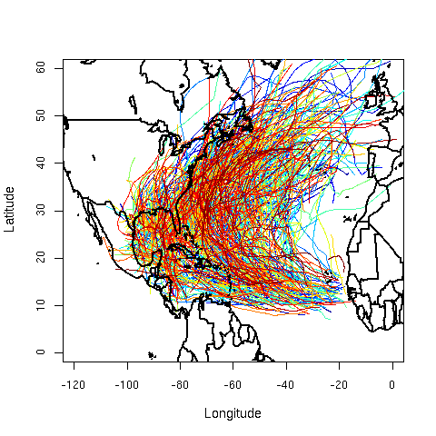
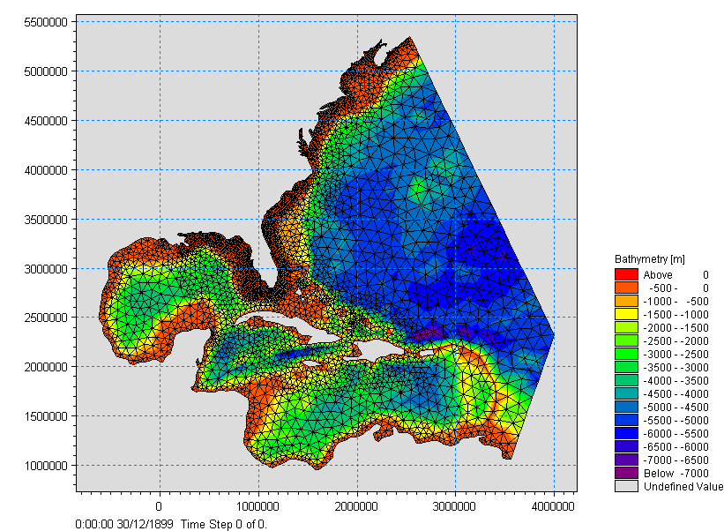
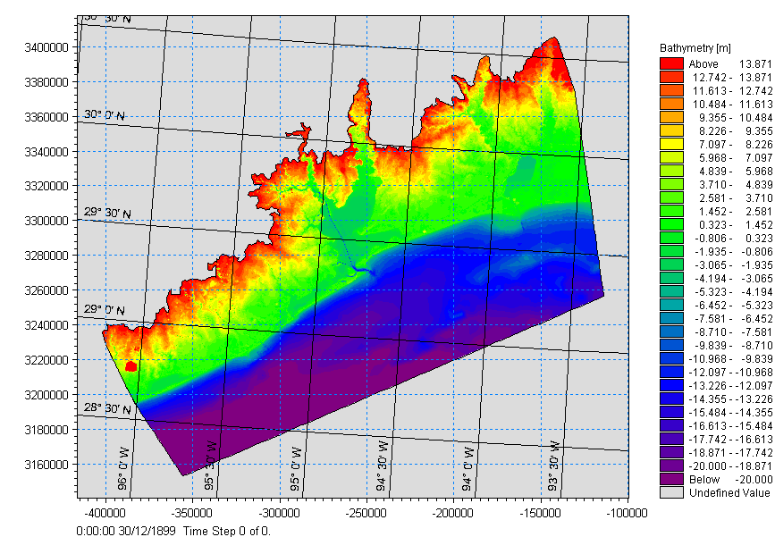
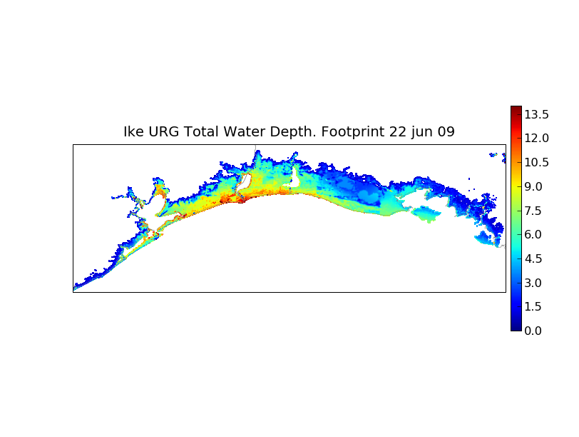
RMS Surge Modeling
TRACK SET
WIND FIELD
REGIONAL MESH
LOCAL MESH
FLOOD DEPTHS
Notes:
The single most important aspect of RMS surge modelling is the direct physical linkage of the RMS hurricane wind field throughout the lifetime of the storms directly to out surge inundations via a nested local and regional mesh configuration.

Slide 17
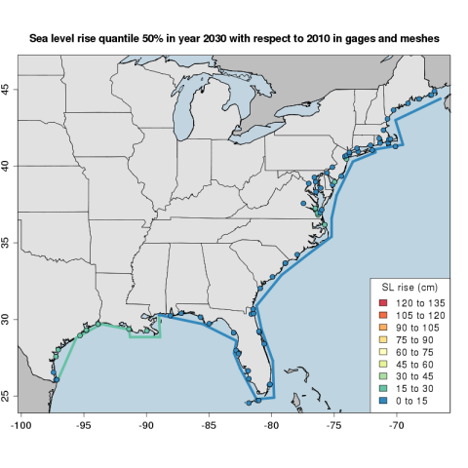
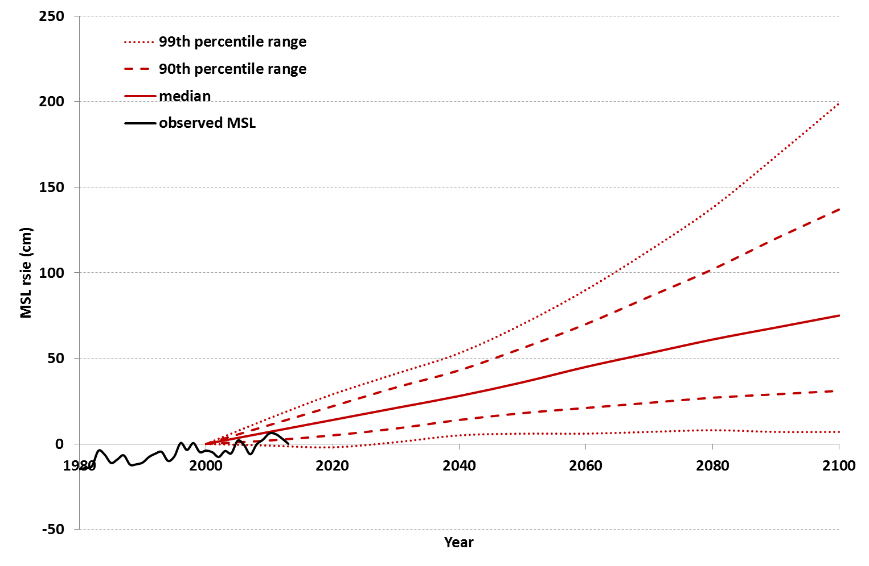
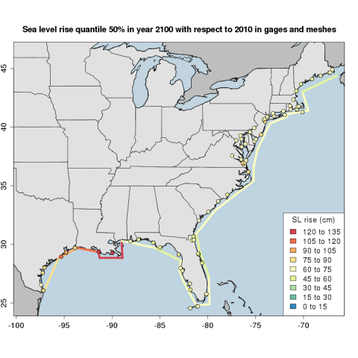
Sea Level Rise: Surge Hazard adjustments by Region
Battery, NYC
2030
2100
Distribution of SLR is sampled for each region of the US

Slide 18
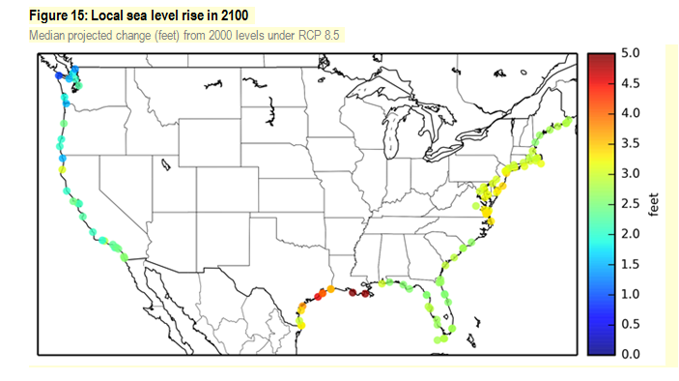

Slide 19
multi-model ensemble end-of-century changes
Hurricane Activity Rates
Multi-model ensembles produce ‘expected’ changes
Individual models show significant variation

Slide 20
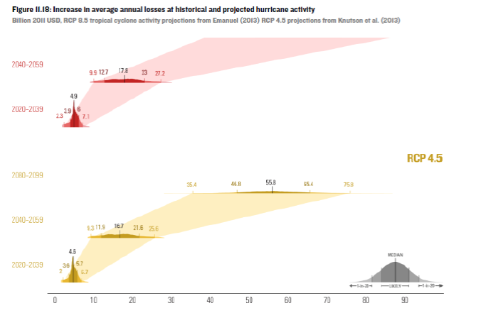
Expected sea level rise and modeled changes in hurricane activities
(Billion 2011 USD)
Current baseline is ~24bn (15bn wind only)

Slide 21
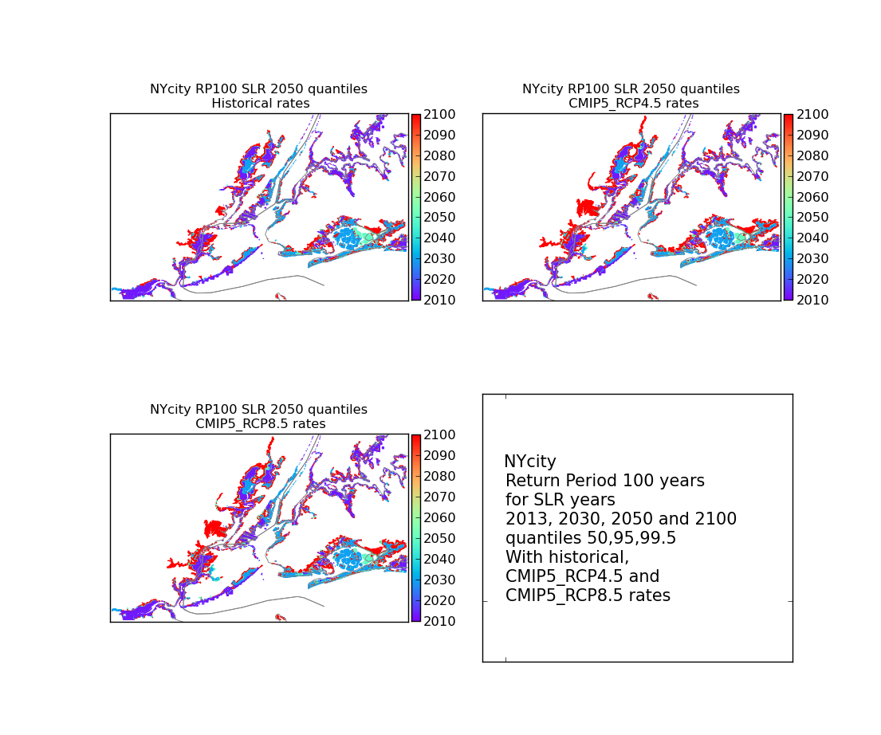
Date of advance of 100 yr RP flood zone

Slide 22
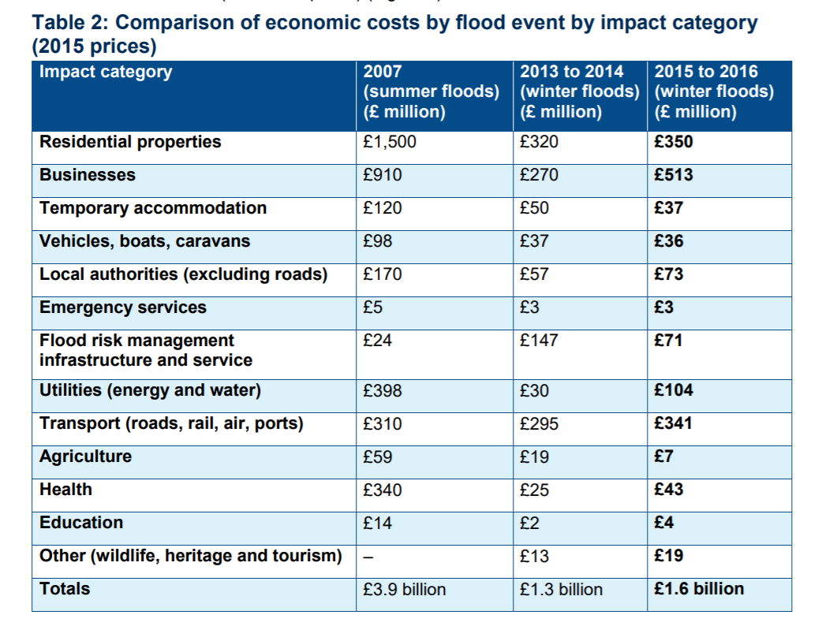
UK Floods impact on business
In the 2007 floods, utility losses were £397 million, 10% of total damages
Loss of power affected 750,000 people and 350,000 people had their water supply interrupted for 17 days

Slide 23
The expanding impact of prolonged Power outages
Because electricity is always there, we have come to rely on it without question and have allowed it to infiltrate all aspects of our lives.
In December 2015, life for more than 100,000 people in Lancaster reverted to a pre-electronics era, in a flood induced blackout that lasted for more than 24 hours.
  The gas central heating in our houses, Cordless phones, Computers, Wi-Fi routers, some door locks all need a mains supply.
  We pay for a coffee with a contactless card, read our bank statement online, keep our address book in ‘the cloud’, send emails rather than letters and fill up our cars using pumps.
. Although these dependencies were not difficult to see, few had thought through the implications of losing so many aspects of modern life at once.
'Living without Electricity', a report from the Royal Academy of Engineering, Lancaster University and the Institution of Engineering and Technology about the experience of the city of Lancaster (Kemp 2016).Foreword by Sir Mark Walport, Chief Scientific Adviser

Slide 24
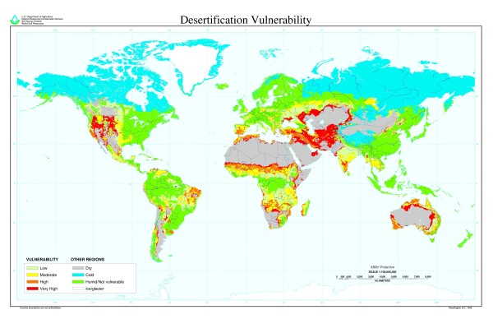

Slide 25
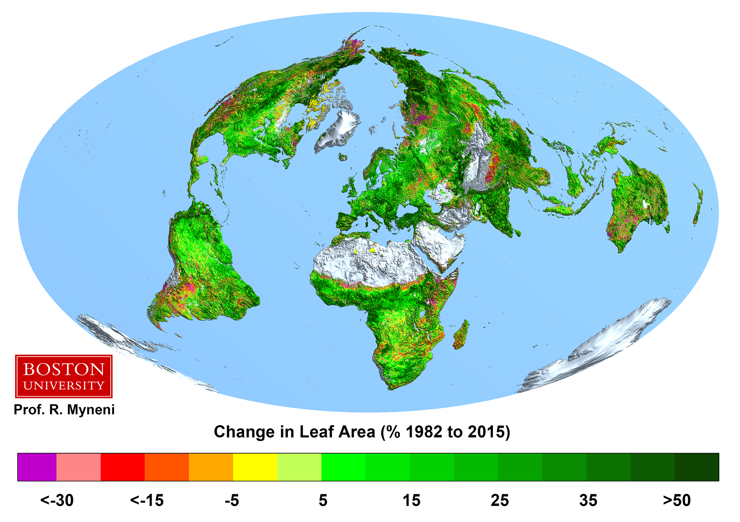

Slide 26
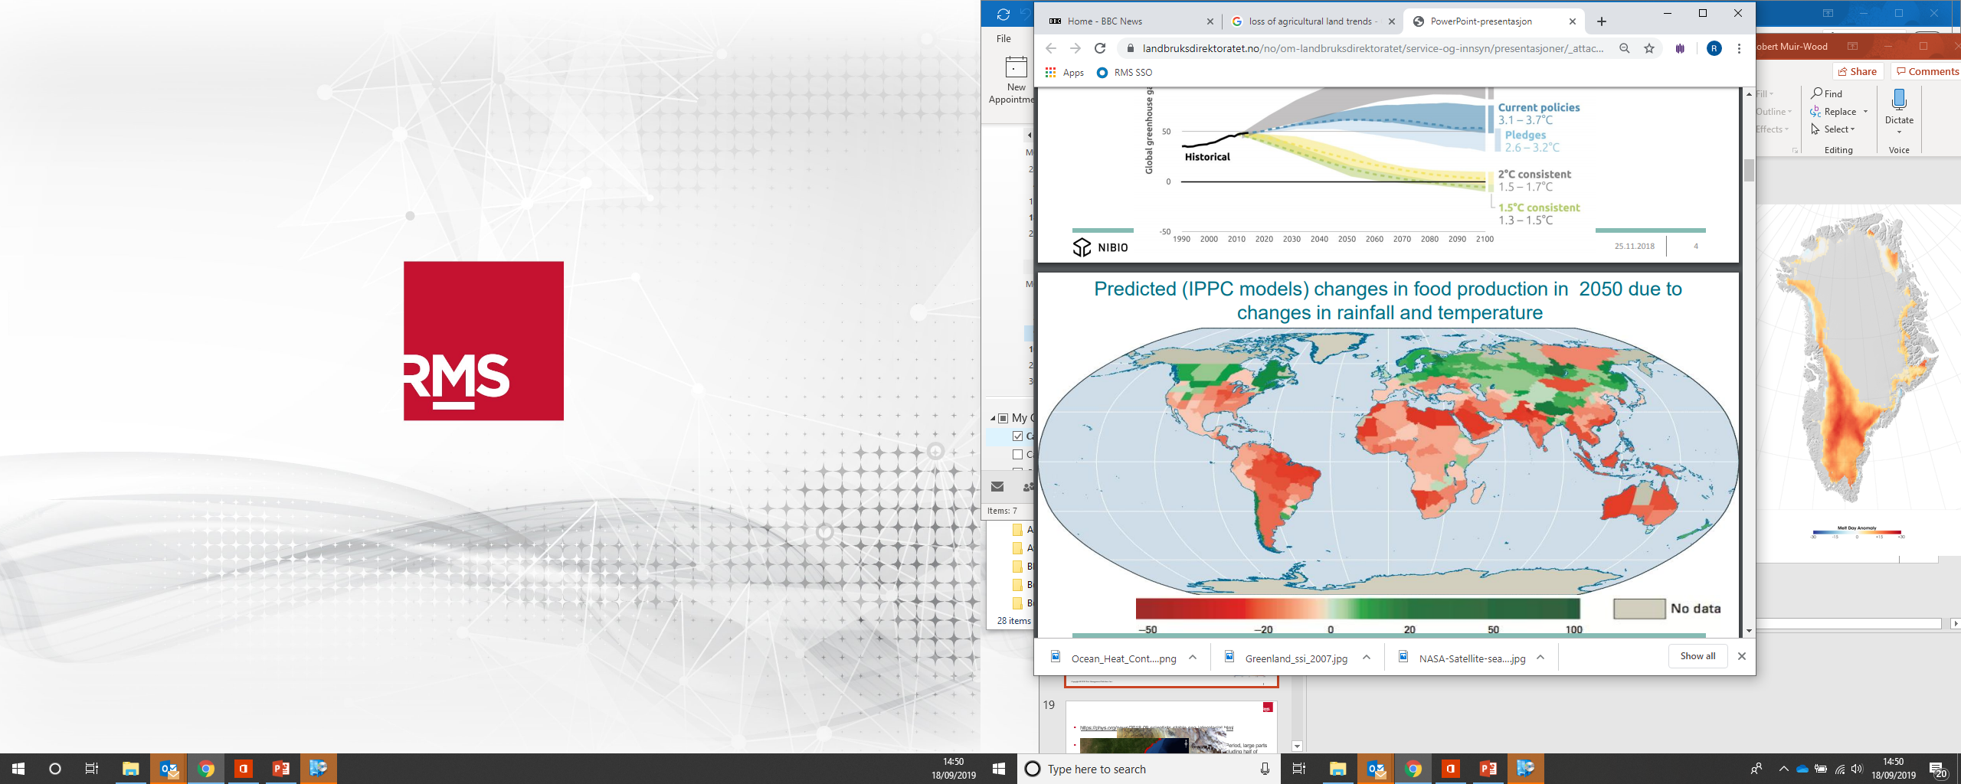

Slide 27
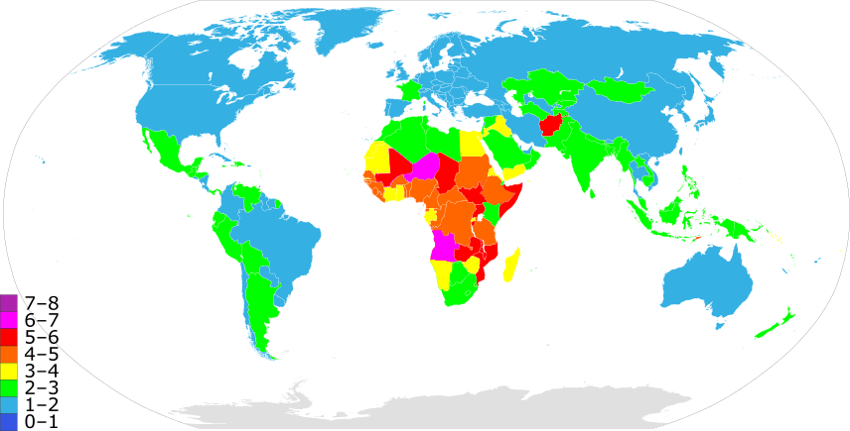
Number of children born to a woman over her lifetime
Notes:
Afghanistan highest birth rate in Asia: 6.6 per woman
Compensation for high levels of child mortality and violence and Taleban.
Population 76M by 2050 36M today 10M in 1960 feeds the violence

Slide 28
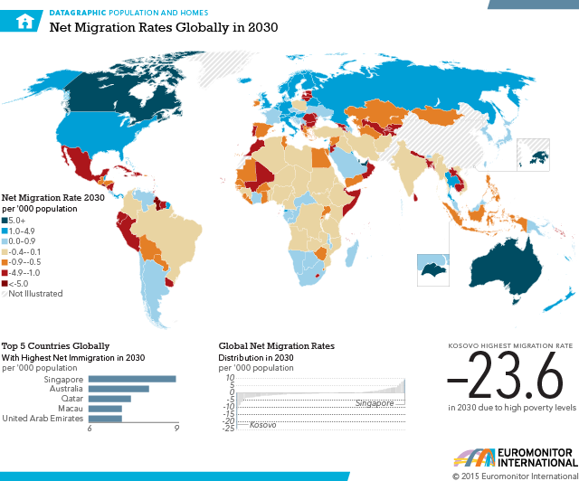
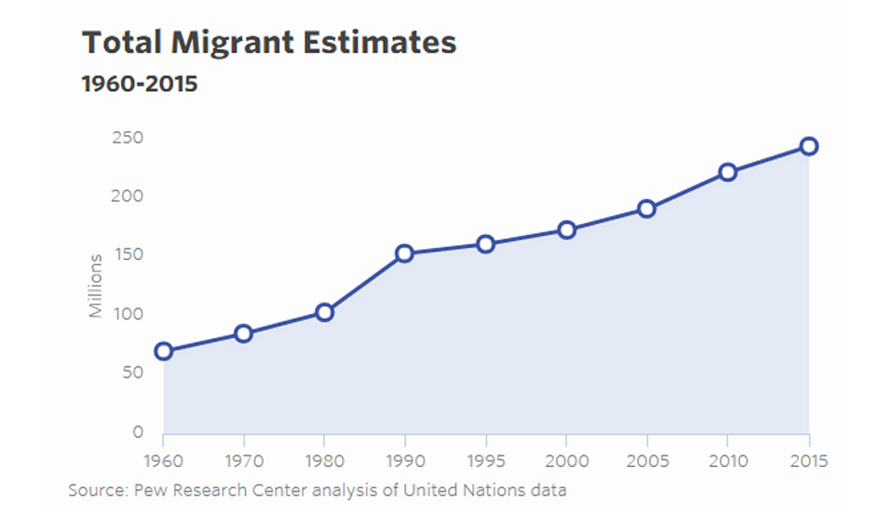

Slide 29
How attitudes shift around what is no longer condoned and the evolution of norms
By 1900
By 2000
By 2030?
  Slavery
  Capital punishment for theft
  Child Labour
  Penal Colonies
  Restrictive Male Suffrage
  Capital punishment
  Corporal punishment
  Illegal Abortion
  Discrimination on the basis of race, gender and sexual orientation
  Smoking
  Gas guzzlers
  Meat eating
  Outdoor cats
  Gender based prizes
  Plastics
  Flying
  More than 2 children

Slide 30
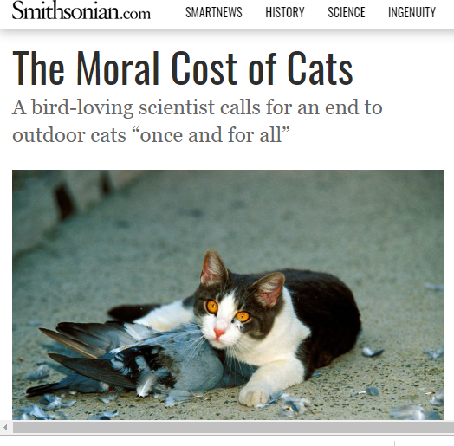
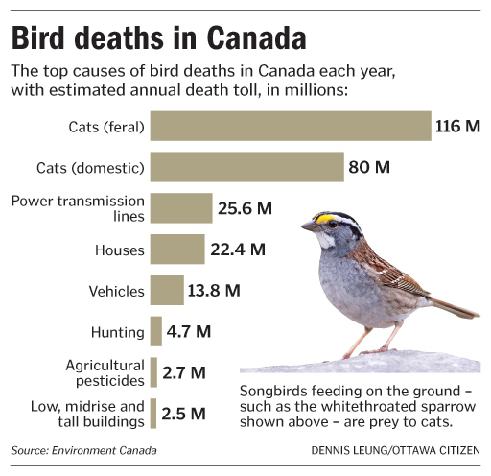

Slide 31
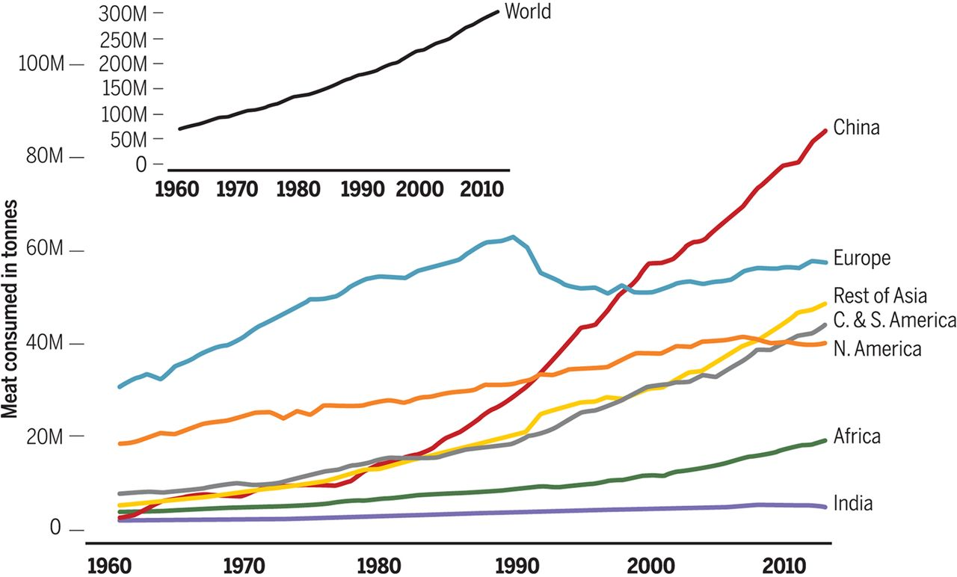

Slide 32
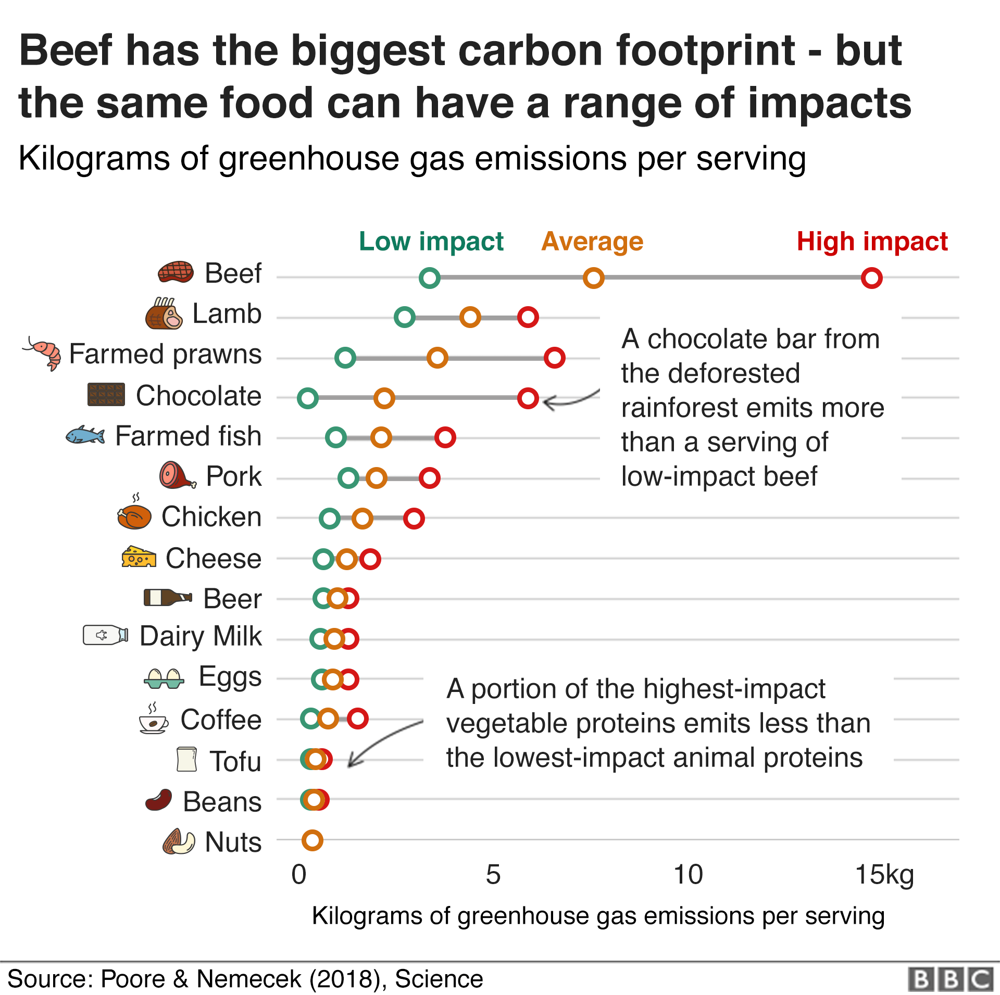

Slide 33
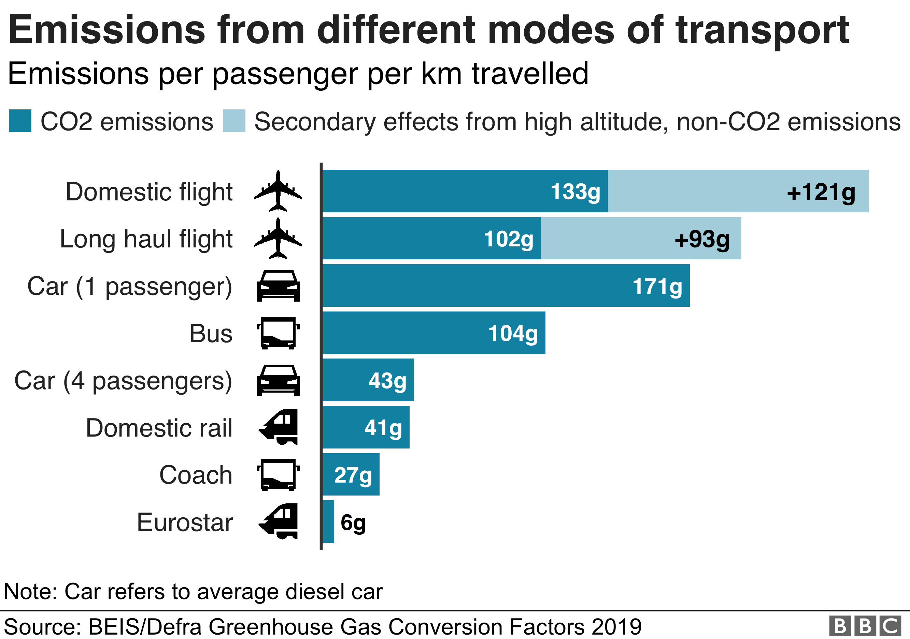

Slide 34
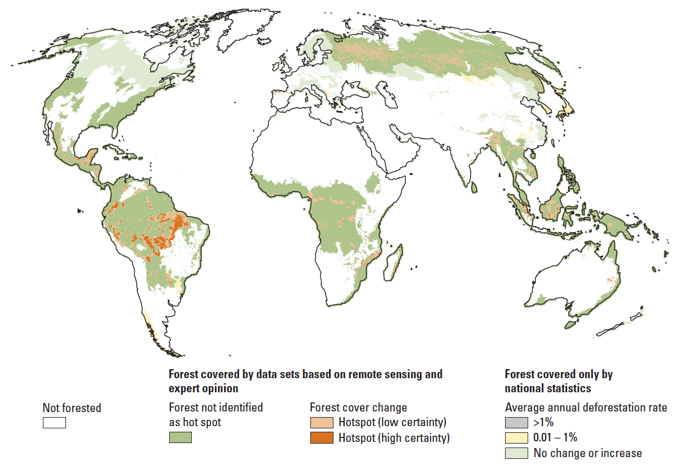
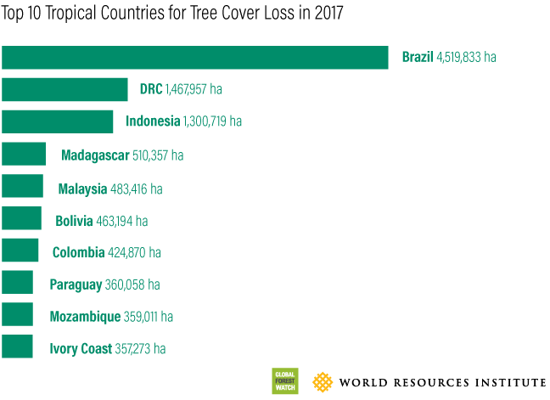

Slide 35
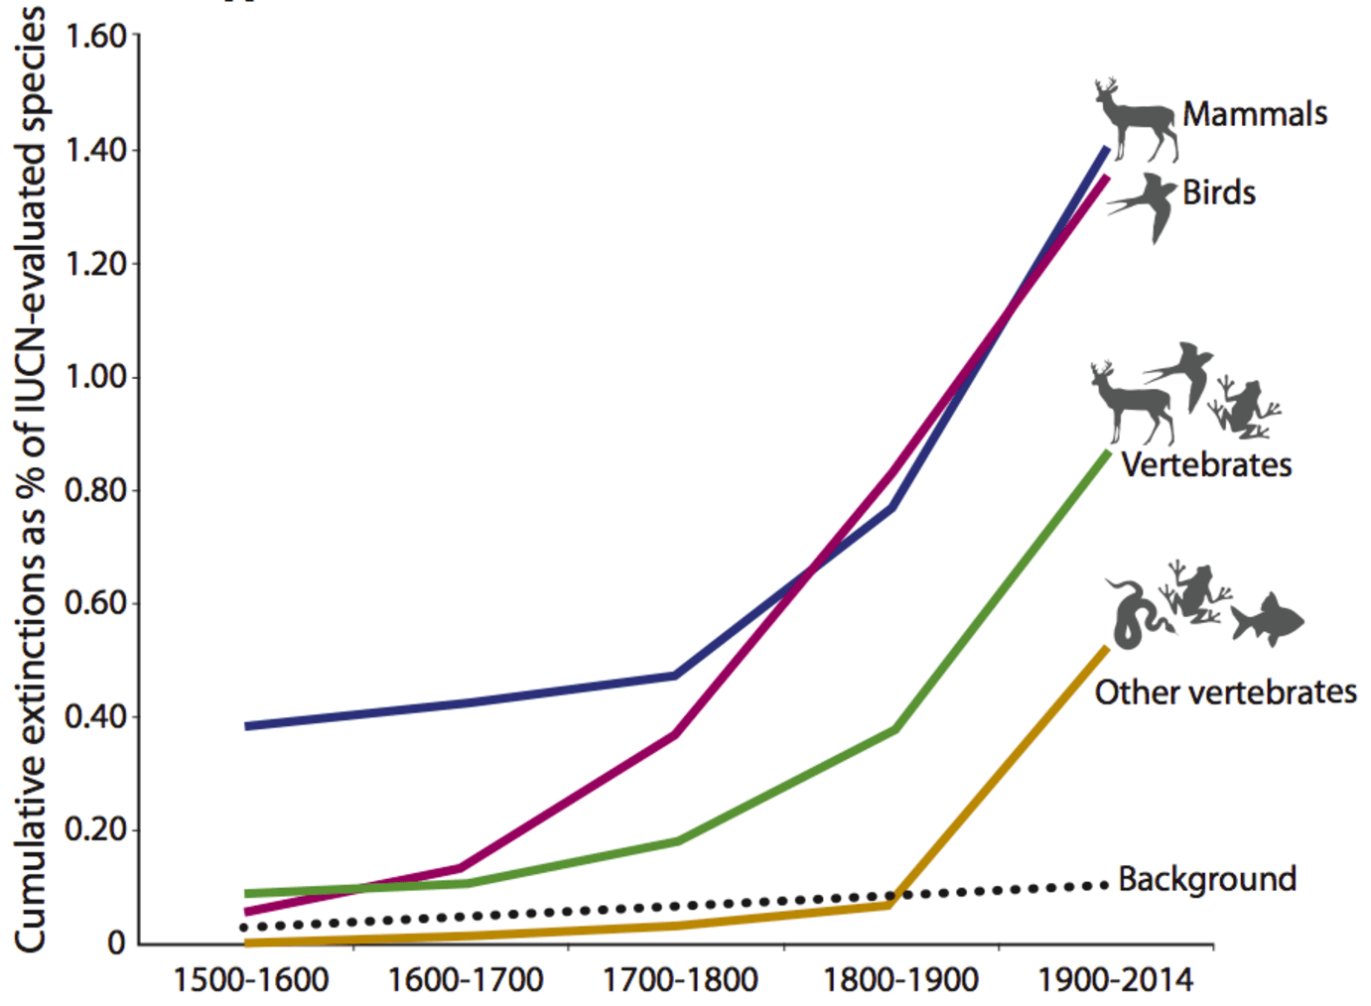
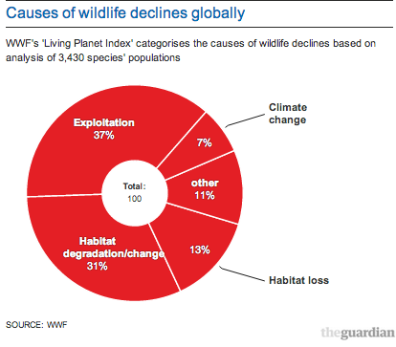
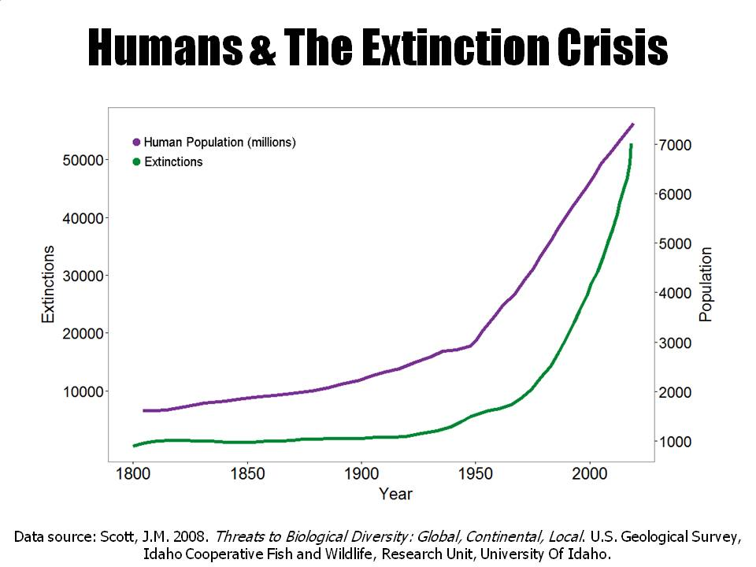

Slide 36
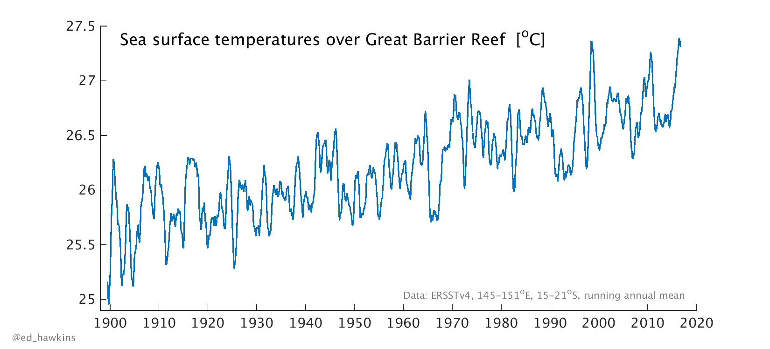


Notes:
Crown of thorns starfish

Slide 37


Slide 38


Slide 39

Notes:
The highest risk and the Highest risk gradient is at the coast

Slide 40






The business of elevating and relocating
Ports
Hotels & condos
Power plants
Airports
More than $2 Trillion within 1m of sealevel
refineries
Marinas

Slide 41




Sea level rise: ‘Your Flight has been cancelled by high tide’
Bangkok 2011
Osaka 2018
La Guardia 2012
Grand Bahama x 5 in 15 years

Slide 42



Slide 43

Loss of value from flooding risk by ZIP
13.7 real estate transaction analysed 2005-2017
First Street Foundation and Columbia University
28.6M properties - $15.9B loss identified
Florida $5.4BN, NJ $4.5BN, NY $1.3Bn
Ocean City, Miami Beach, Charleston
FloodiQ.com
https://firststreet.org/press/rising-seas-erode-15-8-billion-in-home-value-from-maine-to-mississippi/

Slide 44

Notes:
Do not underestimate the capacity to adapt.

Slide 45


How many people Died in the 2003 French Heatwave ‘la canicule’ ?
Hottest summer for 500 years
27,000 ‘excess deaths’ across Europe (>50% France)

Slide 46

How many lives were saved following the 2003 heatwave in France?
La ‘anticanicule’
- 22,900
Annual
Deaths
2000-2002
2000-2002+2005
La canicule
+17,900

Slide 47
2012-2016 California Drought
Farmers shifted to highest value crops
Previous droughts (as in 1988-1992) have created infrastructure and administration, as has 2012-2016
Worst multi-year drought for 500 years
Lost 1/3 of water supplies
https://ascelibrary.org/doi/full/10.1061/%28ASCE%29WR.1943-5452.0000984
Agri Losses $1.7Bn 2014-2015, $10Bn over 5 years
Turnover $45Bn/yr – State’s Economy $2.3Tn
  Above ground storage 52 km3
  Below ground 500 km3. > 70km3 groundwater supplied during drought.
  Need to reduce consumption by 2.5km3/yr to sustain supply

Slide 48

How do cities manage their perennial flooding problems?

Slide 49
Managing a Business through climate change & Habitat Loss
Supply chains
Anticipating shifts in extremes
Disaster Management
Future of the business sector
Liability for inaction (and losses)
Anticipating carbon pricing
Stranded Assets
Shifts in cultural norms

Slide 50

And it ends with trees
Notes:
Rewilding

