Slide 1
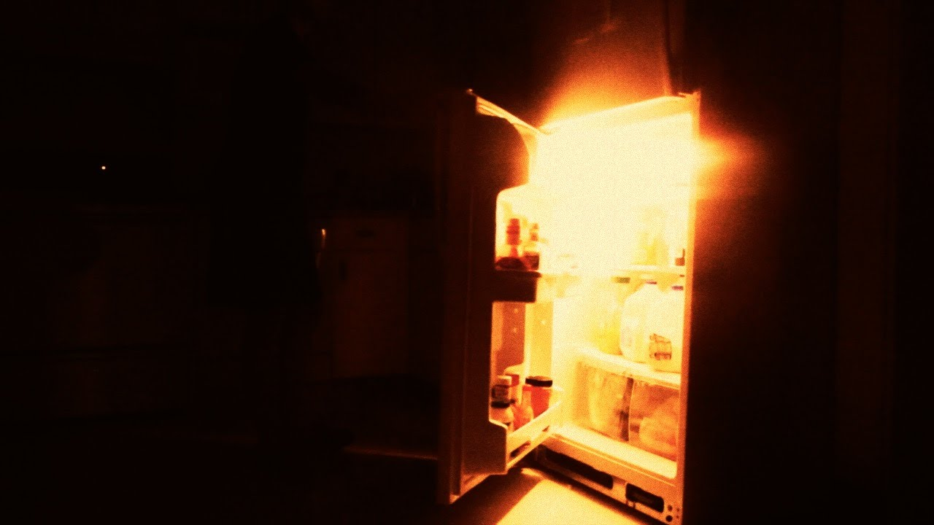
WHEN YOUR FRIDGE BITES BACK
How to manage risk in a connected world
……………………… and still sleep at night.
Rod Johnson
RSA Global Risk Solutions
June 2018

Slide 2
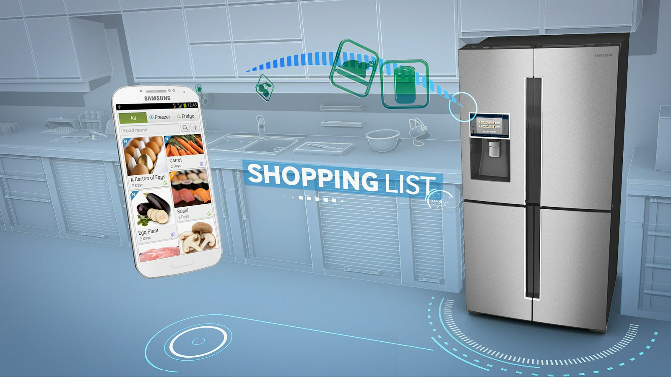
Living in a frictionless world……..
Notes:
EXAMPLE COPY SLIDE
1 column + thread
A thread can be added to slides to break up the presentation or to avoid large blank spaces. Try to avoid overuse of the thread. Additional threads are available.
Try and keep body copy to a uniform size throughout the presentation. Try not to squeeze too much copy onto one slide.

Slide 3

What radicalised your fridge?
The Internet of Things
The Cloud
Industry 4.0 – cyber physical systems
Machine learning and AI
People
Notes:
EXAMPLE COPY SLIDE
1 column + thread
A thread can be added to slides to break up the presentation or to avoid large blank spaces. Try to avoid overuse of the thread. Additional threads are available.
Try and keep body copy to a uniform size throughout the presentation. Try not to squeeze too much copy onto one slide.

Slide 4
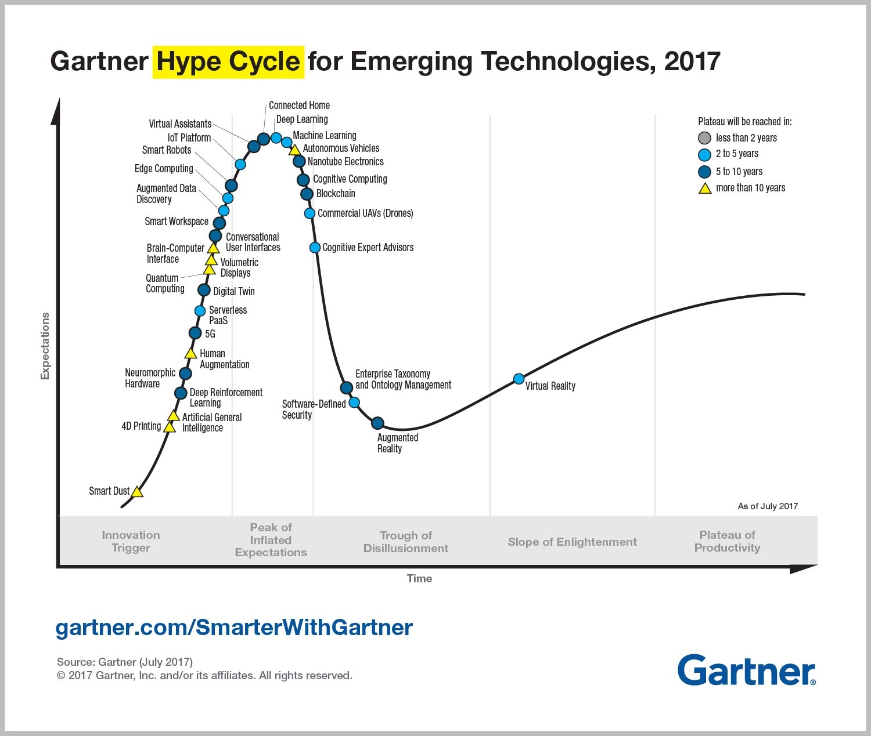
When is all this going to happen?

Slide 5

Some applications of IoT at home

Slide 6

………. and at work

Slide 7
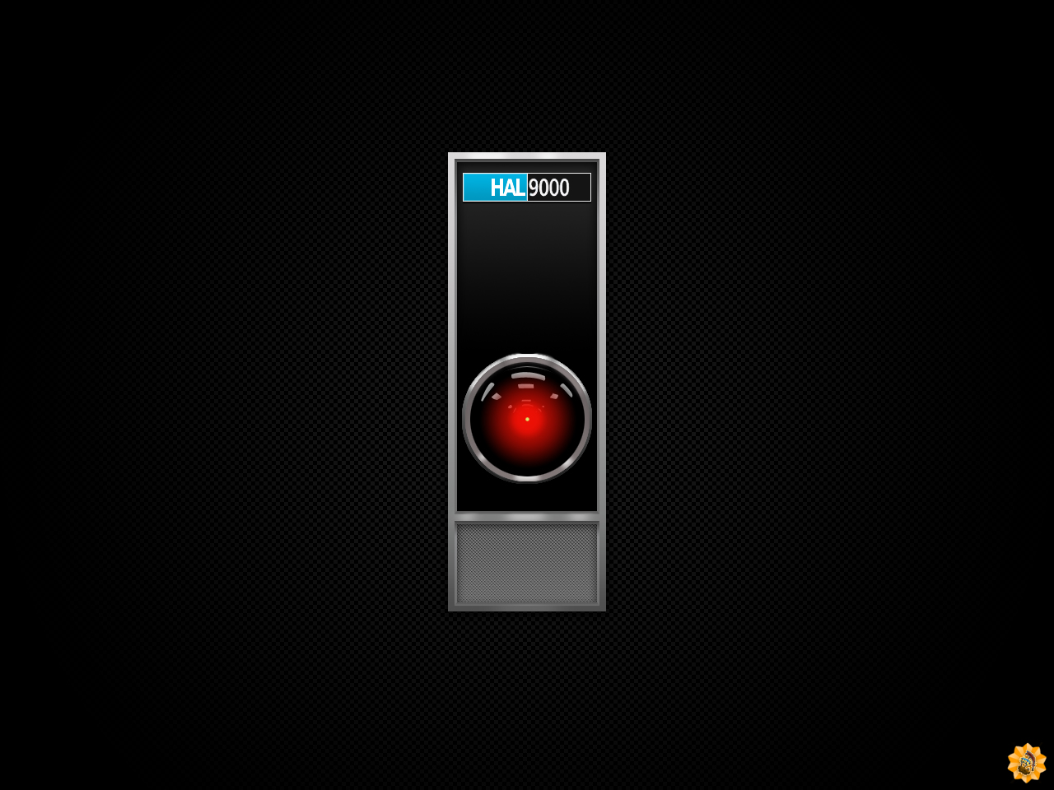
The enterprise risks presented by a frictionless world
Cyber physical attack – IoT making it ever more likely
Silent cyber – the risks you have but don’t recognise or treat
Data accumulation – the compliance bomb waiting to go off
Security protocols and procedures – the stuff you could do but don’t
The end of privacy – what does that mean for your proposition?

Slide 8

Managing the risk
Understand your customer proposition from where the customer stands - what is important to them?
Understand data technology
Prepare your organisation for knowing – and if you knew what would you do differently? How much risk would you accept?
There will be unintended and hidden consequences – beware of the killer orthodoxy

Slide 9
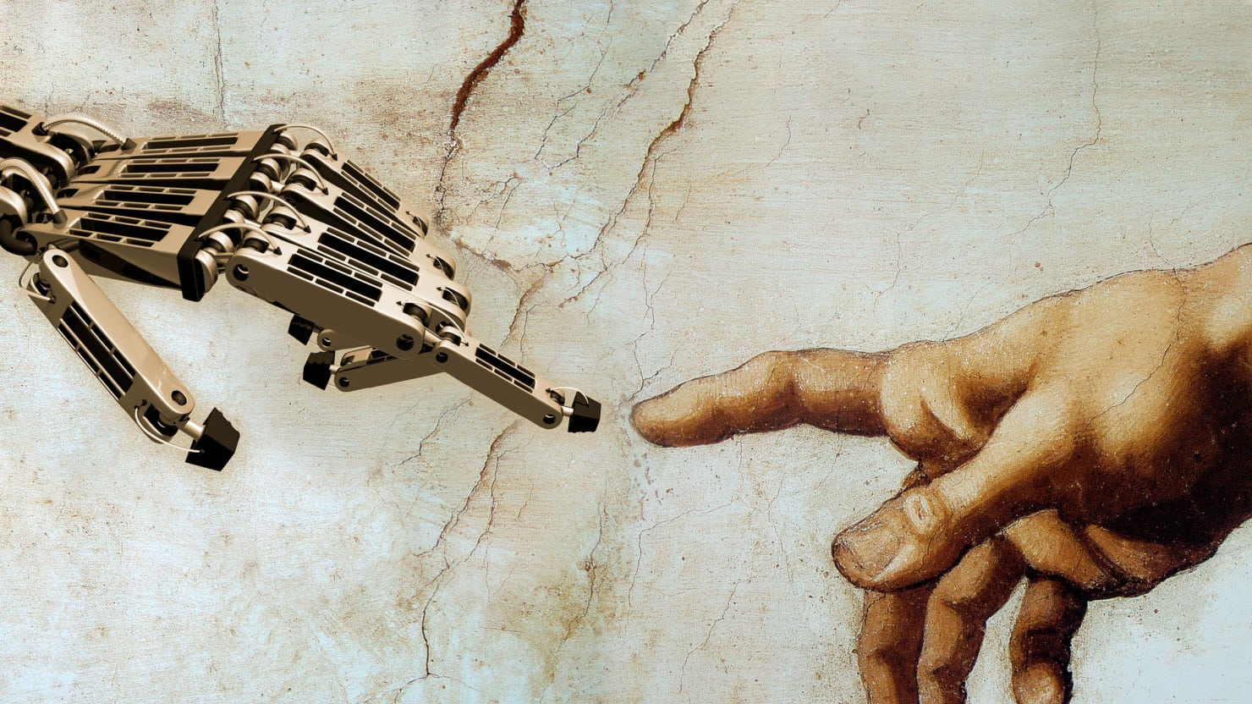
Thank you for listening

