Slide 1



Slide 2
Improving the Reporting and Reward for Risk
Some less enlightened attitudes to risk and insurance:
Comment | Resultant Key Performance Indicator (KPI) Target
Our insurance is a cost, so we just need to minimise the premium? | Reductions in insurance premium expenditure.
You want me to spend how much money on improvements? I’ve never had a claim in that area, it’s not worth it. | Minimise risk management funding where there are no short term losses.
I only really care about what my competitors are doing in this area. | Indemnity limit to be in the top quartile of selected peer group.
That’s just more internal reporting, I want to cut it back. | Minimising the number of risk and compliance measures being escalated.
I know we have claims but they’re insured, that makes it a good deal for me to spend the premium. | More claims!

Slide 3
Some Principles for Establishing KPIs
Define what is important to your organisation, your boss, and your function.
Link your KPIs to the core business objectives, for example:
  Organisational: revenue, profit, or costs.
  Boss: financial, legal, regulatory, social, ethical.
  Function: claims, costs, customer satisfaction, communication.
Make them actionable by your audience.
If you are unsure which KPIs to use – try asking.

Slide 4
Compiling and Presenting KPIs
Set your baseline numbers and decide how to capture and analyse the data
Use analytics to get to the statistics you need.
Present results in a clear and concise way at agreed intervals.
Three KPIs is probably not enough but 12 is probably too many.
Dashboard format – provides a high level summary.
Using graphics, charts, and Red, Amber, Green (R-A-G) ratings brings the numbers to life.
Tell the underlying story.
Include leading as well as lagging indicators.
Include future targets.
Individual risk KPIs are difficult and can be too slow.

Slide 5
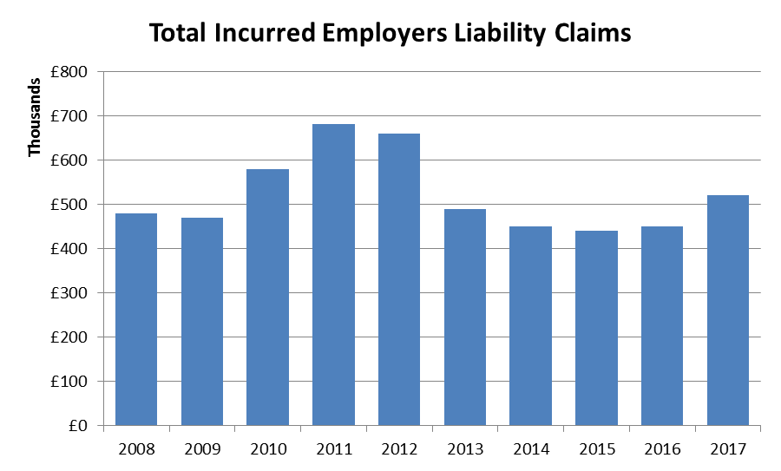
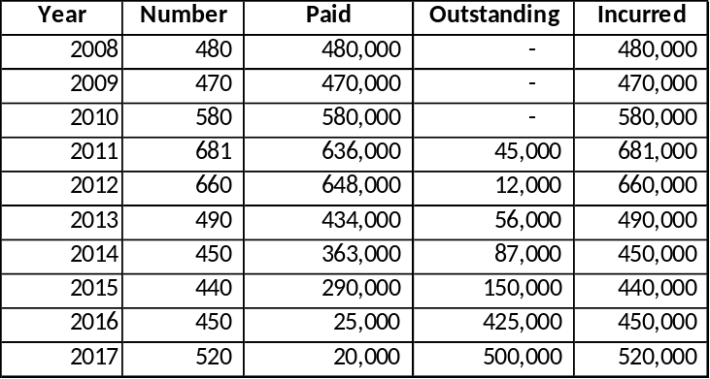
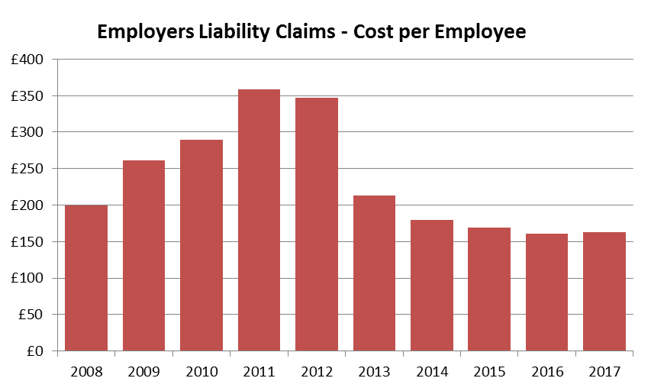
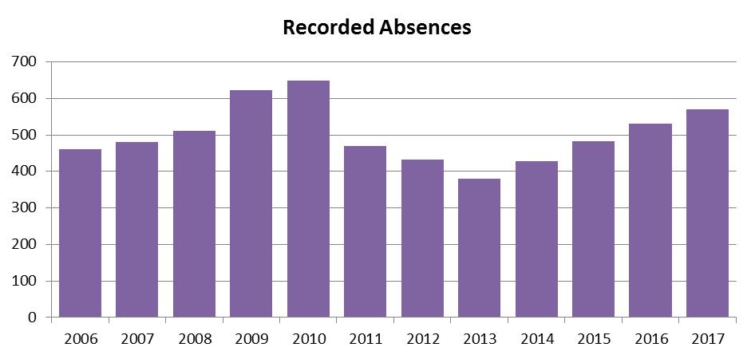
Example – Employers Liability Claims
Many ways to tell a story
Source: Illustrative data

Slide 6
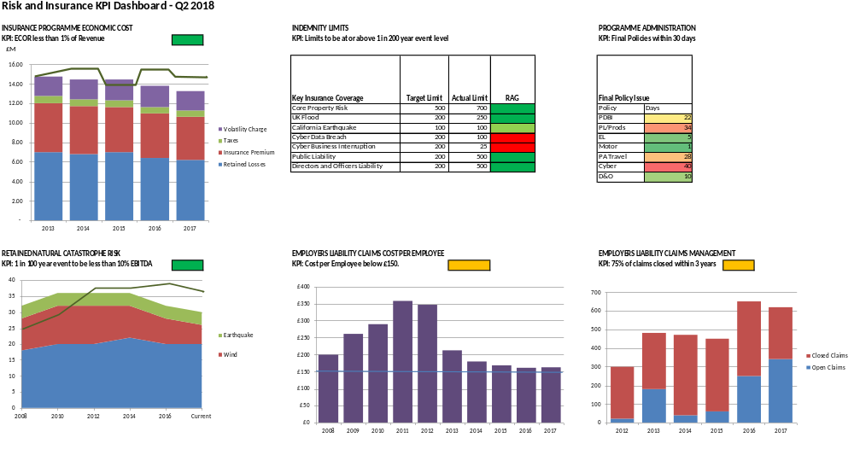
Dashboard Format
Making reporting clear and concise aids executive buy-in
Source: Illustrative data

Slide 7
Examples of Existing KPIs
A selection from a large and diverse population
Risks | Insurance | Claims | Governance | Risk and Insurance Team Performance | Service Provider Performance
Risk register improvements (reducing frequency or severity) | Total Cost of Risk reduction | Reduction in claim numbers | Compliance with risk reporting guidelines | Customer Survey scores | Broker administration and costs
Reducing 1 in 200 year loss outcome | Split in retained vs. transferred costs | Target for overall claims costs | Number of people being trained in risk management | Number of internal publications | Claims handler responsiveness
Number of new risks identified | Counterparty credit risk management compliance | Accident rates | No breaches of local tax and regulations | Succession planning of key positions | Document processing metrics
Key risks reduced to as low as reasonably possible | Premium savings | Lost time incidents | Retained insurable risks to be within group risk tolerance and appetite | Business unit contact | Policy issuance timings
Proportion of contracts reviewed by risk team | Coverage | Top five claim causes identified and actioned | Risks outside target parameters to be escalated in agreed timelines | One and three year plan completed | Reduction of administrative task time

Slide 8
Measuring Reductions in Uncertainty
Risk is the effect of uncertainty on outcomes (ISO 31000)
The value of insurance is reducing uncertainty – to purchase or evaluate it without putting a price on that uncertainty is incomplete.
Using sophisticated data and analytics we can now price uncertainty (volatility) which reveals the value of insurance.
Setting insurance programme cost KPIs should include this element.
Premium vs. Total Cost of Risk (TCOR) vs. Economic Cost of Risk (ECOR).
Risk improvements can also be measured in this way.

Slide 9
KPIs for the Cost of Insurance Programmes
The value of insurance is in the management of volatility
Volatility of outcome
Total Cost of Risk
Economic Cost of Risk
Cost of Insurable Risk
Full insurance, no retention
VALUE CREATION
Insurance with reasonable deductible
No insurance
Expected retained losses
Expected retained losses
NO
INSURANCE
CURRENT
PROGRAMME
OPTION
A
OPTION
B
Illustrative, not to scale
PREMIUM
IMPLIED RISK CHARGE
RETAINED LOSS
Source: Illustrative data

Slide 10
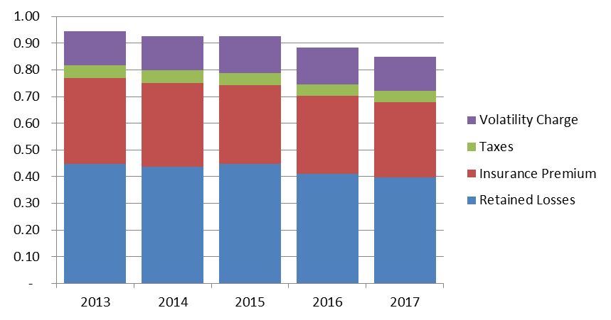
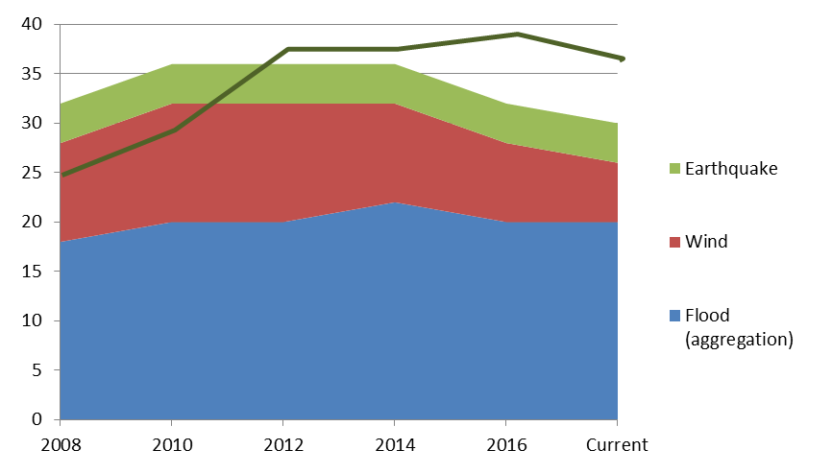
Example KPIs – Insurance Costs and Risk Control Improvements
Insurance Programme Cost as % of Group Revenue
Natural Catastrophe Exposure and EBITDA
10% EBITDA
Source: Illustrative data
EBITDA: Earnings before interest, taxes, depreciation, and amortization

Slide 11
What Good Looks Like
Managing risk is managing uncertainty
Link your KPIs to the performance of the core business.
Make the KPIs relevant to specific audience members.
Link them to actionable outcomes.
Not too many, not too few, presented well.
Make use of greatly improved data and analytics to analyse risk and measure how you are managing and reducing uncertainty.
Then hit the targets!

