Slide 1
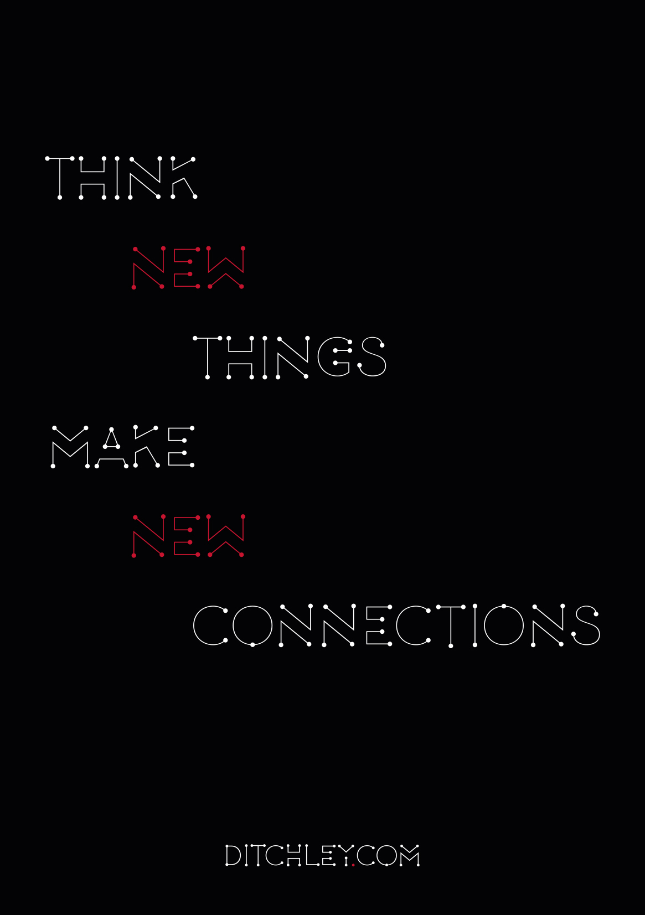
Notes:
James Arroyo
Director Ditchley
Renewal of democratic societies and states
Before that worked for HMG on foreign policy and national security
Preoccupied with Brexit.
But it would be a mistake to forget that whilst we go through our peculiar national crisis other people have other plans.
Some bigger things to think about,

Slide 2
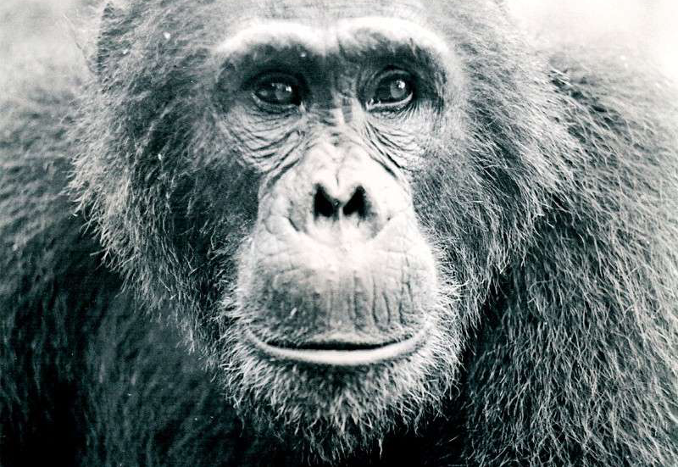

Notes:
We have to start with who we are.
We are still the naked ape.
Lust for power
Sex
Territory
A demand for fairness which is a positive force but also:
Spite
Cruelty once unleashed that is hard to stop and that becomes a force in its own right.
That in humans can amount to evil, where the pleasure in violence becomes its own end.

Slide 3
?
Notes:
Alongside our animal nature we have something that is unique to us.
A search for meaning.
We find questions in nature:
What can I eat?
How do I win this battle?
But as far as we know only humans ask why.
It drives us.
If we can find meaning in something , a narrative, then we can bear great hardship.
Victor Frankel - Man’s Search for Meaning.
Values essential. If you are not engaging this most human of characteristics then you are dealing with apes.

Slide 4
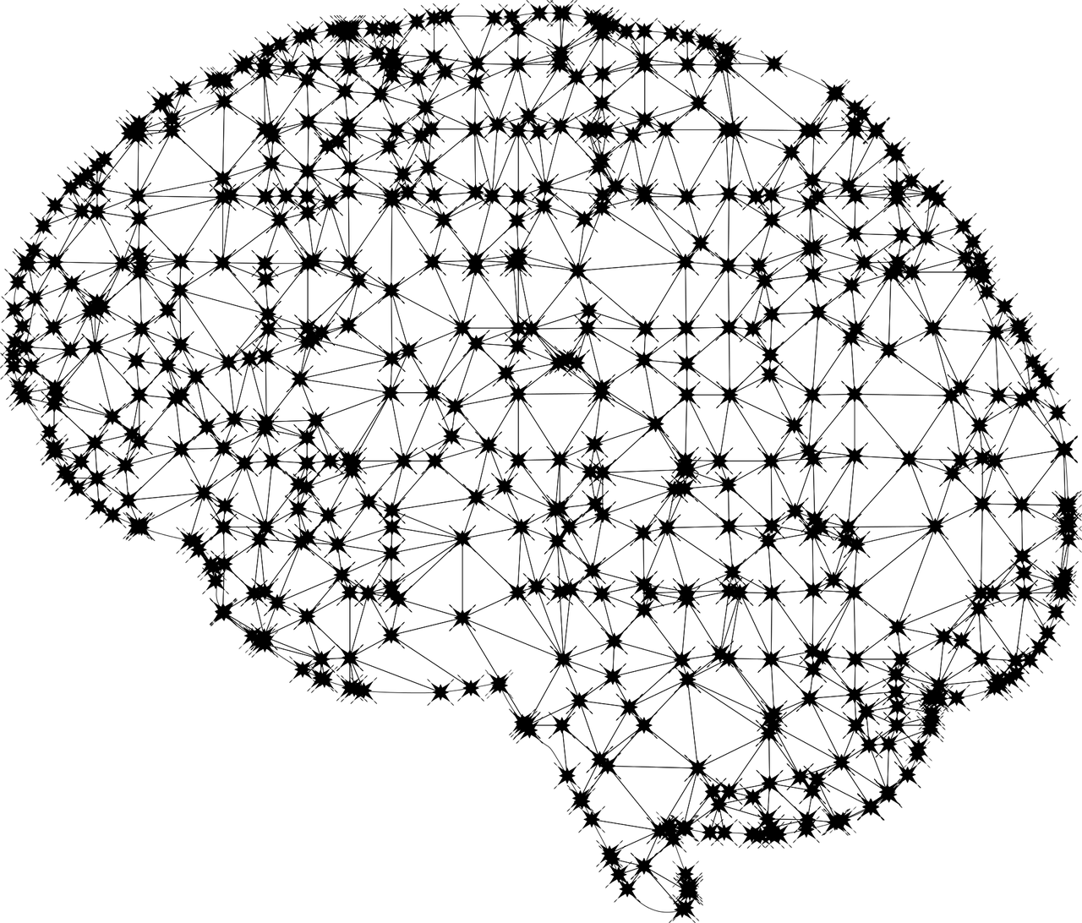
Notes:
The human brain is a network. People are networked beings, taking meaning from their position in a network.
Networks online make spread of ideas and information easier.
AI – machine learning
It’s simplicity
It’s universal application
The stick

Slide 5
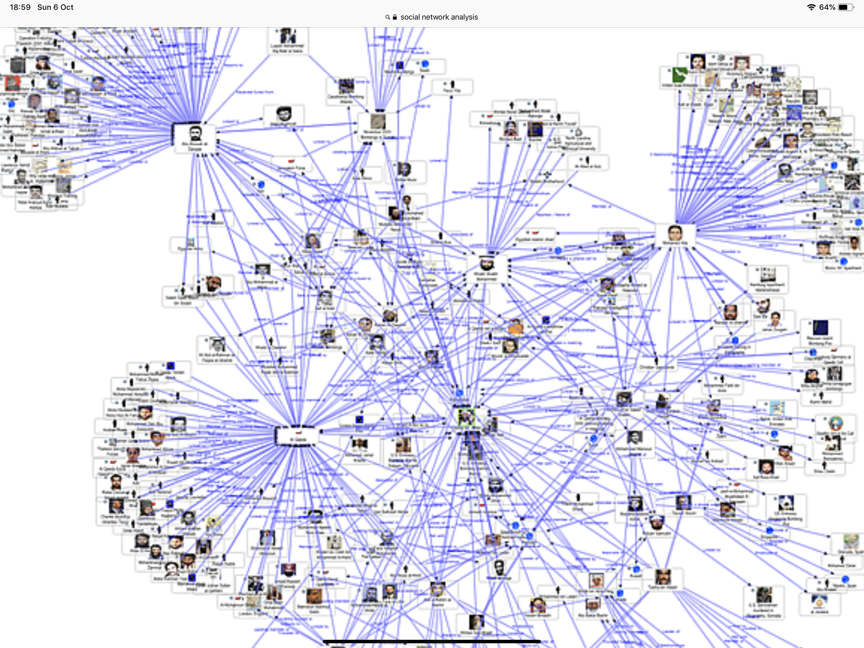
Notes:
Connectivity is making our social networks ever more extensive and complex.
This enables a more rapid distribution and social spreading of ideas.
The fact these networks are now represented in digital data is a major change.
If we have the data then we can map them.
Even if we don’t have the data about you – we can map and predict by inference, know you by the company you keep.
Personalised marketing.
Personalised influence.
Personalised cyber attacks.
Personalised warfare.
It’s the same map.

Slide 6
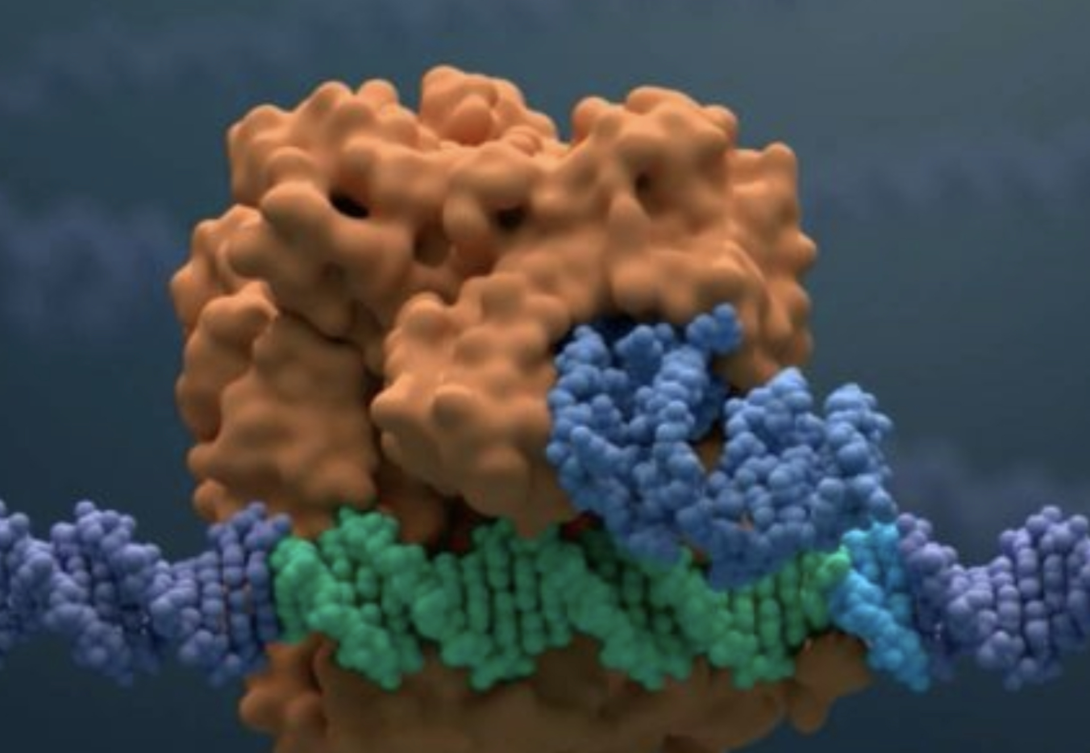
Notes:
CRISPR-Cas 9
Bio-engineering
Empirical computation

Slide 7
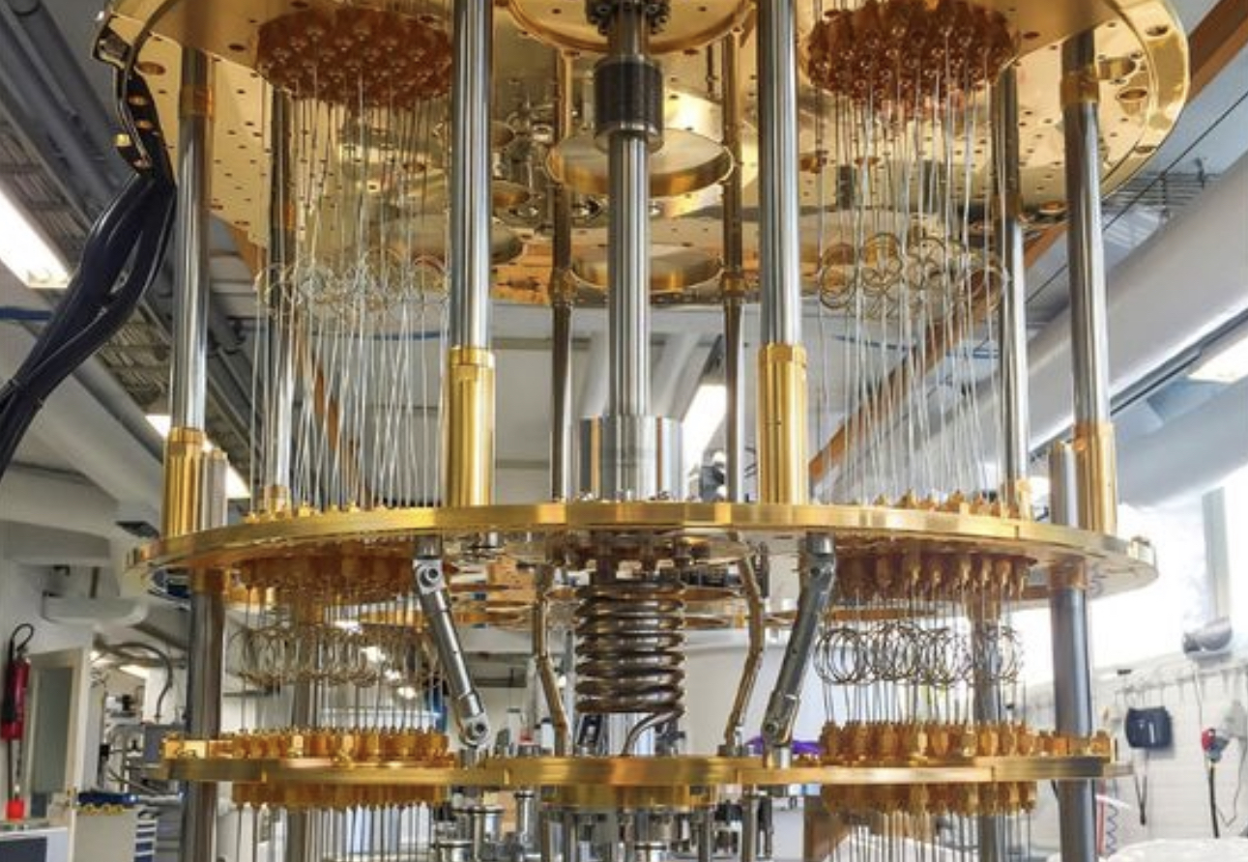
Notes:
Quantum computing

Slide 8
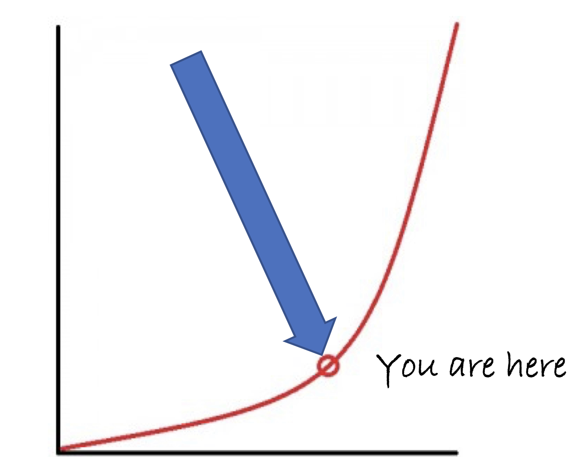
Notes:
Exponential change
But also climate as risk
Cyber as risk
Personalised influence as risk
AI as risk
Immigration as risk
Hope and inspiration
What’s the compass bearing?

Slide 9
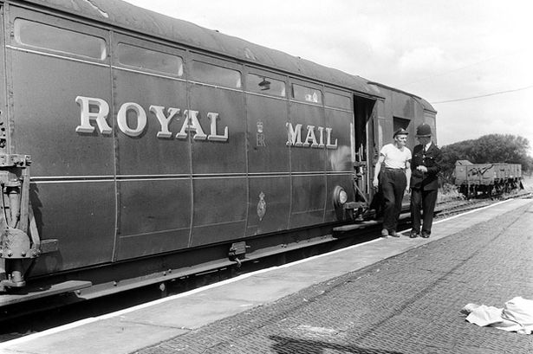
Notes:
Crime and cyber.
Follow the money
All crime apart from physical online
A crisis for policing
Split between two worlds

Slide 10
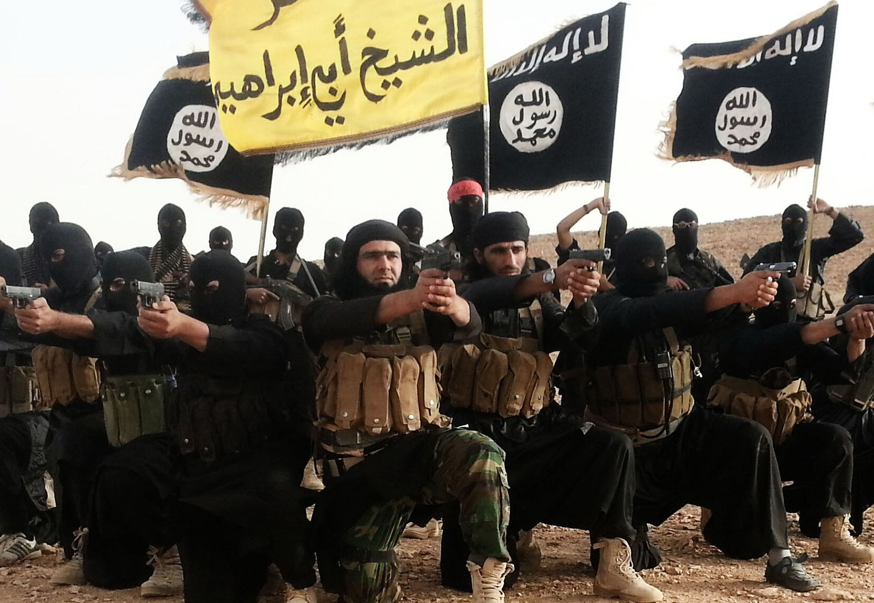
Notes:
ISIS has been defeated territorially but not as a movement or even less as an idea.
ISIS’ emergence as a quasi state was a big part of its appeal but also its downfall by making it a target.
ISIS was interesting for several reasons:
Its deliberate use of extreme violence.
Its sexual exploitation of non ISIS women.
Its acceptance of a role for women though within the movement – there was a famous female ISIS poet glorifying attacks.
The diaspora from the fall of the Caliphate threatens to be a problem for years to come.
How do we deal with people who have seen and done so much evil?
How can they be integrated back into societies?
Will they move on from just do it terrorism – knives and cars – to something more deadly?
AQ still there and re-building. A taste for spectaculars. And ingenuity – the Yemeni bombmaker, - liquids, shoes, underpants and most impressive of all, photocopiers from Yemen.
It is helpful when terrorists are bearded men as in this picture. But support for terrorism or freedom fighters is broader than that.

Slide 11
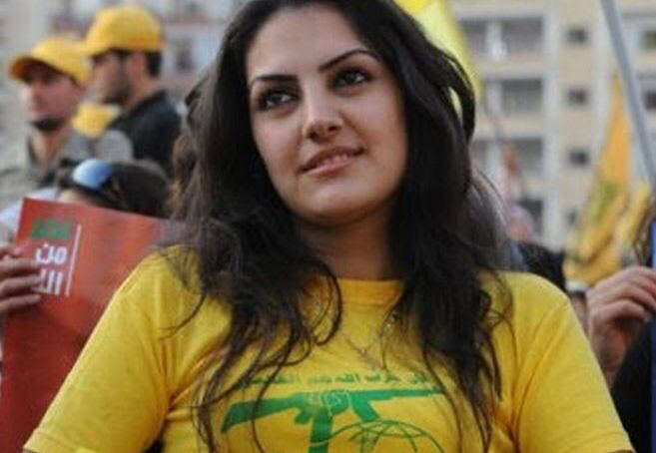
Notes:
Hizbullah is perhaps the world’s most disciplined and potentially deadly terrorist actor.
Backed by Iran, they aim to be a national and not just religious movement.
Well armed and well trained. Their lack of action abroad is a political choice. Conflict between Iran, Israel and the US could unleash action.
Iranian and Hizbullah action is constrained for the moment by the need to sustain European support for the nuclear deal. Long may that continue.
The roots of modern terrorism lie not in Islam but in the conflict between the far left, far right and mainstream society in the West. With deeper roots in 19th century anarchism.

Slide 12
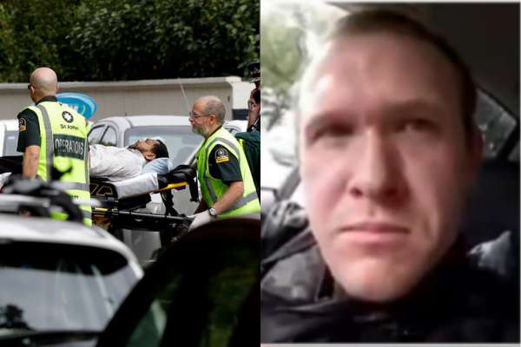
Notes:
Just as with Islamic terrorism, modern political terrorism is using the technological revolution to increase capabilities and to amplify effects.
Right wing terrorism is growing with attacks in the US – 50 people killed in 2018 - and most recently and shockingly in New Zealand.
ISIS perfected the art of using the Internet for spreading their ideology and terror. It has now been picked up by the far right.
Andre Brevik the Norwegian neo-nazi called his killing spree his book launch.
But the live streaming of attacks has brought a new immediacy and new permanency to terrorist propaganda – terrible footage will likely lurk for ever in dark corners of the internet
Terrorists will use whatever weapons are available – knives and cars in the UK; a truck in Marseilles; commandeered planes in 9/11; assault rifles when possible; homemade or stolen explosives.

Slide 13
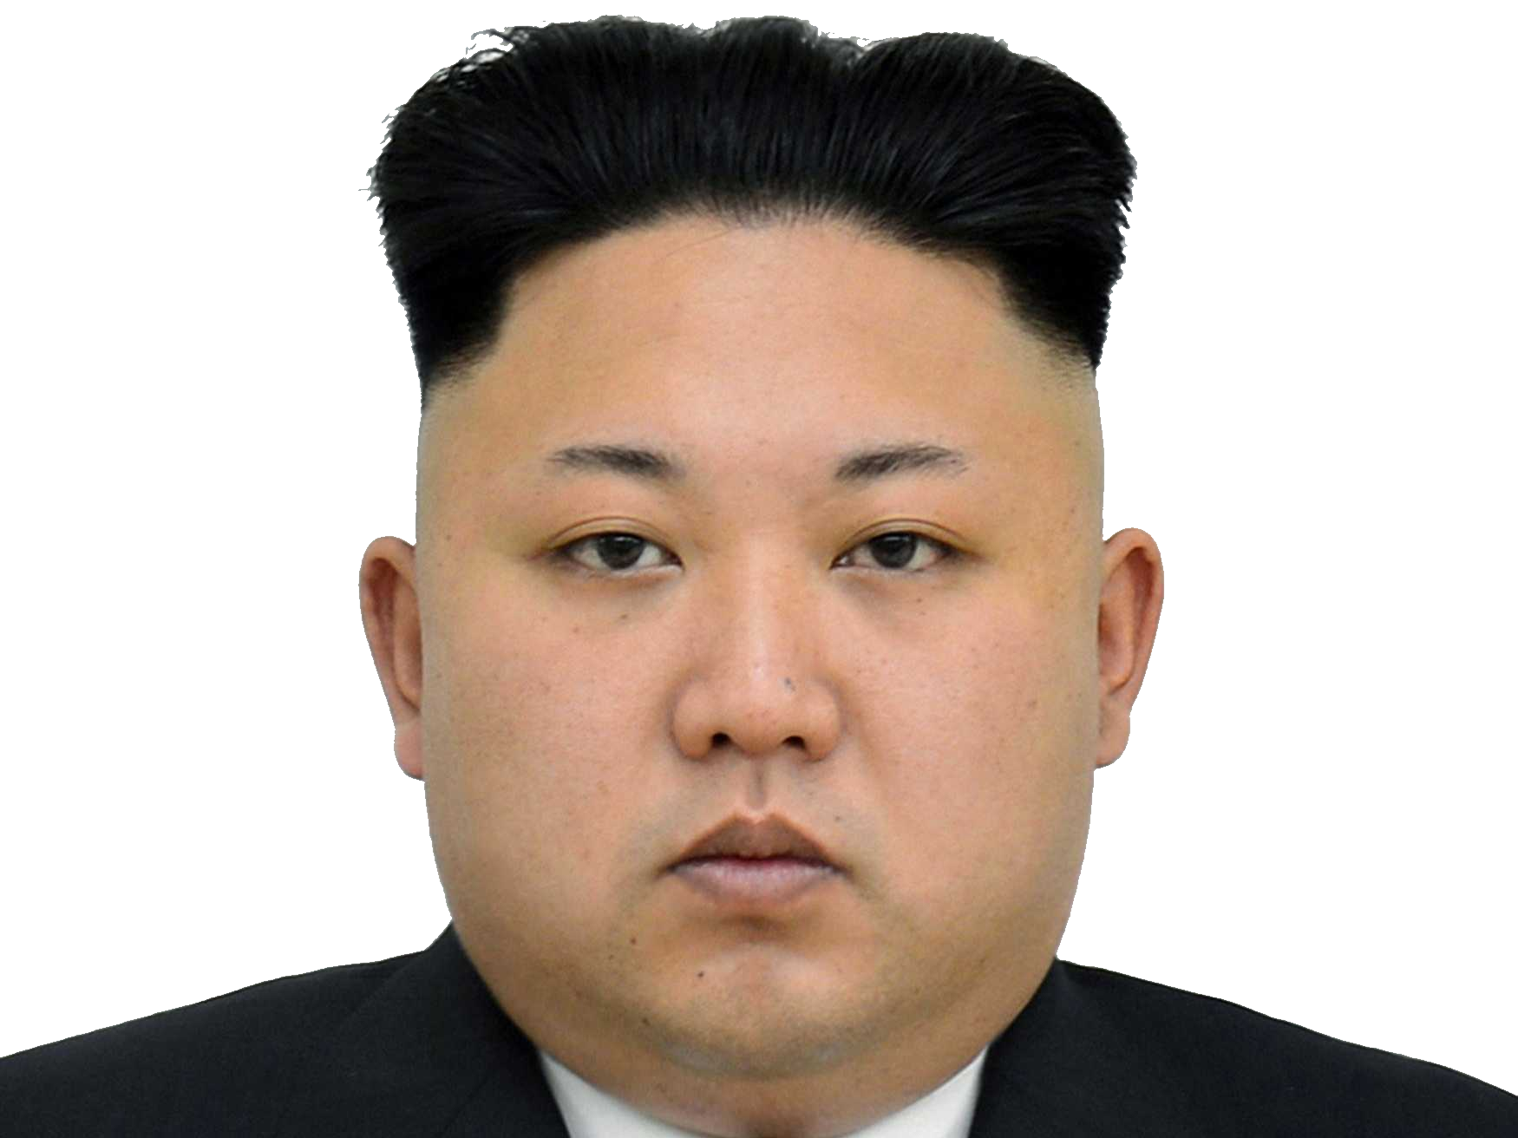
Notes:
No one with this bad a haircut should have nuclear weapons.
But he has and he is building longer range missiles.
Still no answers.

Slide 14
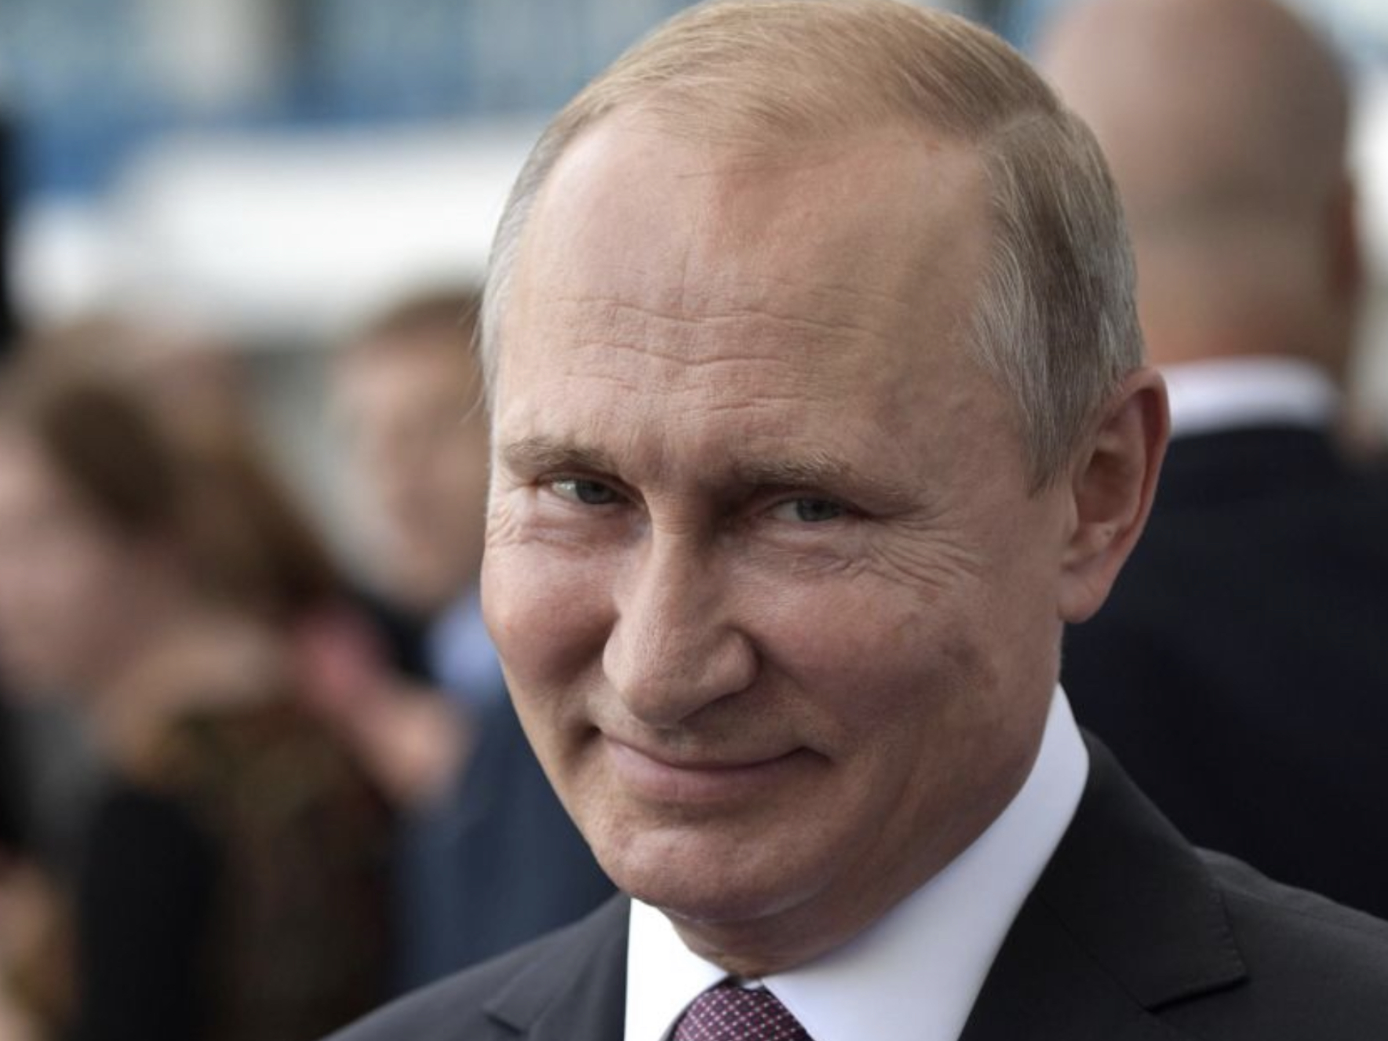
Notes:
Russia – become a tactical power with nuclear weapons
Cyber playbook showing the way.

Slide 15
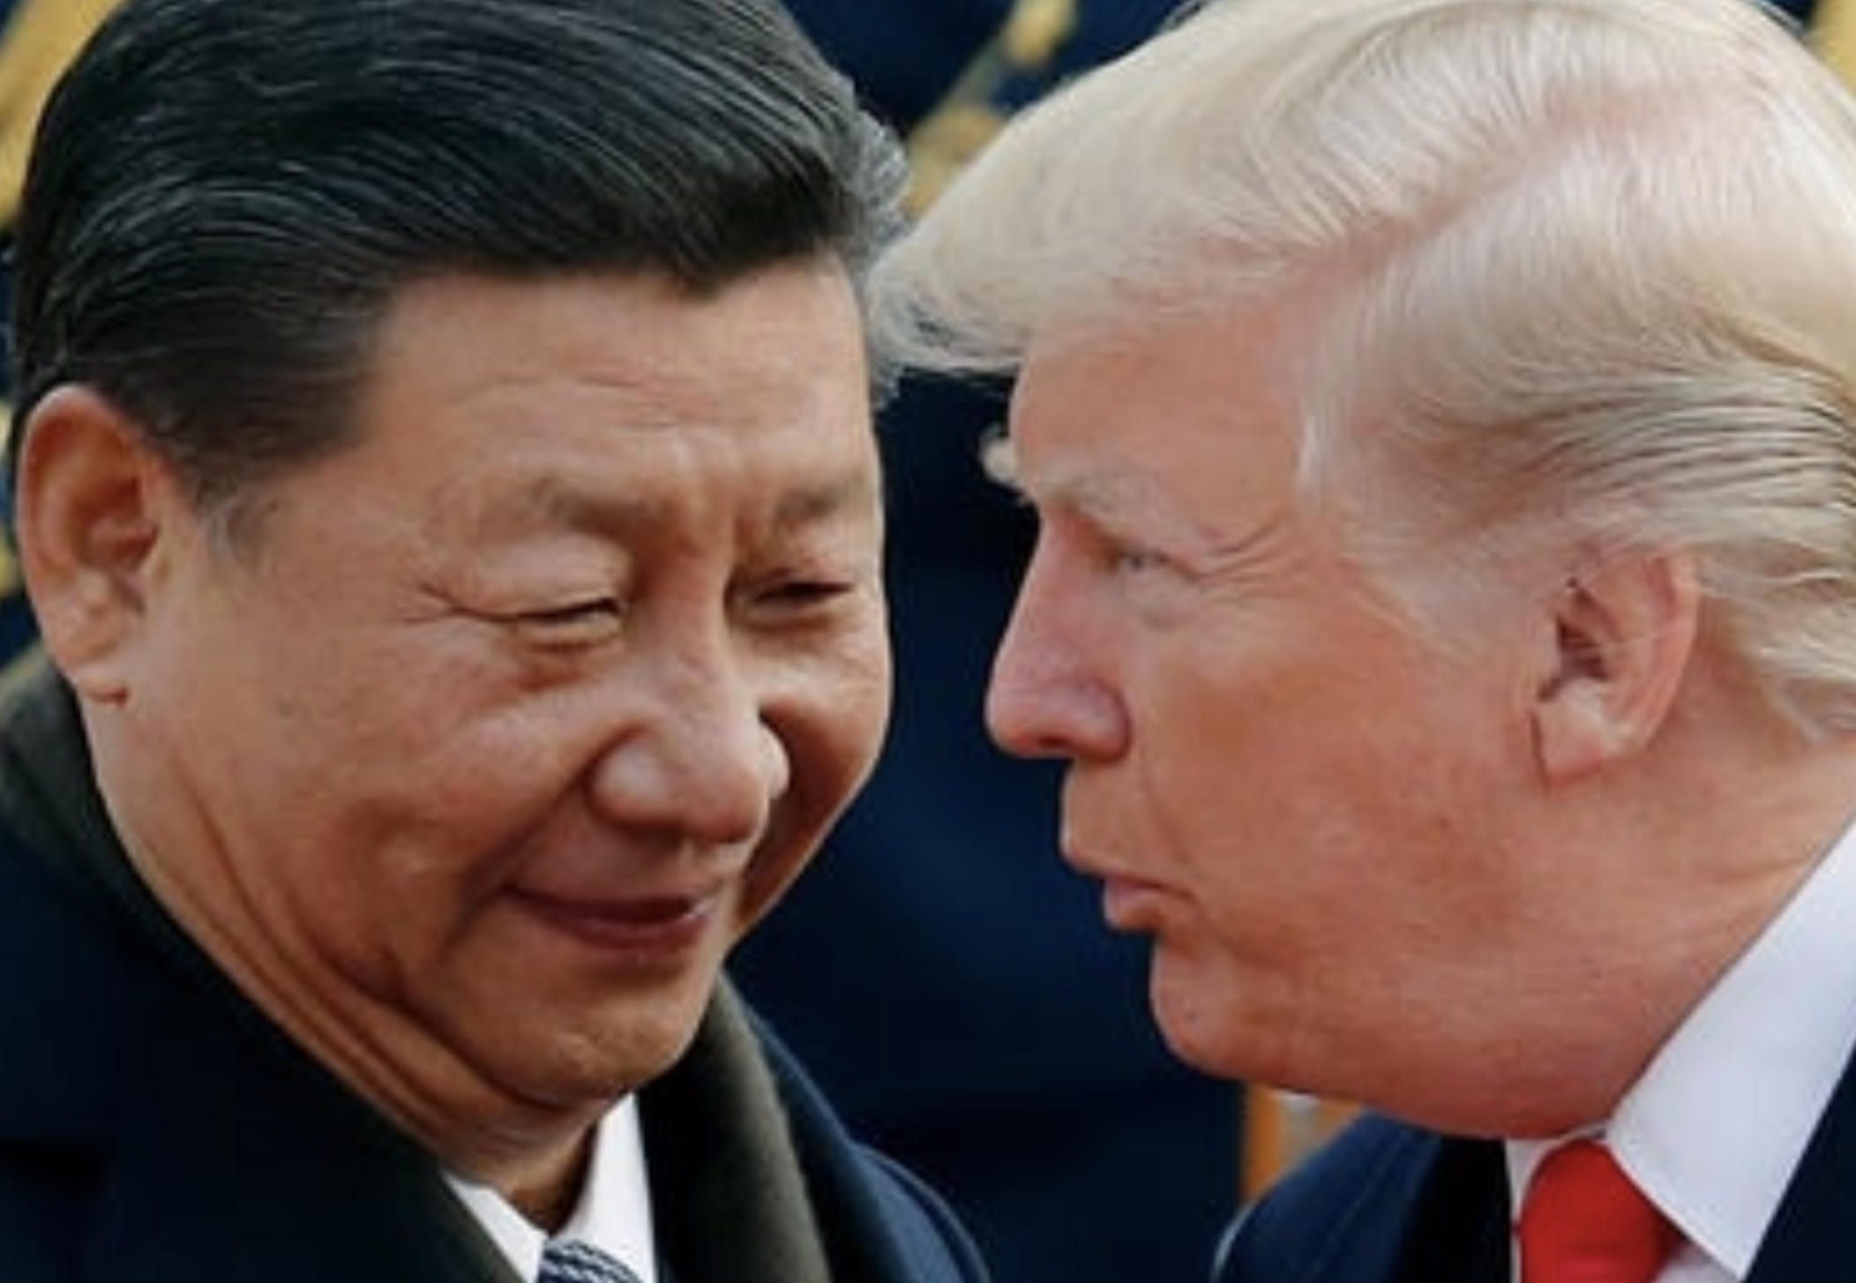

Slide 16
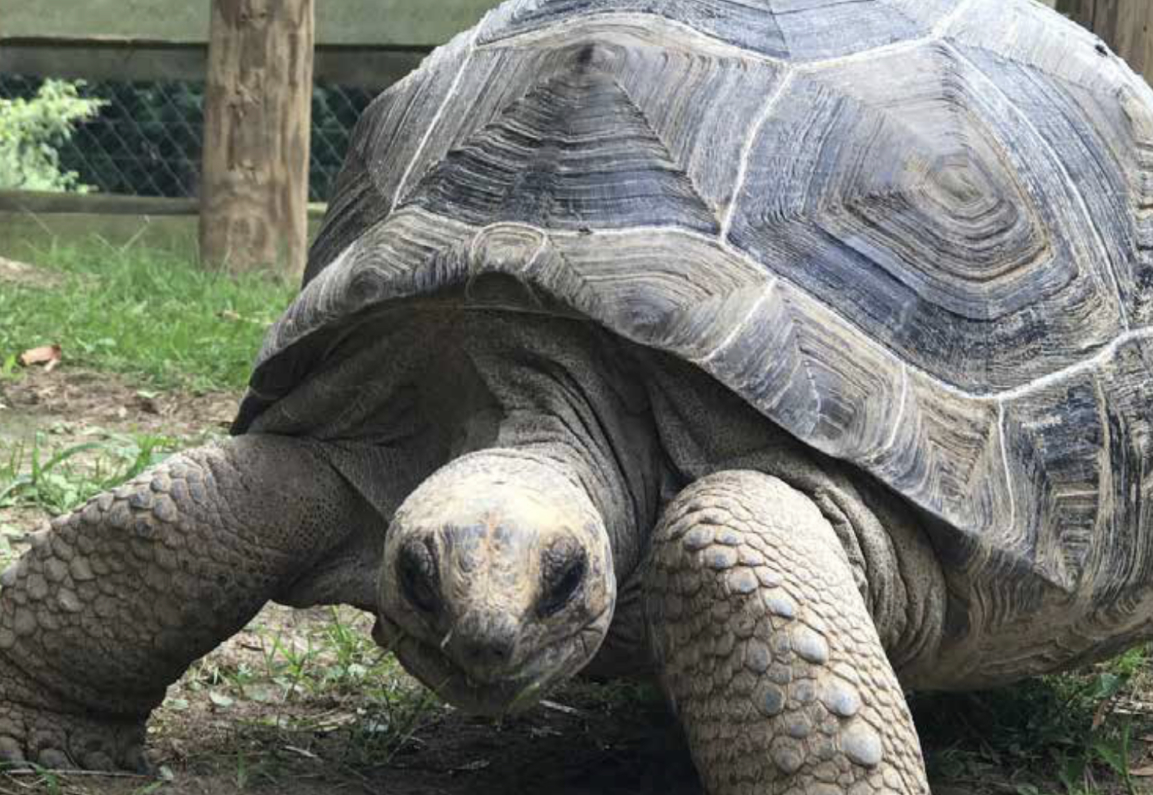

Slide 17
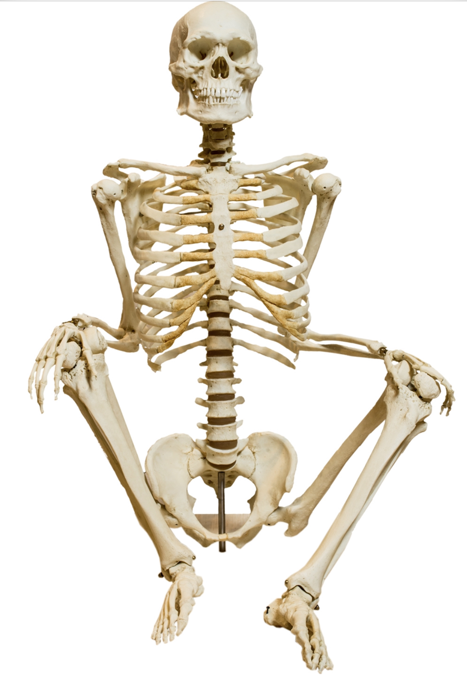

Slide 18
?

