Slide 2
Securing The Human Factor – People Are Your Biggest Risk!
Haroon Malik, Director – Cyber Security Consulting

Slide 3
Key points
Cyber threats are changing
Its not all about the technology
Awareness maturity framework
The way forward
1
2
3
4

Slide 4

The story so far…

Slide 5


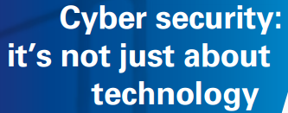
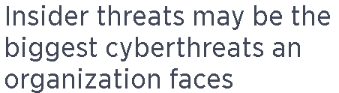
Dig a little deeper….

Slide 6
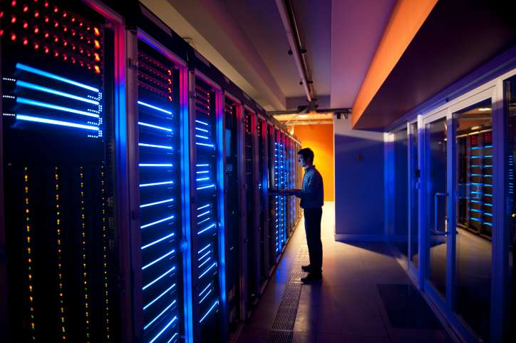
Technology – still the best ‘first line of Defence’?

Slide 7
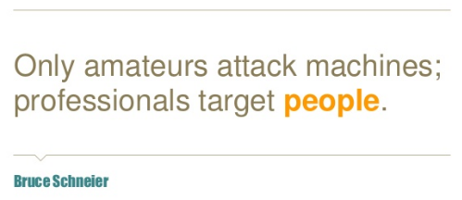
Who me?

Slide 8
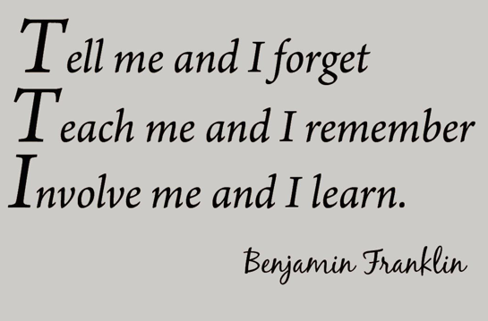
How do we engage our people?

Slide 9

Where does your organisation fit?
Metrics framework
Cultural change
Promoting awareness & behavioural change
Compliance-focused
Non existent

Slide 10

Executive level support and sponsorship

Slide 11

Empower people

Slide 12

The best firewall

Slide 13

Doing without doing

