Slide 1
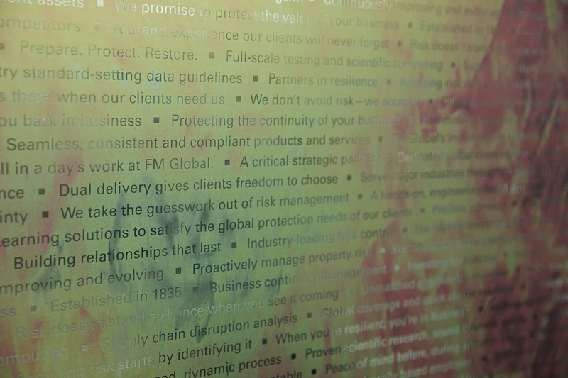

Taking a byte out of data,
turning big data into smart data
Owen Lewis
Operations Vice President
Account Engineering Manager
AIRMIC CONFERENCE 2018
Notes:
Big data …. Big subject
Will share what FM Global is doing in this space

Slide 2

Notes:
Living in a time of unprecedented data creation and capture …..
….. but how do we harness for risk management benefit?
Not going to talk about Internet of Things, Artificial Intelligence, data aggregation or other jargon or buzzwords
Predictive Analytics …… using data led models based on risk engineering data to predict where losses are most likely to occur

Slide 3
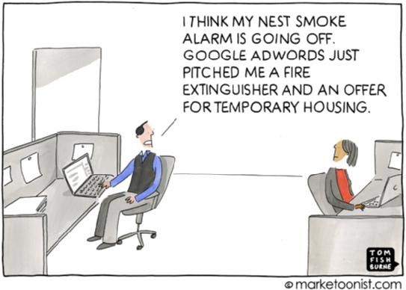
Notes:
We believe that the majority of all loss is preventable
Big data becomes smart data …. when you can act on the insights

Slide 4



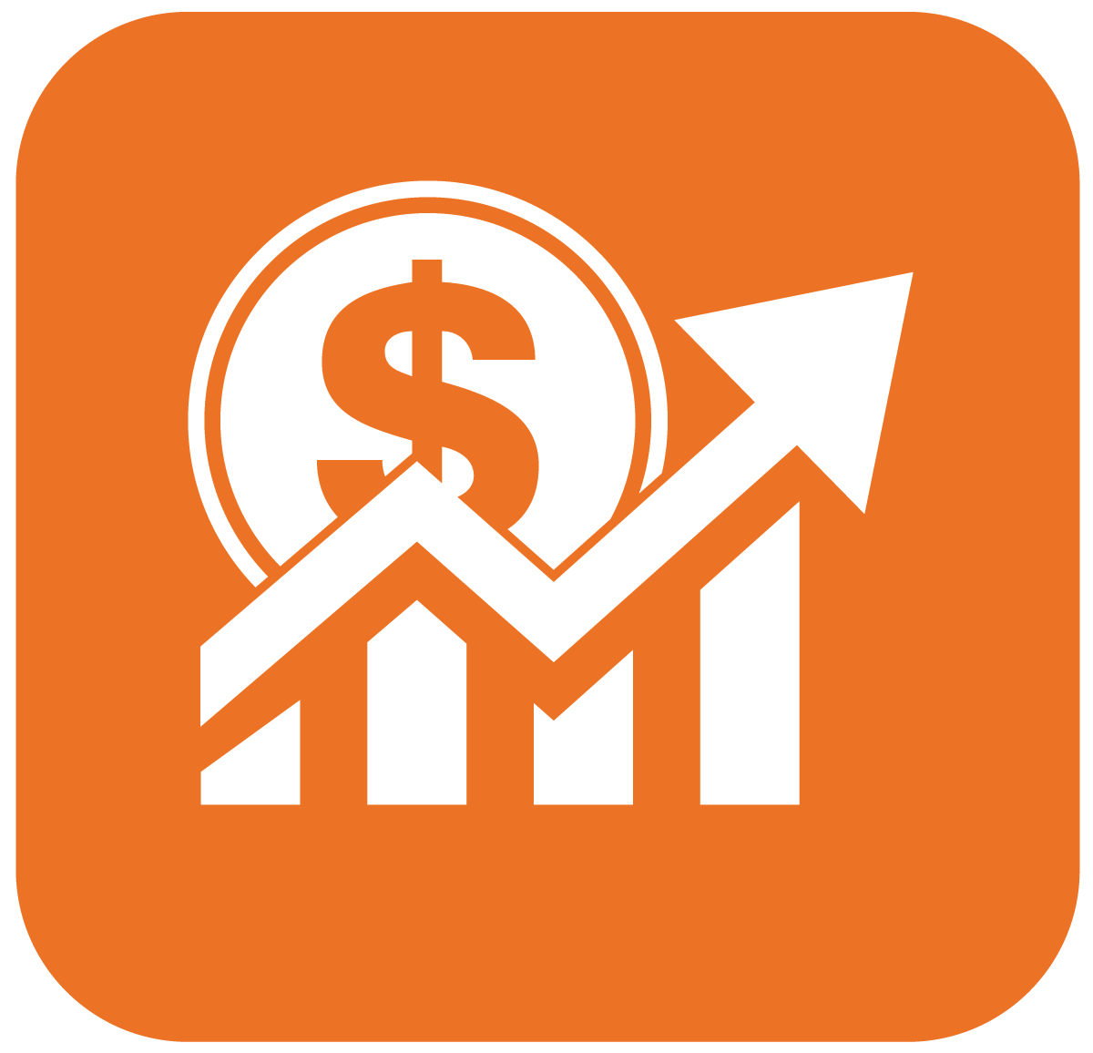



Notes:
Imagine business leader of a large, multinational company.
<CLICK>
hundreds of facilities and thousands of employees around the world.
<CLICK>
responsible for increasing profits, protecting shareholder value,
<CLICK>
and avoiding disasters
<CLICK>
building resilience into your business.
Where do you start?
<CLICK>
Suite of tools that could filter your view of the world, quickly, easily and reliably.
<CLICK>
See the countries in which you operate that are the most resilient, and least resilient…
<CLICK>
most critical locations, filtered on the basis of risk quality,
<CLICK>
and narrowed down to locations most likely to suffer a major loss.
<CLICK>
identify which individual pieces of equipment are most likely to fail.
In a nutshell, that’s what FM Global analytics tools do.

Slide 5
Spotting risk is critical.
Predicting it changes everything.
700 data points from 100,000 location visits each year.
Notes:
Collecting risk engineering data for nearly 200 years
….. only recent years started to think of this as “big data”
Our engineers visit after losses, to ensure we understand the loss and capture various contributing factors as data points
Each year we have:
1500 engineers visiting 60,000 insured locations around the world
Collecting approximately 700 data points during 100,000 location visits per year
All trained the same way and working to the same loss prevention standards.
Use the same reporting software capturing data points for underwriting and communicating findings to our clients
Result is: an extremely large, clean and consistent big data set, which we can compare those same risk indicator data points before and after the loss has occurred

Slide 6
RiskMark
Locations with the lowest RiskMark scores
are 7x more likely to experience a loss.

Slide 7
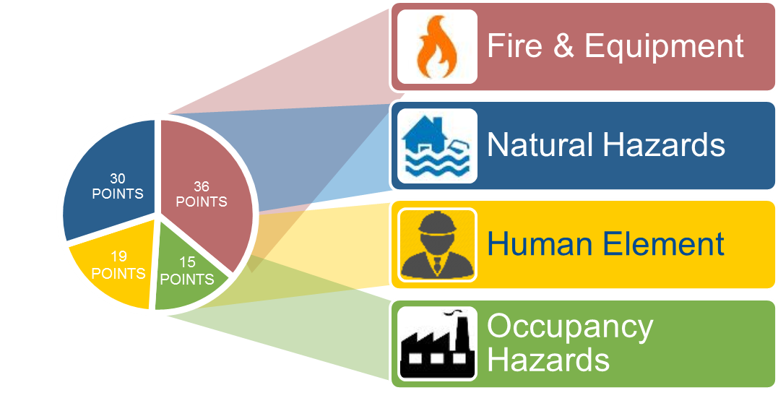
RiskMark
Notes:
We’ve had RiskMark for more than a decade now.
RiskMark - location risk benchmarking tool, based on risk factors observed by our engineers.

Slide 8
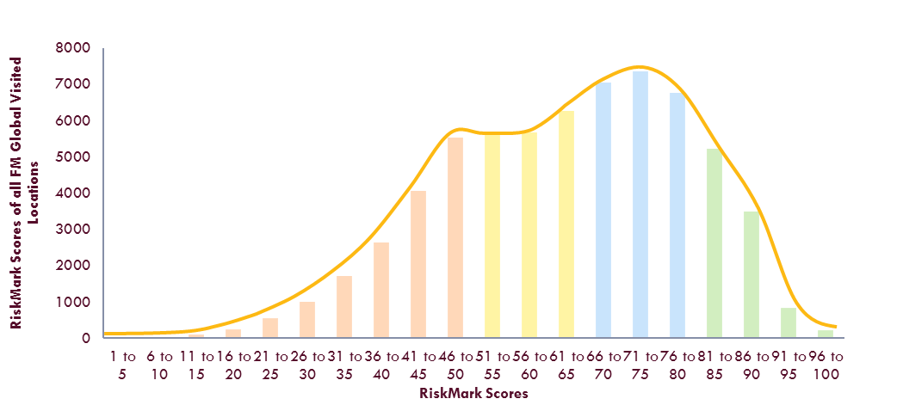
RiskMark

Slide 9
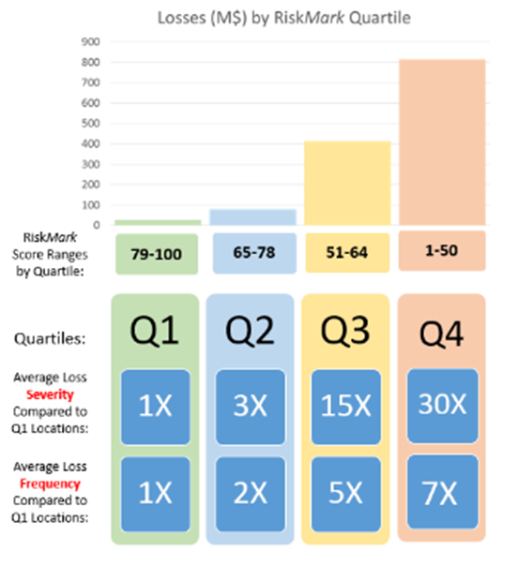
RiskMark

Slide 10
Locations Predisposed
Top 1,000 locations identified as predisposed to loss generate 30% of losses >$3m per year
Notes:
You may have multiple locations, but do you know which are most likely to experience a loss?
For the past 5 years, on average 30% of large losses (>$3M) occur at the 1000 locations identified at the beginning of the year.
As you would expect from FM Global, we undertake data led analysis. We study losses and have been able to develop a tool that predicts the top 1000 locations that would have a loss >$3m.
This model doesn’t include natural hazard losses, just fire or boiler & machinery losses.

Slide 11
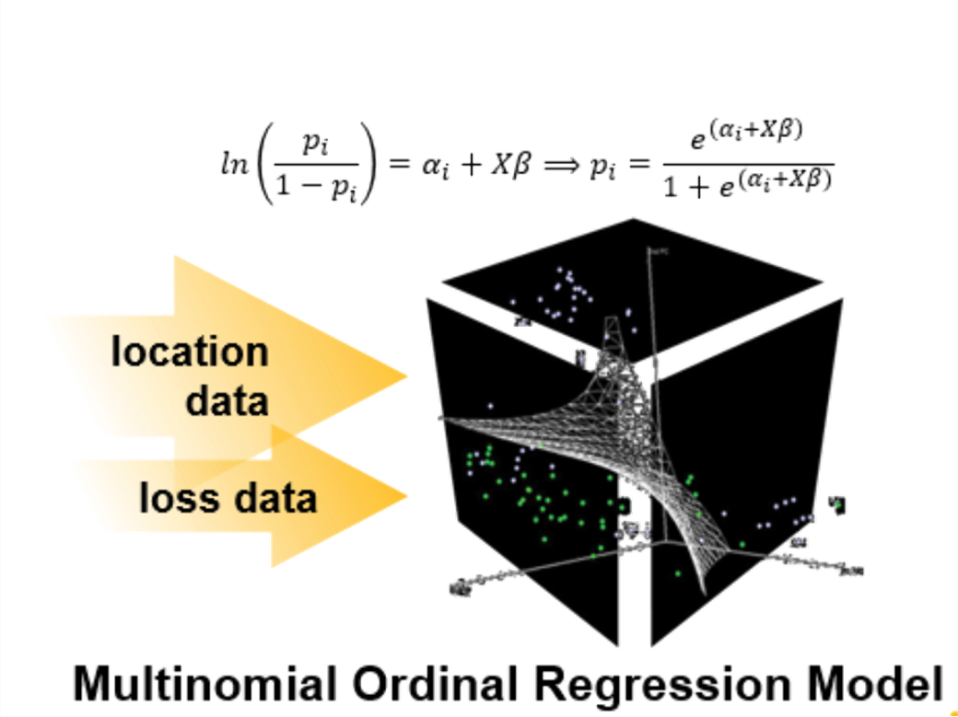
Notes:
How did we do this ….. Constructed a model, using location risk data and overlaying loss data
The math is pretty exotic
Multinomial Ordinal Regression Model
But lets focus on how we can use the insights to improve the risk management process
Let me show you why I trust this model …..

Slide 12
Locations Predisposed
2013
2014
2015
2016
2017
data from
60,000
engineered locations
23%
29%
27%
29%
45%
15×
16×
13×
14×
22×
Top 1,000 locations (< 2%) predisposed to having a loss
All losses >$3M Gross at engineered locations in a given year
Percentage of losses >$3M captured within the top 1,000 locations
Notes:
This is a predictive model, now validated by losses with a strong correlation.
Our engineering analytics gives our teams and clients the insight to better focus efforts on those locations that may be more likely to have a fire or B&M related loss.
For the past 5 years, the locations identified as predisposed to loss at the beginning of the year are on average 16 times more likely than chance to experience a large loss throughout the year.
Consult with our clients, where to focus risk improvement efforts and also our risk engineering time.

Slide 13
Relative Likelihood
Relative Likelihood exposures are 2x
as likely to be associated with a loss.
Notes:
Relate back to large multi-national company example ….. hundreds, maybe thousands of loss prevention recommendations
Relative Likelihood identifies those exposures, at a location, that are most likely to be associated with a loss so you can prioritise.
Example:
- Poor hot work control
- Missing interlock on pumped ignitable liquid system
- Lack of fire protection system
Reflects the exposure itself and site factors
Prioritise: predictive knowledge that will enable strategic, cost-effective decision making.

Slide 14

Recommendation Relative Likelihood
Higher Relative
Likelihood
20%
2x
None
Natural
Hazard
10%
Notes:
Split of recommendations across FM Global’s book of business.
Loss data and Predictive Analytics models show that Higher Relative Likelihood are twice as likely to be associated with a loss than those in the pool of “all others” shown above.
Natural hazard exposures have a greater frequency of occurrence than other risk losses, e.g. high hazard flood is 1 in 100 year frequency.

Slide 15
Equipment Factors
Breakdown of equipment at risk
is up to 5x more severe.
Notes:
Equipment factors is the tool we use to help assess equipment breakdown potential.
Typically larger more industrial locations with high value / critical process equipment:
e.g. transformers, turbines, presses, switchgear, boilers
Long lead times, drive revenue for the business
Keeping your business up and running depends on how your equipment is designed, installed, operated, maintained and protected.

Slide 16
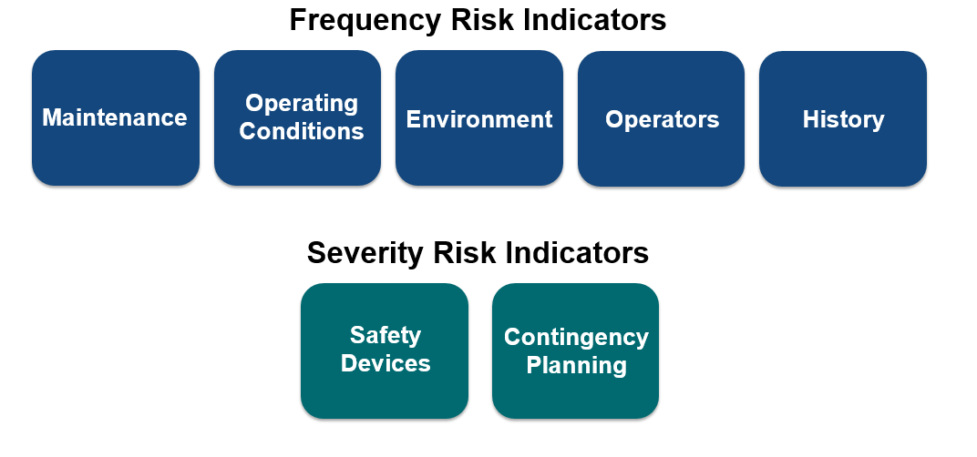
Equipment Factors
Notes:
Equipment Factors are a set of seven observable conditions we assess equipment against and provide satisfactory or unsatisfactory data point.
They help indicate the equipment most at risk, the frequency and severity of equipment breakdown.
Lots of research on-going in this area to further develop models for particularly types of equipment

Slide 17
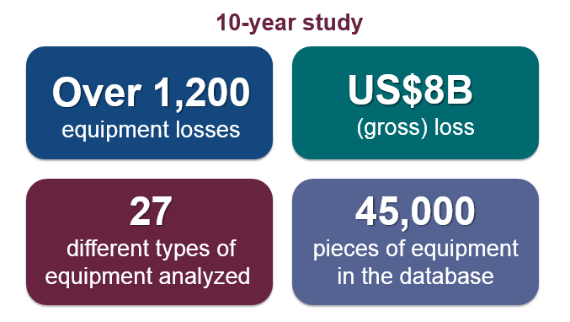
Equipment Factors Loss Study
Notes:
10 year loss study – 2003-2012. Loss dollars are USD
45,000 pieces of equipment at time of study – Currently the data base is over 50,000 pieces of equipment
The loss study demonstrates the links between equipment breakdown loss frequency, severity and the Equipment Factors.
Key takeaways from the loss study include - Click through and describe.
Frequency and severity of loss increases with the number of Unsatisfactory Factors
Equipment with 1 or 2 unsatisfactory Factors can have significant exposures, particularly when the Factors are loss drivers for the equipment
Equipment with both a frequency and severity Factor rated unsatisfactory is a contributing factor for loss
What about equipment with 3 or more unsatisfactory Factor ratings? This equipment has the highest frequency and severity for loss.

Slide 18
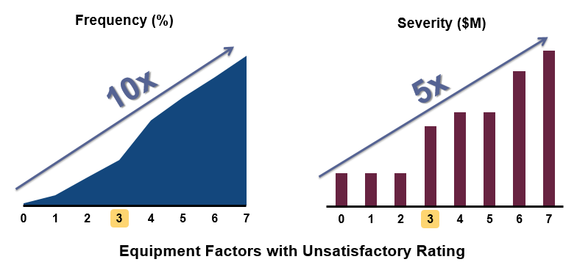
Equipment Factor Loss Study
Notes:
The 10-year loss study of over 1200 equipment losses from our equipment data base, totaling over $8B in gross loss demonstrates the links between frequency and severity of equipment breakdown loss and the Equipment Factors.
Loss Study Takeaways
- Frequency and severity of loss increases with the number of unsatisfactory Factors
- Equipment with 1 or 2 unsatisfactory Factors – loss drivers
- Equipment with both a frequency and severity Factor rated unsatisfactory is a contributing factor for loss
- Equipment with 3 or more Factors rated unsatisfactory have the highest frequency and largest severity of loss
The percentage of equipment with three or more Factors rated unsatisfactory that had a loss was 10x higher than equipment with zero to two unsatisfactory Factors (20% to 2% sustaining a loss).
The average loss severity increases up to 5x overall as the number of unsatisfactory Factors increases ($20 to $4m).

Slide 19





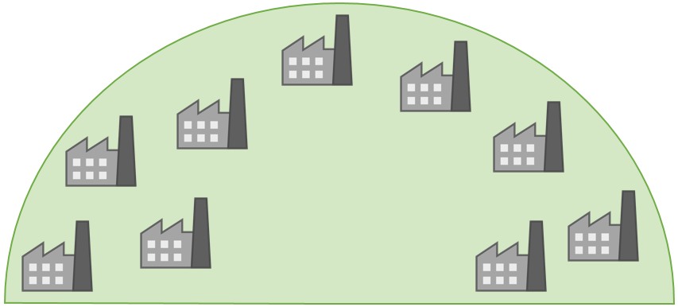











C-SUITE
61
PREDISPOSED
85
RISK MANAGER
59
73
82
PREDISPOSED
PLANT MANAGER
PREDISPOSED
65
64
46
75
66
HIGH LIKELIHOOD
Notes:
Resilience is a choice. The majority of all loss is preventable
Risk Managers and others in your organisation take advantage of these tools.
Data led prioritisation to target your resources:
- Focus risk management time on critical exposures
- Use predictive analytic metrics to build consensus for action
- Prioritise capital expenditure for risk improvement & resilience
Bottom line: use these tools to efficiently reduce exposure to your business

Slide 20
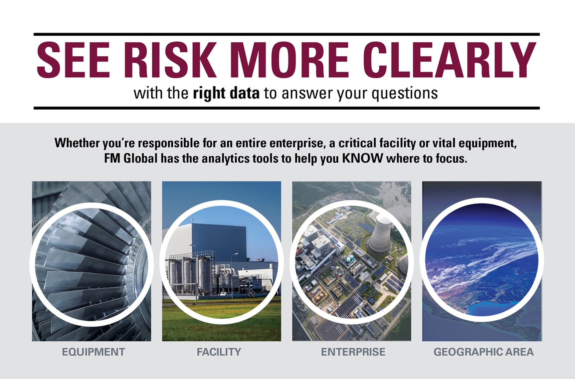
Notes:
Powerful strategic risk management tool
Overlaying the data driven priorities with the client’s business and future objectives will validate where the actual risk improvement priorities lie
Put together with detailed analysis of supply chain financials and production interdependencies

Slide 21
Spotting risk is critical; predicting risk changes everything. In a world that’s full of data, finding a way to see through the noise to the most important risks, and knowing which ones are most likely to occur sounds like an art. It isn’t. It’s a science. What turns big data into smart data? What’s the difference between benchmarking and prediction? How can you balance operational hazards against inherent, sometimes country-wide, risk? And how do you validate those data-driven priorities?
All of these can be explored in just twenty minutes… from field-collected data points to embedded sensor feeds, more data doesn’t mean rich data. And it’s the latter that helps take the guesswork out of risk management.

