Slide 1

Airmic ERM Forum 2019
9 October 2019

Slide 2






Notes:
A bit about my background – also worked with Majid Al Futtaim and Mubadala here in the region
Let me start by introducing you to ,my daughter Lulu….she wasn’t named after the supermarket

Slide 3
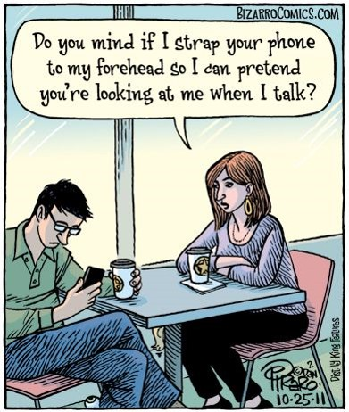

The
WAR
for
Notes:
From where I started over 30 years ago at BA, the war for an employees attention has never been greater
Put your phones, laptops in the middle of the tables…your IQ goes down by 10 points when they are on or near you

Slide 4
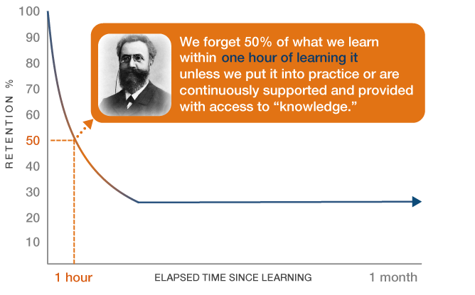
Ebbinghaus Forgetting Curve

Slide 5
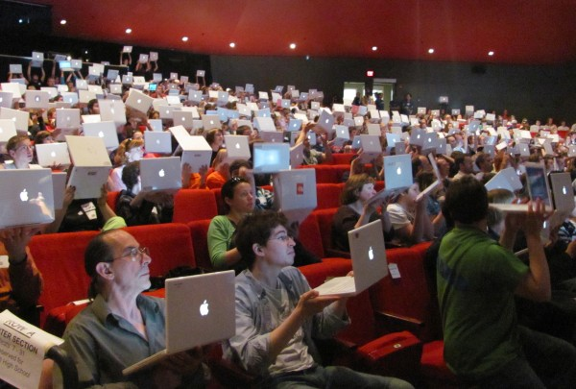
1:3

Slide 6







telephone
radio
television
web
Social media
4
2
13
19 days
The speed of change is exponential
38
years to reach
50m people
77
Source: Phil Male, Cambridge University, 2015
Notes:
So we live in exponential times…

Slide 7
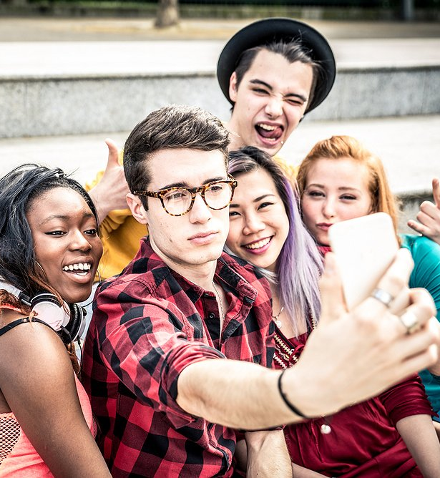

Gen Z: 2.8 seconds
Goldfish: 9 seconds
150 times a day
Source: Microsoft and Google
Notes:
If you are a millennial, the chances are you will look at your phone at least 150 times every days. That’s about once every 5 minutes in your waking day. Probably more when you are bored or distracted. Who has managed to keep their phones at arms length? Research has also shown that millennials have an attention span of 2.9 seconds…arguably worrying when a goldfish has apparently a 9 second memory.
However don’t be fooled into thinking that this means that millennials don’t take information in. Wrong. What it means is that they have an ability to process information far quicker that oldies like me.
As a result we are seeing a change in how information is packaged together..just look at this.

Slide 8


Slide 9
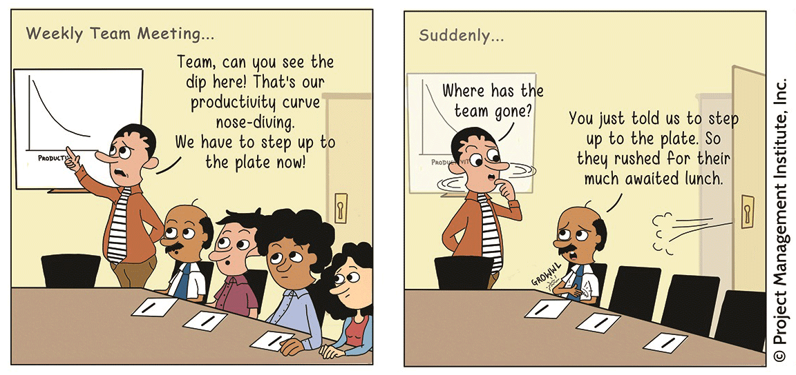

Slide 10
US$37billion
Source: Cognisco, 2008

Slide 11
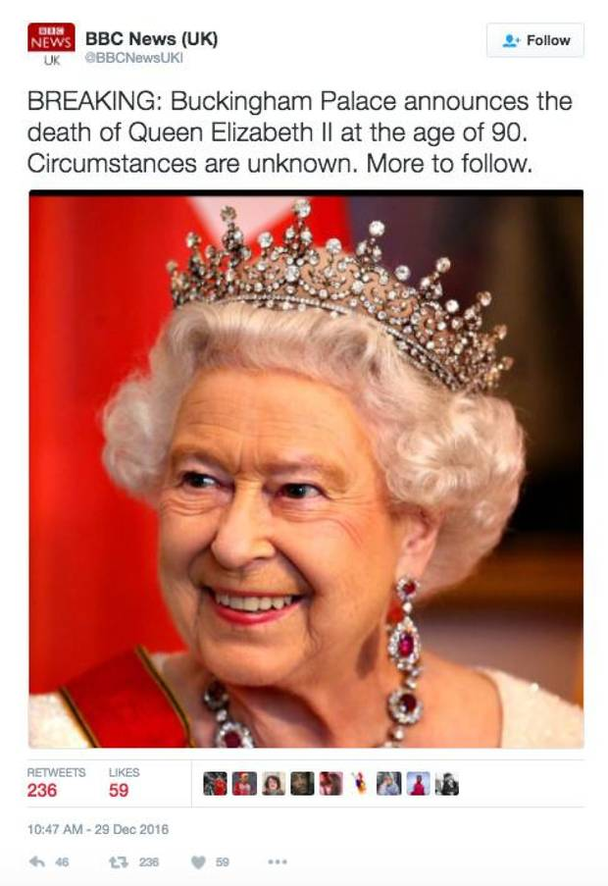
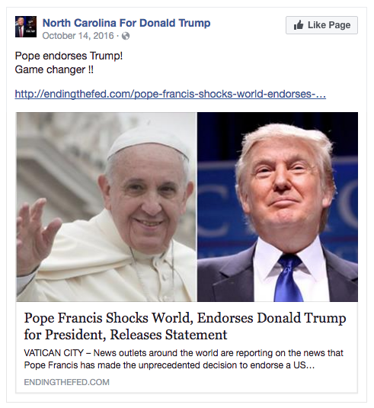
Notes:
If the Queen said those things 60 years ago, I wonder what she would make of the current ways to communicate. President Trump has arguably become the master of using Twitter to by-pass the media completely and talk directly to US voters. However, we can’t always believe everything we see on social media. Sadly fake news has become a reality and feeds our insatiable appetite for more information.

Slide 12
1 in 3
Trust news from social media
Notes:
In fact, given that nearly 200 million people globally use Facebook as their primary source of news – that’s the equivalent to a country the size of Brazil – it’s no surprise that a whopping 2/3rds of people can’t tell the difference between good journalism and rumours.

Slide 13
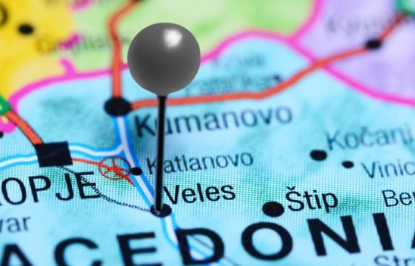
Source: BBC News, 2016
Notes:
US election fake news traced back to Veles in Macedonia
Lucrative for smart technology students…more than 5x the average salary

Slide 14

Notes:
So given this, we shouldn’t be surprised that TRUST between ‘leaders’ in society and the ‘rest’ continues to be very fragile indeed.

Slide 15

“If you can't explain it to a six year old, you don't understand it yourself” Albert Einstein
Notes:
That’s common sense story..
But the interesting thing is that if any of you have teenagers, you’ll know how difficult it is to get their attention on anything
BUILD: As Albert Einstein once said If you can't explain it to a six year old, you don't understand it yourself

Slide 16
ETHOS
PATHOS
LOGOS
Notes:
So what’s the secret behind the success of these forms of communication? Well go back 2000 years to Aristotle for the answer…

Slide 17
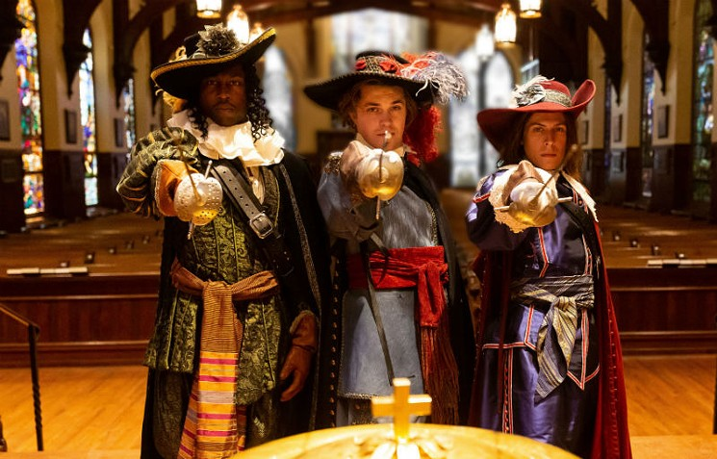

Slide 18
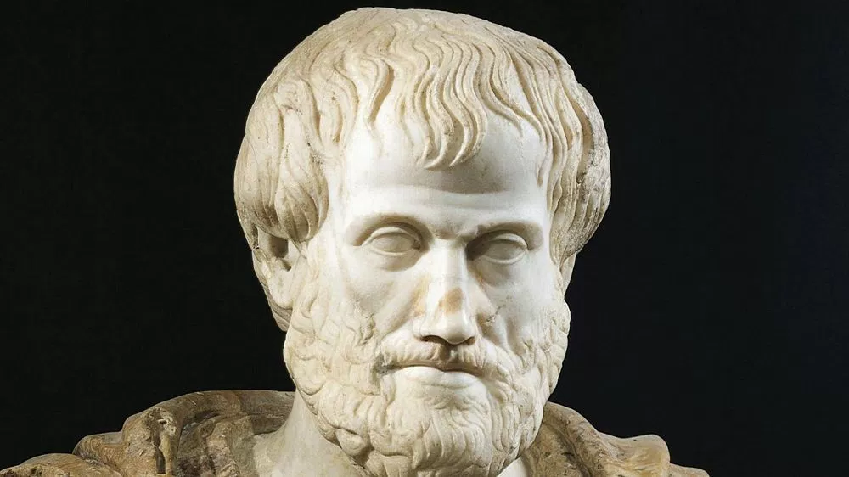
ETHOS
PATHOS
LOGOS
Notes:
So what’s the secret behind the success of these forms of communication? Well go back 2000 years to Aristotle for the answer…

Slide 19

ETHOS
Notes:
The ability to inspire TRUST in your audience.

Slide 20
Credibility is about your experience, your track record and how you behave (do your words match your deeds)
Reliability is about your actions and how dependable they appear
C + R + I
TQ =
SI
Intimacy is about how safe people feel talking with you and sharing their thoughts in confidence
Self interest is about whether you do things for your own interest or for others
http://trustedadvisor.com/trustInstitute.trustQuotient/toplink

Slide 21
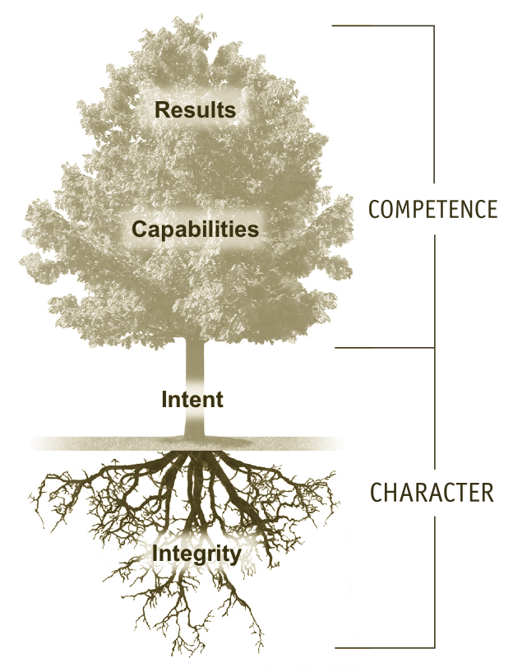
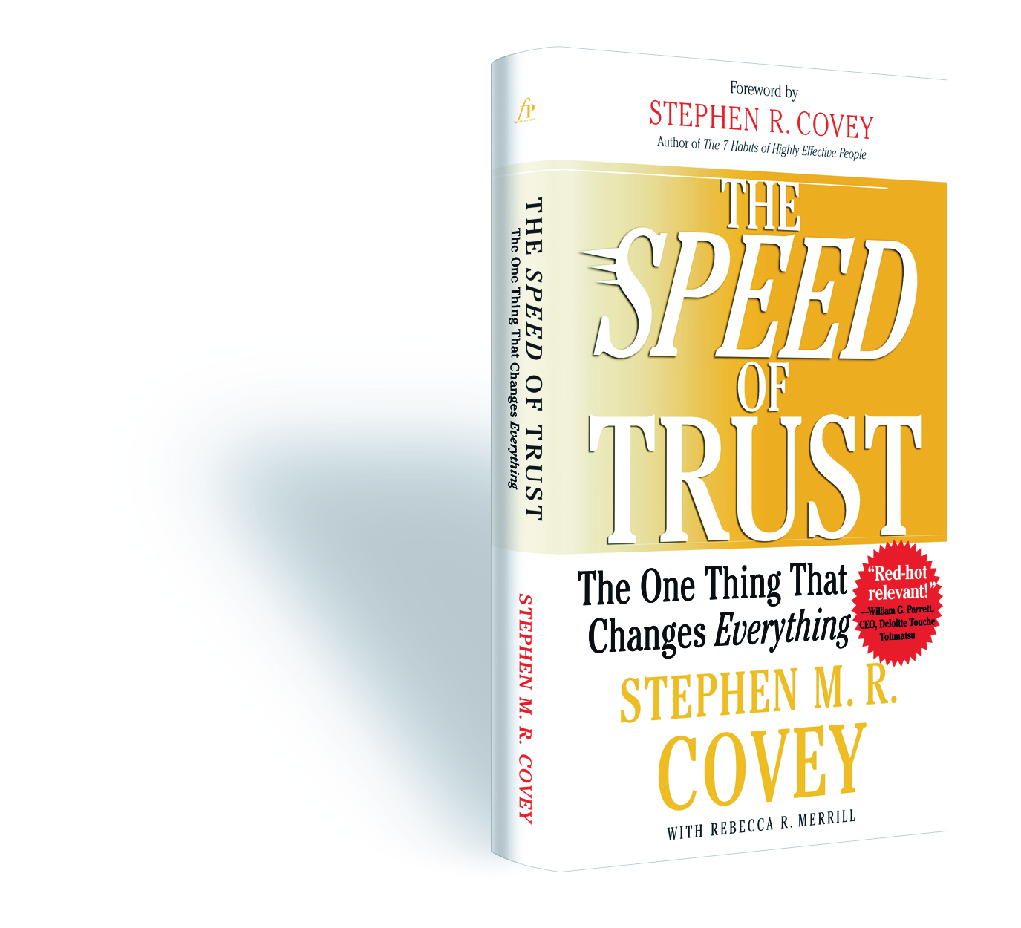

Slide 22
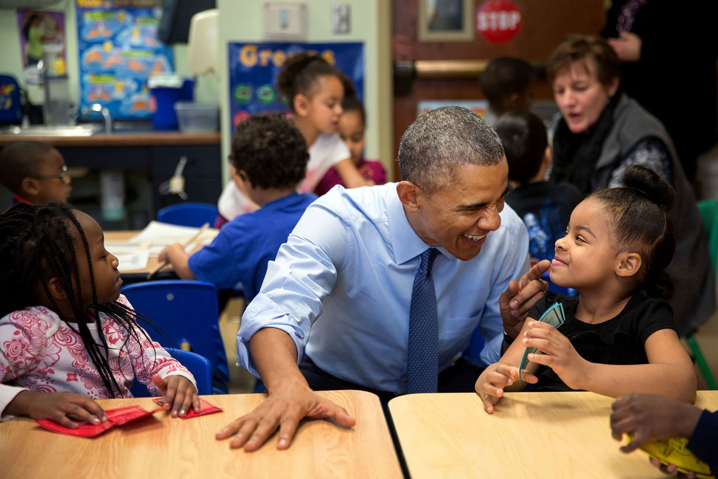
PATHOS

Slide 23


Slide 24
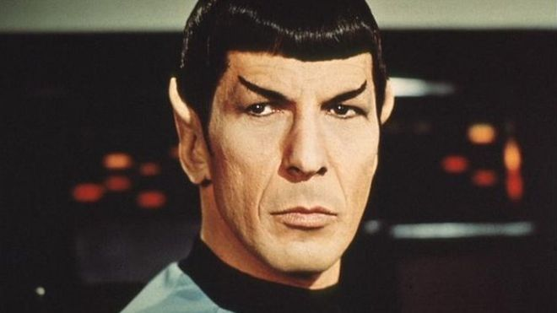
LOGOS

Slide 25

Source: Phil Male, Cambridge University, 2015
Notes:
Of course it’s a duck…no it’s not it’s a rabbit. Logic can persuade.

Slide 26

KAIROS

Slide 27
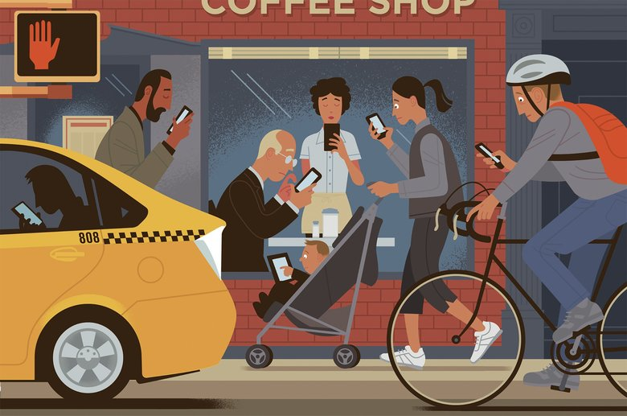
Notes:
So with this happening in our brains, it’s no surprise that we are seeing information addiction on every street corner. And in fact, while we can have some fun with this there is a serious angle to it as well. As we know, social media is having serious mental health consequences.
So how on earth do we ensure that our message cuts through when we a tsunami of information AND people unable to judge the difference between NEED TO KNOW and WANT TO KNOW
Let me take you three principles that I believe relevant for internal and external communications.

Slide 28
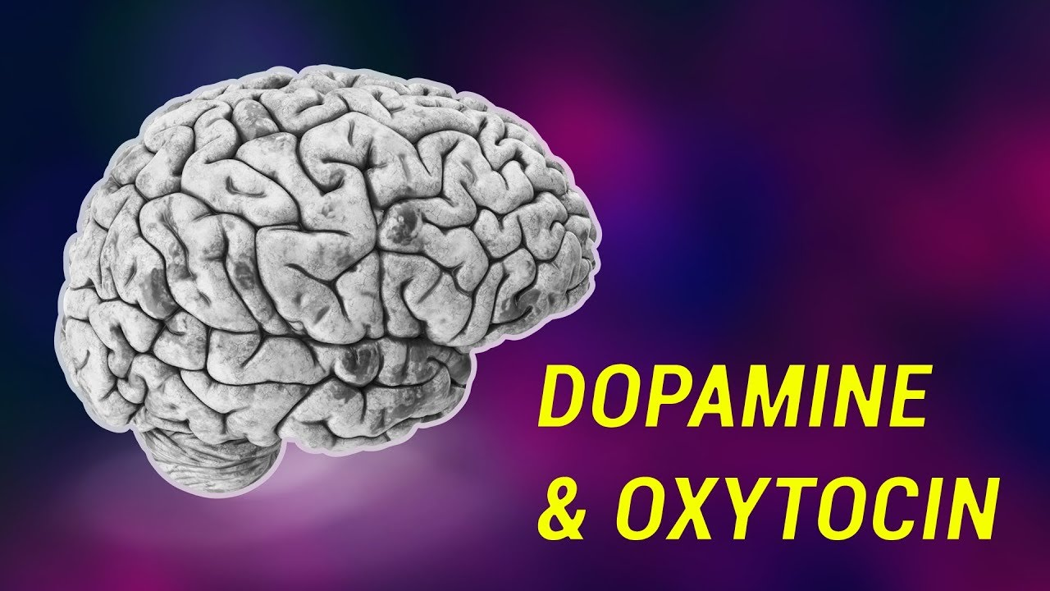
Notes:
Our craving for more information is based on dopamine…the chemical our brain releases to make us feel good. Every time we get a ping alert on our phone ….it triggers a rush of dopamine. Every time we get some information that tells us something new…you guessed it, we get a dose of dopamine. It’s the same chemical that makes us feel good when we eat food that we just love.

Slide 29


Slide 30

AUTHENTIC &
ADAPTABLE
Notes:
The first is AUTHENTICITY. The word comes from the Greek word authentikos which means ‘genuine’. We use it a lot in business today to reflect if something is both truthful and comes from someone who is purposeful and responsible.
What is interesting is that this principle has been around for many, many years and is not something new. How many of you have watched the TV series about Queen Elizabeth called The Crown? If you haven’t don’t worry too much.

Slide 31
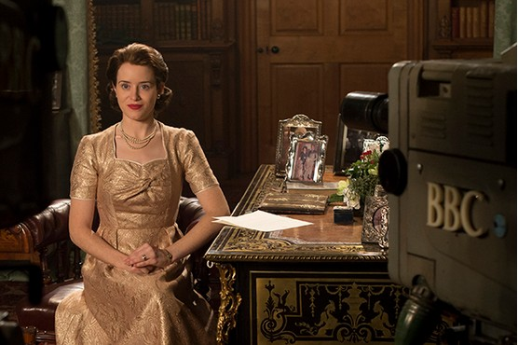
“In this new world where we can communicate so easily”
Notes:
In one episode set in 1957, it tells the story of the British monarchy having a serious crisis. They were seen as been out of touch with reality and their people. The episode shares the true story of a man by the name of Lord Altrinham meeting the Queen to discuss his ideas on how the Royal family should change and communicate to the public. At the meeting, she says – and remember this was over 60 years ago – in this new world where we can communicate so easily, how do I reach my people. She was of course talking about television. Lord Altrinham said that she needed to talk directly with people and bring her message into the homes of people up and down the country. This led to her televising her Christmas message. He also said that she needed to get closer to her people by meeting them directly. This led to the now famous Buckingham Palace Garden parties. It’s a bit like the story Colin shared yesterday about the Shell executive on his bike.

Slide 32
BREVITY
(and speed)
Notes:
Next up, is what I call Brilliant Basics. In a world when everything is complicated already, it always surprises me that we continue to over-complicate our own profession. In fact, I would argue that the biggest challenge for Communicators over the next 5 years is simplification – namely to make the employee experience for communications more engaging, self service and intuitive.
BUILD: “Life is really simple, but we insist on making it complicated.”
― Confucius

Slide 33

Get to the point…you have less than 6 seconds
Notes:
The 6-second commercial. Check them out on Google, but there are more and more of these types of commercials emerging on social media platforms like Instagram and Snapchat.
What was the message in this one? Global warming.

Slide 34
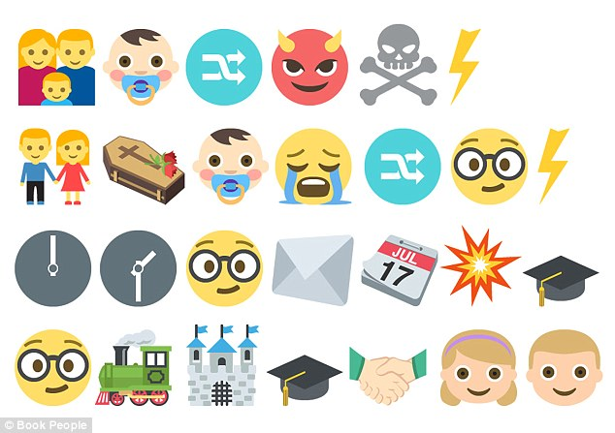

Source: Phil Male, Cambridge University, 2015
Notes:
We are also seeing a whole new universal language emerge that crosses languages and cultures. Yes, the emojicon. …there are now over 2800 of them now. Let’s a quick test…which famous book is this referring to?

Slide 35
CONNECTIONS
Notes:
And to my third and final part of my breakthrough the noise philosophy. That is to be clear and concise.

Slide 36


Slide 37
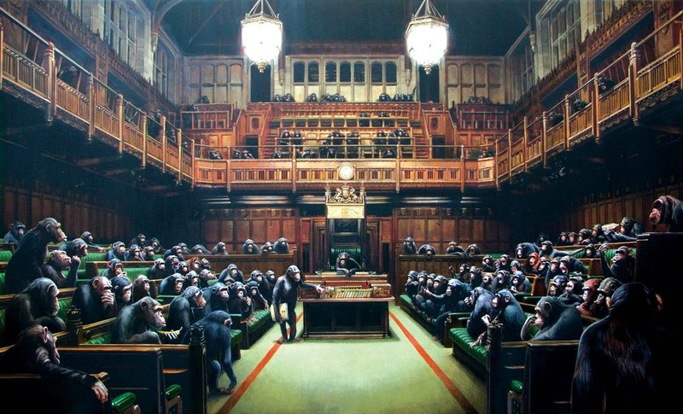

Slide 38


Slide 39
AUTHENTIC &
ADAPTABLE
BREVITY
(and speed)
CONNECTIONS
Notes:
And to my third and final part of my breakthrough the noise philosophy. That is to be clear and concise.

Slide 40
And
FINALLY…

Slide 41
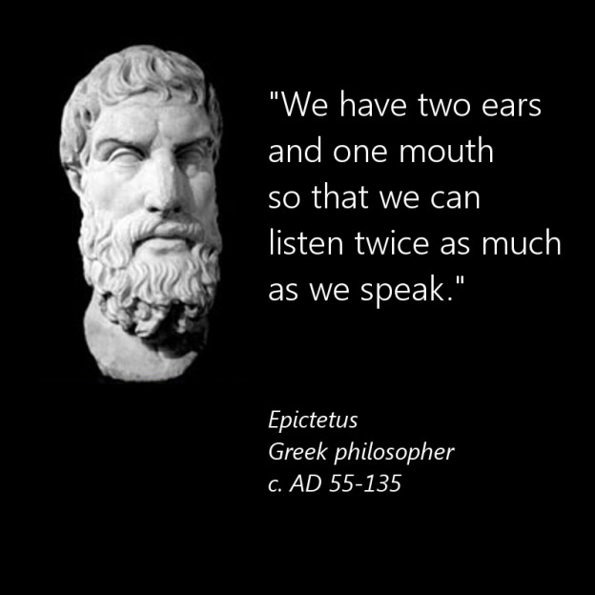

Slide 42
Thank you

