Slide 1
Major loss: Engage your insurers effectively, maximise your recoveries
  Airmic Conference Workshop 2018
    12 June 2018
      Greig Anderson, Partner greig.anderson@hsf.com
      Tony Dempster, Partner anthony.dempster@hsf.com
      Paul Lewis, Partner paul.lewis@hsf.com
      Xavier Mützig Johnson Matthey

Slide 2

Scenario
Flagship store of well-known retailer in Liverpool, SellsEverything
Brand prides itself on “being in everyone’s home for Christmas”
3 December – significant fire in the store in the plant room
Injuries to employees and customers
Significant property damage forces store to close for 4 weeks in the run up to Christmas

Slide 3
Overview
Immediate considerations
Internal investigations
Managing claims against/from third parties
Engagement with insurers

Slide 4
Immediate considerations

Slide 5
Engagement with internal stakeholders
Insurance is a significant asset for a company
Important to get buy-in early on
Crucial that management make decisions about managing an incident with insurance in mind
Risk manager / insurance team needs to be empowered to have immediate and ongoing involvement in the incident response

Slide 6
Scenario: which insurance policies may be relevant?
Property Damage and Business Interruption
Public Liability
Employer’s Liability
Directors and Officers Liability?

Slide 7
Scenario: Notification
Property Damage/Business Interruption policy:
The insured must notify insurers of any occurrence which is likely to give rise to a claim under this policy as soon as practicable upon the Head of Insurance or the General Counsel being made aware of such an occurrence
Public Liability policy:
The insured shall as a condition precedent to insurers’ liability give written notice immediately of any occurrence which may give rise to claim under the policy
Notes:
Slides shows notification clauses of two key policies relevant to this scenario. Good v Bad clauses.
Public liability requires immediate notification of circumstances – risk manager in error thinks he doesn’t think necessary to notify as no complaints from third parties received as yet
Failure to notify ‘immediately’ = breach of conditions precedent = insurers can deny liability for claims which arise from this occurrence
Keep notifications under review as matters develop

Slide 8
Notification - takeaways
    “Do exactly what it says on the tin”
    Notify all potentially relevant policies
    Be aware of different requirements in different policies
    Beware time limits
    Beware conditions precedent – clause requires compliance before insurer can be liable to pay the claim
    Liability policies – provide for insured to notify insurers of circumstances and claims
    Keep notifications under review as matters develop

Slide 9
Evidence preservation
Put in place a process to preserve all relevant material/evidence, including all electronic data
Retain all evidence securely to prove all aspects of claims, eg. physical evidence, accounting records and documentation
Agree protocols for inspection and testing with relevant stakeholders
Going forward, log communications with insurers’ representatives (including loss adjusters) and minute calls and meetings

Slide 10
Scenario: Social media
Increasingly bad publicity on social media following the incident using the hashtag #NoXmasinmyhome
@SellsEverything have been radio silent since my life changed whilst Christmas Shopping. Spending Christmas in hospital #NoXmasinmyhome
@SellsEverything Not sure how I can collect all the Christmas shopping I had done online and opted to ‘Click and Collect’ when store closed indefinitely and telephone lines constantly engaged. Merry Christmas – NOT! #NoXmasinmyhome

Slide 11
Scenario: Press statement
CEO makes press statement in response to negative media coverage
We are taking this incident very seriously. I am personally taking charge of an internal investigation which will be a no holes barred look at what went wrong. The cause of the fire is still unknown at this early stage initial indications are that there was a failure of our sprinkler system.
I will also personally make sure that all those impacted by the incident are properly recompensed. As a starting point, I promise that anyone impacted by these events will receive at least £1,000 as a gesture of our goodwill.
Notes:
In response to increasingly negative comments on social media the CEO makes a press statement without reference to the risk manager or legal.
Be careful that external communications are consistent – eg what is said in the media is what you would say to any regulator and be what you want to say to insurers
Don’t assert facts not yet known-
Beware ex gratia payments for which there is unlikely to be cover. As well as going above and beyond legal liability to potential claimants.
If the insured wants to later seek to argue that this payment of £1000 represents what insured’s legal liability then you have not received insurers consent
May want to argue at a later date that these are mitigation costs – may be difficult if they have been described as a ‘gesture of goodwill’

Slide 12
External communications - takeaways
Ensure all external communications are consistent – to media, to regulators, to insurers
Do not assert facts that are not yet known in response to media pressure
Do not take steps that might amount to an admission of liability (without insurer consent)
Do not offer to pay compensation (without insurer consent)
Beware offering ex gratia payments / compensation that goes above and beyond legal liability as unlikely to be covered
Have coverage in mind when drafting external communications

Slide 13
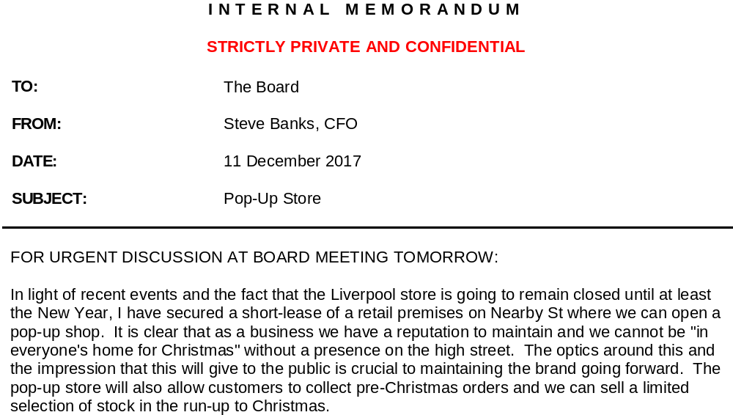
Scenario: Board memorandum
Notes:
This is a note essentially on mitigation costs
Highlights need for Board/senior management to understand insurance implications of their decisions and have coverage in mind when taking decisions.
Danger of expressing reasons internally
Be careful how characterise
Avoid stating (in non-privileged documents) the purpose of any mitigation steps that have been or may be taken because the Company might ultimately wish to characterise the purpose of such payments to accord with its position on coverage (e.g. as costs of mitigating BI losses or of avoiding/minimising claims).

Slide 14
Contingency planning
Incident response / mitigation costs
Important to put yourself in the best position to present your claim to insurers at a later date
Reinstatement of property damage
Business interruption cover for increased cost of working
Additional increased cost of working?
Have an eye on coverage when contingency planning
Keep insurers updated and seek buy-in of insurers / loss adjusters to avoid future disputes

Slide 15
Internal investigations

Slide 16
Scenario: Initial investigation
CEO instructs Health & Safety officer to produce a ‘Lessons Learned’ report
Extract from report:
Conclusion 1:
In October, a new air conditioning unit for the store was installed in the plant room by a sub-contractor, CoolAir Ltd. The investigation has revealed that the air conditioning unit was not installed correctly and not in accordance with required safety standards. The unit overheated and started the fire.
Notes:
Carry out effective internal investigations – investigations for non-insurance purposes (i.e. HSE, lessons learned) rarely focus on the correct issues for coverage
Cloak investigations in privilege where appropriate (and be careful of lessons learned exercises) – how cloak in privilege. Also be careful of internal commentary on privileged documents.
Take care after discovery of loss or after an underlying claim is made not to prejudice insurers’ subrogation rights (or potential rights), e.g. settling claims or making admissions without insurers’ consent
Fact-finding exercises – best directed and controlled by insured on major losses – collate documents / witness proofs / control access of loss adjusters/other insurer representatives
Potentially major exercises which should be informed by an understanding of coverage implications (but the facts are the facts)

Slide 17
Scenario: unhelpful speculation
Internal emails
From: Green, Ron
Sent: 6 December 2017 15:35
To: Wright, Harry
Subject: !!!!
Bloody hell! Did you see what happened at the weekend?
I had a quick fag in the plant room that morning – feel sick it might have something to do with that. Do you think I’ll get the boot?
Not-so Merry Christmas ☹
R
Notes:
In the meantime, colleagues have been speculating on other potential causes. Unhelpful in non-privileged documents.
May suggest insured did not take reasonable precautions to prevent property damage – breach of cp

Slide 18
Scenario: unhelpful speculation
From: Wright, Harry
Sent: 6 December 2016 15:55
To: Green, Ron
Subject: RE: !!!!
Calm yourself down! I heard the Chief Exec say it was something to do with the sprinklers. But I’ve warned you about using that plant room as your smoking hut for so long.
Fancy a beer after work?
From: Green, Ron
Sent: 6 December 2017 15:35
To: Wright, Harry
Subject: !!!!
Bloody hell! Did you see what happened at the weekend?
I had a quick fag in the plant room that morning – feel sick it might have something to do with that. Do you think I’ll get the boot?
Not-so Merry Christmas ☹
R
Notes:
Another unhelpful speculation that might impact cover under PD/BI

Slide 19
Scenario: breach of policy term?
Property Damage and Business Interruption policy
Precautions and Reasonable Care condition
It is a condition precedent to insurers’ liability that the Insured shall take reasonable precautions to avoid, prevent or minimise any contingency of a type insured by any Section of this Policy, and comply with statutory and other obligations and regulations imposed by any authority as far as they may assist in avoiding, preventing or minimising any contingency of a type insured by any Section this Policy.

Slide 20
Internal investigations – takeaways
Carry out effective internal investigations – investigations for non-insurance purposes (i.e. HSE, lessons learned) rarely focus on the correct issues for coverage
Cloak investigations in privilege where appropriate and avoid preparing non-privileged documents that may be prejudicial
Fact-finding exercises – best directed and controlled by insured on major losses – collate documents / witness proofs / control access of loss adjusters/other insurer representatives
Potentially major exercises which should be informed by an understanding of coverage implications (but the facts are the facts)

Slide 21
Managing claims against/from third parties

Slide 22
Scenario: third party claims
1000s of complaints
Injured or distressed by the fire
Unable to collect Christmas shopping ordered online
Personal data stolen: financial loss
Personal data stolen: mental distress

Slide 23
Scenario: new developments
Claim against CoolAir
Data breach

Slide 24

Scenario: Claim against CoolAir Ltd
COO of CoolAir is a close friend of CEO of SellsEverything
CEO of SellsEverything is keen to resolve issues quickly
CEO has an informal meeting with the COO of CoolAir
CEO agrees to settle any potential claim against CoolAir for 50% of losses incurred by SellEverything to date

Slide 25

Scenario: data breach
Fraudsters take advantage of resource strapped company
Details of customers who have placed orders online, including names, addresses and credit card details stolen
More social media traffic

Slide 26
Scenario: subrogation
Actual –v- Contingent subrogation rights
SellEverything may be in breach by settling with CoolAir Ltd without insurer consent
Insurer’s rights may have been prejudiced
Takeaway
Take care not to prejudice insurers’ subrogation rights (or potential rights), e.g. settling claims or making admissions without insurers’ consent
Subrogation clause in PD/BI
Where any amount is paid under this Policy in respect of a Claim, the Insurer shall be subrogated to all rights of recovery of the Company (whether or not the Company has been fully compensated for its actual loss). The Insurer shall be entitled to pursue and enforce such rights in the name of the Company and the Company shall provide the Insurer with all reasonable assistance and co–operation in this regard including the execution of any necessary documents. The Company shall not do anything to prejudice the Insurer’s rights of recovery.

Slide 27
Data breach – initial response
Immediate communications/notifications to consider:
    Internally
    Customers
    Regulators eg. ICO
    Police / law enforcement
Insurer engagement
    Consider any (additional) relevant policies, eg. Cyber, D&O, PPL General Liability
    Further notifications
    Check any cyber incident response cover and seek prior insurer consent to any costs incurred eg. forensic costs
    Engage with insurers in relation to any proposed remediation

Slide 28
Liability Claims and Investigations – takeaways
    Legal liability
    Policy will cover insured for legal liabilities (eg. Morrisons decision)
    No cover for ex gratia payments
    Costs
    Defence costs
    Mitigation costs
    Incident Response costs
    Investigation / Pre-Investigation costs
    NB. Structuring of retainers
    Not normally include insured’s own internal costs
    Fines – insurable?
    Consent of insurers
    Ensure specific request is made of insurers for prior consent to costs being incurred or settlement (waiver in the alternative)
    Consent not to be unreasonably denied, delayed or withheld?
  Claims Conditions
  It is agreed that the Insured shall not negotiate admit liability or make any promise payment or settlement without the Insurer’s written consent.
  The Insurer shall not be liable to indemnify the Insured for any costs and expenses which have been incurred without the Insurer’s prior written consent.
Notes:
Is there a legal liability to pay all of these claims? Eg customers inconvenienced
Note dealing with different policies – PL and Cyber – watch interaction and potentially different policy conditions
Most liability insurance policies impose some form of ongoing contractual obligations on the insured to co-operate with insurers
This ordinarily requires the insured to give insurers all information and documents reasonably requested and assist in the investigation, defence and settlement of the loss or underlying claim
Normally the duty of the insured and not the duty of the insurers to defend underlying claim in a liability context
No admissions of liability without consent

Slide 29
Engagement with insurers

Slide 30
Presenting the Claim
    Read the policy and tell the story of the claim on your terms
    Don’t rely on the loss adjusters or insurers to work it out for you
    Proofs of Loss
    Observe deadlines
    Check and diarise limitation deadlines:
      6 years from date of damage under English law property policy
      6 years from ascertainment of liability by judgment, award or settlement under English law
      BUT these periods are often varied by contract and under other systems of law
      If in doubt, get a standstill agreement in place or issue protective proceedings

Slide 31
Engaging with insurers
Engage closely with all insurers throughout the matter and seek to develop and maintain a constructive relationship
Ensure that insurers are given a reasonable period to respond to any requests for consents/confirmations
Remember the loss adjuster acts for the insurer
Manage insurers' requests for information: be constructive but be prepared to query and/or push back where requests appear unreasonable or irrelevant
Consider express confidentiality regime for sensitive and/or proprietary information
Notes:
Don't speculate on the claim in front of the loss adjuster

Slide 32
Appendix: Typical process
Property Claim Flowchart
Initial Response
Insurance notification
Other notifications
Privileged investigation?
Preserve evidence
No subrogation waivers
Cause Investigation
Fact finding
Expert enquiries
Focus enquiries with an eye on coverage
Coverage
Insuring Clause
Extensions
Exclusions
Basis of indemnity
Claims conditions
Limits/deductibles
Quantum
Evidence/vouchers
Adjustment
Proof of Loss (if required)
Settlement
Form of Acceptance
Settlement Agreement
Payments on Account
Subrogated Recoveries
LOSS
Liability Claim Flowchart
Initial Response
Notify circumstances
Notify claims
Consent for defence costs
Claim cooperation conditions
Subrogation opportunities
Investigation and defence of third party claim
Liability established by: judgment, award, settlement with insurers' consent
Coverage
Insuring clause
Extensions
Exclusions
Claims conditions
Limits/deductibles
Aggregation
Settlement
Indemnify ascertained liability (settlement by consent)
Indemnify defence costs
Subrogation
CIRCUMSTANCES
CLAIM

