Slide 1

THE future of RISK MANAGEMENT & uNDERWRITING
Allianz Global Corporate & Specialty SE
  AIRMIC – WORKSHOP D8
  Tim Galloway – Allianz
  Charles Clarke – Praedicat

Slide 2

1
Why do we need to change? Why now?

Slide 3
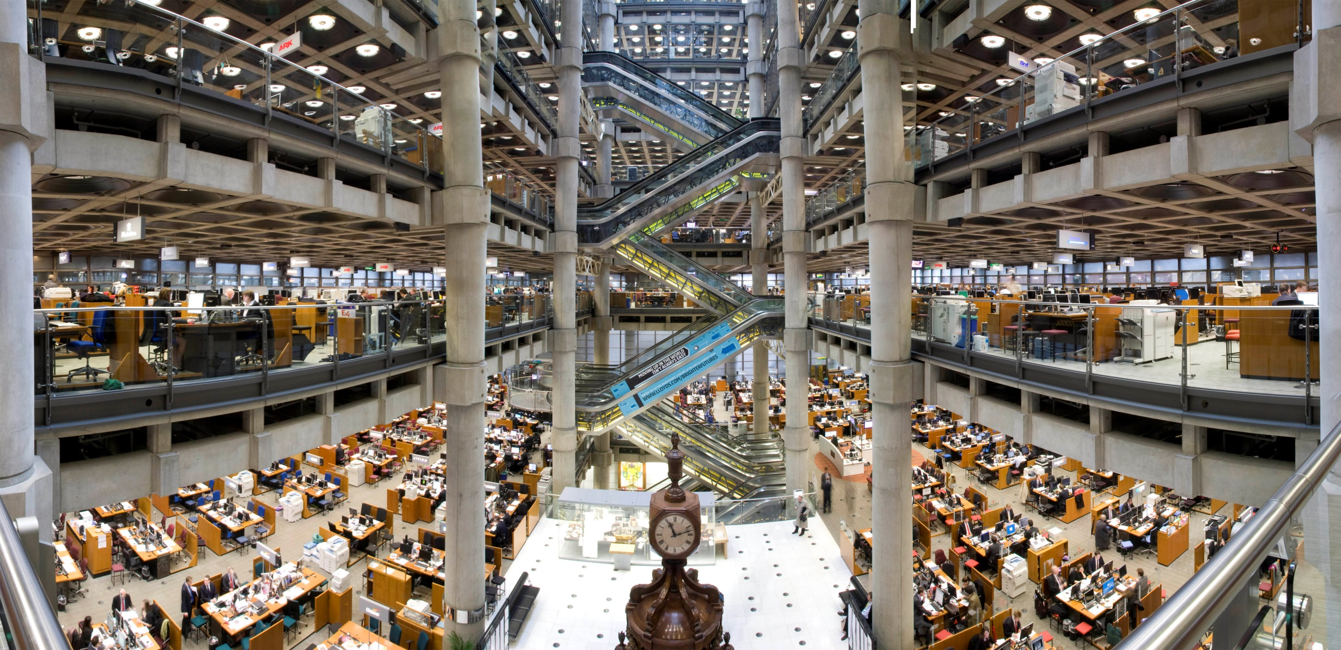
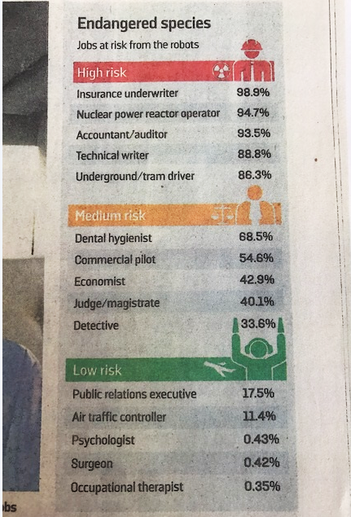
Is your job going be around in 20 years?
DISRUPTORS!
source: The future of employment: how susceptible are jobs to computerisation, Oxford University, 2013
Notes:
1 – Product will look different: the risk landscaping is changing e.g.:
New liability coming out of autonomous driving
Industry 4.0 – shifting loss scenarios: less frequency due to all sensors / machines but more severe losses if one happen
Intangible Assess – New companies are assets light (Facebook, Uber, Twitter, etc…) Property is no longer the enabler.
How do you come –up with response for the changing needs?
2 – Existing roles will evolve and new roles will emerge:
The roles of the UW will change & evolve and we have to prepare.
The UW Academy is a instrumental tool to help to prepare our UW for the changes
3- Service platforms will play a central role:
In the past, traditional business model use to work like pipes: Input – output – sell
New business models work like platform: e.g. youtube, apple store, etc…
What does that mean to us? We are busy exploring new business models ideas (connection to the session business model session)

Slide 4

Is your job going be around in the next 20 years?
QUESTION
What emerging technology is being implemented or researched in your company that will require insurers’ input?
DISRUPTORS!
Notes:
1 – Product will look different: the risk landscaping is changing e.g.:
New liability coming out of autonomous driving
Industry 4.0 – shifting loss scenarios: less frequency due to all sensors / machines but more severe losses if one happen
Intangible Assess – New companies are assets light (Facebook, Uber, Twitter, etc…) Property is no longer the enabler.
How do you come –up with response for the changing needs?
2 – Existing roles will evolve and new roles will emerge:
The roles of the UW will change & evolve and we have to prepare.
The UW Academy is a instrumental tool to help to prepare our UW for the changes
3- Service platforms will play a central role:
In the past, traditional business model use to work like pipes: Input – output – sell
New business models work like platform: e.g. youtube, apple store, etc…
What does that mean to us? We are busy exploring new business models ideas (connection to the session business model session)

Slide 5



Notepad of a liability underwriter
Will the current liability insurance solutions be sufficient?
What about “new” types of claims?
How should I adapt to new technology?
How can insurers really understand the exposure and react accordingly?
…

Slide 6
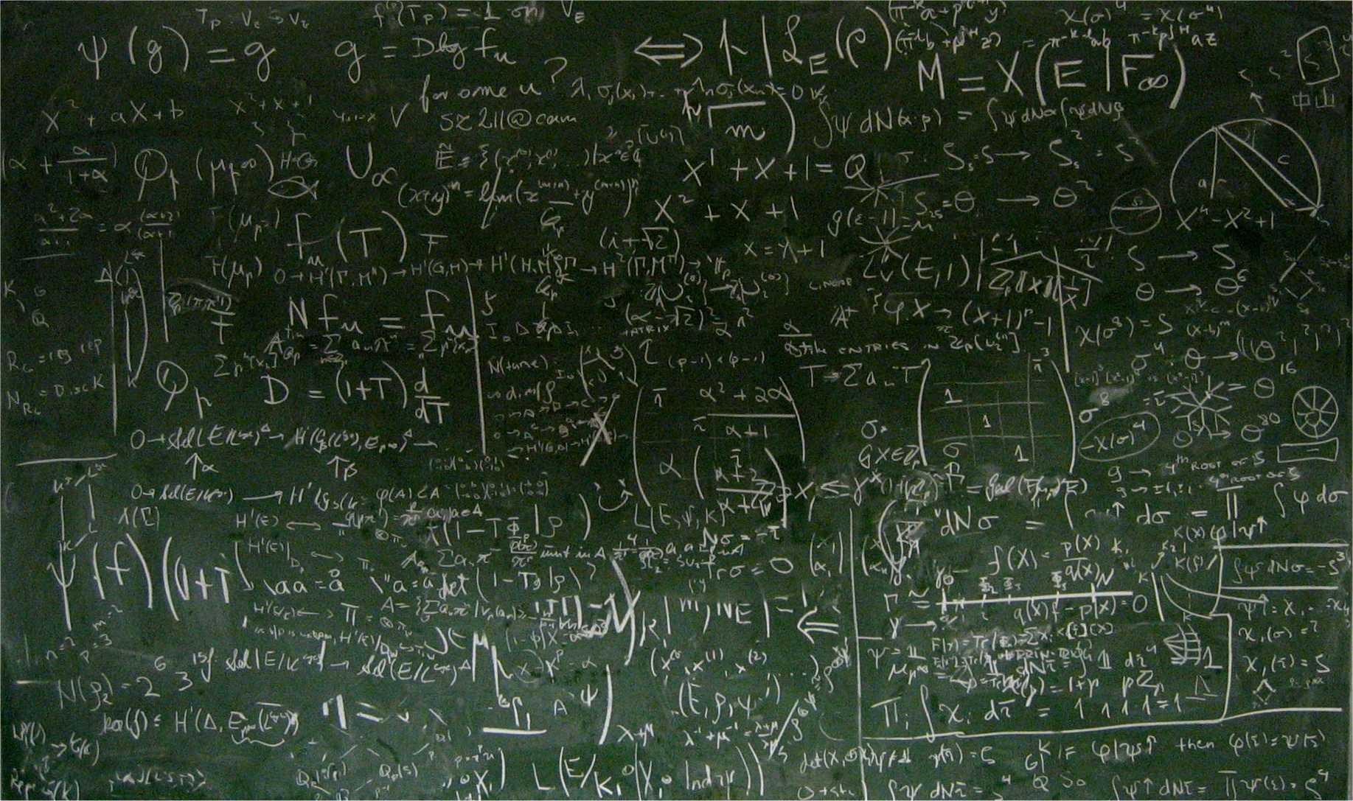
Our top predictions
2
Existing roles will evolve and new roles will emerge
1
3
Products will look fundamentally different
Service platforms will play a central role
Notes:
1 – Product will look different: the risk landscaping is changing e.g.:
New liability coming out of autonomous driving
Industry 4.0 – shifting loss scenarios: less frequency due to all sensors / machines but more severe losses if one happen
Intangible Assess – New companies are assets light (Facebook, Uber, Twitter, etc…) Property is no longer the enabler.
How do you come –up with response for the changing needs?
2 – Existing roles will evolve and new roles will emerge:
The roles of the UW will change & evolve and we have to prepare.
The UW Academy is a instrumental tool to help to prepare our UW for the changes
3- Service platforms will play a central role:
In the past, traditional business model use to work like pipes: Input – output – sell
New business models work like platform: e.g. youtube, apple store, etc…
What does that mean to us? We are busy exploring new business models ideas (connection to the session business model session)

Slide 7

The role of future underwriter
“
Some say underwriters are a dying breed. I fundamentally disagree – but the role will change dramatically.
We must kick off the journey in moving us towards the future of underwriting.
Hartmut Mai,
Chief Underwriting Officer Corporate
Sales Executive
Decision Scientist
”
Innovator
Customer Advocate
Notes:
In the next 7-10 years, in addition to evolving products and service platforms, the role of the underwriter will change, and both individuals and the wider company must evolve in response
Our business will still be based on trusted partnerships with our customers, but Underwriters of tomorrow will need a multi-faceted skill set – and will need to take on four key roles
Sales Executive
Decision Scientist
Customer Advocate
Innovator

Slide 8

Why now?
The future will be 20% data collection and 80% interpretation
You will have the tools for far deeper and more predictive risk analysis
Currently underwriters spend 80% of their time collecting data and 20% interpreting it

Slide 9
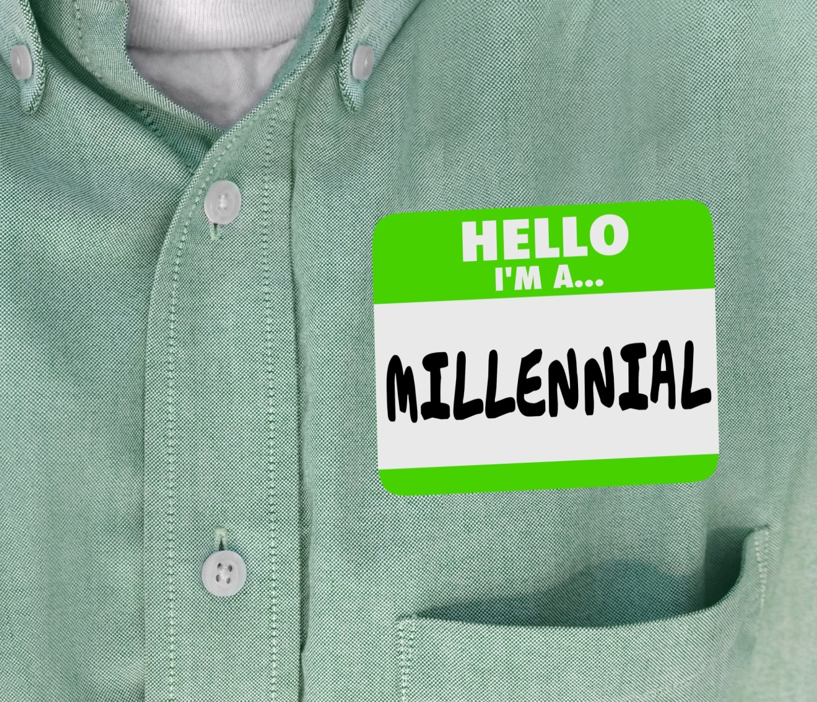

2
The future is already here.
Let’s start using it.
THE FUTURE

Slide 10
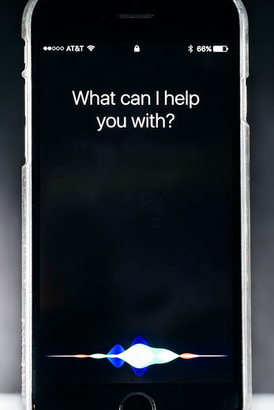
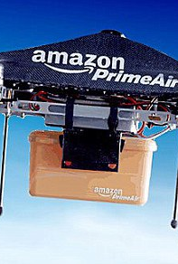
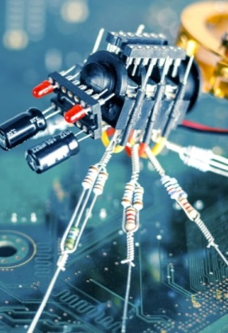
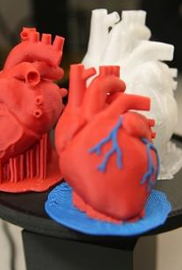
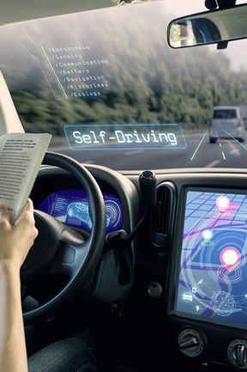
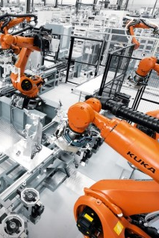
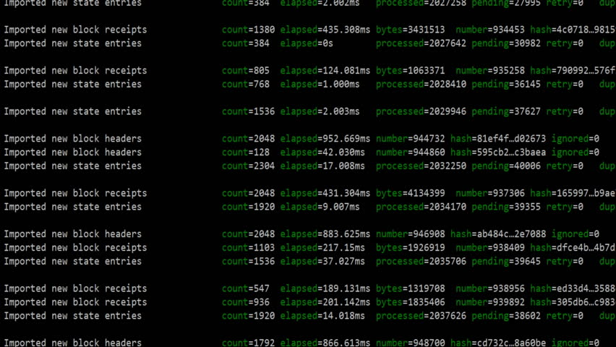
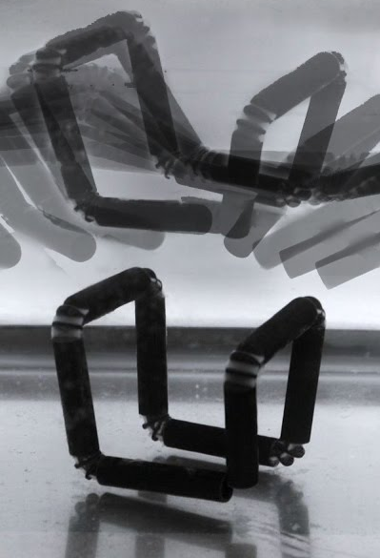
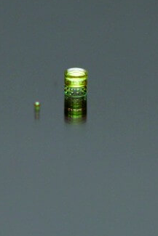
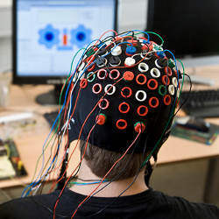
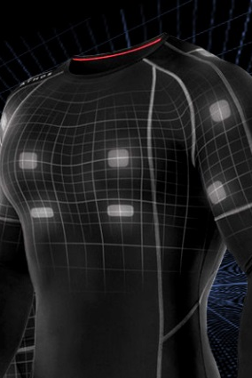
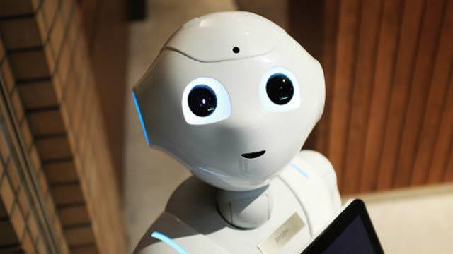
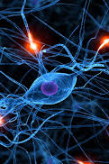
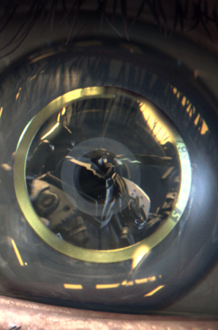

current and emerging trends
THE CURRENT FUTURE
Artificial Intelligence
Drones
Nanotechnology
3D Printing
Autonomous Driving
Robotics
Blockchain
THE EMERGING FUTURE
4D Printing
Smart Dust
Brain computer Interface
Wearable IT
Smart Robots
Neurobusiness
Human Augmentation

Slide 11
Revolutionizing client interaction by using technology
Making sense of and organizing data
AI - Giving context and insights with human touch
Data Analytics - Modelling risks from aggregated external data sources
Providing a blockchain-enabling data transparency and facilitating communication
Chatbots - Facilitating and learning from customer integration
Providing the most intuitive way to facilitate human / machine interaction

Slide 12

3
Our strategic framework

Slide 13
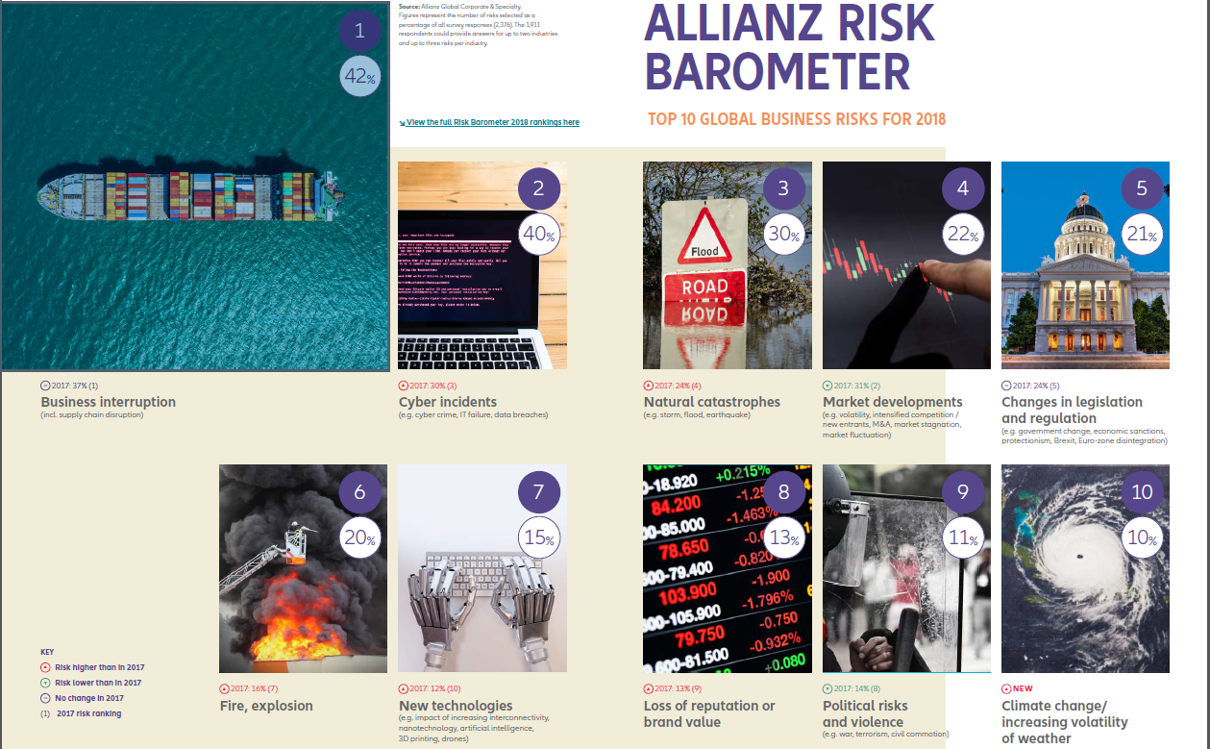
Top risk assessment
Notes:
The AGCS Board recently engaged EY to help assess our current level of maturity and future state goals for leveraging digital underwriting capabilities for Mid Corp and Large Corporate busines
The assessment is based on EY’s P&C capability model which provides detailed analyses of basic, competitive and leading practices across 38 key underwriting capabilities. EY developed a capability model for insurance companies. As part of the USE project did a self assessment on each capability: where we are and where we would like to be.
Detailed current and target states are defined for each capability, providing a clear roadmap to the future state for digital underwriting.
10 Capabilities were prioritized
Proof of Concepts will be evaluated against their ability to support these key capabilities.
Market Management & Claims are also doing a Capability Assessment Model. The three client facing functions will be “speaking the same language”
The Capability Assessment model gives a strategic framework to drive the the transformation in Underwriting.
Using data and new technologies to push the 10 selected capabilities, we will not only be able to gain efficiencies and productivity, but also to improve customer journey/interaction/ better manage our portfolios, and create a culture of decision making driven by data

Slide 14

QUESTION
What emerging technology is being implemented or researched in your company that will require insurers’ input?

Slide 15
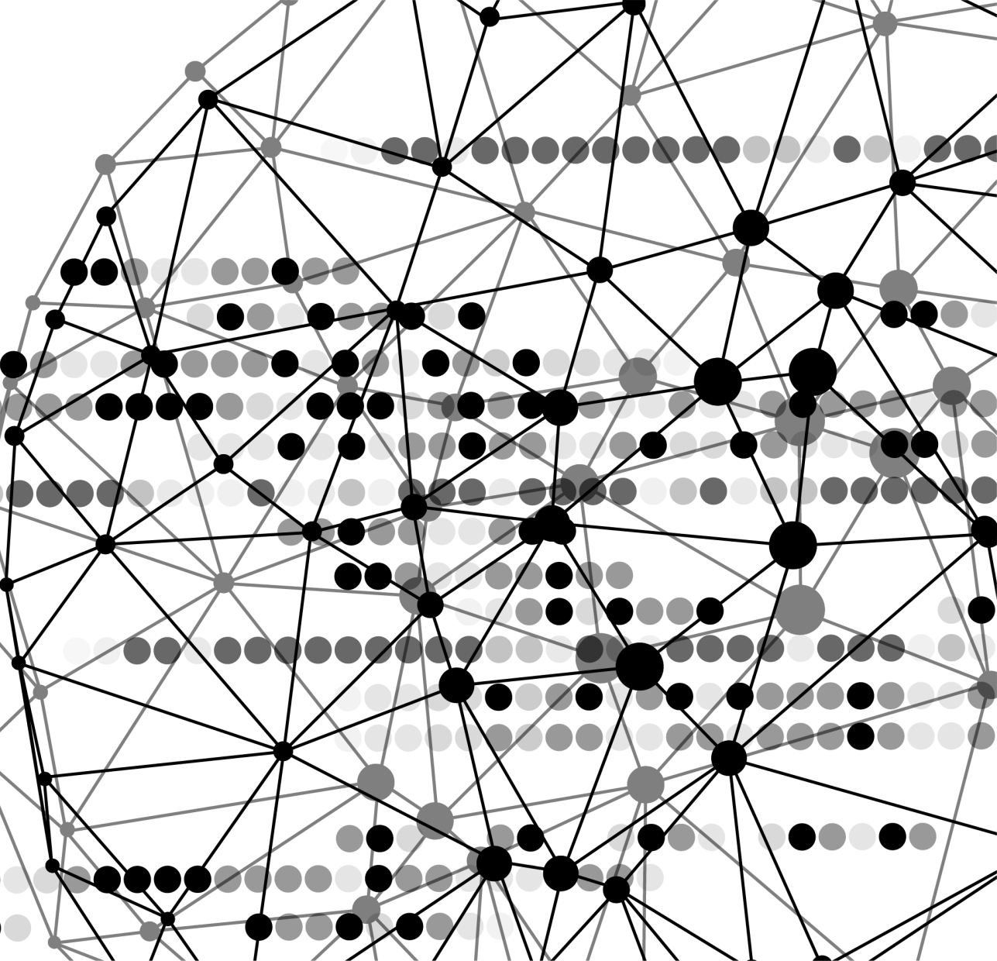


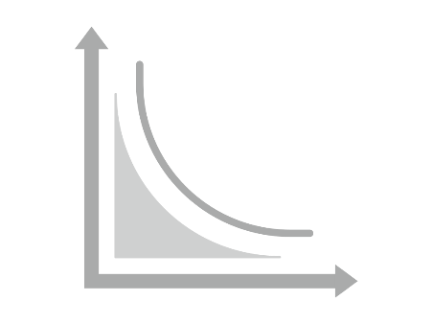

Introducing our partner praedicat
Science
Technological
Innovation
Risk

Slide 16
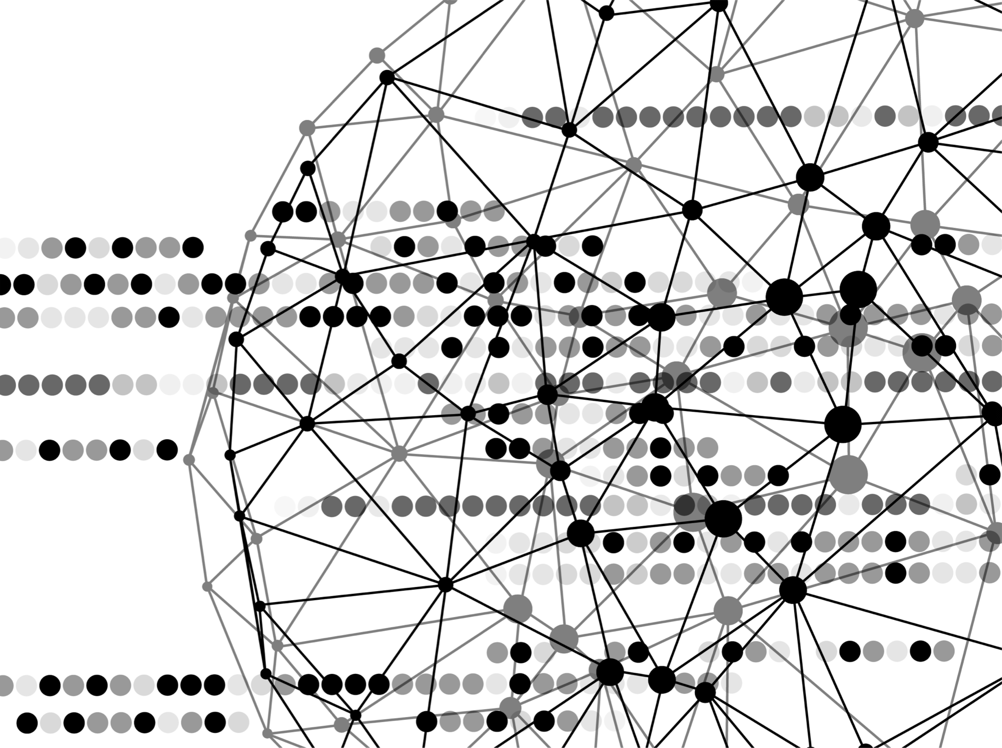
An emerging risk crystal ball
Charles Clarke
charles.clarke@praedicat.com
CONFIDENTIAL & PROPRIETARY. FOR INTERNAL USE ONLY.

Slide 17


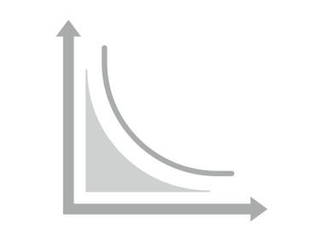
Emerging Risk is an Inherent Part of Commercial Innovation
Science
Technological
Innovation
Risk

Slide 18
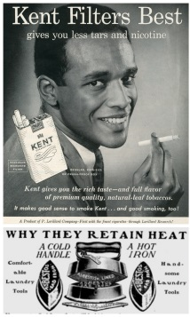
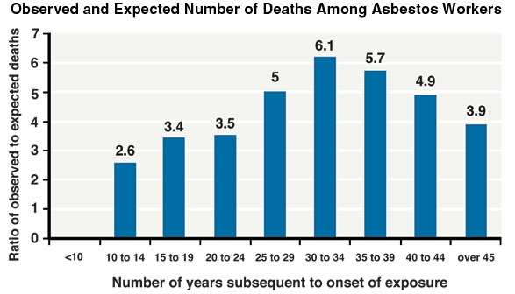
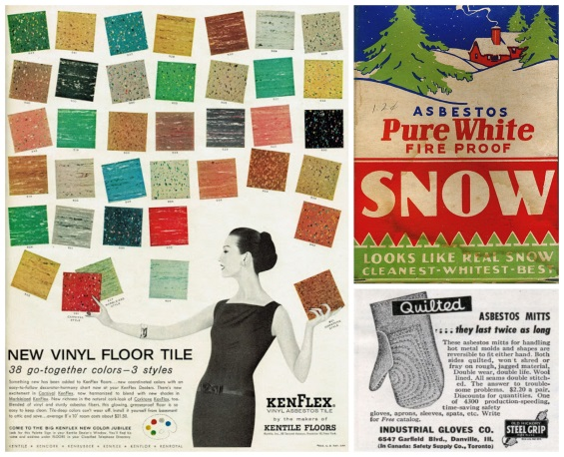
As the Risks Emerge, the Aggregations can be Catastrophic
Science
Technological
Innovation
Risk
$200B

Slide 19

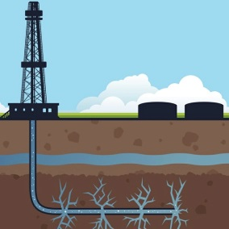

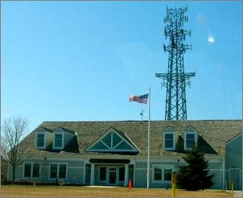
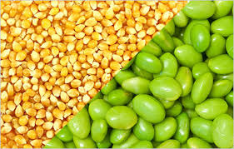
“Disruptive” technologies are emerging with increasing frequency
Science
Technological
Innovation
Risk

Slide 20




We use science to predict risk.
RISK
REWARD
20

Slide 21



















INNOVATION AND INFORMATION
COMES IN MANY FORMS

Slide 22
How do you identify and assess your emerging risk?

Slide 23
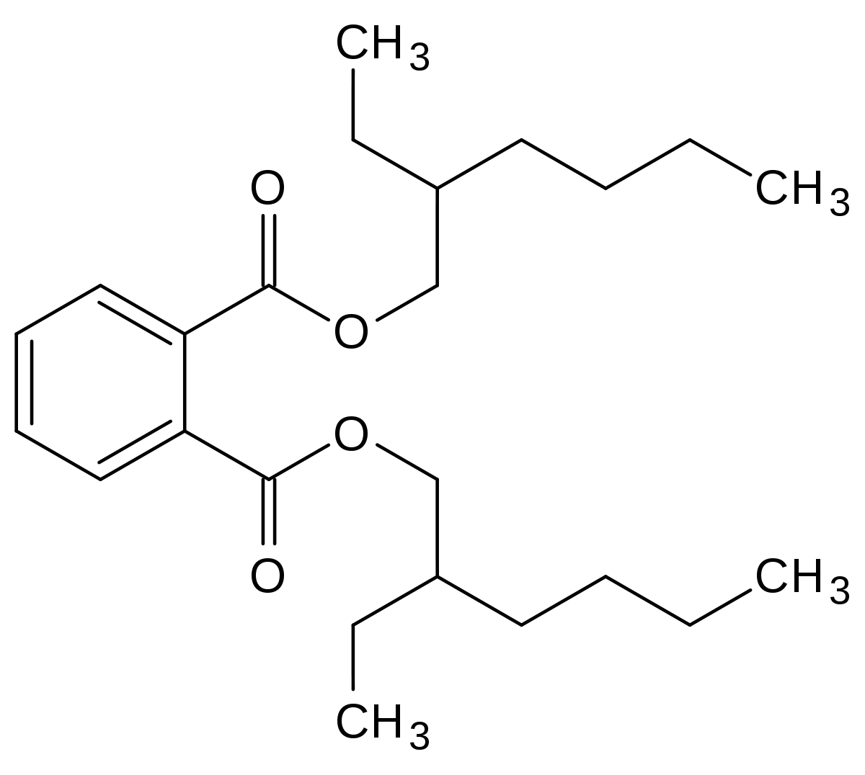

Slide 24
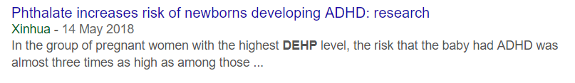
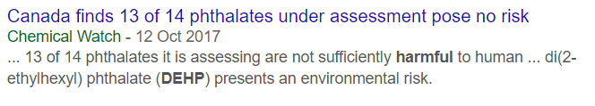

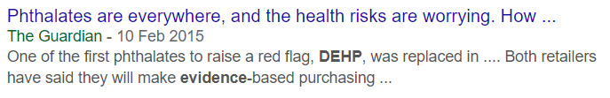
How do you identify and assess your emerging risk?

Slide 25

Praedicat relies on the scientific community to find the signal from the noise
WHY
SCIENCE?
DRIVES PUBLIC OPINION
JUSTIFIES LITIGATION
IDENTIFIES TRENDS
SCALABLE CREDIBLE GLOBAL

Slide 26

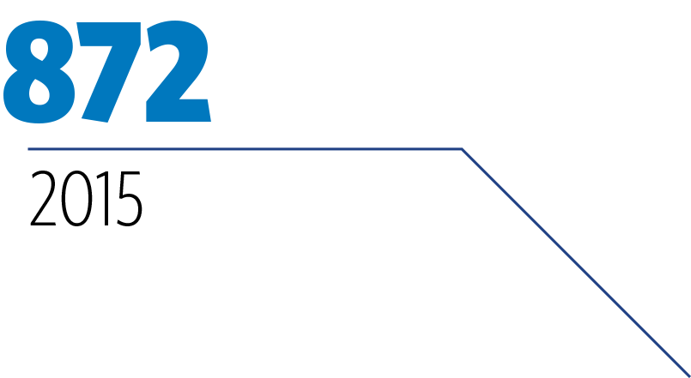


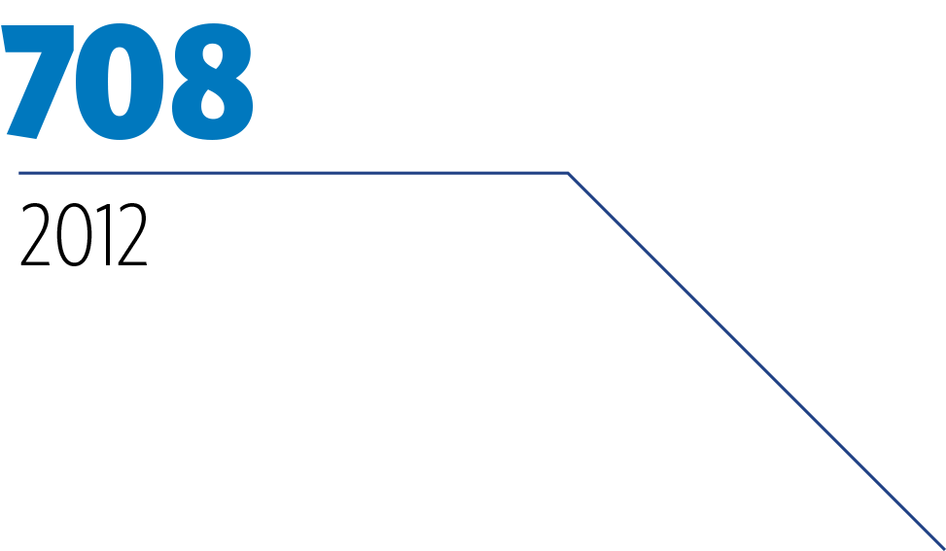
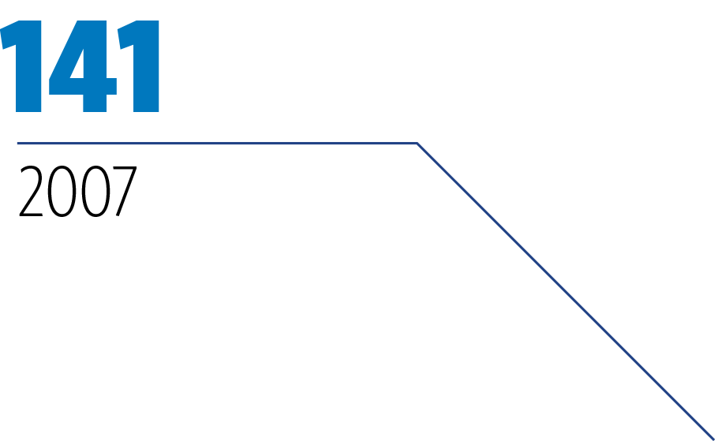
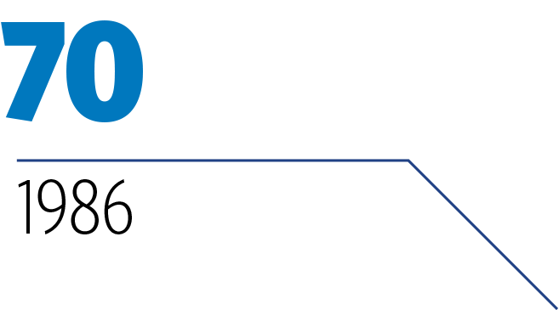
EXPLOSIVE PEER REVIEWED SCIENCE ON DEHP
We help you sort through
all the peer reviewed science by assigning one score that represents scientific consensus
0.83
DEHP causes Reproductive Injury
YEAR vs # OF ARTICLES PUBLISHED
We then forecast the evolution of science
26

Slide 27
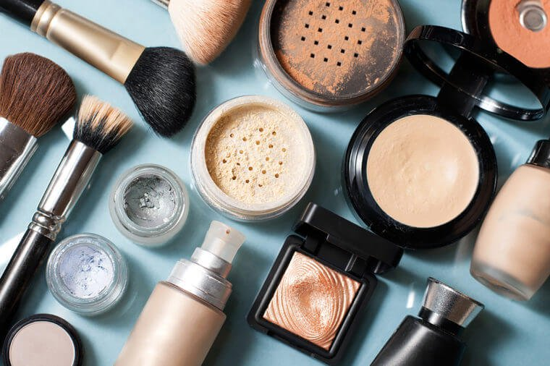

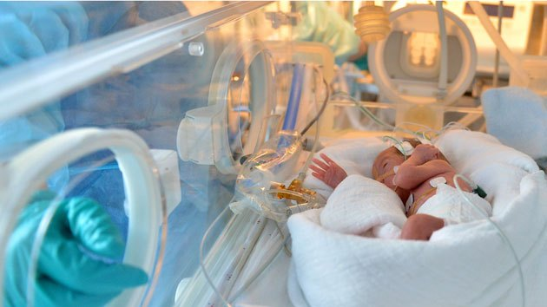
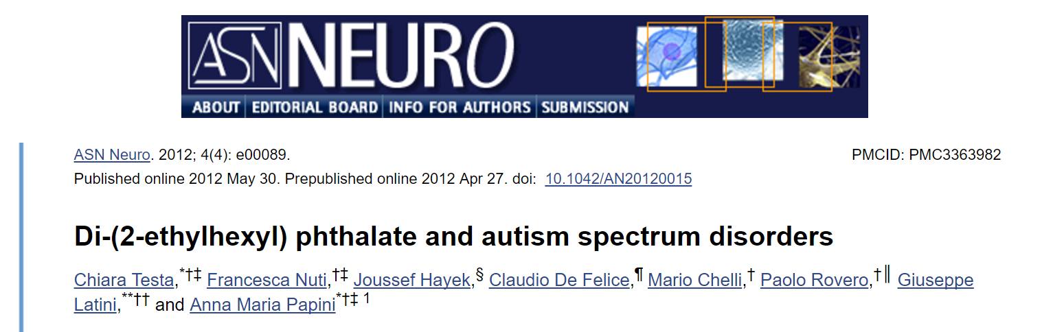
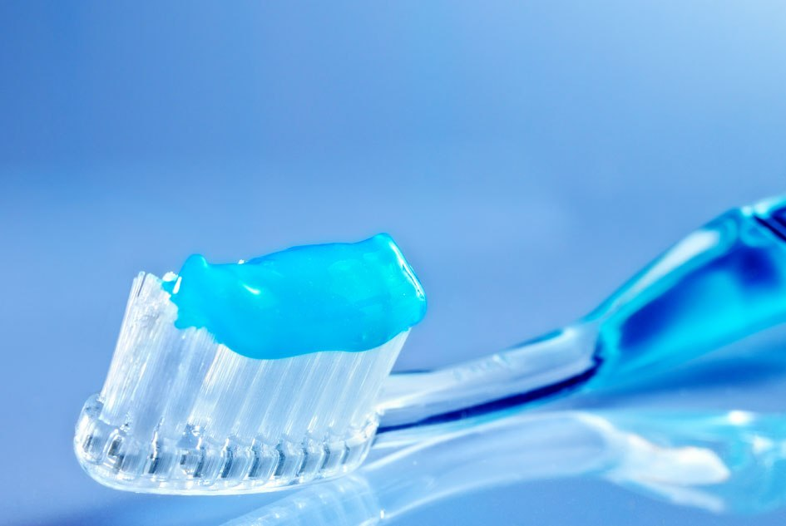

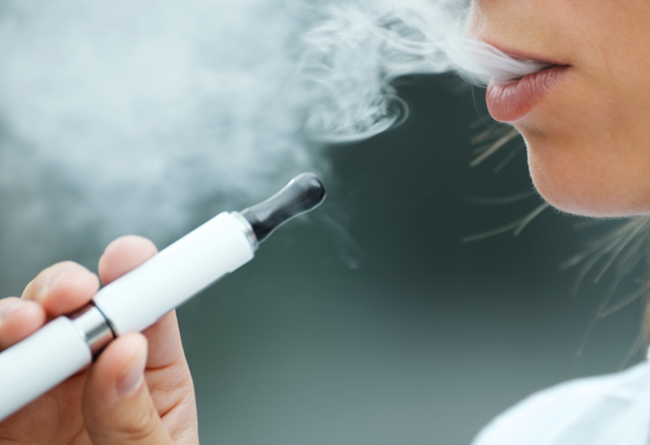
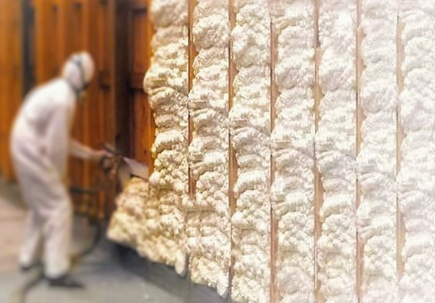


EXAMPLE, PLEASE?
Hypothesis: Exposure in the NICU causes autism
Over 3,000 published scientific papers study DEHP
with nearly 200 annually
DATA CREATED
Plaintiffs
Compensable harm
Defendant industries
State of the science

Slide 28
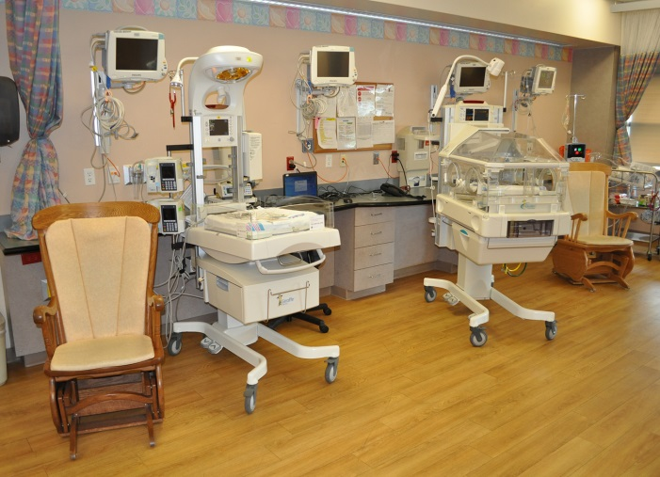
How Praedicat builds its data and risk models
Step One. Identify risks in scientific literatures
The Risk: Exposure to chemical DEHP in the NICU causes autism
Risks are identified and tracked using algorithmic search, machine learning and natural language processing

Slide 29
Subject experts review articles and extract metadata
Age and sex differences in childhood and adulthood obesity association with phthalates
Int J Hyg Environ Health. 2014 Jul;217(6):687-94
Exposure to environmental chemicals may play a role in the development of obesity. Evidence suggests phthalate exposure may be associated with obesity in children and adults. To examine the association of ten urinary phthalate metabolites mono-n-butyl phthalate (MnBP), mono-ethyl phthalate (MEP), mono-isobutyl phthalate (MiBP), mono-2-ethyl-5-carboxypentyl phthalate (MECPP), mono-2-ethyl-5-hydroxyhexyl phthalate (MEHHP), mono-(2-ethyl-5-oxohexyl) phthalate (MEOHP), mono-2-ethylhexyl phthalate (MEHP), mono-benzyl phthalate (MBzP), mono-(carboxylnonyl) phthalate (MCNP), and mono-(carboxyoctyl) phthalate (MCOP) grouped by molecular weight of their parent compounds with body weight outcomes in children, adolescent and adult participants in the National Health and Nutrition Examination Survey (NHANES) 2007-2010. We performed multinomial logistic regression to analyze the association between obesity and urinary phthalate metabolite concentrations in children and adolescents and adults. Low molecular weight (LMW) phthalate metabolites (MnBP, MEP and MiBP) are significantly (p<0.05) associated with higher odds for obesity in male children and adolescents. High molecular weight (HMW) phthalate metabolites (MECPP, MEHHP, MEOHP, MEHP, MBzP, MCNP, and MCOP) and di-2-ethylhexyl phthalate (DEHP) metabolites (MEHHP, MEOHP, MEHP and MECPP) are significantly (p<0.05) associated with higher OR for obesity in all adults. Additionally, DEHP metabolites are significantly associated with obesity in all female adults; whereas DEHP and HMW metabolites are significantly associated with OR for obesity in males 60 years and older. We found age and sex differences in the association between urinary phthalate metabolite concentrations and body weight outcomes. Reverse causation cannot be excluded since overweight and obese people will have more fat mass, they may store more phthalates, thus leading to higher excretion concentrations.

Slide 30
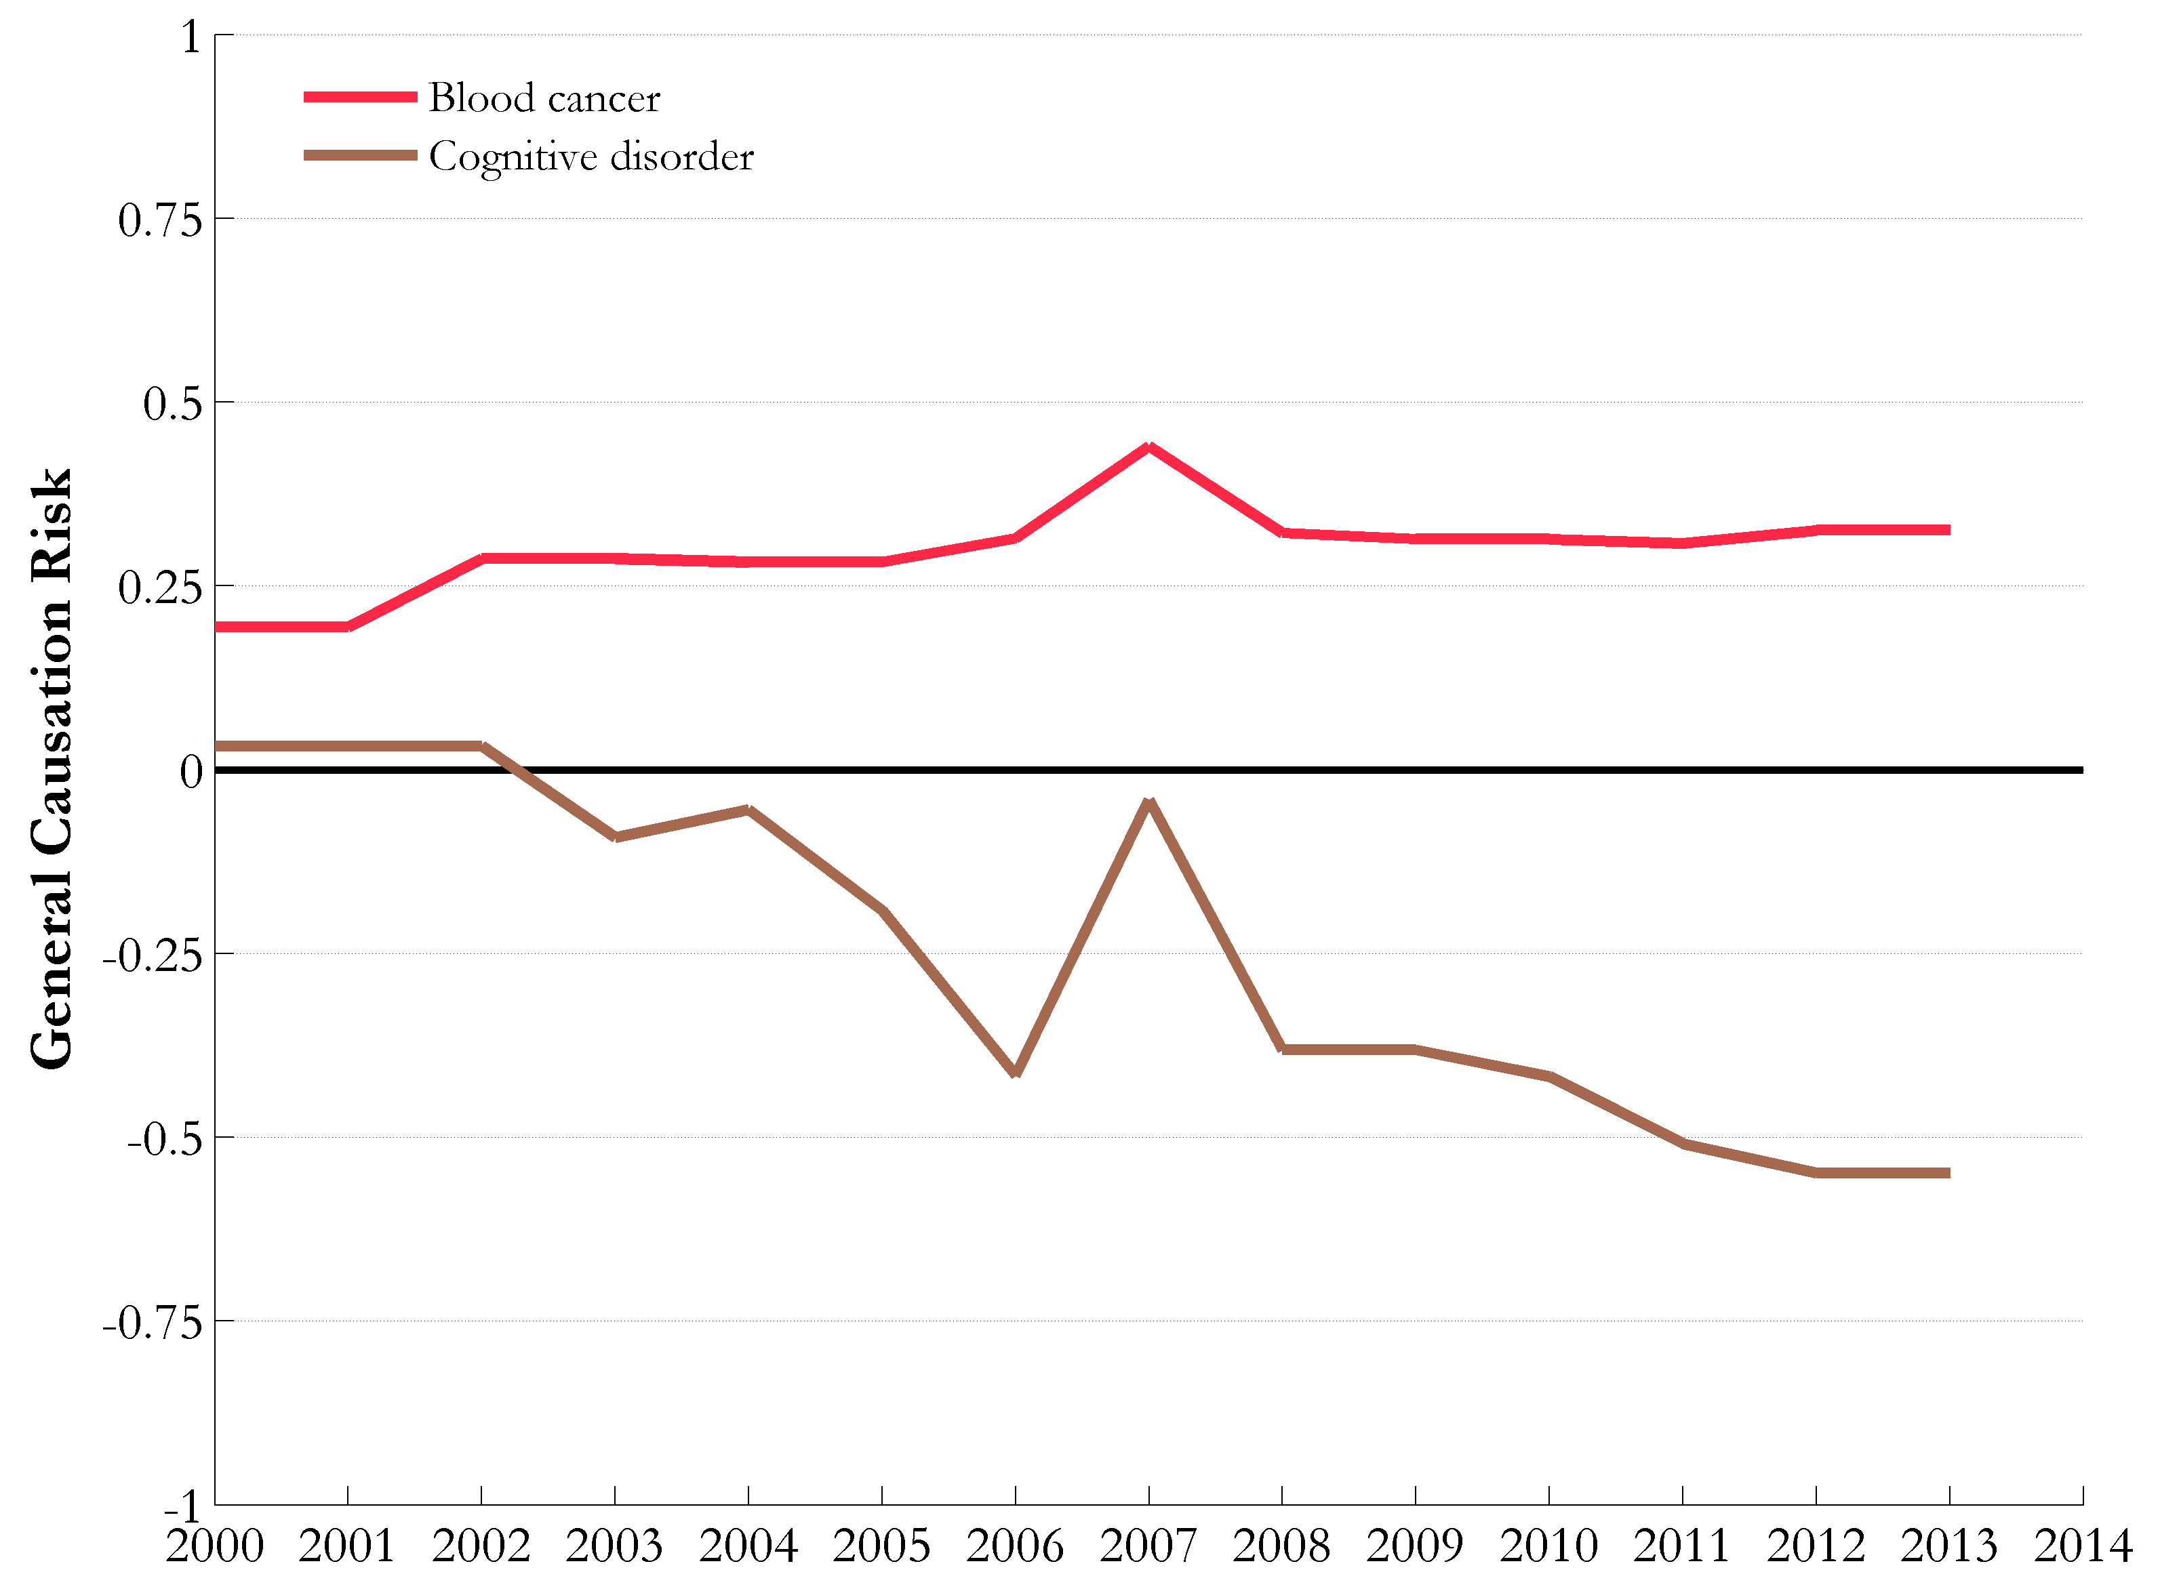
Example: radiofrequency radiation
Negative cohort study
Two positive cohort studies
Mixed evidence since 2009
+ve cross-sectional
-ve case-control
-ve meta-analysis
Two positive controlled human trials
Four negative controlled human trials

Slide 31
How Praedicat builds its data and risk models
Step Two. Convert science data to litigation risk data
Plaintiffs (Children from the NICU)
Compensable harm (Autism)
Defendant industries (Hospitals, Medical Devices, Medical tubing, PVC manufactures, Chemical companies)
State of the science (Still new, but growing)
Praedicat has created over 50,000 simulated mass liabilities out of scientific literatures

Slide 32
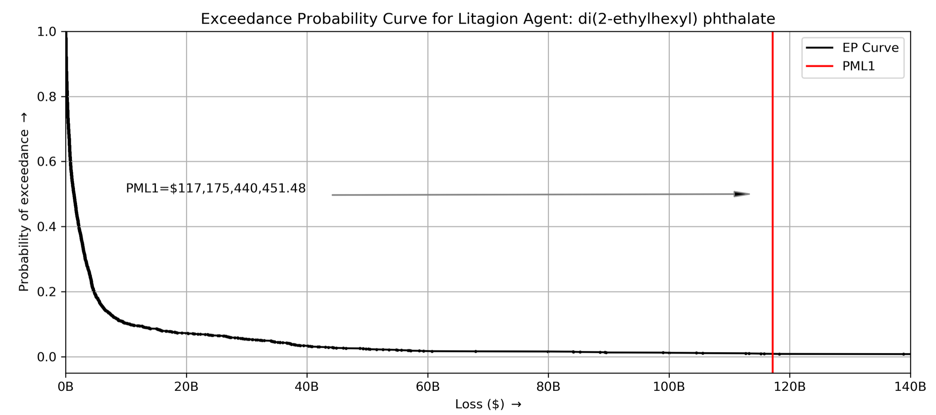
How Praedicat builds its data and risk models
Step Three. Connect risks with common named perils and simulate litigations under different futures of the science
DEHP is a complex clash of chemicals, plastics, toys, building products, food production and medical devices
Able to produce a $117B mass litigation at 1% probability
DEHP
What is an insurer’s exposure to DEHP?

Slide 33
Praedicat’s shifting place in the innovation curve
Maturity
Growth
Introduction
Sales
R&D
Innovators
Early
Adaptors
Early
Majority
Late
Majority
Laggards
Time

Slide 34

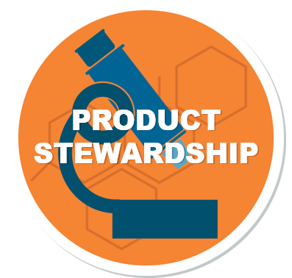
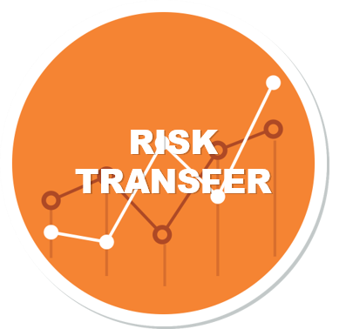
RESEARCH & DEVELOPMENT
REFORMULATIONS & SUBSTITUTIONS
RISK TRANSFER & INSURANCE
+ Monitor all the science for all the chemicals in circulation
+ Increase confidence when releasing new products
+ Move faster on substitutions
+ Ensure that reformulations exceed the safety of their predecessors
+ Quantify exposure to high impact, low frequency events
+ Re-evaluate insurance tower structures for self-insurance vs risk transfer needs
RISK MITIGATION
PUBLIC
OPINION
CAPITAL PRESERVATION
+ Reduce a product’s health, safety, and environmental impact
+ Manage end-of-life products
+ Anticipate regulatory risk
+ Increase confidence in new product lines
+ Access science-based intelligence on chemicals and products before the public
+ Evaluate downstream uses
+ Evaluate capital by benchmarking to a forward-looking analysis of potential litigation
+ Manage unexpected aggregations of current or past M&A activity
34

