Slide 1
Airmic Conference Workshop D7
Using predictive analytics to minimise property damage

Slide 2
Introduction and welcome:
Paul Taylor (Airmic)

Slide 3
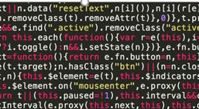
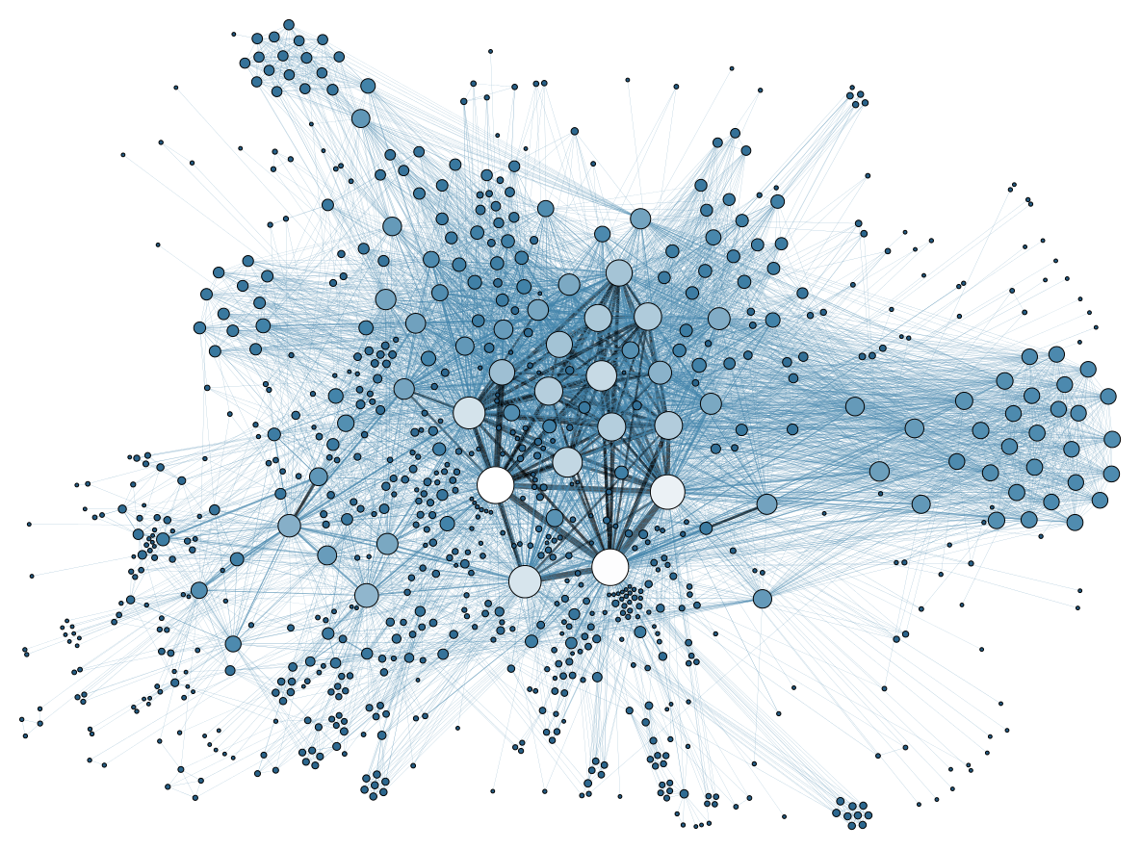


Big data
By Martin Grandjean - Grandjean, Martin (2014). "La connaissance est un réseau". Les Cahiers du Numérique 10 (3):
37-54. DOI:10.3166/LCN.10.3.37-54., CC BY-SA 3.0, https://commons.wikimedia.org/w/index.php?curid=29364647
Notes:
Today’s world is full of information, whether we know it or not, lots of data is being generated around and about us.
The data could be created from customer transactions; company operations; vehicles and transportation; internet consumers entering information to buy goods or access services; digital cameras or sensors on machines, inanimate objects comprising the —the list goes on.
Abundant storage means that a lot of this data is captured and then stored somewhere for future analysis – A lot of the uses can be very beneficial such as fraud detection, monitoring of traffic or disease outbreaks, however we have all heard stories about how Cambridge Analytica manipulated data from Facebook for political purposes and we notice how often annoying pop-up ads try to target our interests.
Recent studies indicate that the amount of data is doubling every two years, a rate which trends indicate is accelerating, so big data is likely here to stay and will probably exert an increasing influence upon our everyday lives.
Think about the last time you flew somewhere and you probably can’t even begin to imagine how much data was generated. According to Virgin Atlantic during a typical flight a Boeing 787 creates at least half a terabyte of data. Now think about all the passenger ticketing data, weather, air traffic control and airport information exchanges then you see the scale of it. Next, given how competitive today’s airline industry is, it’s understandable that this data can help airlines compete by joining the dots to work out how and where they can become more efficient.
.

Slide 4
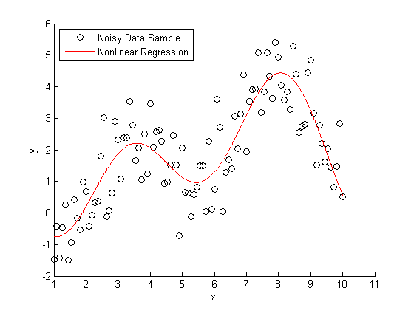
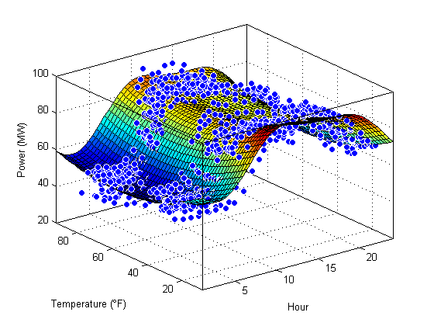
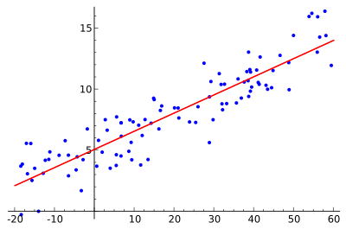

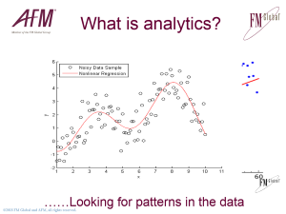
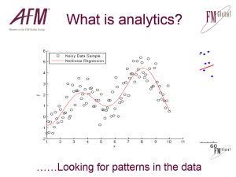
What is analytics?
Higher Relative
Likelihood
20%
None
Natural
Hazard
10%
……Looking for patterns in the data
Notes:
Big data refers to gigantic volumes of data which are too large and complex to be processed using traditional tools and techniques. Often the raw dataset is too large to be stored in the memory of a single computer. Big data is the raw material which can enable enhanced insight, decision making and process automation
Data analytics is the science of examining raw data with the purpose of drawing conclusions about that information.
Data Analytics involves applying an algorithmic or mechanical process to derive insights. For example, running through a number of data sets to look for meaningful correlations between each other.
It is used in a number of industries to allow the organizations and companies to make better decisions as well as verify and disprove existing theories or models.
The focus of Data Analytics lies in inference, which is the process of deriving conclusions that are solely based on what the researcher already knows.
In its most simplest form we could fit a straight line to a data set, however, this only works when relationships are linear of directly proportional
An example of a more complex curve fit is non-linear regression as shown in the next example, but what happens when there are many dimensions to the data set so that there is a relationship best illustrated by a map or surface joining the data points. The mathematical relationships start to get very complicated and beyond simple analysis. This example is only comparing power demand for a small town over time and comparing it to the ambient temperature. Big data would be way more complex than this example and could have inputs such as the time of day/week/year, town demographic and age profile, consumer energy mix and tariffs, the list goes on. The more relevant data we have and the longer the snapshot we can gather over time the better our understanding will become – that is as long as we are looking at the right variables
As the data sets become larger and more complex we need to use computer based algorithms to identify trends and relationships of statistical significance. Once we master this step and achieve a good confidence in the statistical reliability of our data we start to develop a very deep understanding of how the variables interact.
We can start
Familiar with liner regression from school
Extend to curves (non-linear)
Extend to multiple inputs
Power demand for a small town
Useful tool
Need a large ,consistent data set
Garbage in – garbage out
Testable

Slide 5

The power of analytics
Recognise past events
Explain relationships
Predict future outcomes
Take action

Slide 6
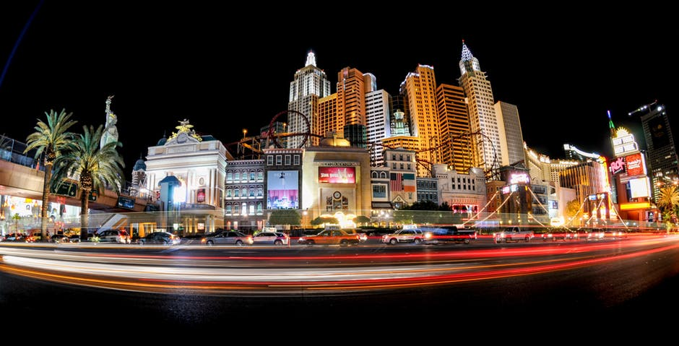
How do casinos use analytics?
Analyse their customers’ previous gambling history and identify patterns
Predict future behaviours so offers and promotions can be tailored to individual customers
Notes:
As you see we’ve got you in a casino environment to play a game which will demonstrate predictive analytics at work,
Casinos and the gambling

Slide 7
Spotting risk is critical.
Predicting it changes everything.
700 data points from 100,000 location visits each year.
Notes:
Now lets look at how an insurance move things a step further:
Imagine that you have collected a good data set which has a large number of data points which have been consistently collected over a long time.
"Predictive analytics—Technology that learns from experience (data) to predict the future behaviour of individuals in order to drive better decisions

Slide 8

Property and business risk?
Loss history + Risk identification
Predictive Analytics => Higher Likelihood
= Improve & mitigate risk

Slide 9
RiskMark
Know the risk quality of your locations.
Locations with the lowest RiskMark scores
are 7x more likely to experience a loss.

Slide 10
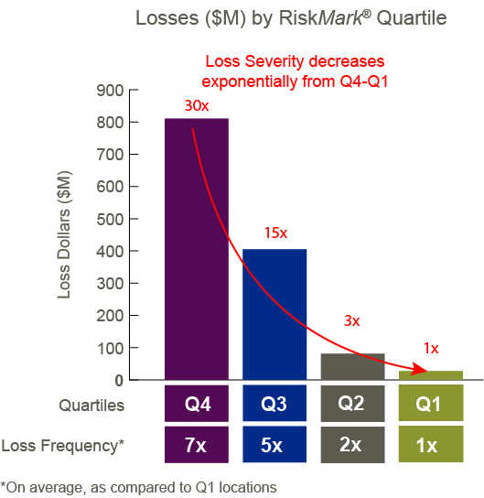

Slide 11
Locations Predisposed
Know which sites
are most vulnerable.
Sites identified through Locations Predisposed are 15x more likely to experience a significant loss.

Slide 12
Locations Predisposed to Loss
60,000
Visited Locations
1,000 most predisposed to loss
27%
2%
actual losses

Slide 13
Higher Relative Likelihood
Higher Relative
Likelihood
20%
2x more likely
Natural
Hazard
10%

Slide 14

Let’s play predictive analytics!
Pixabay.com

Slide 15

Combining modern design and classic materials to create high quality furniture you can enjoy for years to come.
Bayes & Taylor
‘Tradition for the future’
Pixabay.com
Notes:
Expected duration: 90 minutes.
Welcome to our workshop where we will be discussing how the power of big data and predictive analytics can be harnessed by insurance companies and corporate risk managers to help identify where losses are most likely to occur and prioritise risk improvement activities.
We have created a fictitious company called Bayes and Taylor aka B&T (no similarity to any real company implied) which is HQ’d in the UK but has international operation and sales. B&T manufactures and sells a range of high quality, high end wood furniture which is manufactured in Romania with some finishing . The key markets are wealthy customers and businesses such as premium hotels chains.

Slide 16
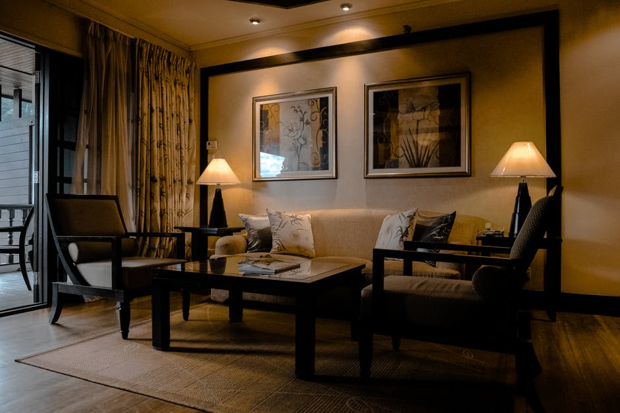
Romanica
‘Stately, elegant and hard wearing’
Quality and style for a lifetime of service

Slide 17
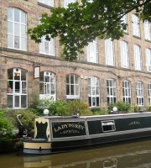
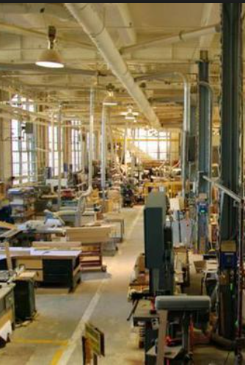
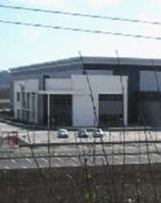
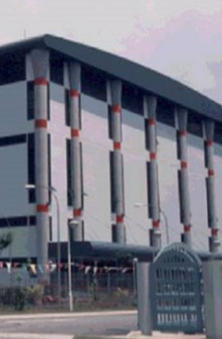
Our Locations
Bollington
HQ
Bucharest
Mfg & Logistics
Newark
Distrib. Ctr.
Hong Kong
Dist. Ctr.

Slide 18

Product flows
Bollington UK
Bucharest RO
Newark, NY, USA
Hong Kong
Notes:
There’s three main locations.
[click to reveal the natural hazard exposures]
Each have their own natural hazards to deal with as shown.

Slide 19








Natural hazards exposures
Bollington, UK,
B&T HQ
Bucharest RO
, Manufacturing & European DC
Newark, NY, USA
Americas Distribution Centre (DC)
Snow
Windstorm
Earthquake
Flood
Hong Kong,
Asia DC
Notes:
There’s three main locations.
[click to reveal the natural hazard exposures]
Each have their own natural hazards to deal with as shown.

Slide 20
Risk Profile: Risk Mark & Quartiles
RM=21
4th Quartile
Predisposed
RM=51
3rd Quartile
RM=81
1st Quartile
RM=67
2nd Quartile
Bollington
HQ
Bucharest
Mfg & Logistics
Newark
Distrib. Ctr.
Hong Kong
Dist. Ctr.

Slide 21
How to play
Actions / Recomm-endations
Maintain profits
Limit business and property loss
Final score
Notes:
ACTIVE SLIDE
We’ll now talk you through how to play, where the end goal is to get the highest final score (it must be a positive one to win).
Hover over each box in slideshow mode and click once to hyperlink to the example worksheet. Proceed to explain each worksheet to the teams. After explaining the respective worksheet, click on the company logo in that slide to return to the How To Play slide.

Slide 22
Team roles:
Risk and Insurance Manager: All
CFO: Casting vote for budget allocation
Finance Manager: Looks after chips!
Accountant: Updates profit statements

Slide 23
Rules
Allocated budget each year, 3 years total
  First year budget is 20 chips
You may not over-spend
Up to three events each year
Recommendations marked * apply to all B&T locations when completed
Notes:
Of course there are some rules to follow.
Click arrow to go to Budget examples. This is what they have on their Actions / recommendations sheet. If you have already clicked on the Actions / recommendations sheet hyperlink to explain the budget process then ignore the action on this slide.

Slide 24
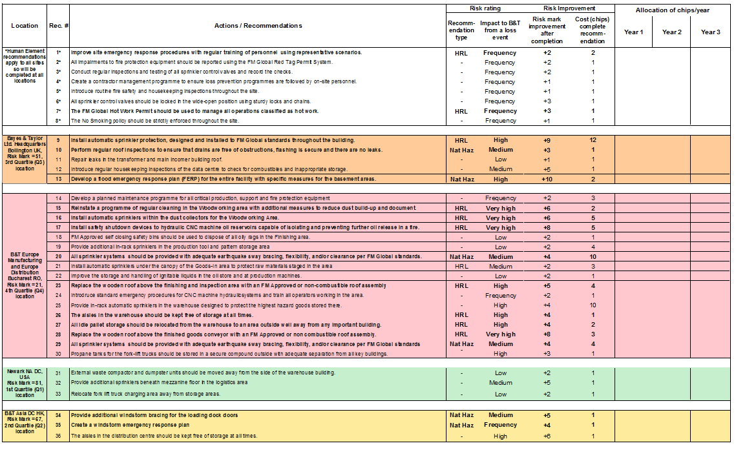
Recommendation sheet
Notes:
Next slide shows how to fill this in.

Slide 25
Recommendation sheet
X
X
X
X
X
X
X
X
X
Notes:
Next slide shows how to fill this in.

Slide 26
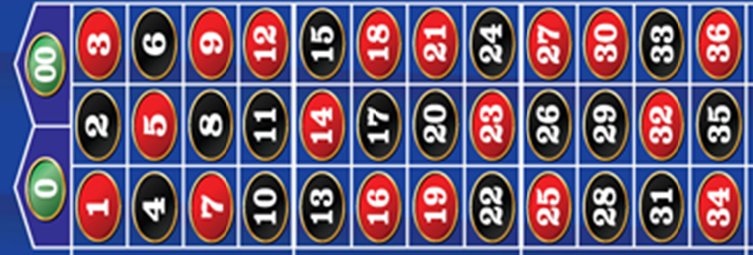
Events
Notes:
Year 1 and 2 events: teams roll two dice to determine what incidents (events) occur – with a total of 3 in the year.
Note:
Year 1 is hyperlinked to the completed Profit Statement sheet to show players how to complete this sheet.
Year 2 is hyperlinked to the completed Market share sheet. Click through each entry on the sheets.

Slide 27
How to play the game
Review the recommendations sheet and allocate your budget recording your selection in the column of the corresponding year.
  Place your recommendation completion card with chips on the corresponding number of the roulette felt (*recommendations apply to all locations)
  Unspent budget goes to next year
Spin the roulette wheel and record profits on the sheet
  Repeat up to three times in each year
Facilitator recovers the chips spent on risk improvement and allocates budget for following year. Leave the card to show completed recommendations
Repeat for three years and total up the profits at the end to find out which team has one
Notes:
Of course there are some rules to follow.
Click arrow to go to Budget examples. This is what they have on their Actions / recommendations sheet. If you have already clicked on the Actions / recommendations sheet hyperlink to explain the budget process then ignore the action on this slide.

Slide 28
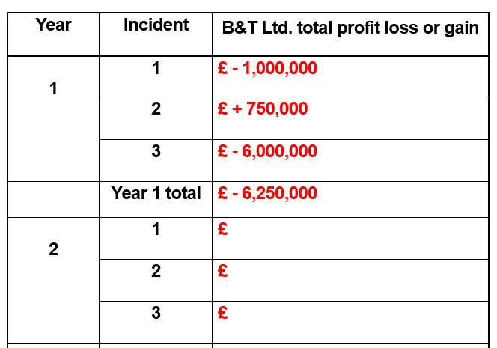
Profit statement

Slide 29
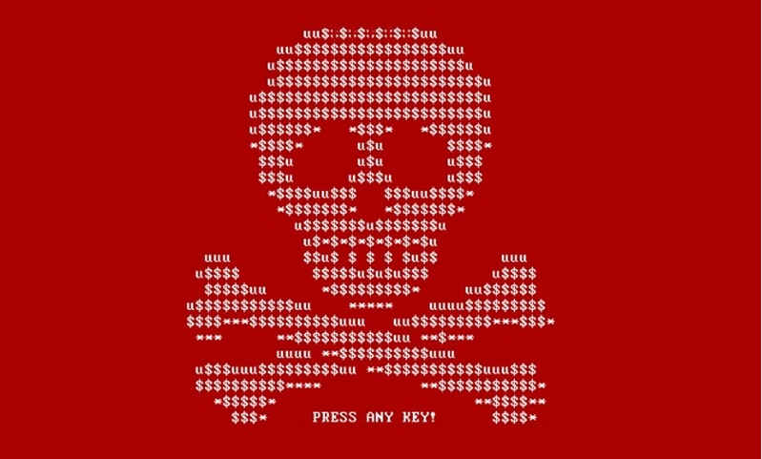
Event 0: Romania & Worldwide
It is January and a cyber ‘Petya’ attack strikes B&T. Updates of a Romanian tax program have been uploaded by criminals which exploit a weakness in operating systems to download malware masquerading as patches.
Notes:
Roll 12: epidemic. Participants to update score sheets (entering the zero impact).
Facilitator to adjust illness to suit region.
After ppts tally the impact from this event click on return arrow to move to the final year’s budget determination (slide 10) and subsequent decision making process for recommendation completion with the available funds.

Slide 30
Event 0: Romania & Worldwide
If you completed the following:
Recommendation 14 (develop planned maintenance programmes)
You tested the patches in isolation and discovered the malware before it could be installed on the network.
In addition B&T has recently published an article in industry journals to explain how flexible machining stations linked to the production and accounting systems are regularly patched and protected against cyber attacks as part of the maintenance regime.
Positive media attention helps sales, particularly since a direct competitor infected a major hotel chain’s computer network
Profits increase by £1,000,000 (plus)
Notes:
Roll 12: epidemic. Participants to update score sheets (entering the zero impact).
Facilitator to adjust illness to suit region.
After ppts tally the impact from this event click on return arrow to move to the final year’s budget determination (slide 10) and subsequent decision making process for recommendation completion with the available funds.

Slide 31
Event 0: Romania & Worldwide
If you did not complete recommendation 14 (develop planned maintenance programmes) the entire B&T computer network is brought to it’s knees for two weeks!
Worse still, an over-enthusiastic member of the sales team managed to infect the largest customer’s network with a memory stick shared with a key customer.
Combined effect is a decrease in profits of £1,000,000
Enter (minus) - £ 1,000,000 in your table
Notes:
Roll 12: epidemic. Participants to update score sheets (entering the zero impact).
Facilitator to adjust illness to suit region.
After ppts tally the impact from this event click on return arrow to move to the final year’s budget determination (slide 10) and subsequent decision making process for recommendation completion with the available funds.

Slide 32
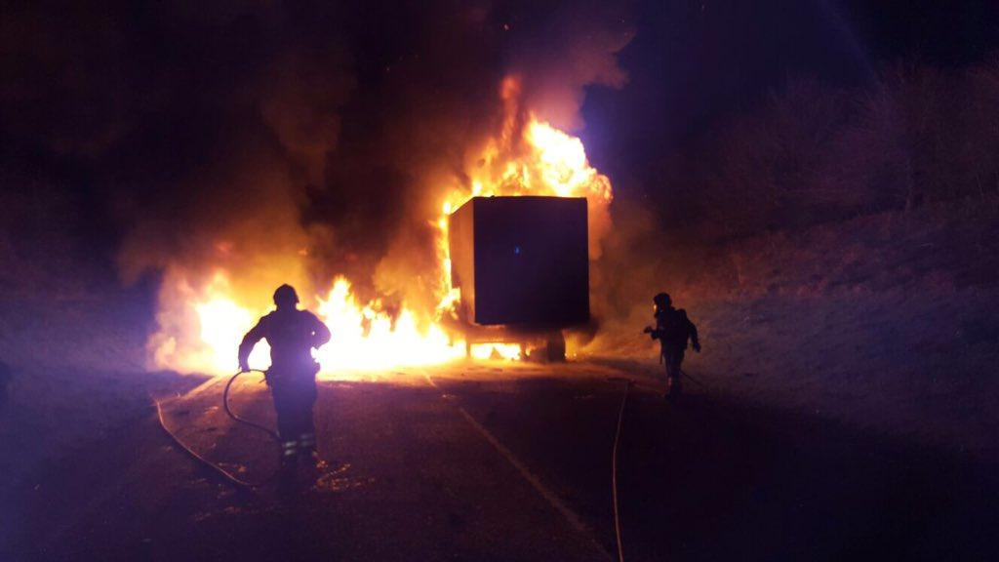
Event 1: Romania
It’s August at B&T Ltd Manufacturing, Bucharest, when a trailer is backed up to the Goods-In loading dock under the canopy and catches fire.
Gazette & Herald
Notes:
Roll 2, trailer fire, controlled

Slide 33
Event 1: Romania
If you completed the following:
Recommendation 21 (protect the Goods-In canopy) sprinklers operate and bring the fire under control. The local fire brigade is notified by the plant and extinguishes the fire when they arrive. Damage to the canopy is superficial and operations resume the next day.
A critical order for a new customer is processed on time and £1,000,000 (plus) profits are generated.

Slide 34
Event 1: Romania
If you did not complete recommendation 21 (protect the Goods-In canopy with sprinklers) but completed the following :
Recommendation 1 (improve site emergency response)
and
Recommendation 8 (enforce no smoking policy) the fire was due to a faulty electrical system. The emergency team reacts and the fire brigade is quickly notified. The canopy is weakened and operations are impacted for two weeks during emergency strengthening work
There is some disruption to operations but it is made up by additional shifts with a small cost to profits of £250,000 (minus).

Slide 35
Event 1: Romania
If you did not complete recommendation 21 to install sprinklers but completed only one of the following :
Recommendation 1 (improve site emergency response completed)
or
Recommendation 8 (enforce no smoking) completed the fire was due to a faulty electrical system. The emergency team reacts and the fire brigade is quickly notified. The canopy is weakened and operations are severely impacted for two weeks during emergency strengthening work
But not both
The canopy is badly damaged and operations are severely affected for a month whilst it is dismantled and a temporary solution put in place before repairs commence.
Profits are down by £ 1,000,000 (minus).

Slide 36
Event 1: Romania
If you did not complete any of the following:
Recommendation 1 (improve emergency response)
Recommendation 8 (enforce no-smoking policy)
Recommendation 21 (protect canopy)
The fire was caused by a discarded cigarette and there is a delay notifying the fire brigade.
There is a severe fire which collapses the canopy and damages the production building. The fire is reported in regional news headlines and there is negative publicity.
Profits for the year are down by £3,500,000 (minus)

Slide 37
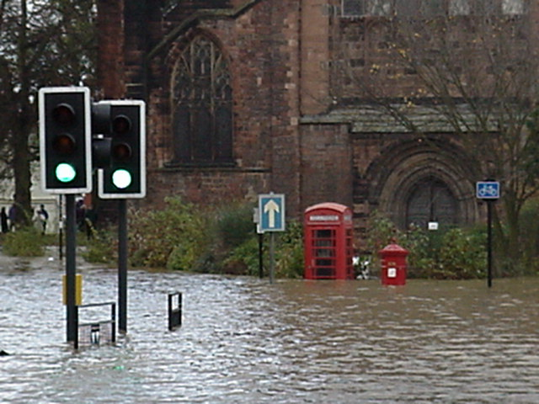
Event 2: UK
It is early December when a flood strikes Bollington. The flood level rises on Monday and remains for two days. B&T Ltd.’s HQ is virtually paralysed for the entire week.
Notes:
Roll 3, flood event at main site
Photo courtesy of http://enr.construction.com/multimedia/. North Carolina 1999 after Hurricane Floyd came through.

Slide 38
Event 2: UK
If you completed the following:
Recommendation 13 (develop a flood emergency response plan)
The plan is implemented as part of the disaster recovery plan and all key business functions recover with little impact.
You are able to process a key order in time with profit up £500,000 (plus)

Slide 39
Event 2: UK
If you did not complete the following:
Recommendation 13 (develop a flood emergency response plan)
Several key projects do not get completed before year-end.
As a result, profits drop at B&T Ltd by £2,500,000 (minus) for the year.

Slide 40
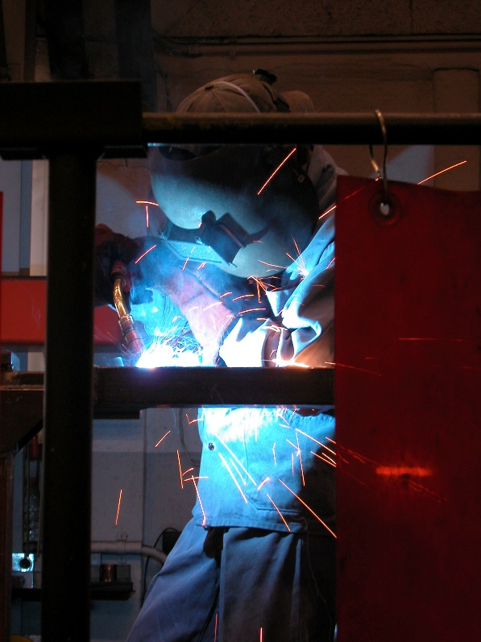
Event 3: Romania
It’s May.
At B&T Ltd’s manufacturing facility near Bucharest a worker begins work to install new equipment with an oxy-acetylene torch.
Notes:
Roll 4: hot work fire

Slide 41
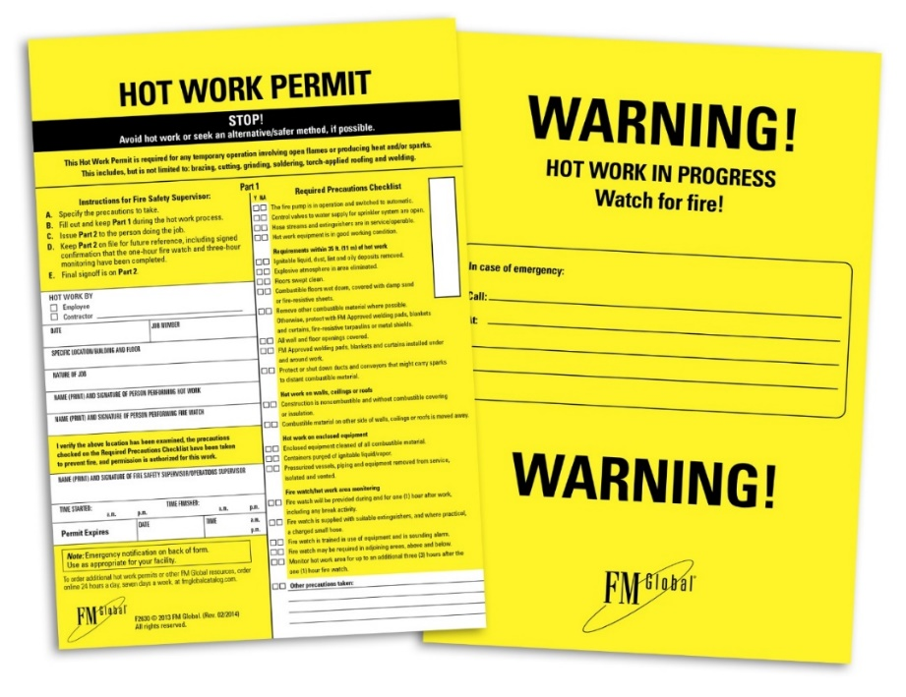
Event 3: Romania
If you completed the following:
Recommendation 7(use the FM Global Hot Work Permit) the work proceeds without incident. A new metrology station is installed which generates £250k savings in its first year of operation.
You record this as £250,000 profit (plus)

Slide 42
Event 3: Romania
If you did not complete the following:
Recommendation 7(use the FM Global Hot Work Permit) a hot work management system is not used and a fire results.
If however you completed the following:
Recommendation 23 (replace the wooden roof in Finishing area), damage is limited to the new equipment and immediate area.
Delayed shipment of several large orders, £500,000(minus) loss of profits

Slide 43
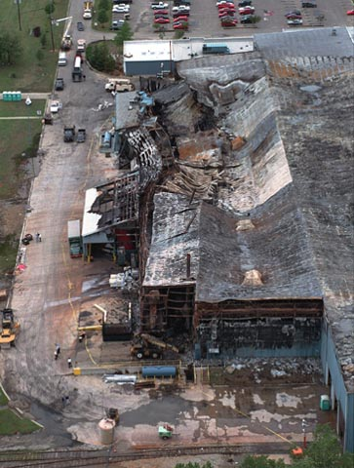
Event 3: Romania
If you did not complete either of:
Recommendation 7 (use hot work permit)
Recommendation 23 (replace wood roof)
Smouldering embers start a fire in the evening when the area is unmanned. It spreads to the old wooden ceiling joists and causes a major fire.
£5,000,000 (minus) loss of profits for B&T Ltd.

Slide 44
Event 4: UK
It’s October and a fire occurs in the tape storage area of the data centre at B&T Ltd’s corporate HQ in Bollington, UK.
If you completed either one or both of the following:
Recommendation 9 (install sprinklers throughout)
or
Recommendation 12 (introduce regular housekeeping inspections)
You are able to restore your data processing with virtually no disruption. Profits increase £500,000 (plus)
Notes:
Roll 5, fire in data centre

Slide 45
Event 4: UK
If you did not complete any of:
Recommendation 9 (install sprinklers throughout)
or
Recommendation 12 (introduce regular housekeeping inspections of the data centre)
The disruption is extensive.
Due to cancelled orders, the impact is:
£3,000,000 (minus) loss of profits for B&T Ltd.

Slide 46
Event 5: Romania
It’s July.
A worker at B&T Manufacturing near Bucharest, RO accidentally damages a pressurised hydraulic oil line on one of the CNC machines.
Notes:
Roll 6: spray fire

Slide 47
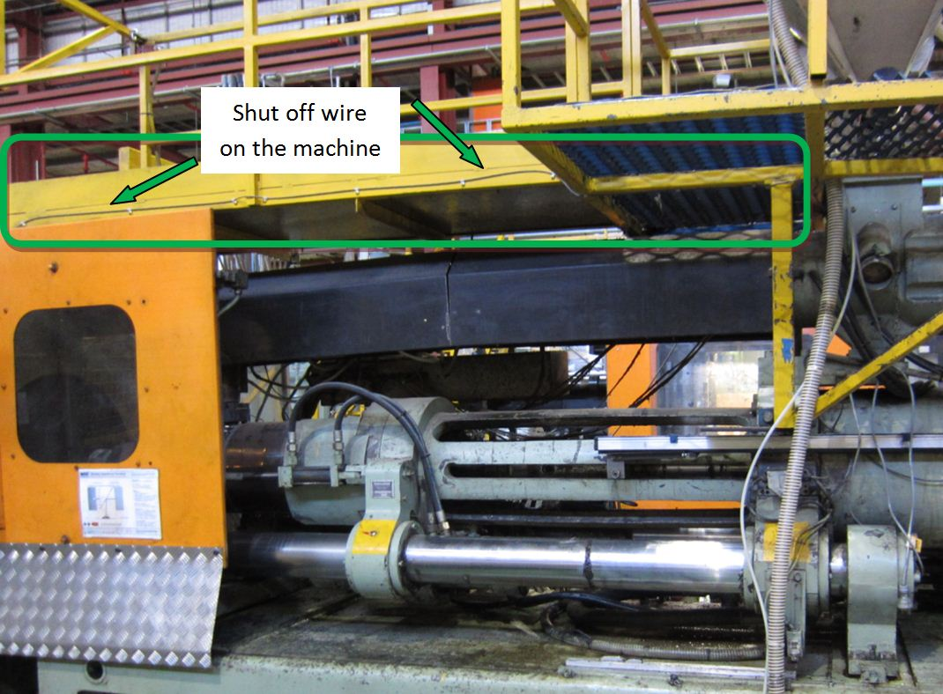
Event 5: Romania
If you completed the following:
Recommendation 17 (install safety shut-down to prevent oil release)
The oil supply is automatically shut down and no further damage occurs.
Profits increase £500,000 (plus)

Slide 48
Event 5: Romania
If you did not complete the following:
Recommendation 17 (install safety shut-off to prevent oil release)
but did complete
Recommendation 24 (introduce emergency procedures)
An operator handles the incident well, but not before considerable damage is done.
Production of round leg furniture products is curtailed and B&T Ltd's Asia DC is running out of stock.
The resulting loss of product supply affects the Asia sales a £1,000,000 (minus) drop in profits.

Slide 49
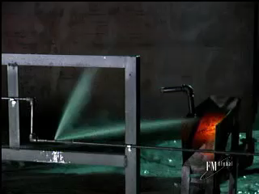
Event 5: Romania
If neither
Recommendation 17 (install safety shut-down to prevent oil release)
nor
Recommendation 24 (introduce emergency procedures for hydraulic systems)
was completed, the entire facility is severely damaged due to a fast-spreading oil spray fire and production is down for 6 months.
Outcome:
£ 7,000,000 profit loss at Manufacturing site.
£ 1,000,000 profit loss at the Newark NA DC.
£ 500,000 profit loss at the Hong Kong Asia DC.
Total loss = £8,500,000 (minus)

Slide 50
Event 6: Romania
It’s October and the B&T Ltd.'s Warehouse in Bucharest catches fire on a Sunday morning.
If you completed all of the following:
Recommendations 25 (provide in-rack sprinklers)
Recommendation 26 (keep aisles free of storage)
Recommendation 27 (relocate idle pallet storage)
A few sprinklers control the fire until the fire brigade arrives and there is virtually no financial impact to the business.
Coincidentally in the following month a competitor loses a warehouse in the area to an arsonist. B&T fulfils their orders generating £1,000,000 (plus) additional profit for B&T!
Notes:
Roll 7, fire with control / lack of sprinklers.

Slide 51
Event 6: Romania
.
If you completed the following:
Recommendations 25 (provide in-rack sprinklers)
But did not complete either one or neither of the following:
Recommendation 26 (keep aisles free of storage)
Recommendation 27 (relocate idle pallet storage)
Sprinklers struggle to keep the fire under control until the fire brigade arrives. There is extensive stock damage and smoke contamination.
B&T has to work hard to fulfil outstanding orders, there is a loss in profitability of £250,000 (minus)
Notes:
Roll 7, fire with control / lack of sprinklers.

Slide 52
Event 6: Romania
If you did not complete recommendation 25 (in-rack sprinklers) but completed all of the following:
Recommendation 1 (Improve emergency response)
Recommendation 26 (Keep aisles clear)
Recommendation 27 (Relocate idle pallet storage)
Recommendation 28 (Replace wood roof over finished goods conveyor)
Recommendation 30 (Relocate propane tanks outside),
Fire spread is relatively slow, it doesn’t spread along the finish goods conveyor and early fire brigade intervention limits warehouse damage.
Financial impact: profit loss of £1,250,000 at B&T Ltd manufacturing due to reduced production volume whilst the warehouse is repaired and losses at the NA and Asia DCs to £375,000 each.
Total profit lost = £2,000,000 (minus)

Slide 53
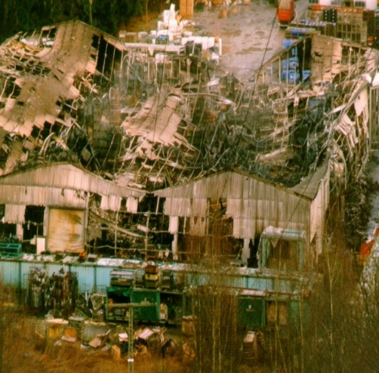
Event 6: Romania
If you did not complete recommendation 25 (in-rack sprinklers) but completed the following:
Recommendation 28 (replace wood roof over finished goods conveyor)
But did not complete any one or all of the following:
Recommendations 26 (keep aisles free of storage)
Recommendation 27 (relocate idle pallet storage)
Recommendation 30 (relocate propane tanks outside)
The warehouse is lost
Total profit loss:
£ 5,500,000 (minus)

Slide 54
Event 6: Romania
If you did not complete both of the following:
Recommendation 25 (install in-rack sprinklers)
Recommendation 28 (replace wood roof over conveyor)
Nor did you complete any one or all of the following:
Recommendation 26 (keep aisles free from storage)
Recommendation 27 (relocate idle pallet storage outside)
Recommendation 30 (relocate propane tanks outside the warehouse)
The fire is severe and spreads to the manufacturing facility causing significant damage and a long recovery. The event makes local news.
Profit loss:
£ 15,000,000 for Europe
£ 1,500,000 for Newark NA DC
£ 1,000,000 at Hong Kong Asia DC
Total profit loss:
£ 17,500,000

Slide 55
Event 7: Romania
It is May at B&T Ltd Manufacturing Bucharest, when an oil spill occurs and an unusually large amount of oily rags has to be disposed of.
Notes:
Roll 8: ignitable liquid hazard

Slide 56
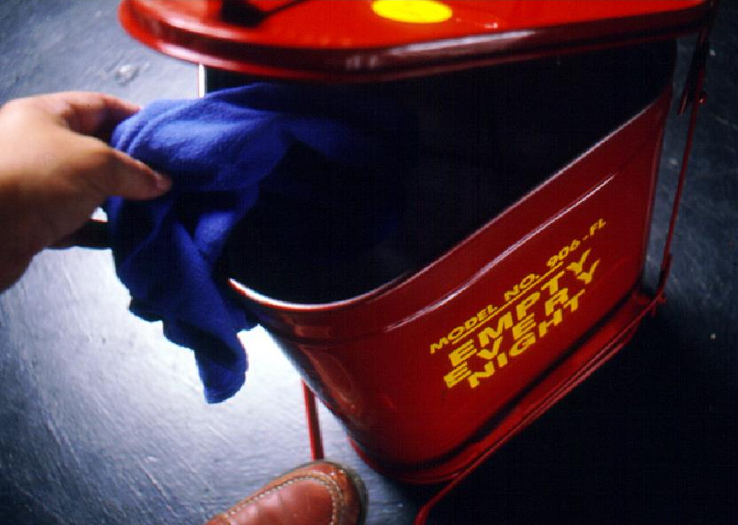
Event 7: Romania
If you completed recommendation 18 (provide FM Approved self closing safety bins), there is no incident.
Profits increase £100,000 (plus)

Slide 57
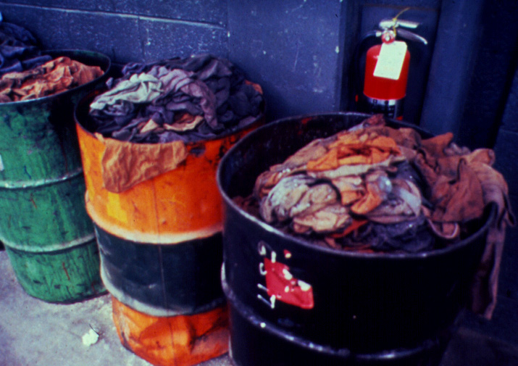
Event 7 Romania
If you did not complete recommendation 18 (provide FM Approved self closing safety bins), spontaneous combustion occurs within the open bin. Sprinklers save the building, but a critical machine is severely damaged, which causes a delay on several large American orders due for delivery by August 1st.
There is a £100,000 profit loss (minus)

Slide 58
Event 8: Romania
It is November at B&T Ltd's warehouse in Romania when a fork lift trucks hits a sprinkler riser.
If you completed recommendation 3 (conduct regular inspection and testing of sprinkler control valves), one of your employees closes the sprinkler control valve right away and water damage is negligible.
Profits increase £250,000 (plus)
Notes:
Roll 9: Valve closure

Slide 59
Event 8 Romania
If you did not complete the following:
Recommendation 3 (conduct regular inspection and testing of sprinkler control valves), improper maintenance delayed the valve closure, you flood the warehouse and loose an entire shipment that was bound for an important customer in Asia.
£ 750,000 profit loss at B&T in Europe.
£ 500,000 profit loss at the Hong Kong DC
Total loss = £ 1,250,000 (minus)

Slide 60
Event 9: UK
In September a storm with heavy rain hits the Bollington area, where the corporate headquarters is located.
If you completed all of the following
Recommendation 10 (perform regular roof inspections)
and
Recommendation 11 (Repair leaks in roof)
The roofs and drains function as expected, your employees clean up the fallen leaves and no further damage results from this storm.
A planned launch event for the new Romanica Exclusiva range takes place without delay the next week. It will proves popular in the coming year generating additional profits of £250,000 (plus)
Notes:
Roll 10, heavy storm, drains overflow

Slide 61
Event 9: UK
If you did not complete either recommendation 10 (perform roof inspections) or 11 (repair leaks) or neither most of the roof drains are blocked, water enters the building/transformer enclosure and the facility is closed for a week. The launch event is postponed at short notice.
The negative publicity from the delayed launch affects sales within the UK and abroad.
Profit loss:
£ 750,000 at B&T Ltd Europe
£ 375,000 at each of the DCs
Total loss in profitability = £1,500,000 (minus)

Slide 62
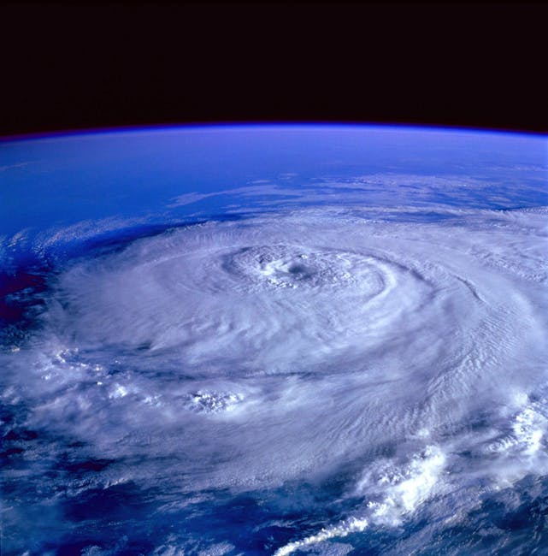
Event 10: Hong Kong
It’s April when a windstorm hits Hong Kong area where the B&T Asia distribution centre is located.
.
Notes:
Roll 11, windstorm event nearby

Slide 63
Event 10: Hong Kong
If you completed either
Recommendation 34 (provide additional bracing to doors)
or
Recommendation 35 (create a windstorm emergency response plan)
or both your facility was prepared for the storm which struck.
There is only minor damage to the building envelope and operations resume quickly with minimal disruption.
Some of the big hotels faired less well and there is a local peak in sales.
Profits increase by £500,000 (plus)
Notes:
Roll 11, windstorm event nearby

Slide 64
Event 10: Hong Kong
If you did not complete recommendation 34 (brace doors nor 35 (create a windstorm emergency response plan) your facility was under prepared for the storm.
There building envelope is damaged by debris leading to roof damage and water ingress. Much stock is damaged, leading to cancelled orders.
Profits decrease by £500,000 (minus)
.
Notes:
Roll 11, windstorm event nearby

Slide 65
Event 11: Romania
It is February at B&T Ltd’s facility in Bucharest, RO when a magnitude 5.7 earthquake strikes the region.
Minor shake damage is experienced to buildings and structures.
Notes:
Roll 12, small EQ

Slide 66
Event 11: Romania
If you completed recommendations 20 (provide EQ bracing to sprinkler systems in manufacturing) and 29 (provide EQ bracing in warehouse) there is no impact to operations.
This financial year has been a good one for B&T, where sales rally just towards the end of the month. Overall B&T profits are up by £1,500,000 (plus)
Notes:
Roll 12, small EQ

Slide 67
Event 11: Romania
If you did not complete recommendations 20 (EQ bracing manufacturing sprinklers), but completed 29 (EQ bracing warehouse sprinklers) or neither.
The coupling on an overhead sprinkler main ruptures and the fire pump starts when the pressure drops.
There is extensive water damage to equipment and goods. There is a loss in profit of £1,000,000
Notes:
Roll 12, small EQ

Slide 68
Event 12: Romania
It is May when thunderstorms pass through central Europe. The area around Bucharest suffers a severe hailstorm which causes a lot of damage to the area.
Notes:
Roll 2, storm damage, power outage

Slide 69
Event 12: Romania
If you completed recommendation 23 (replace wooden roof over Finishing and Inspection areas) then the storm passes with no impact to operations bar minor damage of low value buildings.
The cement asbestos roof of a local competitor is holed in many places and production shut for repair/decontamination. B&T fulfils their orders in the short term gaining a new big order.
Profits increase by £500,000 (plus)
Notes:
Roll 2, storm damage, power outage

Slide 70
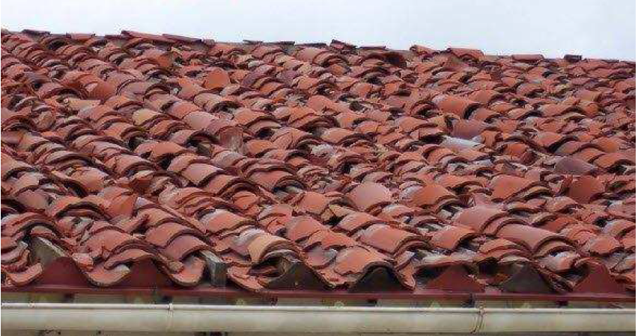
Event 12: Romania
If you did not complete recommendation 23 (replace wooden roof over Finishing and Inspection areas). The roof is severely damaged and the new metrology station below suffers water damage.
Profits reduce by £250,000 (minus) due to addition cost of quality controls

Slide 71
Event 13: Romania
October:
A fire breaks out at the B&T Europe manufacturing plant.
If you have completed recommendation 2 (record all impairments using the FM Global Red Tag Permit System) then all valves were fully open and the automatic sprinkler system extinguished the small fire.
The positive publicity of B&T’s resilience increases profits by £250,000 (plus)
Notes:
Roll 3, fire with partially open valve

Slide 72
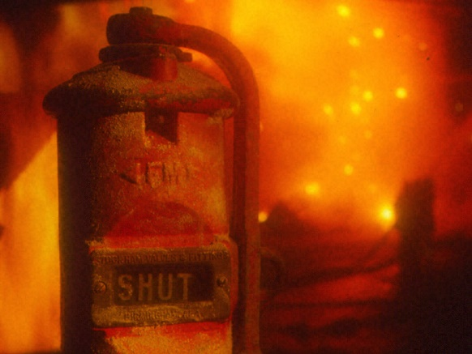
Event 13: Romania
If you did not complete recommendation 2 (record all impairments using the FM Global Red Tag Permit System), the subject sprinkler control valve is partially closed.
Low water flow results in more extensive fire damage. Most of your employees are busy cleaning up smoke and water damage, a shipment gets delayed causing penalties to be assessed.
£500,000 profit loss (minus)

Slide 73
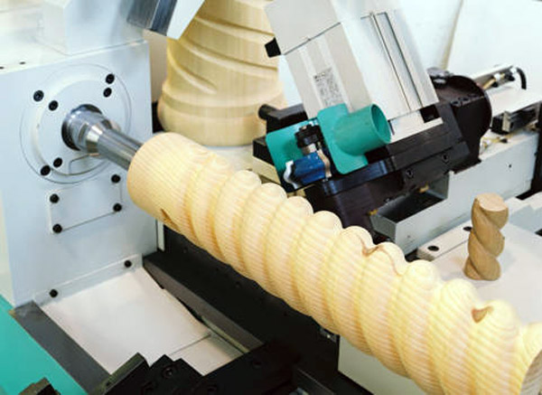
Event 14: Romania
It’s April.
A fire occurs at B&T’s manufacturing plant near Bucharest at one of the flexible manufacturing turning stations.
Notes:
Roll 4: fire with valve closed (Red Tag)

Slide 74
Event 14: Romania
If you completed the following:
Recommendations 2 (record all impairments using the FM Global Red Tag Permit System)
Recommendation 6 (lock sprinkler valves open)
Recommendation 22 (improve storage and handling of ignitable liquids)
The fire is extinguished right away with no disruption to the business. The new product gets out on time and its success is a game changer for the year, vastly exceeding all expectations
£ 750,000 increased profit at the Asia DC
£1,750,000 additional profit for B&T Ltd manufacturing in Romania
Total increased profit is £2,500,000

Slide 75
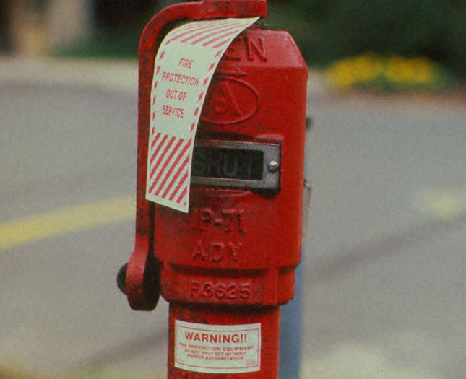
Event 14: Romania
If you did not complete recommendation 6 (lock sprinkler valves open) but did complete 2 (use Red Tag for impairments) and 22 (improve ignitable liquid storage and handling), the shift supervisor was aware of the closed valve and extinguished the fire with a properly pressurised fire hose.
Business was not affected.

Slide 76
Event 14: Romania
If recommendations 2 (Red Tag) or 6 (lock sprinkler valves open) were not completed, but recommendation 22 (improve storage and handling of ignitable liquids) was completed there is some damage to the manufacturing line which impacts production.
Reduced production volume means delays in some orders and a profit loss of £250,000.

Slide 77
Event 14: Romania
If neither recommendations 2 (Red Tag) nor 6 (lock sprinkler valves open) nor recommendation 22 (improve storage and handling of ignitable liquids) were completed, the fire spreads to involve a plastic container of lubricating oil which was next to the machine.
The whole of one manufacturing line is severely damaged with a big impact to production.
Reduced production volume translates into a profit loss of £1,250,000 (minus)

Slide 78
Event 15: Romania
It is September at B&T Manufacturing in Bucharest, RO when the fire pump breaks down.
Notes:
Roll 5 – fire pump out of service.

Slide 79
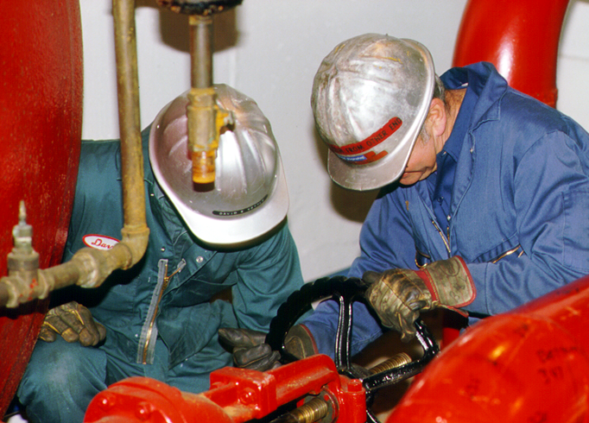
Event 15: Romania
If you completed recommendation 14 (develop a planned maintenance programme), the broken seal is replaced with a spare.
There is no impact on your business.

Slide 80
Event 15: Romania
If you did not complete recommendation 14 (develop a planned maintenance programme) but did complete recommendation 4 (create a contractor management programme), it turns out that the impeller is seriously damaged and it will take about four weeks to get a replacement.
As employees and contractors ‘live and breathe’ your loss prevention programs, time passes without any further incident happening.

Slide 81

Event 15: Romania
If you did not complete either recommendation 14 (develop a planned maintenance programme) nor
4 (develop a planned maintenance programme), a contractor causes a fire while repairing the roof. The roof collapses during fire-fighting and a fire-fighter gets seriously injured.
The press has a field day as a result of inappropriate preparation. The plant is closed for a month while government agencies review your procedures. Due to negative press your business suffers:
£1,500,000 profit loss B&T Ltd manufacturing
£ 500,000 profit loss at each DC
Total profit loss £2,500,000 (minus)

Slide 82
Event 16: Romania
It is October when an earthquake of magnitude 8 strikes the region around Bucharest.
Notes:
Roll 6: EQ hazard

Slide 83
Event 16: Romania
If you completed recommendations 20 (provide EQ bracing to sprinkler systems in manufacturing) and 29 (provide EQ bracing to sprinkler systems in warehouse), your automatic sprinkler system withstands the forces and extinguishes a fire caused by a short circuit. Your business is not affected by this incident which allows you to support neighbouring companies. Several management magazines spotlight your responsiveness.
£ 2,100,000 increased profits B&T Ltd manufacturing
£ 700,000 profit gain at the Newark DC
Total profit gain £ 2,800,000

Slide 84
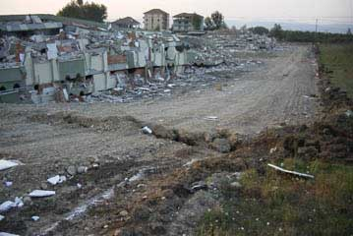
Event 16: Romania
If you did not complete one or both of recommendations 20 (provide EQ bracing to sprinkler systems in manufacturing) or 29, the sprinkler piping ruptures, causing major water damage and a fire caused by electrical short circuits gets out of control.
Profit losses occur:
£ 2,200,000 at B&T Ltd Europe
£ 500,000 at the Newark NA DC
Total loss in profits of £ 2,500,000 (minus)

Slide 85
Event 17: UK
It is November when a fire erupts in the data centre’s UPS (uninterrupted power supply) system at B&T Ltd corporate headquarters.
If you completed recommendation 9 (install sprinklers throughout), fire doors close automatically and the sprinklers quickly control the fire. Operations at the site are not affected.
The planned ‘Black Friday’ promotion goes ahead as planned and generates additional profits of £500,000 (plus)
Notes:
Roll 7: fire in Data Centre

Slide 86
Event 17: UK
If you did not complete:
Recommendation 9 (install sprinklers throughout),
but did complete
Recommendation 12 (introduce regular housekeeping inspections),
fire is limited to the UPS unit but it takes time to retrieve the data from old tapes and paper copies
Fortunately you can retrieve most of the lost data through your back-ups and operations are not significantly affected. No impact

Slide 87
Event 17: UK
If you did not complete:
Recommendations 9 (install sprinklers throughout) or
Recommendation 12 (introduce regular housekeeping inspections),
the fire destroys the UPS system before your site emergency response team gets the fire under control.
Shipments are delayed, causing a drop in profits of £500,000 minus for B&T Ltd manufacturing.
The distribution centres are unaffected and so is the market share.

Slide 88
Event 18: Hong Kong
December:
A fire starts in the rack storage area of B&T Ltd’s Asia DC in Hong Kong, .
If you completed recommendation 36 (keep aisles free from storage), the fire is limited to one rack and easily controlled by two in-rack sprinklers with virtually no disruption to the business.
Notes:
Roll 8: rack storage fire, int’l DC

Slide 89
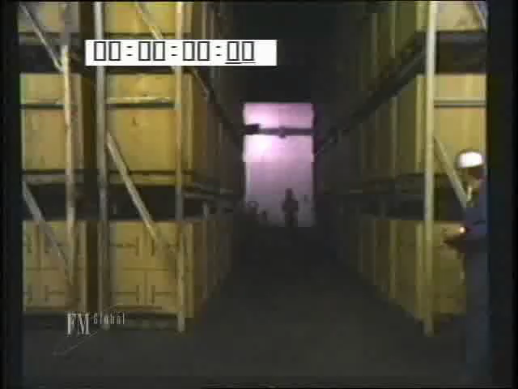
Event 18: Hong Kong
If you did not complete recommendation 36 (keep aisles free from storage), the fire spreads into the aisle before the sprinkler system gains full control, and a larger area of rack storage is damaged.
A shipment is delayed and you lose the customer.
£500,000 profit drop.
Notes:
Insert uncontrolled fire video ?

Slide 90
Event 19: UK
It is June when a disgruntled former employee phones in a poisoning threat at reception of B&T Ltd’s Headquarters in Bollington.
Your evacuation plan works well. A forensic search of the building over the weekend reveals contamination. The disruption is minor with no financial impact.
Notes:
Roll 12: bomb threat
Click return arrow to go back to Events, Year 3 where you can then advance to the winner slide.

Slide 91
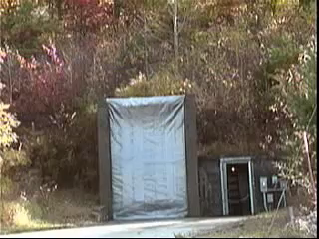
Event 20: Romania
It is August when a small explosion occurs in one of the dust collectors at B&T Ltd's manufacturing plant near Bucharest.
Notes:
Roll 10: Dust explosion.
Insert dust explosion video ?

Slide 92
Event 20: Romania
If you completed recommendation 16 (install sprinklers within the dust collector), the sprinklers take control of the situation and water and smoke damage is minimal.
Sales are strong and profit increases by £1,000,000 (plus)

Slide 93
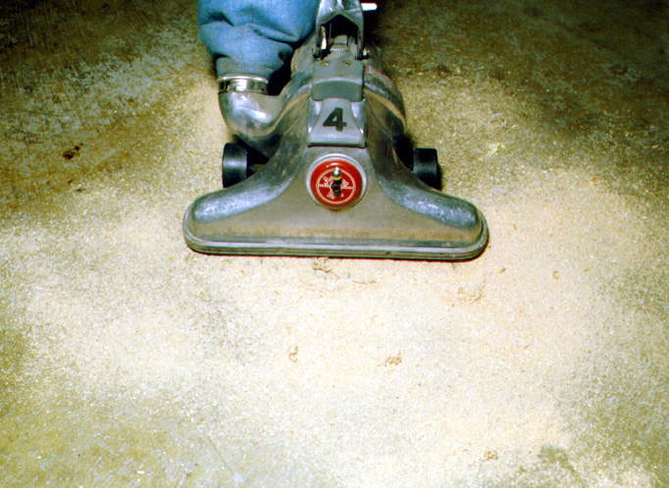
Event 20: Romania
If you did not complete recommendation 16 (install sprinklers within the dust collector) but did complete 15 (introduce regular cleaning), the resulting damage is not as severe.
Profit loss:
£3,750,000 at manufacturing
£ 600,000 at Newark DC
£ 400,000 at Hong Kong DC
Total loss in profits of £ 4,750,000 (minus)

Slide 94
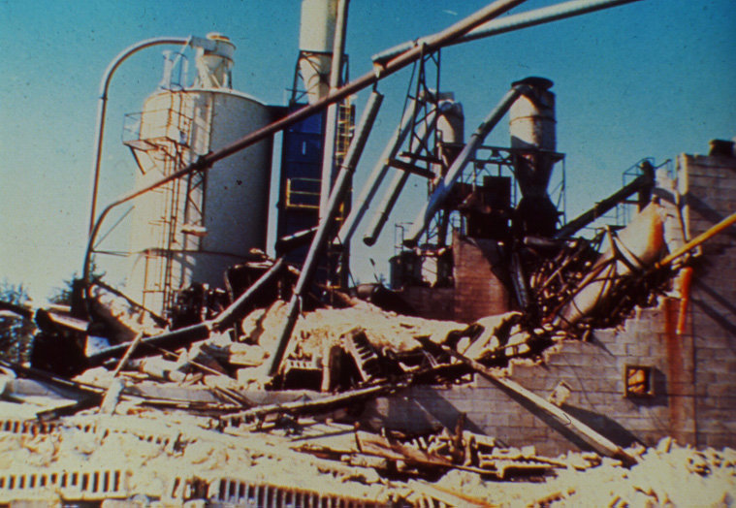
Event 20: Romania
If you did not complete recommendations 16 (install sprinklers within the dust collector) nor 15 (introduce regular cleaning), the small explosion triggers additional explosions in the surrounding area and you lose the building.
£7,500,000 profit drop B&T Ltd's mfg
£1,200,000 profit drop at Newark DC
£ 800,000 lost profits Hong Kong DC
Total loss in profits of £ 9,500,000 (minus)

Slide 95
Event 21: Romania
It is August when a small fire occurs in B&T Ltd's warehouse near Bucharest, RO.
Notes:
Roll 11: smoking ignition source

Slide 96
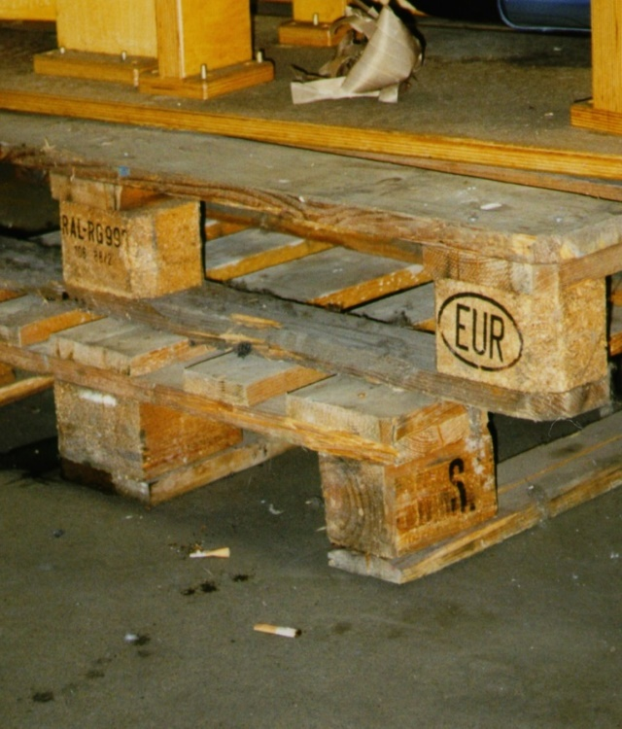
Event 21: Romania
If you did not complete recommendation 8 (enforce no smoking policy), it turns out that the fire was caused by a careless smoker.
Sprinklers control the fire but news spreads fast and the resulting bad press coverage causes profit drop:
£1,500,000 at manufacturing
£ 750,000 at Newark DC
Total drop in profits of £ 2,250,000 (minus)

Slide 97
Event 21: Romania
If you completed recommendations 8 (enforce no smoking policy), and 7 (use FM Global Hot Work Permit), it turns out that the fire was caused by a grinding spark.
But due to your excellent hot work policy the fire was extinguished right away and the resulting good publicity increases profits:
Increase in profit of £1,500,000 (plus)

Slide 98
Event 22: Romania
It is October when a fire starts in the pallet storage area at B&T Ltd's Warehouse in Bucharest, RO.
If you completed recommendation 27 (relocate idle pallets outside warehouse), you mitigated the risk of an idle pallet fire and experience no significant disruption to the business.
Sales are good and profits up £500,000 (plus)
Notes:
YEAR 3: Roll 2, warehouse fire in pallets

Slide 99
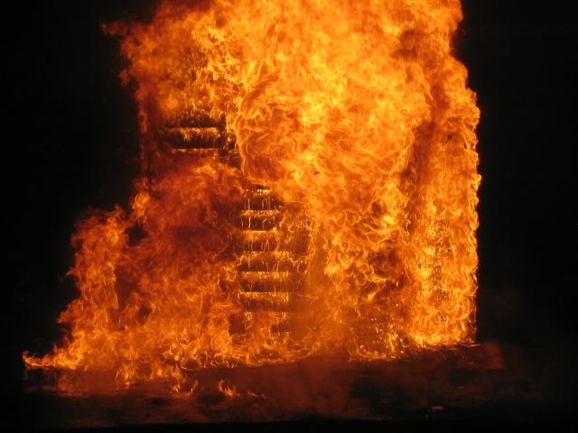
Event 22: Romania
If you did not complete either recommendations 27 (relocate idle pallets outside warehouse) but did complete recommendation 28 (replace wood roof) the idle pallet fire quickly overtaxes the sprinkler system and an uncontrolled fire destroys the warehouse, it doesn’t spread to the manufacturing building.
Profits drop:
£ 4 million loss at B&T Europe
£ 1 million loss the Newark DC
£ 1 million loss at the Hong Kong DC
Total loss of £6,000,000 (minus)

Slide 100
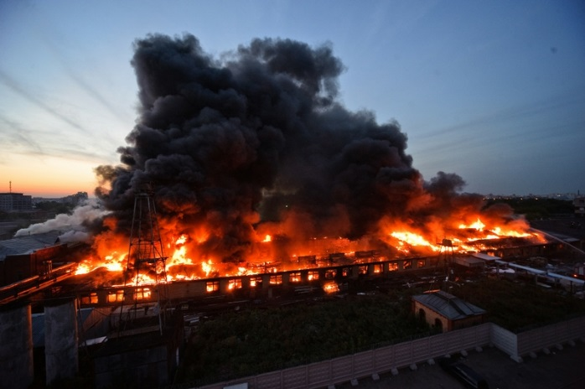
Event 22: Romania
If you did not complete either recommendations 27 (relocate idle pallets outside warehouse) nor 28 (replace wood roof) the idle pallet fire quickly overtaxes the sprinkler system and an uncontrolled fire destroys the warehouse, it spreads along the wooden roof of the conveyor to manufacturing causing major fire damage:
Profits and market share drop as follows:
£ 12 million loss at B&T Europe
£ 6 million loss the Newark DC
£ 3 million loss at the Hong Kong DC
Total profit loss = £ 21,000,000

Slide 101
Event 23: Romania
During a summer shut-down B&T engineering teams perform upgrades to the flexible manufacturing systems. A new CNC machining program calibration with new tooling ignites sawdust from the chair leg being turned.

Slide 102
Event 23: Romania
If you completed recommendations 3 (regular housekeeping inspections), 4 (contractor management programme) and 14 (planned maintenance programme), the clean conditions, ceiling sprinklers and a knowledgeable contractor tackle the fire, bringing it under control.
This coincides with a public enquiry into a competitor’s fire trialing the same tooling which had severe consequences so B&T receives excellent press for a very sophisticated loss prevention program.
Profits go up:
£6.5 million at B&T Ltd manufacturing
£2 million at the Newark DC
£1.5 million at the Hong Kong DC
Total increase in profits of £10,000,000 (plus)

Slide 103
Event 23: Romania
If you did not complete any of the recommendations 3 (regular housekeeping inspections), 4 (contractor management programme) or 14 (planned maintenance programme), the contractor has isolated the sprinklers and flees the building. There is a major fire
This coincides with a public inquiry into a similar fire trialing the same tooling so B&T receives press scrutiny and is fined for poor procedures.
Profits go down:
£10 million at B&T Ltd manufacturing
£2 million at the Newark DC
£1.5 million at the Hong Kong DC
Total decrease in profits of £13,500,000 (minus)

Slide 104
Event 23: Romania
If you only complete one or two of recommendations 3 (regular housekeeping inspections), 4 (contractor management programme) or 14 (planned maintenance programme). There is a fire involving a turning station
Profits go down:
£ 2,000,000 at B&T Europe manufacturing
£ 500,000 at the Newark DC
£ 500,000 at the Hong Kong DC
Total decrease in profits of £ 3,000,000 (minus)

Slide 105
Event 24: USA
It is November and a rack needs to be repaired at B&T Ltd’s North America DC in Newark.
Notes:
Roll 3: hot work ignition source

Slide 106

Event 24: USA
If you completed recommendation 7(use the FM Global Hot Work Permit) , the contractor uses your hot work permit system and the work is completed without impacting your business.
A new order generates £ 500,000 profit (plus)

Slide 107
Event 24 USA
If you did not implement recommendation 7(use the FM Global Hot Work Permit), storage left in the rack catches on fire. Your sprinkler system controls the fire successfully and damage is limited
Profits and market share are affected:
£ 150,000 lost profits (minus) at Newark DC
Notes:
This photo is a Russian meat factory on fire from http://englishrussia.com/2011/08/09/hot-smoking-sausage-the-meat-factory-on-fire/

Slide 108
Event 25: UK
In August, a flood hits the north of England and in particular the Bollington area where B&T Ltd is located.
Notes:
Roll 4: Flood hazard

Slide 109
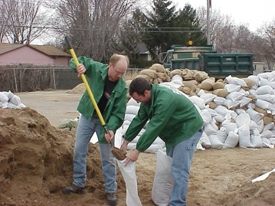
Event 25: UK
If you completed recommendation 13 (develop a flood emergency response plan) your flood emergency response team handles the incident well and you experience no business disruption.

Slide 110
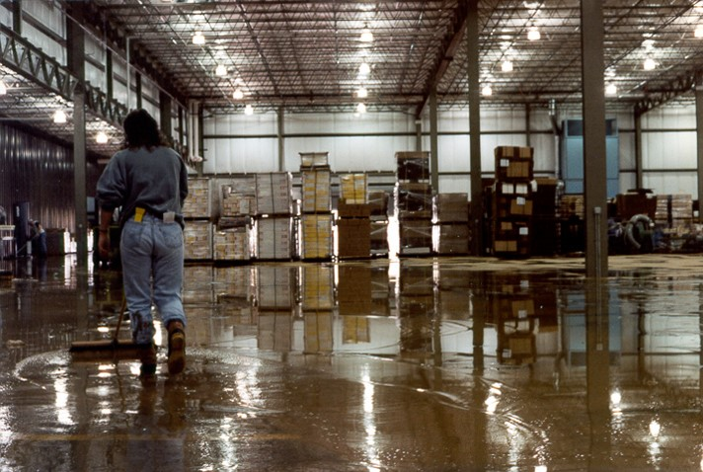
Event 25: UK
If you did not implement recommendation 13 (develop a flood emergency response plan), B&T Ltd’s special orders preparation area is out of action for two weeks and an important customer cancels their shipments.
Profits are £500,000 (minus) lower as a result.

Slide 111
Event 26: Romania
It is September when a fire starts in the pattern and tool rack storage area of B&T Ltd’s European manufacturing facility near Bucharest.
If you completed recommendation 19 (provide in-rack sprinklers) and 3 (regular housekeeping inspections) , the sprinklers and emergency response team quickly bring the fire under control. Disruption is minimal.
Less than a month after the fire a long standing customer requests a special order of a discontinued furniture range. The tools are retrieved and the order generates £250,000 profit (plus).
Notes:
Roll 5: rack fire

Slide 112
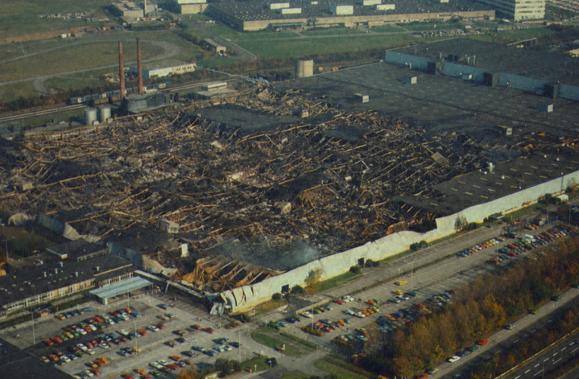
Event 26: Romania
If you completed recommendation 19 (provide in-rack sprinklers) but not recommendation 3 (regular housekeeping inspections), an employee closes the sprinkler valve before the fire is fully extinguished, trying to minimise water damage. The fire spreads and the building is lost. You lose important sales.
Lost profits and market share drop:
£ 8 M at B&T Europe
£ 1 M at the Newark DC
£ 1 M at the Asia DC
Total loss £10,000,000 (minus)
Notes:
Rec no. 14-03-4 is contractor orientation
14-04-3 is valve inspection.

Slide 113
Event 26: Romania
If you did not complete recommendation 19 (provide in-rack sprinklers) but completed 3 (regular housekeeping inspections) the ceiling sprinkler system and fire brigade prevent total loss of the building. Important shipments get delayed.
£ 3 M profit drop B&T Ltd manufacturing
£ 0.5 M drop at the Newark NA DC
£ 0.5 M drop at the Hong Kong Asia DC
Total drop in profits of £ 4,000,000 (minus)

Slide 114
Event 27:UK
It is July and heavy rain falls, resulting in a flood event throughout northern England. The B&T corporate HQ is affected.
Notes:
Roll 6: flood hazard at HQ (basement)

Slide 115
Event 27: UK
If you completed recommendations 13 (develop a flood emergency response plan), 11 (repair roof leaks) and
10 (regular roof inspections), your flood emergency response team handles the incident well. Still, your building is surrounded by water for six days.
The good media coverage as a result of your ‘outstanding resilience and customer service’ improves profits and market share:
£ 500,000 increase in profits for the year (plus)
Notes:
Rec no.s relate to FERP and roof maintenance

Slide 116
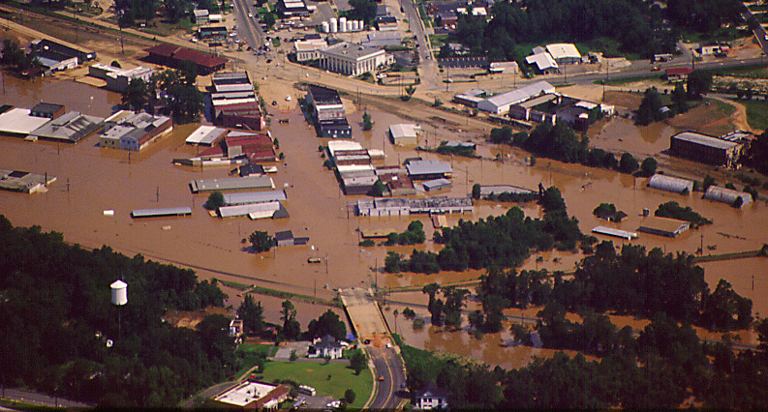
Event 27: UK
If you did complete recommendations 13 (develop a flood emergency response plan) but not one or both of 10 (regular roof inspections), or 11 (repair roof leaks) the entire site is not flooded but there is some water damage. Your customer delivery service is not available for one day.
Profit losses occur as a result.
£ 100,000 profit lost

Slide 117
Event 27: UK
If you did not complete recommendations 13 (develop a flood emergency response plan) but completed 10 (regular roof inspections), or 11 (repair roof leaks) or both the entire site is flooded but there is limited or no water damage from roof leaks. Your customers’ delivery service is not available for several days.
Profit losses occur as a result.
£ 500,000 profits lost (minus)

Slide 118
Event 27: UK
If you did not complete recommendations 13 (develop a flood emergency response plan), nor 11 (repair roof leaks) nor 10 (regular roof inspections), the entire site is flooded. Your customers’ delivery service is not available for several days.
Profit losses occur as a result of poor publicity in the media.
£1,000,000 profit lost

Slide 119

Event 28: Romania
It is March at B&T Ltd’s manufacturing plant in Europe where a High Intensity Discharge (HID) lamp shatters and fragments fall to the ground.
Notes:
Roll 7: lighting ignition source

Slide 120
Event 28: Romania
If you did complete recommendation 22 (improve storage and handling of ignitable liquids) the hot fragments fall to the concrete floor with no effect. The engineering manager has noticed the regular bulb failures and is convinced that LED lighting should be installed. This event triggers him to act.
LED lights around the whole plant provide an annual saving of £ 100,000 (treat as profit = plus).

Slide 121
Event 28: Romania
If you did not complete recommendation 22 improve storage and handling of ignitable liquids) the hot fragments fall into an oily area next to a CNC machine. A small fire starts and plastic oil containers melt allowing the fire to grow.
Fortunately the area is protected by sprinkler which are operated by the heat and control the fire after thirty minutes. The oil aggravated the fire and there is significant damage to one production bay.
Profits drop by £2,000,000

Slide 122
Event 29: Romania
November:
A fire erupts at one of the hydraulically powered CNC machines at the manufacturing plant.
If you completed recommendation 17(install safety shut-down to prevent oil release), damage is minimal as the machine shuts down immediately and the sprinkler system takes control of the oil fire. There is no impact as a result.
This is a busy month supplying furniture for a large hotel chain refurbishment project which generates £500,000 profit (plus)
Notes:
Roll 8: hydraulic hose fire

Slide 123
Event 29: Romania
If you did not complete recommendation 17 (install safety shut-down to prevent oil release)
but did complete 24 (introduce emergency procedures) , an intense oil fire starts and sprinklers operate with limited effect at first
A well trained operator takes immediate action, switches off the hydraulic oil supply and evacuates the area, leaving sprinkler to cool the fire until the fire brigade arrives.
Damage is moderate and an important product launch at an industry trade fair is delayed.
Profits fall £750,000. (minus)
Notes:
Rec #14-04-3 is for the whole site, valve inspection.

Slide 124
Event 29: Romania
If you did not implement either recommendation 17 (install safety shut-down to prevent oil release)
or 24 (introduce emergency procedures), the fire gets out of control.
The majority of the CNC machines in this area are damaged and important shipments are delayed.
You are losing customers and the financial impact is:
£ 2,800,000 loss of profits at the manufacturing site
£ 2,200,000 profit drop at the distribution centres
Combined loss in profits is £5,000,000 (minus)

Slide 125
Event 30: UK
It is May and B&T Ltd's corporate HQ building undergoes major renovations.
If you completed recommendation 4 (contractor management programme), all contractors are familiar with your loss prevention programs and renovations run smoothly.
New efficiencies add £500,000 to profits (plus)
Notes:
Roll 9: contractors

Slide 126
Event 30: UK
If you did not complete recommendation 4 (contractor management programme), a contractor performs unauthorised hot work in the electrical room and causes a fire.
The disruption of power supply leads to the loss of some important customer data.
There is a £1,250,000 loss (minus) of profit for B&T Ltd.
.
Notes:
Rec # 14-04-4 applies to the whole Asheville site and relates to contractor orientation.

Slide 127
Event 31: Romania
It’s December.
B&T Ltd's Manufacturing in Bucharest experiences a short circuit within an electrical cabinet.
Notes:
Roll 10: electrical ignition source

Slide 128
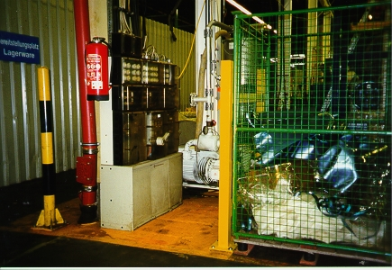
Event 31: Romania
If you completed recommendation 5 (safety and housekeeping inspections), combustibles are nowhere near the cabinet and the loss is limited to a few wires.
There is no impact to operations or profits.

Slide 129
Event 31: Romania
If you did not complete recommendation 5 (safety and housekeeping inspections), a ready-to-go shipment of special order high-end furniture in cardboard boxes is adjacent to the cabinet and catches fire, resulting in total loss.
£500,000 loss (minus) in profits for B&T Ltd.
Notes:
Rec no. 14-04-2 applies to whole site, relates to housekeeping inspection.

Slide 130
Event 32: Romania
It is September a spark from machining operations goes into the main dust collector starting a small fire
If you did complete recommendations 16 (install sprinklers within the dust collector) and 6 (lock sprinkler valves open), sprinklers operate and damage is limited, production resumes the next day. This is fortunate as there has been an uptick in order.
Profit is £250,000 up (plus) on the forecast for the year
Notes:
Roll 11: external exposure

Slide 131
Event 32: Romania
If you did not complete recommendation 16 (install sprinklers within the dust collector), but completed recommendation 6 (lock sprinkler valves open) the fire inside the dust collector grows and eventually breaks out making ceiling sprinklers operate instead. The dust collector needs to be replaced and production is affected.
There is a £500,000 reduction (minus) in profits for the year.
Notes:
Roll 11: external exposure

Slide 132
Event 32: Romania
If you did not recommendation 6 (lock sprinkler valves open) the water supply to sprinklers in the dust collector area has been isolated. Fire inside the dust collector grows and eventually breaks out but ceiling sprinklers in the immediate area fail to operate instead. There is severe damage to this part of the facility and production is affected for six months.
There is a £1,500,000 (minus) reduction in profits for the year.
Notes:
Roll 11: external exposure

Slide 133
Event 33: Romania
It’s January.
A pin-hole leak appears in a pressurised hydraulic oil line on one of the CNC machines.
Notes:
Roll 6: spray fire

Slide 134
Event 33: Romania
If you completed recommendation 17 (install safety shut-down to prevent oil release), the oil supply is automatically shut down and no further damage occurs.

Slide 135
Event 33: Romania
If you completed recommendation 24 (introduce emergency procedures) but did not complete recommendation 17 (install safety shut-down to prevent oil release), an operator handles the incident well, but not before considerable damage is done.
There is a £500,000 drop (minus) in profits.

Slide 136
Event 33: Romania
If neither recommendation 17 (install safety shut-down to prevent oil release) nor recommendation
24 (introduce emergency procedures) was completed, the entire facility is severely damaged due to a fast-spreading oil spray fire and production is down for 6 months.
Outcome:
£6,000,000 profit loss at Manufacturing site.
£750,000 profit loss at the Newark NA DC.
£500,000 profit loss at the Hong Kong Asia DC.
Total loss to profits = £ 7,250,000 (minus)

Slide 137
Event 34: Romania
It is June when a small explosion occurs in the main of the dust collector at B&T Ltd's manufacturing plant near Bucharest.
Notes:
Roll 10: Dust explosion.
Insert dust explosion video ?

Slide 138
Event 34: Romania
If you completed recommendation 16 (install sprinklers within the dust collector), the sprinklers take control of the situation and water and smoke damage is minimal.

Slide 139
Event 34: Romania
If you did not complete recommendations 16 (install sprinklers within the dust collector) nor 15 (introduce regular cleaning), the small explosion triggers additional explosions in the surrounding area and you lose the building.
£12,500,000 profit drop B&T Europe
£1,500,000 profit drop at Newark DC
£ 1,000,000 lost profits Hong Kong DC
Total loss in profits of £ 15,000,000

Slide 140
Event 34: Romania
If you did not complete recommendation 16 (install sprinklers within the dust collector) but did complete 15 (introduce regular cleaning), the resulting damage is not as severe.
Profit loss:
£4,000,000 at manufacturing
£ 800,000 at Newark DC
£ 700,000 at Hong Kong DC
Total loss in profits of £ 5,500,000

Slide 141
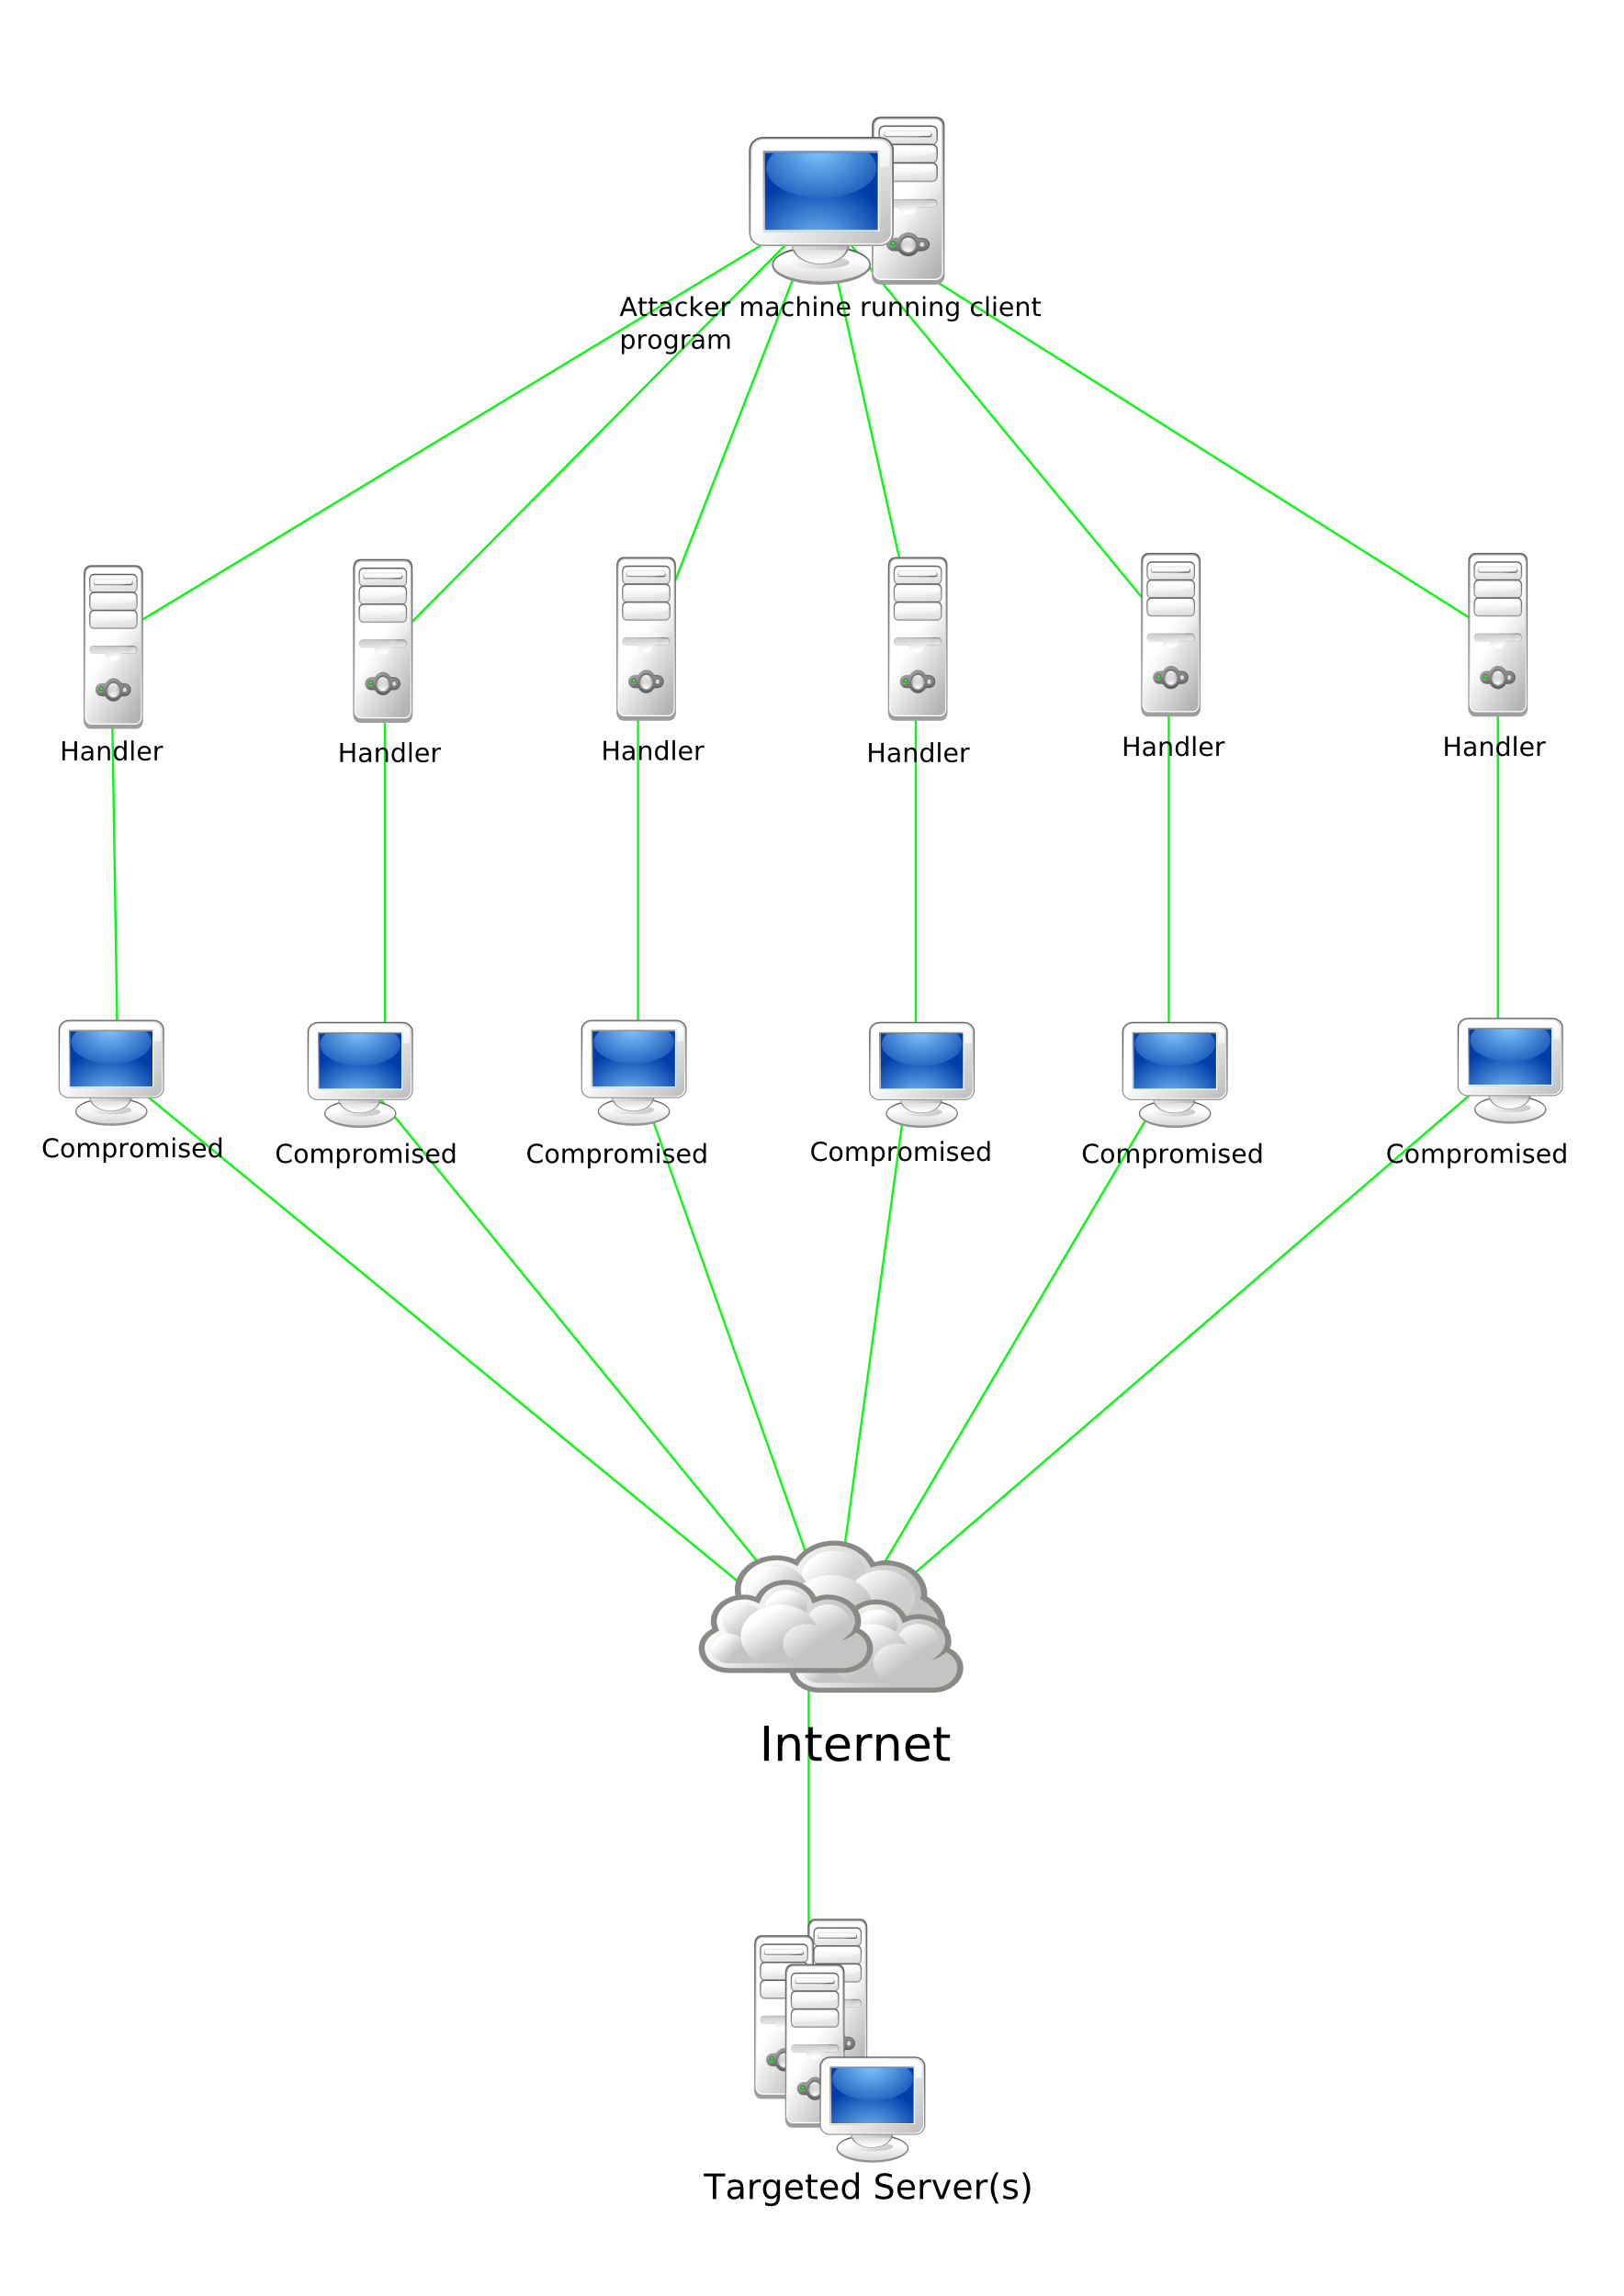
Event 35: Worldwide
It is July and a Distributed Denial of Service (DDOS) attack strikes the B&T sales website.
Notes:
Roll 12: epidemic. Participants to update score sheets (entering the zero impact).
Facilitator to adjust illness to suit region.
After ppts tally the impact from this event click on return arrow to move to the final year’s budget determination (slide 10) and subsequent decision making process for recommendation completion with the available funds.

Slide 142
Event 35: Worldwide
B&T’s emergency response procedures include cyber risks. The attack is resisted although sales are lost.
Loss of profit £100,000 (minus)
Notes:
Roll 12: epidemic. Participants to update score sheets (entering the zero impact).
Facilitator to adjust illness to suit region.
After ppts tally the impact from this event click on return arrow to move to the final year’s budget determination (slide 10) and subsequent decision making process for recommendation completion with the available funds.

Slide 143
Event 36: Worldwide
Nothing happens this month.
Profits increase £250,000 (plus)
Notes:
YEAR 3: Roll 2, warehouse fire in pallets

Slide 144
And the winner is…
Tally the scores in the profit statement
Transfer to total profit box at the bottom of the sheet
Notes:
CONGRATULATIONS!
Highest positive score wins!
Lowest property damage and interruption to business

Slide 145
Thanks for playing…
Key learning points
Share your reactions
Notes:
Facilitator to ask some ‘Processing’ questions during the debrief:
Players share and interpret their reactions (so what happened to your team / score?)
Players identify concepts from their reactions (so what did I learn?)
Players apply concepts to their own situations (so what now?)

Slide 146
Airmic Conference Workshop D7
Using predictive analytics to minimise property damage

