Slide 1
The Reality of Multinational Insurance Programs:
Challenges and Solutions with Cross Border Claims and Servicing

Slide 2
Content
Overview – Multinational Programmes 3
Structure 6
Freedom of Services 7
DIC/ DIL 8
FEL Endorsements 9
Examples 10

Slide 3

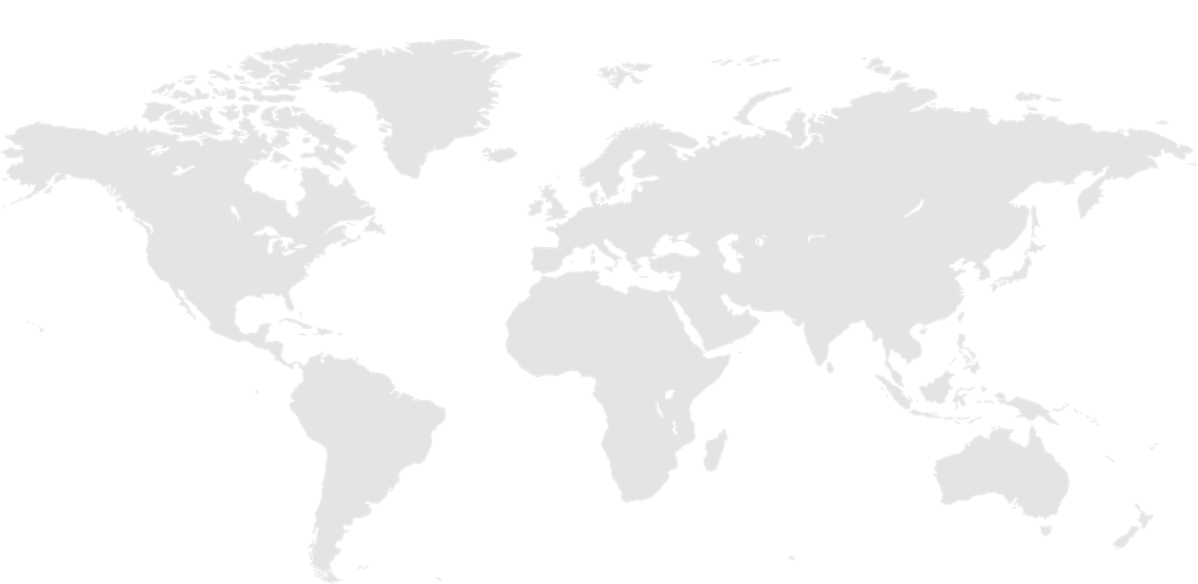
Overview MN Programmes
3 options to cover risks for customers with operations in more than one country
1
Decentralized approach:
One policy in each country, no link between them
2
Global approach:
Single policy from headquarters covering all countries
3
Multinational Program:
Master + Local policies with the same insurer
The solution for each client should take into account:
  Licenses which must be held by insurers and brokers
  Legal and regulatory rules
  Tax law (payment of premium tax in the country of risk)
  Mandatory coverage
  Proof of Insurance required by local operations
  Wording to be issued locally
  Communication between the parties
  Transparency
Notes:
Slide for Ana to go over the program types and the items to be taken into account

Slide 4

Structure - Challenges
Non-admitted permitted countries:
Countries where an insurer is permitted to write without licence on a ‘non-admitted’ basis
Australia, Canada, Chile, Germany, Peru, Sweden, UK, United States (conditionally)
In practice, many countries permit unlicensed insurance but impose differing levels of restrictions
Non-admitted prohibited countries:
Countries where an insurer (holding no license) is not permitted to cover risks in the relevant country
Most restrictive – Argentina, Brazil, China, India, Japan, Mexico, Russia, Switzerland
No easy dividing line between countries that permit non-admitted insurance and those that do not.

Slide 5


‘Freedom of Services’ (FOS)
What is it?
Ability for an insurer located in the European Economic Area (EU plus Iceland, Liechtenstein and Norway) and benefiting from necessary licenses to cover under one single policy risks from other EEA countries.
Policy is written in home country language (translation is not mandatory)
Cover matches risk manager’s needs
A single policy: simpler administration
Claim settlement is simple
No local fronting costs
Local client may need a policy in their own language, or adapted to specific requirements
Communication problems due to language, legislation and market practices, particularly during claim investigation
Access to some pools may not be possible under FOS
Notes:
Ana to explain this slide and Brexit

Slide 6
Overview - Multinational Programs
Non-compliance | Examples
Claims cannot be paid
Fines
Additional taxes charged on claims payments (income; increased capital)
Loss of license
Reputational damage
Personal jurisdiction – increased legal costs
Argentina - 2009 - local insured and broker fined for illegally transacting life insurance business with an unlicensed foreign insurer.
Brazil - 2011 - US insurer got a USD 6.2 billion fine for illegally selling life insurance in Brazil.
India - 2011 - local insured taxed on a claims payment paid outside of India to its corporate parent under a DIC/DIL clause in a master policy.
Non-compliance | Examples
Proof of insurance does not meet contractual requirements
Limits inappropriate to local risks
Master policy wording implemented locally instead if using local wording
Local Insured not able to obtain the keys for his newly rented shop because the insurance certificate provided does not match the requirements of the rental agreement
Insufficient limit in Australia because sales contract requests AUD 10M from an admitted insurer and local policy had 1M USD
Misunderstanding from local insurer on how to handle claims under a manuscript wording as clauses are not familiar to local market
Notes:
Graham to explain why option 3 is important and what are the non compliance issues affecting claims

Slide 7
Structure -DIC/ DIL
The local policy usually provides cover to a ‘good local standard’
The Master policy usually provides a broader scope of cover than the individual local policies
Difference in Limits (DIL) cover addresses the gap in limits between local and master policies
Difference in Conditions (DIC) cover closes the gap between the cover provided by the local and master policies
Master Policy
Coverage A
Coverage B
Coverage C
Coverage D
Local Policy
Coverage A
Coverage B
Coverage C
Coverage D
✓
limit
100
✓
✓
✓
✓
limit
10
✓
✗
✓
✓
DIC
✓
DIL

Slide 8


Financial Interest Clause
Issue:
In countries where ‘non-admitted is prohibited’, DIC/ DIL coverage under the Master Policy is not permitted for non-admitted insurers
Some specialty products are not available in every territory (Cyber, Crime, etc)
Coverage gap exists and / or local policy cannot be placed
Findings:
if a local entity is not covered locally, or not sufficiently covered,
since Master policy insurer can not indemnify local entity,
parent company suffers a financial loss
Solution under the Master:
Definition for ‘insured’ does not include local entities located in territories where non admitted is not permitted
+
Master policy indirectly provides an indemnity via the coverage of the financial interest of the parent company in the local entity

Slide 9


Claims Example (1)
The customer was global packaging company, headquartered in Singapore.
The customer’s Korea subsidiary received a claim from one of its clients about a non-conforming product (aluminum cans).
Metal particles were found outside the lid of the aluminum can, presenting a hazard to consumers.
The insured had a “controlled master” multinational program bound in Singapore.
It included a locally issued policy in Korea.

Slide 10
Claim Example (1) Q&A
Scenario:
Claim totals $4m and Local policy limit is $5m.
1. Who handles the claim?
Korean insurer
2. Who pays the claim?
Korean insurer Not so fast !
Did you check if local policy wording was covering that claim
3. Who is paid?
Korean local subsidiary

Slide 11

Claims Example (1) – When it Works Well
Claims handling in Korea; coordination in Singapore. Agreed claims protocol in place.
Claim required a payment to the customer’s Korea branch. Due to restrictions on non-admitted insurance in Korea, only a Korean licensed insurer was able to make claim payment.
Subsequent to settlement, insurer’s Korean office was reimbursed by Singapore office, which in turn recovered from customer in Singapore, eroding the aggregate deductible.
Notification following a regulatory investigation in Korea. Claim immediately reported by broker and customer in both territories.

Slide 12

Claims Example (1) – Summary of Issues
Communication – due to having a controlled, documented and clear claims protocol, the customer and broker at both local level and at head office were clear on the claim’s progress, coverage position, throughout the life of the claim. This was particularly important given language difficulties.
Control – the handling team in Korea were aware that the producing office, customer and broker needed to be informed about the settlement of the claim, even though claim was entirely covered within local policy terms.
Coordination – through use of Chubb’s local expertise in Korea, an expert metallurgist in Korea was able to be retained to enhance the claim outcome.
Outcome – the claim was paid in full and the deductible recovered from the customer in a fully compliant manner.

Slide 13

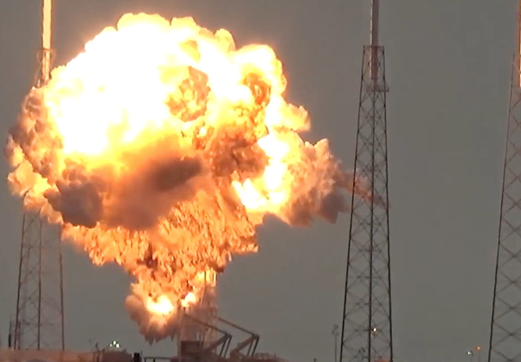
Claims Example (2)
Mining company based in Mexico with operations in several countries in Asia.
Substantial explosion in nickel refinery in Korea.
Local customer had limited insurance or legal expertise.
Global policy – no local policy in place!!

Slide 14
Claims Example (2) Q&A
Scenario:
Claim totals $40m
1. Who handles the claim?
Korean customer
2. Who pays the claim?
Mexican insurer
3. Who is paid?
Parent company in Mexico

Slide 15

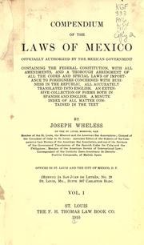
Claims Example (2) – Where it Can Go Wrong
Carrier’s license and operations confined to Mexico:
Unable to undertake claims related activity including retention of experts directly
FEL option
Customer’s claims servicing involvement greatly heightened:
Initial cost in engaging experts
Indirect cost associated with sending COO to subsidiary site for 3 months
Additional Implications:
Regulation prevented payment from non-admitted insurer
Payment to Parent – additional tax liability when transferring
funds to local subsidiary
Regulatory and Financial Scrutiny

Slide 16

Claims Example (3)
The customer was global packaging company, headquartered in Singapore.
The customer’s Korea subsidiary received a claim from one of its clients about a non-conforming product (aluminum cans).
Metal particles were found outside the lid of the aluminum can, presenting a hazard to consumers.
The insured had a “controlled master” multinational program bound in Singapore.
It included a locally issued policy in Korea.

Slide 17
Claims Example (3)
Scenario:
Claim totals $12m. Local Limit is $5m
1. Who handles the claim?
Korean insurer
2. Who pays the claim?
Korean insurer $5m
Singapore insurer $7m
3. Who is paid?
Korean subsidiary company - $5m
Parent company in Singapore - $7m

Slide 18

Purchasing/issuing local policies – the Claims advantages
In non-admitted prohibited countries (e.g. Argentina, Brazil, China, India, Japan, Mexico, Russia, Switzerland), local regulatory requirements are satisfied
Claims are paid in the local country
Follow local law and customs
Local language
Appropriate taxes paid in country
Appropriate wording issued as per local market practice

Slide 19

What is the claims conclusion?
Local policies are critical but having enough local limit and the right coverages is just as important!

Slide 20

Our Global Accounts proposition is based on client feedback:
People – dedicated expert teams built around your needs.
Presence – a global network and the financial strength to deliver on our promise.
Solutions – comprehensive cover for your traditional risks and innovative solutions, for emerging risks.
Technology – leading edge technology
that helps you manage your global programme.
Service – knowing the teams working on your account are ensuring it is compliant and comprehensive.
Notes:
What our Global proposition is built around…

