Slide 1
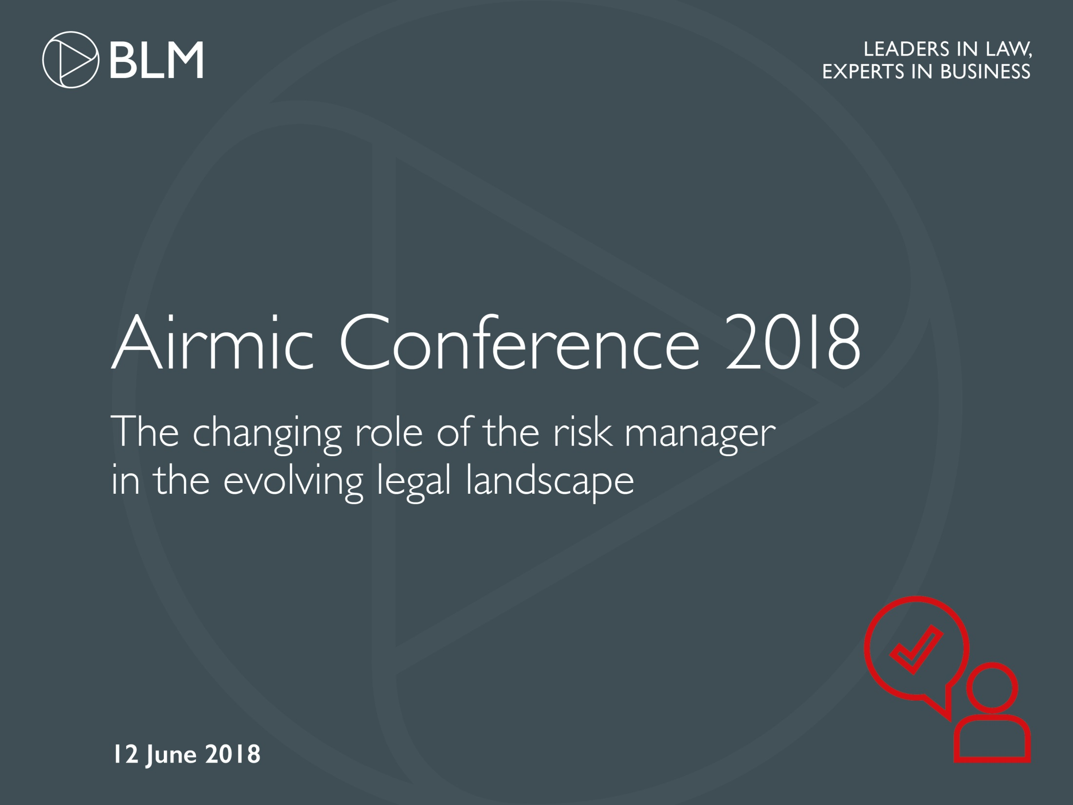

Slide 2

Introduction
Helen Grimberg
Partner
Helen.Grimberg@blmlaw.com
Insert Email address

Slide 3
GDPR: Implications for
Risk Managers and Directors
Nick Gibbons
Partner
Nick.Gibbons@blmlaw.com
Insert Email address

Slide 4
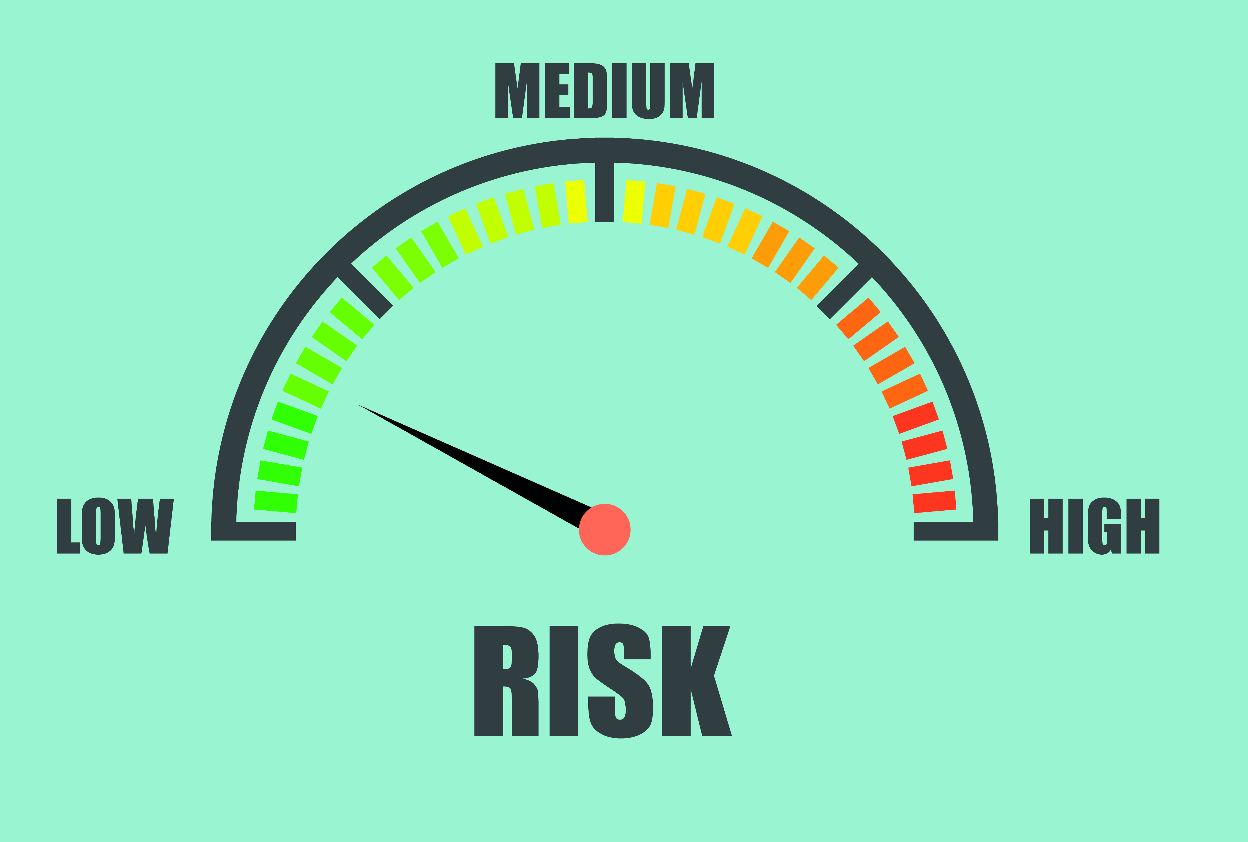
GDPR: Implications for risk managers and directors-summary
What you ought to have done already
Ongoing actions and responsibilities
Accountability is at the core of GDPR: data protection culture rather than a tick-box process
Data protection officer/data protection champion
Comprehensive records of data protection activities
Data protection incorporated into new
projects and initiatives:
Privacy by design
Impact assessments

Slide 5
GDPR: Implications for risk managers and directors-summary
  New third party suppliers and business partners must be checked for GDPR compliance
  Internal systems for dealing with notification, retention, deletion, transfer and subject access should be regularly road tested and robust
  Effective information security measures should be regularly addressed and maintained
  ICO’s “carrot” rather than a “stick” will not last forever: a failure to keep up with GDPR compliance could therefore lead to heavy fines and third party claims against an organisation and possibly claims against directors individually

Slide 6

GDPR : if you haven’t done it already…
  Make sure that decision makers and key people in your organisation are aware of GDPR and its impact
  Review your current data processing activities
  Document what personal data you hold, where it came from and who you share it with
  Establish necessary policies and processes to meet GDPR requirements
  Review how you are seeking, obtaining and recording consent
  Make sure you have the right procedures in place to detect, report and investigate a personal data breach

Slide 7
GDPR : if you haven’t done it already…
  Privacy Impact Assessments - work out how and when to implement them in your organisation
  If your organisation operates internationally, determine which data protection supervisory authority you come under
  Designate a Data Protection Officer or equivalent and assess where this role will sit within your organisation’s structure and governance arrangements
  Review current privacy notices
  Update your subject access procedures
  Look at the various types of data processing you carry out, identify your legal basis for carrying it out and document it

Slide 8

ACCOUNTABILITY IS AT THE CORE OF GDPR
“Arguably the biggest change is around accountability:
The new legislation creates an onus on companies to understand the risks that they create for others, and to mitigate those risks. It’s about moving away from seeing the law as a box ticking exercise, and instead to work on a framework that can be used to build a culture of privacy that pervades an entire organisation.”

Slide 9
Should you appoint a dpo?
Article 37 of the GDPR creates a new obligation to appoint a data protection officer in one of three cases:
If you are a public body
If your core activities require regular and systematic monitoring of data subjects on a large scale
If your core activities involve large scale processing of sensitive data and data relating to criminal convictions
If you don’t have a DPO you should have a Data Protection Champion (“DPC”)

Slide 10
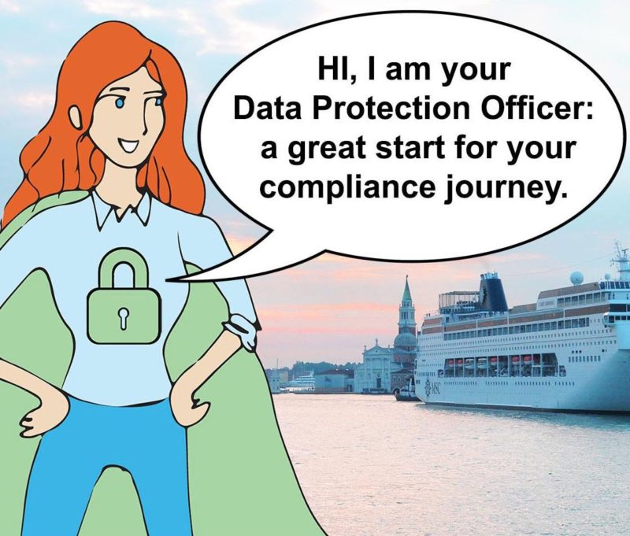
DPO: MINIMUM TASKS
Minimum tasks that a DPO must undertake:
Informing and advising their colleagues of their data protection obligations
Monitoring compliance with the GDPR and the organisation’s data protection policies
Providing advice regarding Privacy Impact Assessments
Co-operating with the relevant supervisory authority
Acting as a contact point for the supervisory authority on data processing issues

Slide 11
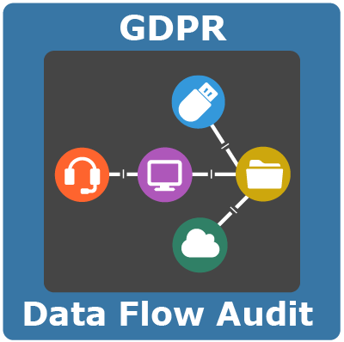
Ongoing data checks
What kind of data is being collected and stored, where and why?
Which different departments/teams store their own data?
How is the data used both internally and externally?
How long is the data retained?
Who has access to the data both inside and outside of the firm?
What procedures and controls are in place to keep data safe?

Slide 12
Risk Managers and directors must raise and maintain GDPR AWARENESS
Who needs to be aware
What do they already know
What do they need to become aware of?
Plan initiatives
Training
Assessment
Documented policies and procedures
Board and management knowledge and buy in

Slide 13
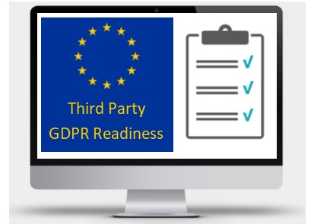
arrangements with NEW third parties
Understand what they do (controller/processor) and what data they process
Contract compliance – ensure that you have a fit for purpose contract in place (cf article28)
Management activities to include the specific breach reporting requirements – maintaining control or a relationship that enables both you and the third party to collectively adhere to the GDPR
Enhance your existing monitoring arrangements to ensure ongoing compliance

Slide 14

GDPR Article 32
Data security measures should, at a minimum, allow:
Pseudonimysing or encrypting personal data
Maintaining ongoing confidentiality, integrity, availability, access, and resilience of processing systems and services
Restoring the availability of and access to personal data, in the event of a physical or technical security breach
Testing and evaluating the effectiveness of technical and organisation measures

Slide 15

WHAT SECURITY MEASURES SHOULD BE IMPLEMENTED
Article 32 flexibility in determining which additional technical measures best ensure data security but Data Controller must document an evaluation of the measure along four criteria:
STATE OF THE ART
PROCESSING PROFILE
RISK PROFILE
COST

Slide 16
DATA PROTECTION BY DESIGN AND DEFAULT
Embedded into the design
Default setting
Support accountability
Maintain transparency
Safeguards

Slide 17

Fines and claims
Fines
Third Party Claims against organisation
Claims against Officers and Directors

Slide 18

ICO APPROACH TO GDPR BREACHES
ICO has a blog on GDPR:
‘This law is not about fines. It’s about putting the consumer and citizen first. We can’t lose sight of that. Focusing on big fines makes for great headlines, but thinking that GDPR is about crippling financial punishment misses the point.
And that concerns me.
It’s true we’ll have the power to impose fines much bigger than the £500,000 limit the DPA allows us. It’s also true that companies are fearful of the maximum £17 million or 4% of turnover allowed under the new law. But it’s scaremongering to suggest that we’ll be making early examples of organisations for minor infringements or that maximum fines will become the norm. The ICO’s commitment to guiding, advising and educating organisations about how to comply with the law will not change under the GDPR. We have always preferred the carrot to the stick.’

Slide 19
RISK AND CLAIMS IMPACT OF
TECHNOLOGICAL ADVANCES
John Lambert
Associate
E: john.lambert@blmlaw.com
Insert Email address

Slide 20
OVERVIEW
The pace of change
Insurance – The Big Data Revolution
Mind the gap!

Slide 21

THE PACE OF CHANGE

Slide 22
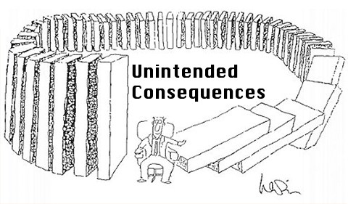
THE PACE OF CHANGE

Slide 23


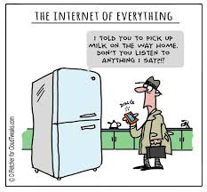

THE PACE OF CHANGE

Slide 24

THE BIG DATA REVOLUTION!

Slide 25

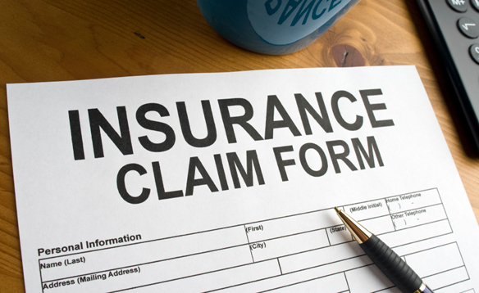

THE BIG DATA REVOLUTION!

Slide 26
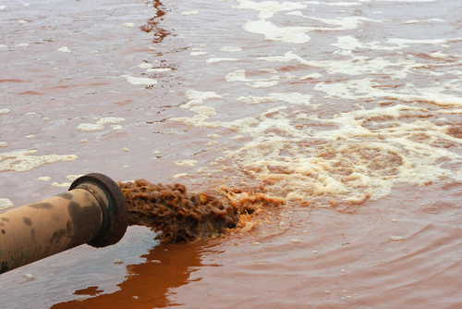


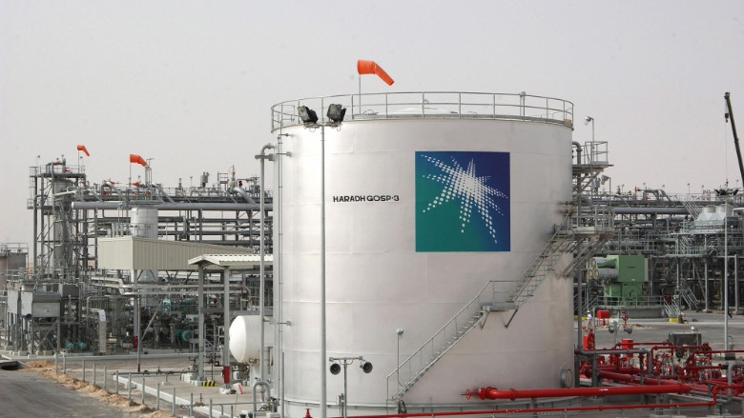
MIND THE GAP!

Slide 27
MIND THE GAP: CONSEQUENCES
Property damage
Network interruption
Data corruption
Theft of Intellectual Property
Cyber extortion
Resultant damage

Slide 28


Slide 29
Minimising risks against D&O’s
and pressing your advantage
Ross Baker
Partner
Ross.Baker@blmlaw.com
Insert Email address

Slide 30
OVERVIEW
Key Risks for D&O’s – Broker Pulse Survey
Macroeconomic changes
Increased regulation
Cyber risks and GDPR
Corporate governance requirements
Corporate prosecution and personal responsibility
Dishonesty - Legal changes to the test

Slide 31
D&O AND COMPANY KEY RISKS IN 2018
BLM Broker Pulse Survey May 2018– Key Risks for UK companies and D&O’s:
85% data breaches
56% Brexit/political instability
43% regulatory investigations and prosecutions.
Still a poor take-up of D&O insurance among SME’s

Slide 32
MACROECONOMIC CHANGES
Brexit
Weak pound
2017 General Election
Rising inflation
Rising interest rates
Wage squeeze
Slower consumer spending growth
Looming consumer debt crisis
Slowing housing market

Slide 33
Increased regulation
Small business, Enterprise and Employment Act – 2015
Deregulation Act 2015
Modern Slavery Act - 2015
Changes to business rates – April 2017
Immigration skills charge – April 2017
Criminal Finances Act 2017 – September 2017
Markets in Financial Instruments Directive II – Jan 2018
Pension auto-enrolment – Feb 2018
Data Protection Act – May 2018
General Data Protection Regulations 2018 – May 2018
AIM Companies: New Corporate Governance requirements – September 2018
Proposed Reform of the UK Corporate Governance Code – January 2019

Slide 34
CYBER AND GDPR
Impact of the GDPR on Directors and Officers
Basic Principles which D&Os should be aware of:
How does personal liability arise?
Regulatory exposure
Civil exposure

Slide 35
CORPORATE GOVERNANCE REQUIREMENTS
25th Anniversary of the UK Corporate Governance Code
Leadership
Effectiveness
Accountability
Senior Managers regime requiring a statement of responsibilities

Slide 36
CORPORATE prosecutions and personal responsibility
Corporate Prosecutions:
Record fines and penalties
Deferred prosecution agreements
Personal responsibility of Directors:
Consent, connivance, and neglect
Disqualification and compensation orders

Slide 37
DISHONESTY TEST
Dishonesty: Civil vs Regulatory vs Criminal standards
Civil: claims alleging breach of fiduciary duty, deceit, dishonest assistance, fraudulent misrepresentation, coverage disputes
Regulatory: solicitors, accountants, directors’ disciplinary proceedings
Criminal: Criminal facilitation of tax evasion, conspiracy to defraud, other offences under the Fraud Act 2006 etc.

Slide 38
DISHONESTY TEST
Established civil test for dishonesty is in: Barlow Clowes International Ltd v Eurotrust International Ltd [2006] 1 All ER 333
“If, by ordinary standards a defendant’s mental state would be characterised as dishonest, it is irrelevant that the defendant judges by different standards”

Slide 39
DISHONESTY TEST
Regulatory & Criminal test was: R v Ghosh [1982] QB 1053 – Court of Appeal held there were two parts:
Whether according to the ordinary standards of reasonable and honest people what was done was dishonest (the "objective test"); and
If it was dishonest by those standards, whether the defendant himself must have realised that what he was doing was by those standards dishonest (the "subjective test").

Slide 40

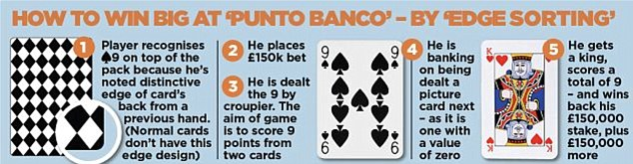
DISHONESTY TEST
Ivey v Genting Casinos (UK) Ltd [2017] UKSC 67
Edge-sorting discovered in £7.7m win
Player advantage or dishonesty?

Slide 41
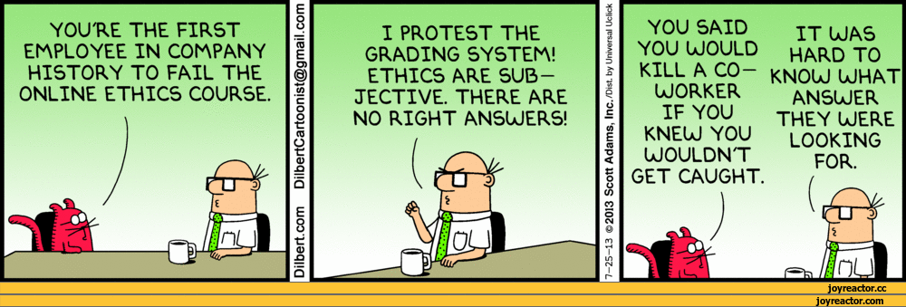
DISHONESTY TEST
Ivey v Genting changes the test in regulatory and criminal cases - Barlow Clowes’ test now applies universally to all cases
Increased focus on integrity and the higher standards expected of professionals

