Slide 1

Airmic 2018 Conference
Human Capital, your most important asset or your biggest risk
12 June 2018

Slide 2
Three quotes at the core of our workshop
‘Your most precious possession is not your financial assets. Your most precious possession is the people you have working there, and what they carry around in their heads, and their ability to work together.’
Robert Reich
Former United States Secretary of Labor
‘It takes 20 years to build a reputation and five minutes to ruin it’
Warren Buffett
'The Oracle of Omaha'
‘Leaders who have strengths in tune with the risk culture of their organisation will have the courage, empathy and ability to take risks in harmony with the organisation’s objectives and will be the foundation for tomorrow’s corporate success’
Julia Graham
Deputy CEO and technical director, Airmic
Notes:
Show of hands -- companies in the room who say people people are their biggest asset – [check in their annual report/website to get exact figure]

Slide 3
Human Capital
‘An aggregation of attributes, including not only skills but also numerous personal characteristics, that determine how productive people are in their workplaces and in society in general’ (Goldin, 2016)
Human Capital is a strategic asset
Strategic assets are key capabilities, core resources and relationships that create value and give the business a unique competitive edge for sustainable success.
The employee is the secret in the sauce and glue that holds organizations together– without ‘right’ employees, other assets are valueless (Leslie Black)
Human capital is more important today than ever
Jobs involving routine tasks are increasingly replaced with knowledge-based roles.
As computers replace workers in performing routine, codifiable tasks, they also amplify the comparative advantage of workers in supplying problem-solving skills, adaptability, flexibility, interpersonal interaction and creativity. (Autor, 2015)
Unprecedented networking of the world’s people and their data are creating new ways of working. Companies that can best aggregate and leverage the collective intelligence distributed throughout their organisation and within their information systems can solve complex problems and gain competitive advantage.

Slide 4
High performance companies leverage their human capital and get results
3x
7.3
operating margin
fewer days lost
high sustainable engagement companies’ operating margins are 3x higher than those with the lowest levels of engagement
    an average of 6.2 days lost per year for employees with high engagement vs. 13.5 days lost per year for the disengaged
49%
    lower retention risk
      Only 15% of employees with high engagement are high retention risks compared to 64% of disengaged employees
Source: Willis Towers Watson Global Workforce and TM&R Studies

Slide 5
What good looks like…
What differentiates high performance cultures from an employee perspective
Leadership, reputation, talent management and customer focus are the marks of excellence
Excellence
Emphasis
Effectiveness
* Willis Towers Watson normative database 2018
Notes:
We took data from our high performance norm 2016 and compared it to the global average 2016
High performance companies have superior financial performance vs their sector, typically measured by ROIC
We grouped the categories into three groups, according the size and significance of the difference to the global average

Slide 6
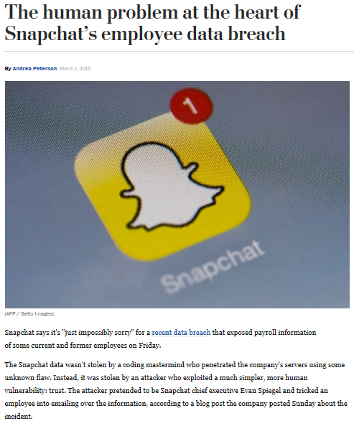

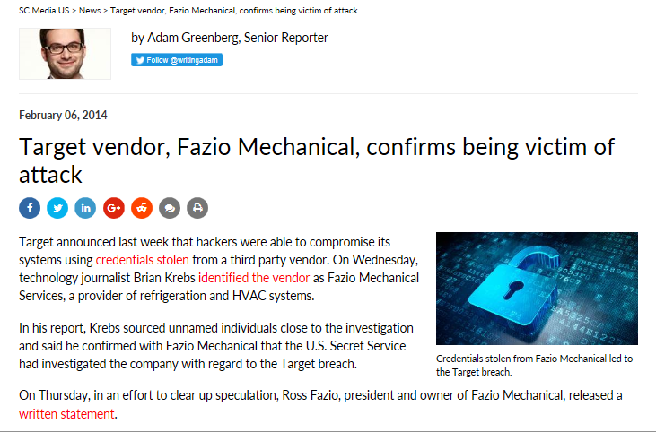
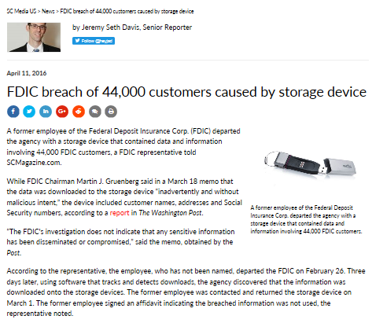
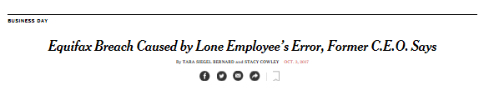
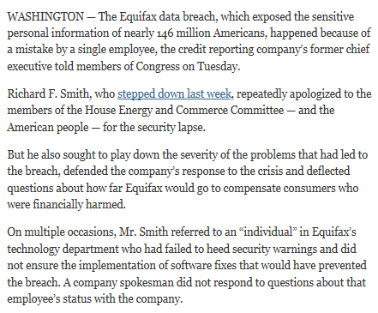
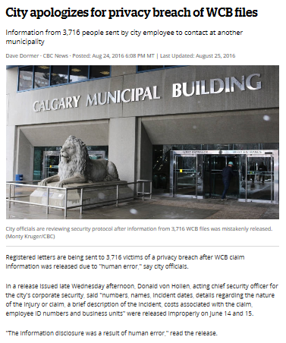
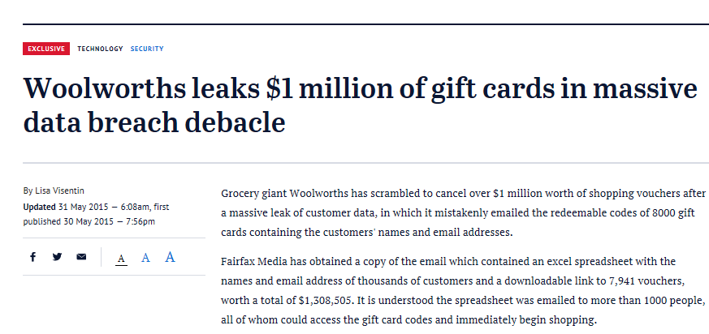
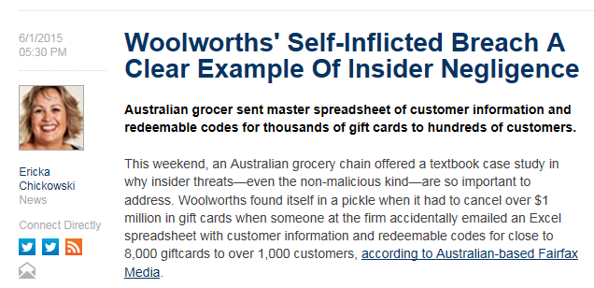
When things go wrong…

Slide 7
In the workplace, people risks are everywhere and culture is at their heart
HR Planning
Succession
Talents/skills supply
Performance
Productivity and quality standards
Health & safety
Environmental & social responsibility
Supplier relations
Organisational culture
Performance orientation
Service orientation
Internal collaboration
Learning, improvement and innovation
Engagement
Shared values
Adherence to code of conduct
Diversity & Inclusion
Reputation and legal
Employer brand
Customer service reputation
Integrity and fairness
Cyber security
Data protection
Rewards
Leadership
Behaviour
Strategic, change and
decision making capabilities

Slide 8

Today, we will focus on Cyber Risk
One of the biggest risks organisations face today
69%
$400b
$148b
The percentage of cyber claims related to employee-driven incidents
Source Willis Towers Watson, 2018
Estimated annual cost of
Cyber crime to global economy
Estimated market size in 2021.
Insurance and L&D fastest growing
Funds lost
from Cyber attacks are unrecoverable
4,000
68%
Ransomware attacks per day in 2018
554
million personal records breached in 2018 alone
Top 3
Most cited concern across industries
£2.7m
Average cost of a data breach in 2017

Slide 9
Time for a mini benchmarking exercise…. Airmic vs. the world!
Have you ever used the same password for more than one platform, system, accounts etc.? Yes/No
Have you ever personally experienced a cyber breach either at home (hacked emails, loss of data, financial loss etc.) or at work? Yes/No
Have you ever shared a password with another person (colleague, spouse, family member, lover, etc.,)? Yes/No
Have you ever used a “simple” password, e.g. all lower case, all numbers, birthday date, sequenced number e.g., 1234 etc.? Yes/No
“By applying these behaviours to the behaviours of a typical company employee, it’s easy to see how hard it is for HR, IT or Risk offices to promote strong passwords on a company network. No security system will be bulletproof if the human users aren’t doing their part to maintain only authorized access to the system.”*
Notes:
Do you use, or have you used, the same password for more than one platform, system, accounts etc.? Yes 39%
Have you ever personally experienced a cyber breach either at home (hacked emails, loss of data, financial loss etc.) or at work? Yes 64%
Have you ever shared a password with another person (colleague, spouse, family member, lover, etc.,)? Yes 41%
Have you ever used a “simple” password, e.g. all lower case, all numbers, birthday date, sequenced number e.g., 1234 etc.? Yes 25% /No

Slide 10
Within the broader risk landscape, Cyber Risk is one of the most common topics of concern amongst global organisations today
Vulnerabilities around valued assets
  The pace of business and the processes in place to manage work have created many challenges:
    Employees pressured to make productivity gains, even as resources are more constrained
    Increasing use of external suppliers, contingent & remote workers, temporary staff
    Increasing use of cloud storage technologies
  Busy people, more and different types of workers & tools → heightened vulnerabilities
  The explosion of information in organisations creates more and more data to manage:
    Personally identifiable information about employees, customers, suppliers
    Information on pending patents or other innovations
    Passwords (to access confidential information)
    Client lists, financial performance, nature of work undertaken
Resulting business risk: cyber breach & theft
With more and more valued information sources ever more vulnerable, organisations face increasing risk from cyber breaches and thefts – unauthorised attempts to steal company information and data for malicious purposes

Slide 11
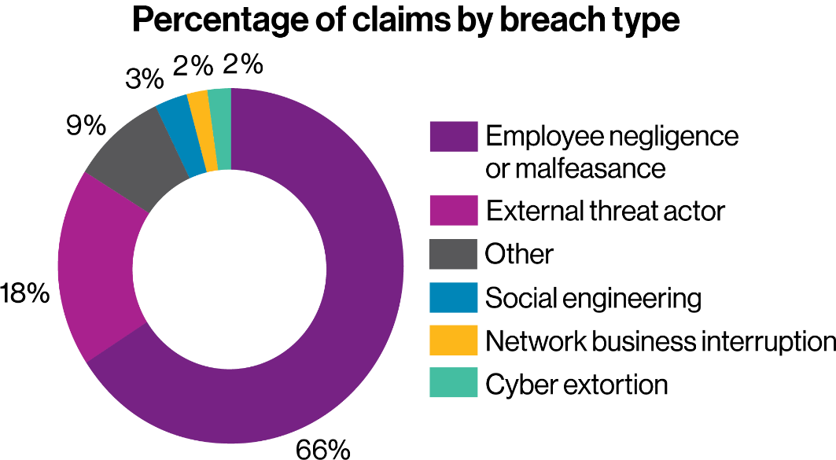
Willis Towers Watson claims data: employee are top source of breaches
  Negligence or malicious behaviours are the most common source of cyber incidents
  Workplace culture can therefore have a major influence in mitigating cyber risk

Slide 12
Companies know that digitization is essential for sustainable performance
Connected employees who are supported by good technology add new value to their organisation
Digitalization amplifies employee creativity, adaptability, ability to solve problems
Virtual brainstorming unlocks creative idea generation
Better collaboration, more innovative solutions
Ongoing exchanges across employees shape company culture
Employees find responses to their questions rapidly
New hires quickly reach high levels of productivity
Employees understand what they need to do to grow and develop
Employee engagement and productivity increase
The organisation reaches high performance levels

Slide 13

At the same time, companies aspire to develop a culture of cyber security
Companies have adopted a wide range of cyber risk management activities, but few have embedded them into their company culture
Which of the following best describes what your organization has accomplished in your cyber risk strategy to date and what you expect to accomplish in the next three years?
Culture of
Cyber Security
Communicate
and Deliver
Adopt
Strategy
No Strategy
Source: 2017 WTW Cyber Risk Survey, employer survey, US.
Today
In 3 years
Risk leaders can also be culture shapers!
Notes:
Now let’s look at the response coorporations are giving to that threat and what they are planning
Today
Limited risk management strategy to tackle cyber
Almost no cyber security culture actions with employees
What s really interesting is where corporations want to be and see themselves in the next 3 years
No strategy: Implemented various risk management activities but have not formally articulated a cyber strategy
Adopt strategy: Adopted and articulated a cyber risk strategy with stated objectives and goals for each program
Communicate and deliver: Effectively communicated the cyber risk strategy with stated objectives and goals to employees
Culture of cyber security: Embedded cyber risk management within our company culture

Slide 14
I have met with my HR counterpart within the last year.

Slide 15
In high performance organisations, risk and people management have much in common
Risk Management Lens | HR Management Lens
Risk & Resilience is a standing boardroom topic. Leaders see risk as an opportunity to innovate and find new revenue streams | Leaders set challenging, realistic and inspiring goals & objectives to deliver sustainable business performance
Integrated and automated response capabilities, including crisis management and coordination of resources to minimize long-term impact | Develop change leadership capabilities: enable, involve, inform and build trust
Know what are the most vital assets and their value. Assess risk to understand exposure and levels. Use data analytics to audit, log, monitor. | Measure the right things to bring focus on what matters
Show flexibility and agility to adapt and continually improve protection mechanisms. Use incidents constructively. | Shared commitment to deliver quality results and to continuous improvement
High performance, integrated defence and response systems linked to operational and financial risk management systems. | Adopt technologies that enhance productivity, paying attention to the people aspects of the implementation.
Understand that no matter how good the technology, it is collaboration and information sharing that are needed to expose security gaps | Understand cohesiveness and teamwork are essential. Focus on collaboration within departments, across functions and countries.
Everyone understands the need for strong governance, user controls and accountability for risk and is trained to respond | Hire the right people, then focus on engagement, growth and development
Shape behaviours through performance management and remuneration | A rewards strategy aligned with the business strategy so that employees strive for the right goals. Managers engage in an ongoing dialogue with employees on performance
Internal communications focus on transparency and finding solutions | Listening organisation that encourages feedback and thoughtfully manages communications.
Cristal clear customer communication strategy and requirements if an incident occurs | Customer at the heart of business decisions
Leadership
Analytics
Agility & Progress
Technology
Collaboration
Training
Accountability
Communication
Customer Focus

Slide 16
Approaches companies are using to shape a strong cyber risk culture

Slide 17
Someone in my team is involved in the on-boarding process for new hires .

Slide 18

To shape a risk-resilient culture, consider the whole employment lifecycle
Is risk embedded in the assessment process and in the selection feedback?
Do we have the right talent to meet our risk objectives?
RECRUITING
What do we tell applicants about our risk appetite, tolerance, culture and behaviours?
What’s our reputation around risk?
Is risk awareness training included in the on-boarding process?
If yes, who delivers that training?
BEFORE JOINING
ON BOARDING
SHAPING A
RISK-RESILIENT
CULTURE
How do we measure our risk resilience?
Do we collaborate to meet our risk objectives?
Do we involve employees in fostering a positive risk culture at work?
Is risk embedded in performance goals?
Are strong cyber risk behaviours rewarded?
How do we deal with inappropriate behaviour?
PERFORMING
DEVELOPING
What risk & compliance training is currently in place? What are the characteristics of a great risk training program?
Are employees aware of their own risk profile?
LEADING
What’s our leaders’ vision for risk? Do senior leaders promote and communicate the desired cyber/risk culture and demonstrate their commitment?
What is our Executive Team’s collective risk profile?

Slide 19
Our Execs have recently gone through an assessment of their leadership style.

Slide 20
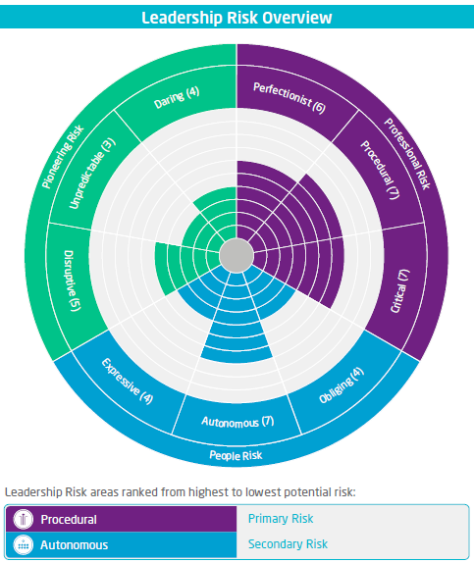
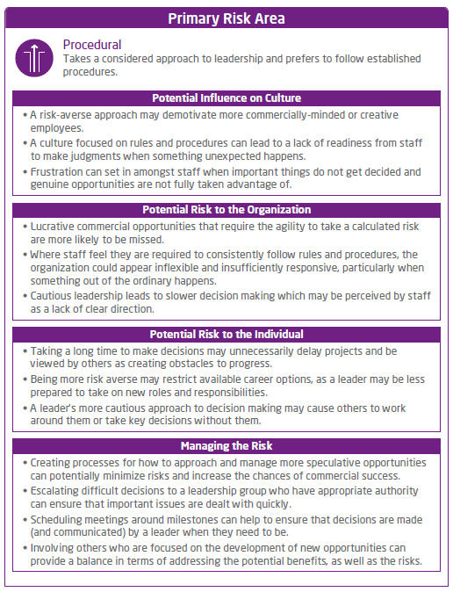
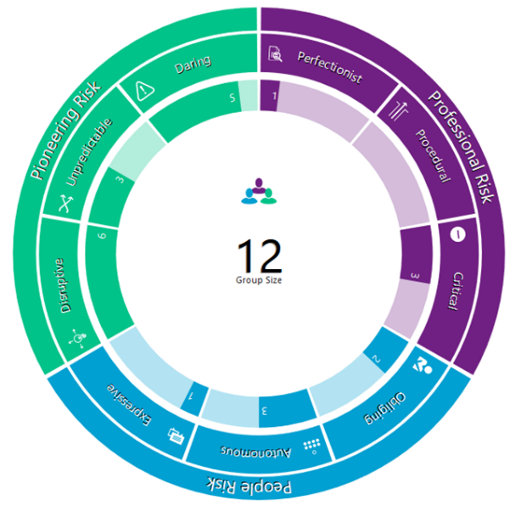
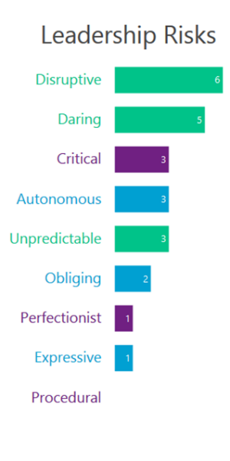
Use psychometrics to help leaders recognise their individual risk profile
Aggregate results to identify potential blind spots within the leadership team
12
Group Size
Individual Risk Profiles- in-depth analysis of a leaders’ behavioural style and risk characteristics. providing individual actions, advice and guidance to manage individual risk behaviour and drive appropriate organisational risk culture
Leadership Team Dashboard- highlights group risk characteristics and overall risk propensity

Slide 21
Some leadership behaviours go a long way...
Leading change, shaping a strong risk culture and building a learning organisation all call for the same set of skills
Inform
Involve
Enable
Build trust and influence others through their own behaviour

Slide 22
Some leadership behaviours go a long way…
Leading change, shaping a strong risk culture and building a learning organisation all call for the same set of skills
Inform
Involve
Enable
Understand threats
Share vision for risk culture
Set expectations for risk management
Use a shared risk language, discussing threats in relation to business goals
Launch awareness campaigns via videos, posters, newsletters
Regularly publish relevant statistics
Articulate desired employee behaviours
Crowdsourcing
Continuous feedback channels
Drive accountability for risk-aware practices
Appoint risk champions in every department to keep others motivated
Encourage cross-functional collaboration to expose security gaps
Empower decision making
Offer high quality risk training
Provide resources, processes and tools to support secure behaviours
Build change readiness and capability, to ensure agile and flexible responses to evolving threats
Run simulation exercises to test automated and integrated responses
Make it easy for employees to report suspicious email messages
Build trust and influence others through your own behaviour
Demonstrate personal commitment
Increase physical presence in the workplace
Invite open and mutually trustful dialogue
Explain how data from simulations and mock-attacks are being used

Slide 23
All our employees have to complete a yearly cyber risk training program.

Slide 24
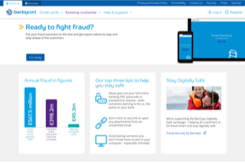
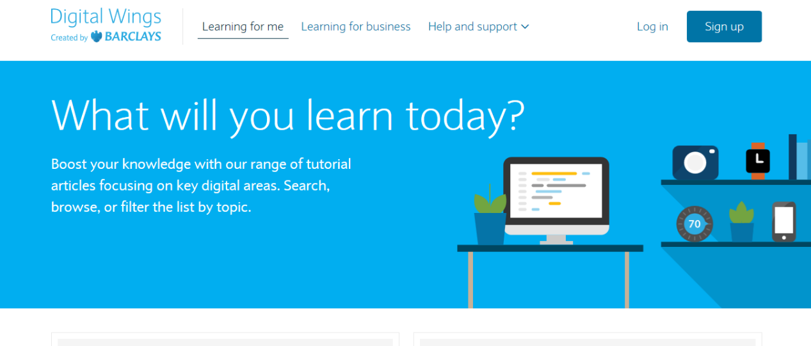
Adopt a comprehensive and engaging risk training program
Reinforce, refresh, evolve
Planned -- formally
Continuous – monthly/quarterly training cycles, not a once-a-year event
Tailored -- by employee populations but required for all
Diverse – gaming, simulated attacks, mobile delivery, in-person
Engaging – current, fun and rewarding
Extended -- to partners and suppliers
Did you know…
Last year, only 20% of companies in the UK reported having staff attend cyber security training in the past 12 months
Mock-phishing provides invaluable insights, but can harm the trust relationship between employees and leadership

Slide 25
We’ve conducted a risk culture survey in the past two years.

Slide 26
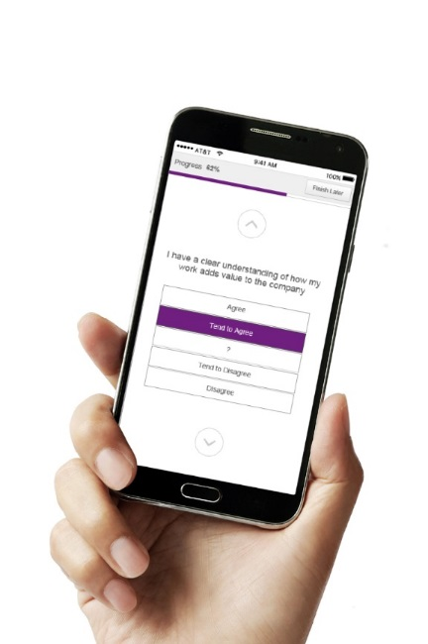
Conduct a (cyber) risk culture assessment
Survey employee attitudes and behaviors to discover vulnerabilities, create awareness, drive action and reduce risk
 | Agree | Tend to Agree | Don’t Know | Tend to Disagree | Disagree
Our leaders have developed a clear risk management strategy | □ | ☑ | □ | □ | □
As far as I know, risk management is mainly the responsibility of our risk management function. | □ | □ | □ | □ | ☑
I understand the impact on our business if we fail to manage risks effectively | □ | □ | ☑ | □ | □
I feel we have sufficient opportunity to discuss risk management issues with other people in the business. | □ | □ | □ | ☑ | □
There’s a constructive working relationship between people in the Risk function and other parts of the business. | ☑ | □ | □ | □ | □
People receive positive recognition for alerting management to risks that may threaten our business. | □ | □ | ☑ | □ | □
Risk management is incorporated in the evaluation of my performance. | □ | ☑ | □ | □ | □
As far as I can tell, people here always follow our risk management policies and procedures. | □ | ☑ | □ | □ | □
It is clear who I should approach if I spotted a risk management issue. | □ | □ | □ | □ | ☑

Slide 27
Our research on cyber risk culture
Cybersecurity Culture refers to the knowledge, beliefs, perceptions, attitudes, assumptions, norms and values of people regarding cybersecurity and how they manifest in people’s behaviour with information technologies.
ENISA (European Union Agency For Network and Information Security)

Slide 28
Employee opinions in organizations experiencing data breaches
    To understand how culture matters to cyber risk, we searched for organizations that experienced a data breach AND for which we conducted an employee survey prior to that breach
    We identified 33 such organizations with data for analysis
    Using their survey scores, we compared the 33 organizations to two
    survey benchmarks:
    The Willis Towers Watson Global High Performance Norm – a benchmark of companies with above-sector average financial results over three years (involves all employees in the comparison)
    The Willis Towers Watson Global IT Functions norm – a benchmark from IT workers in over 500 companies (involves ONLY the IT staff, a critical function in cyber defense, in the comparison)
    Environments experiencing cyber
    breaches lack these
    aspects of employee experience:
  Purpose tied to customer centricity – responsiveness, anticipating needs, optimizing processes
  Work marked by speed & flexibility in making decisions and managing teams
  People practices that empower staff through voice, respect, and support for teamwork
  People practices that stress training & development and aligning pay with performance
1
2
3
4
    These results have specific implications for cyber resilience
    and require human capital practices that drive employee experience in ways that mitigate risk…

Slide 29
Willis Towers Watson point of view on Risk Culture
Risk culture is fundamental and individual to each business
Risk culture can be articulated, measured and actively managed
It is important to take account of both directly observable and psychological factors
Managing risk culture is about controlling risks and also ensuring opportunities are not missed
Managing risk culture is multi-functional, so working across the business is key.
Changing any aspect of culture takes time but progress can and should be monitored
Current practice is mixed - many organisations are now making significant progress, others are being left behind

Slide 30
Our people managers discuss risk as part of the individual performance evaluation process.

Slide 31
Embed risk in the performance management and rewards processes
Set clear goals while giving perspective, provide frequent feedback and reward positive behaviours
Define the performance that matters
  Explain why managing risk is part of everyone’s job
  Reinforce the reporting of hazards or unsafe actions
  Encourage participation in (cyber) safety shares
  Suggest leading a session for their team on risk and safety
  Focus on prevention (e.g., completion of training program by required date, voluntary participation in skills improvement program; participation in cross-functional teams on risk management)
  Make sure employees understand how their performance will be measured
Give frequent feedback
  Provide feedback on their security behaviours at formal performance appraisals and continuously
  Connect positive behaviours and behaviour changes to rewards
Reward positive behaviours
  Use both social (praise, recognition) and tangible rewards
  Ensure senior leaders acknowledge outstanding security behaviours
  Offer rewards that are aligned with company culture
  Agree and communicate in advance appropriate sanctions for non-compliance with security policies and practices
  Publish blogs and stories on positive responses to security and safety threats

Slide 32
Key takeaways

Slide 33
Risk and HR, comprehensive cyber solution. What does good look like? Cultural elements, typically owned by HR are critical. HR has an important role to play and should be closely involved with the Legal, IT and Risk functions.
Diverse ways to manage cyber risk
Assessment:
Measurement + Analytics
Protection:
Mitigation + Transfer
Recovery:
Incident Resilience
Cyber Risk Identification
Cyber Insurance Placements & Programs
Talent Management & Alignment Strategies
Claims Management
Cyber Exposure Quantification
Facultative & Treaty Reinsurance Solutions
Internal Communication & Awareness Programs
Forensic Accounting
Incident Response Consulting
Captive Reserve Funding Solutions
Human Capital Risk Assessments
Incident Communications
Cyber Risk
Culture Survey
Cyber/Silent Cyber Aggregation Modelling
IT Security Services
Business Continuity Consulting
Leadership Risk Assessments
Incident Response
(forensics, mgmt, legal, PR, HR)
Risk Assessments & Analytics
Technical Cyber Assessments

Slide 34
What does this all mean for you?
People risk is an important part of your job today. To be effective as risk leader, you have to move into ‘people stuff’ and work with HR
You have an opportunity to influence the risk behaviour of executives and to shape a positive risk culture that will enhance the reputation of your organisation
Identify those elements of your culture and processes that most impact real life outcomes and prioritise work on improving them
Ensure you can evidence your risk culture (e.g. to Executives, to the Board and to Regulators)
Work with HR colleagues to embed risk awareness at the ‘moments that matter’ across the whole employment lifecycle

Slide 35
What this mean for risk management
Rather than reacting to symptoms, there is a more proactive way to influence behaviours in the workplace
危机
Wéijī
(Crisis)
机会
Jīhuì
(Opportunity)

Slide 36
“The role of security is not to prevent advancement, but should be to enable and protect the business in order to thrive in a digital world inherent with risk.”
Nicola Burr
Cyber Security Manager and Blogger

