Slide 1

Enemies at the Gate
Inside the Attacker's Mindset

Slide 2
Presenters
Patrick Crumplin
Director, Disputes &
Investigations
patrick.crumplin@duffandphelps.com
20 years of investigations and forensic accounting experience in private practice as well as with the police and regulatory authorities.
Fellow of the Association of Chartered Certified Accountants.
MSc in Investigative Psychology.
Effie Lounta
Vice President, Disputes & Investigations
effie.lounta@duffandphelps.com
OSINT specialist in fraud, asset recovery, and corporate intelligence.
7 years of experience in forensic accounting and investigations.
Member of the Association of Chartered Certified Accountants.
MSc in Forensic Accounting.
James Weare, CISSP
Vice President, Information Security
james.weare@duffandphelps.com
Experienced pen tester and cyber incident responder.
7 years industry experience in Security Operations, Audit, and Infrastructure.
Background in Financial Services & Capital Markets.

Slide 3
Agenda
INTRO
01 Our Amazing, Flawed Decision Making
  How do we make decisions?
  How can an attacker interfere with the decision-making process?
02 An OSINT and Doxxing Primer
What is OSINT, and how can it be used against you?
Where do social engineers get this information?
03 How We’ll Socially Engineer You
What is the impact of social engineering?
How can we protect against social engineering?

Slide 4
Does Social Engineering really hurt?
The average number of emails needed to create an entry point in a company:
Just 5. ¹
The median time to discover an attack performed via SE:
1 year.
Victims usually don’t realise they’ve been compromised:
Attacks are typically discovered by third parties.
¹ According to a study by Invincea in 2015.

Slide 5
How much does it hurt?
91% of cyber attacks start with a phishing email. ¹
Organizations spend $3.7 million, and five hours of employee time per employee every year on phishing attacks. ²
And a successful spear-phishing attack costs on average $1.6 million.³
¹ From a report by PhishMe in 2017.
² According to research published by the Ponemon Institute in 2015.
³ Based on research by Vanson Bourne published in 2016.

Slide 6

What can you do to fix it?
Most investments are made in technological solutions:
  Spam filtering
  Network content monitoring
  Signatures-based malware detection
The most important component of your cyber security program is your employees.
Source: urbanitariosdf.org.br

Slide 7

What can you do to fix it?
Source: imgflip.com

Slide 8
Our Amazing, Flawed Decision-Making
1

Slide 9

Fundamental problems
As good as we are at making intuitive decisions, we are easily influenced and sometimes irrational.
The Monty Hall Problem
1
2
3

Slide 10

Gateways & Gatekeepers
3,500 gateways = 3,500 gatekeepers
What about automation?
“Driver blames Tesla Autopilot for Beijing accident”
“HMRC under fire over wrongly issued fines for ‘late’ tax returns”
“How technology led a hospital to give a patient 38 times his dosage”
People remain an essential part of our organisations.
Source: proofpoint.com

Slide 11

The decisions we make
Computers do what they are told… people, not so much
Millions of data points processed every second
Heuristic based decision making
  Conscious and sub-conscious
  Assumptions and generalisations
  Approximations and based on limited information
  Quick & efficient
  Works most of the time, but not all the time; and
  Can be interfered with
Notes:
Citation

Slide 12
Heuristics, bias and the social engineer
Cognitive bias and risk
  Confirmation bias
  Group attribution and groupthink
  Hot-hand fallacy
  Automation bias
  Forer effect
  Stereotyping bias
Good social engineers have an inherent understanding of how to drive behaviour in a particular direction and emotion plays a significant role.

Slide 13

The drivers of social engineering
Trust
Contempt
Respect
Acceptance
Anger
Envy
Fear
Greed
Curiosity
Surprise
Empathy
Embarrassment
Source: propertycasualtyfocus.com

Slide 14

It’s not all doom and gloom
Intuition and common sense are the skills we bring
  ability to recognise behavioural, linguistic and cultural irregularities
  common sense ‘smell test’
Ability to behave in a predictable and rational manner
Source: shutterstock.com
Notes:
Citation

Slide 15
An Open Source Intelligence and Doxxing Primer
2

Slide 16
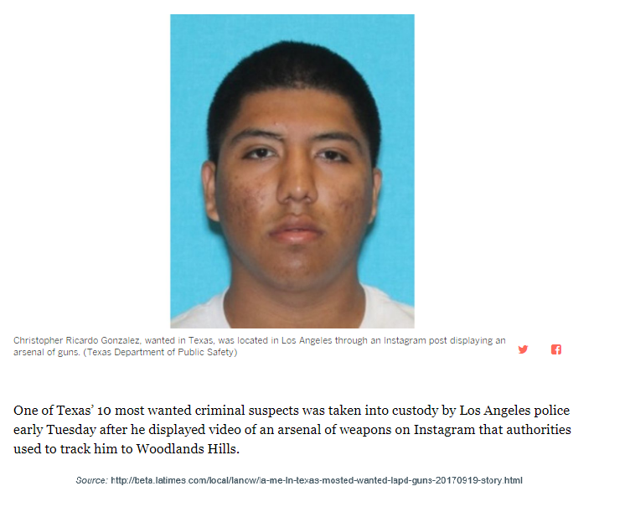
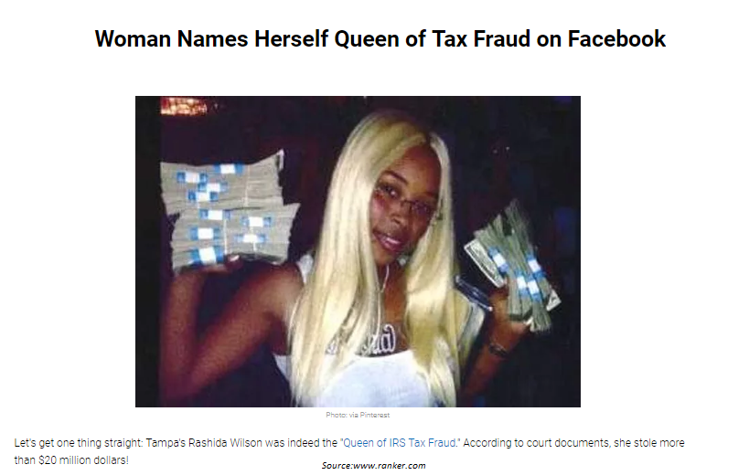
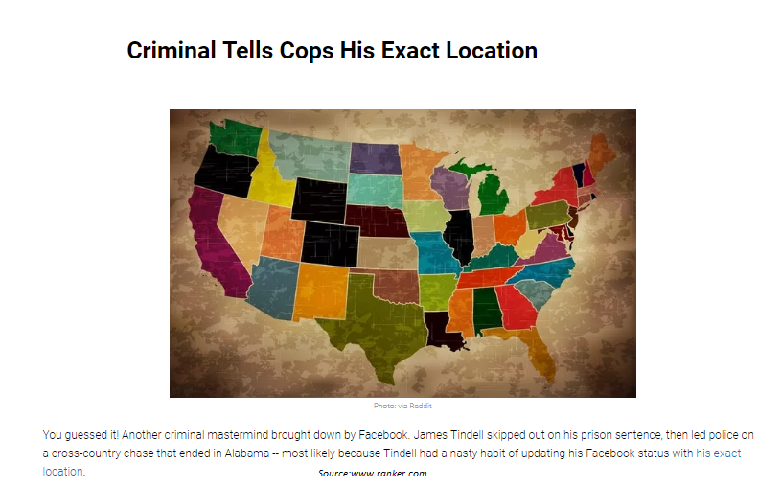
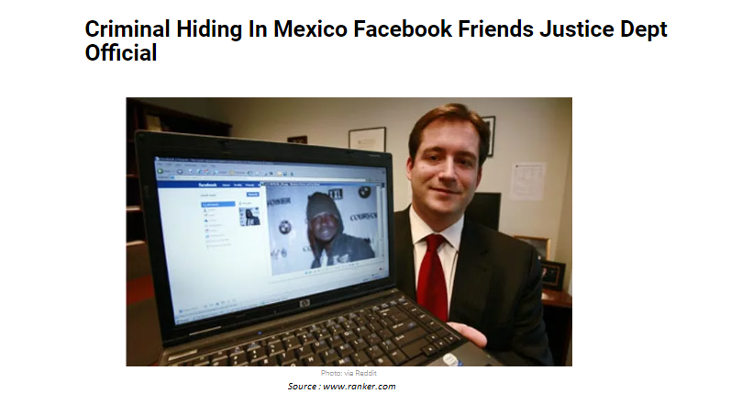
Cases in the news

Slide 17





A case study in asset tracing
Case Background:
A bankrupt individual made a payment to our subject just before he was made bankrupt. A client wanted to locate the subject to serve him notice regarding the money transfer.
Investigation:
UK residency database
Social Media Interrogation
Family connections and lifestyle

Slide 18

Segments of the Web
‘Clear’ Web
Google, Wikipedia, etc.
Approximately 4% of web content
‘Deep’ Web
E.g. Dynamic web pages, sites requiring credentials
Remaining 96% of web content
Includes the ‘dark’ web
‘Dark’ Web

Slide 19
OSINT
OSINT: Open Source INTelligence
OSINT is the aggregation and analysis of publicly available information. This includes media, Social networking sites, Blogs etc…
Traditional
Methods
Companies House
Land registry
Electoral roll
Legal records
Traditional
Methods
Advanced Search Engines
Social media sites
Deep web
Dark web
Archived web pages
Modern
Resources
Modern
Resources

Slide 20

DOXXING
Notes:
Citation

Slide 21
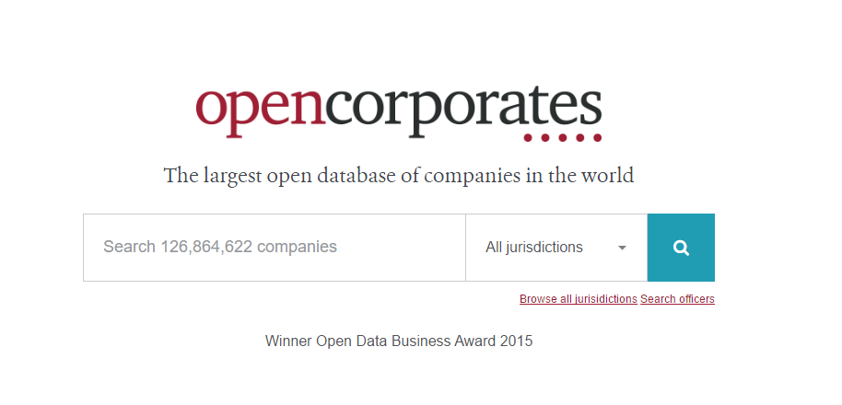

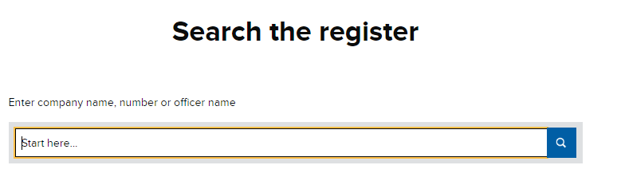
Company searches
Some sources for investigating companies
and beneficial owners:
Open Corporates
Companies House of the relevant country
Black Book Online – US based

Slide 22




People searches
Research the directors and employees of a company - current and previous.
Review websites like glassdoor to find out employees that would be disappointed or frustrated with the targeted company.
Build up a relationship chart.

Slide 23
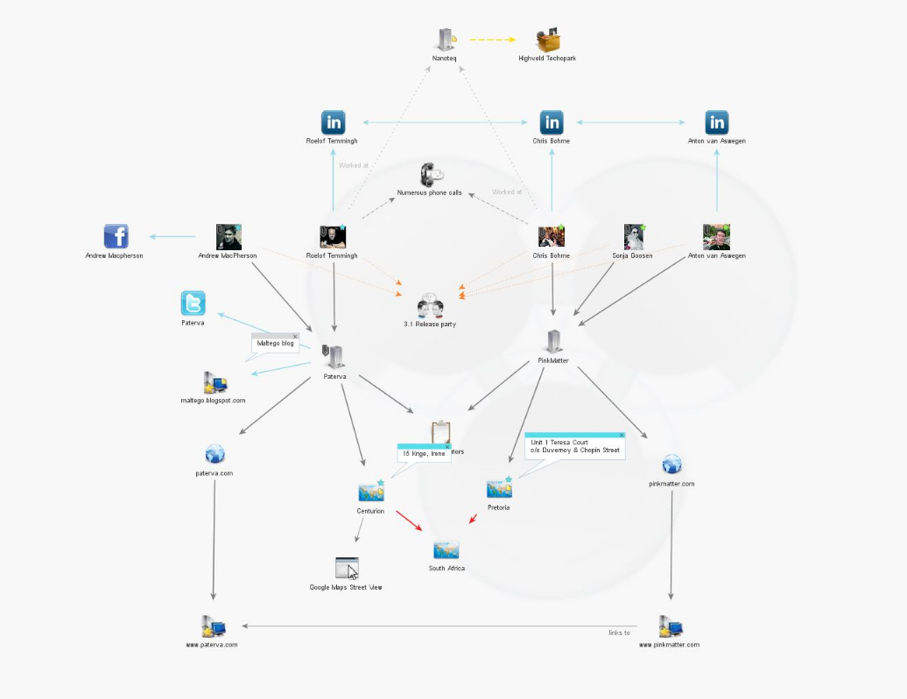

People searches - Maltego

Slide 24
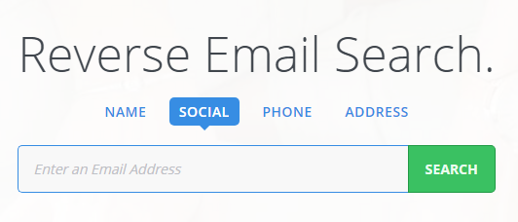
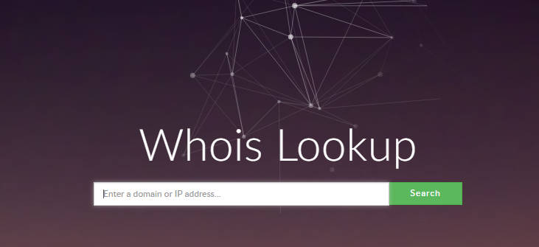
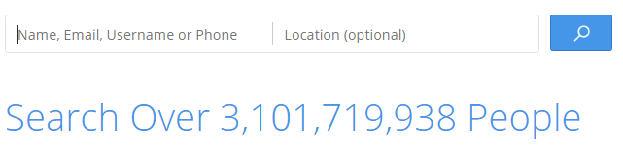
People searches
Once the employees have been found and a target list has been created then we can start investigating their online presence.
Using an anonymous account we would review the targeted employees’ LinkedIn accounts which would provide us with a phone number or an email address.
With minimal information we search online databases to find their social media profiles.
Gather information regarding the domain name, IP and email addresses of the target company.

Slide 25
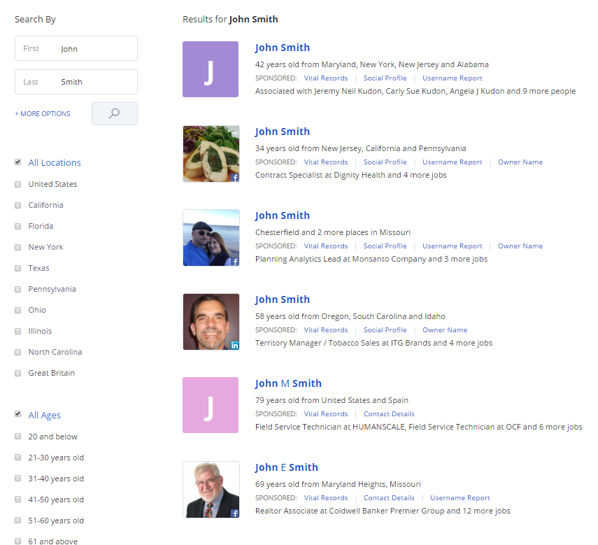
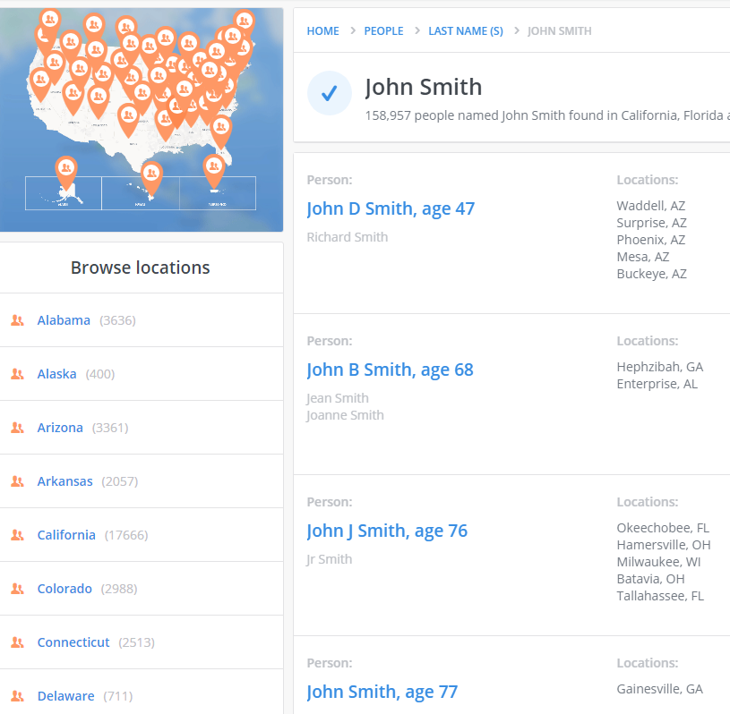
People searches – Example

Slide 26



Other Investigative Tools
Internet Archive
Email validation
Newspaper archives
Domain and IP address searches
Online communities (i.e. reddit)
Username searches
Notes:
Add detail on sites that trade in SE techniques

Slide 27












































Social Media

Slide 28
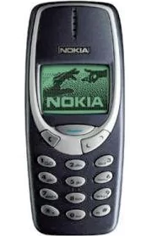
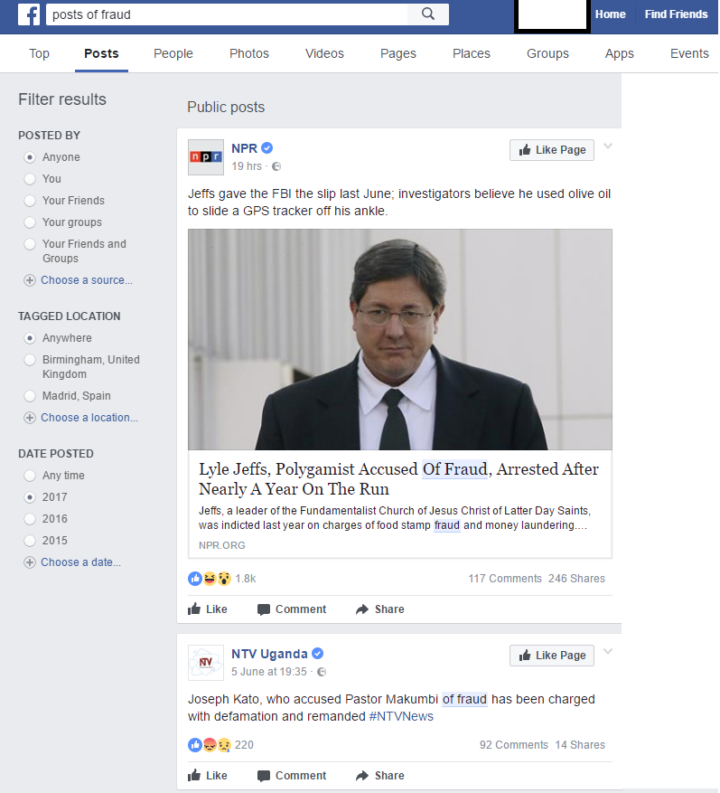
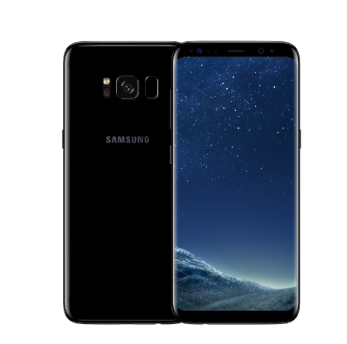
Advanced Facebook searches
Basic Facebook Search
Searches for friends or groups etc…
Source: www.telegraph.co.uk
VS
Advanced Facebook Search
Pictures of [Name/phrase]
Photos in [Location] uploaded by friends [or Name]
Friends of [Name of individual] who are [Single] and live in [Location]
Posts of [Name/ Phrase] who like [Name of Group]
Source:www.samsung.com

Slide 29
Twitter
Searches like Fraud 2018 would search for Tweets containing both “fraud” and “2018”. This is the default operator.
Like Google Advanced searches, there is the Advanced Search for Twitter either using the search operator or the Advanced Search option below:
Using the Search operator
Just adding “” to the “fraud 2018” phrase will return tweets that contain the exact phrase.
Other ways to search:
#fraud
Fraud filter:links
News source:twitterfeed
DID YOU KNOW
that in a Twitter search it is possible to find tweets obtaining positive or negative sentiment using the search operators and adding ☺ and ☹ ???

Slide 30
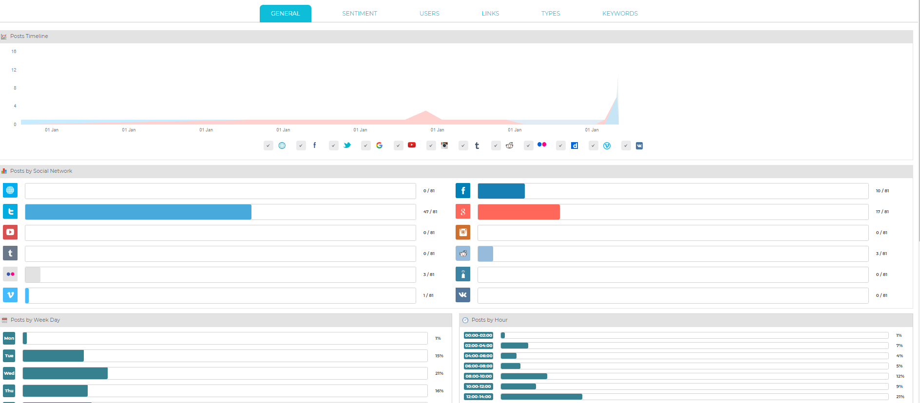
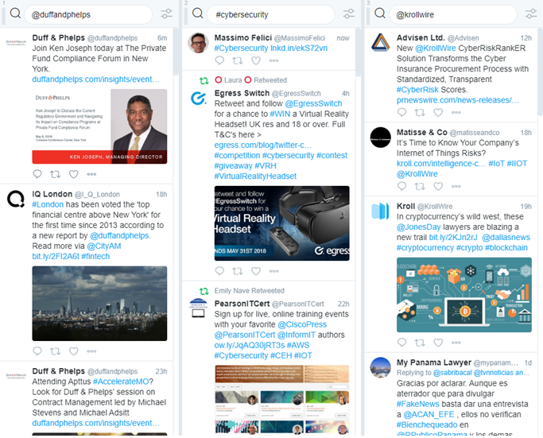
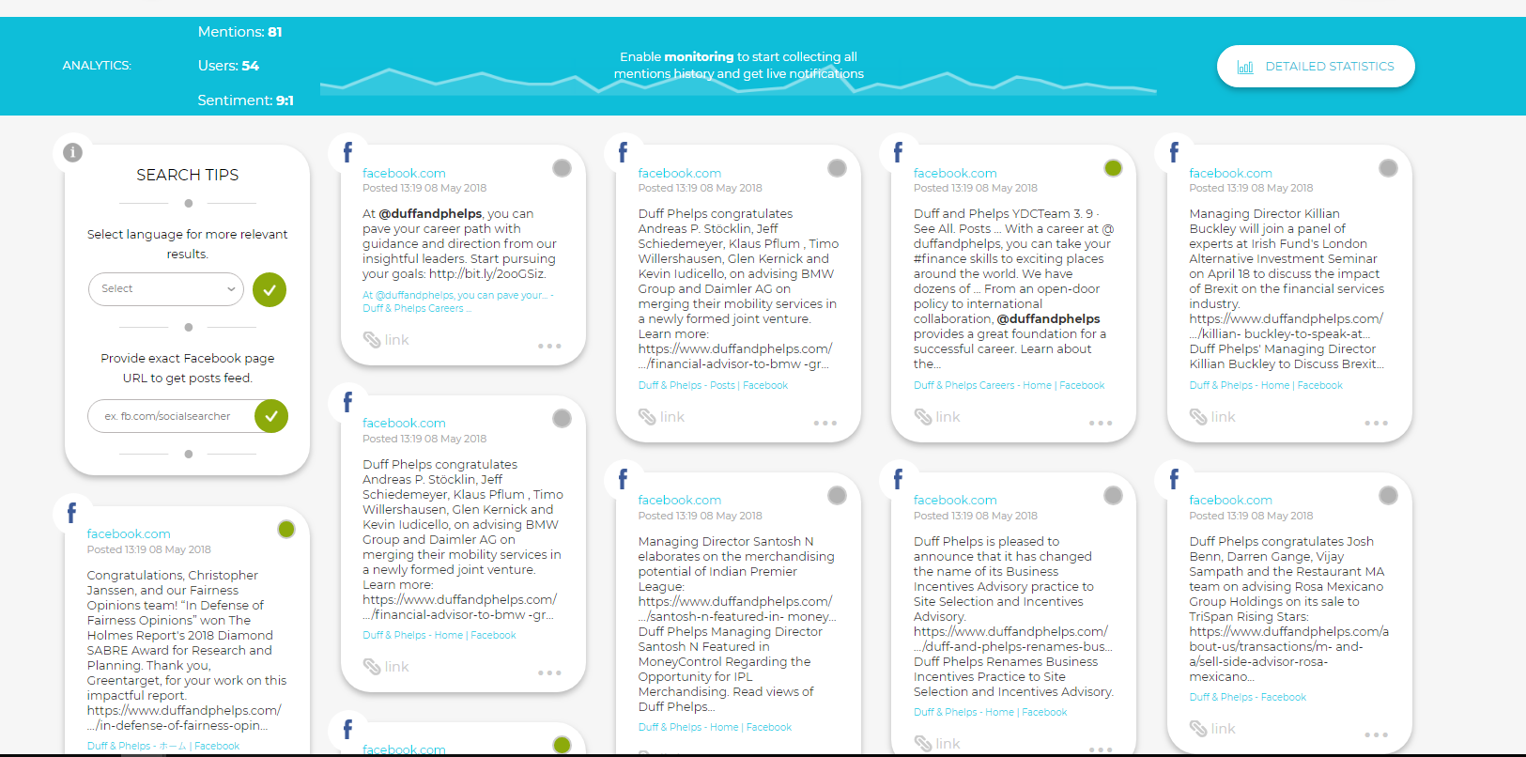
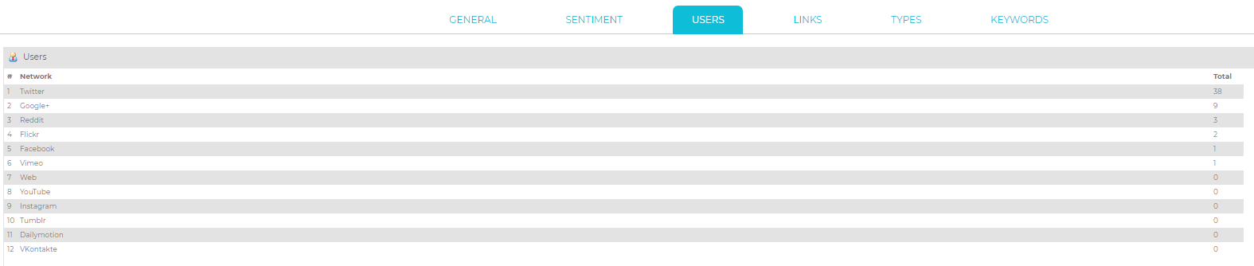
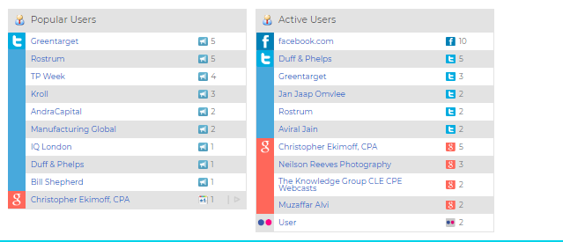
Monitoring online presence

Slide 31
How We’ll Socially Engineer You
3

Slide 32

Social Engineering Capture the Flag
Annual event at DEF CON in Las Vegas, NV
In 2016, event also included Derby Con in Louisville, KY and covered brands such as:
  Disney
  Nintendo
  Sony
  GE Appliances
  Papa John’s International
  …and 15 others
Source: social-engineer.org

Slide 33
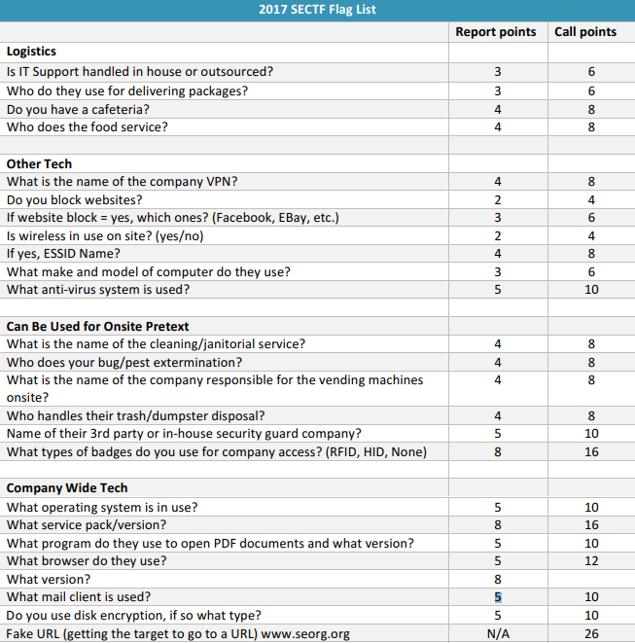
Social Engineering Capture the Flag
Results:
The mean score per company was 121 points.
Notes:
This means most companies got scored on around 25-40 times.

Slide 34
Social Engineering Capture the Flag
Results:
The mean score per company was 121 points.
Standard deviation was 82 points.
Notes:
Obviously, some companies have taken their security awareness training more seriously!

Slide 35
A Few Definitions

Slide 36
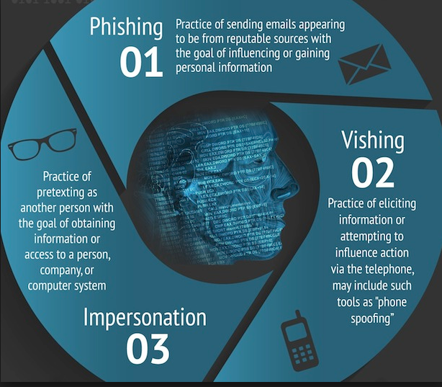
Phishing, Vishing, Smishing, Whaling…
Phishing
Vishing
Smishing
Spear-Phishing:
Targeted phishing
Whaling:
Phishing a high-profile individual to get them to reveal personal or confidential information
…or make a big payment
Source: social-engineer.org
Notes:
The upshot here is that most of these attacks are all variations on a common theme: using fraudulent communications to get you to disclose confidential information.

Slide 37
Pretexting/Impersonation
Hi, this is Carl from IT…
Some pretexts are much more effective than others
Creative pretexts:
  Journalist requesting an interview
  Package delivery
  HVAC vendor
Notes:
Better to explain by example…
In-house IT can be trusted, right?

Slide 38
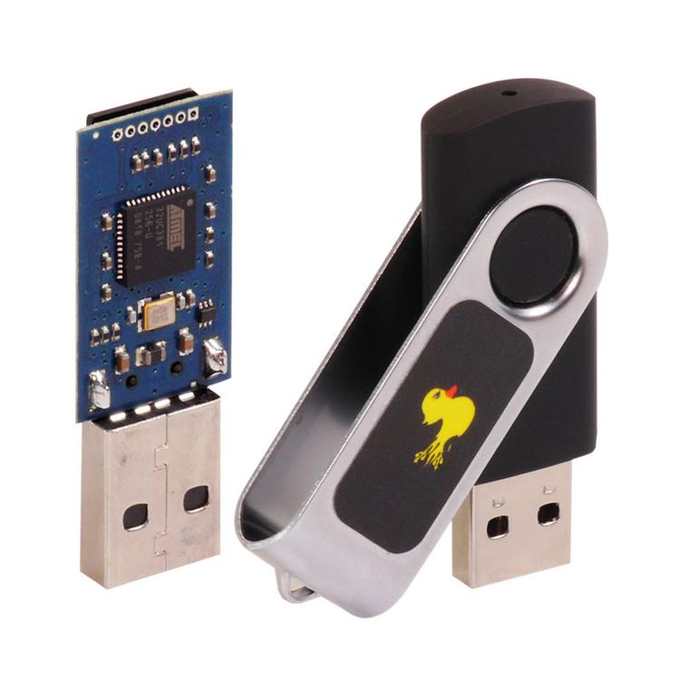
Device Dropping
Step 1: Buy a USB stick
Step 2: ????
Step 3: PROFIT
… Just kidding.
Step 1: Buy a USB stick
Step 2: Add malware
Step 3: Plant that USB stick in a parking lot, or hallway, or in a conference room
Step 4: Own the network
Source: hakshop.com
Notes:
A lot of people think this can’t possibly be effective, but…

Slide 39
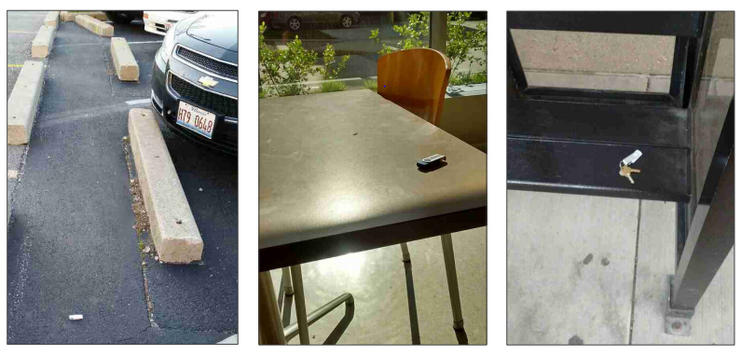
Device Dropping
This really works!
At Black Hat 2016, researcher Elie Bursztein presented research on this topic, dropping 297 USB sticks at the campus of UIUC

Slide 40
Exploitation

Slide 41



The next step: Exploitation
Plugging in some OSINT:
From LinkedIn, we can learn about your corporate structure and org chart, job titles, team associations
Facebook and Instagram can tell us what you’re doing
Monster, GlassDoor, and Indeed can tell us what kind of technology your company is using or looking to make use of
Source: Various Social Media Sites

Slide 42

The next step: Exploitation
Use collected OSINT
  Impersonate IT staff, and call Jeff (LinkedIn)
  Ask Jeff about how his new laptop is working out (Monster/Indeed)
  Tell Jeff you’re calling because Mike, Jeff’s colleague, is on vacation today (Facebook) and you need access to a system that Mike runs (more LinkedIn)
Source: totalpc.info
Notes:
Reminder: In-house IT can be trusted

Slide 43

The next step: Exploitation
With access to the network, let’s do a little reconnaissance
  File shares
  Servers & workstations
  Applications
Source: amazon.com
Notes:
File shares: documents about your internal processes and policies
Servers: Emails
Applications: Finances

Slide 44
The next step: Exploitation
Now, let’s use what we’ve learned
Our target has a new CEO
They want to expand their business in China
They make large payments to their Chinese vendors on a variable schedule
Payments are often authorized by the CEO and a particular executive

Slide 45

The next step: Exploitation
Craft a very convincing phishing e-mail
  Direct the payment to an account you own
  Add a dash of urgency (it turns out this payment is overdue!)
  Make it look like the CEO is the sender
  Send it to the executive

Slide 46
The ‘Fake President’ scam
Pretend to be a high-ranking executive to forward large payments
Nearly 16,000 reported victims in 2017
Exposure totaling in excess of $675 million¹
Other Social Engineering Compromises
Friday afternoon fraud
Forged badge entry & conference room calamity
It’s not just about the $$$
Proprietary and personal data get lost in many of these breaches
GDPR fines will increase the cost substantially
¹ According to the FBI’s IC3 report in 2018.
Notes:
Friday Afternoon Fraud: Real estate fraud involving closing of transactions

Slide 47
Let’s Ask Again:
What can you do to fix it?

Slide 48

What can you do to fix it?
Education is crucial
  Many organizations can run phishing tests to train employees
  Often this requires a major culture shift to empower employees to question everything
Essential requirements
  Realise our flaws
  Be suspicious
  Don’t underestimate the lengths that a social engineer or hacker will go to
  Be aware of the diversity of information out there
  Standard, clear, simple polices and processes
  Clear and rehearsed procedures for unusual or emergency situations
Source: canstockphoto.com

Slide 49

What can you do to fix it?
Incident response planning
  When you have an incident, make sure you know how to mitigate it
And some technology:
  Better spam filtering
  Ransomware prevention (deny attachments)
  OSINT due diligence reviews
  Social engineering penetration testing
Source: himaya.io
Notes:
IR → GDPR, insurance req’s

Slide 50

Q&As

