Slide 1
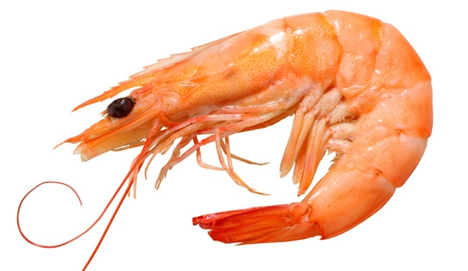

Managing Risk and Opportunities in a Connected World
Notes:
Jkp – conundrum

Slide 2

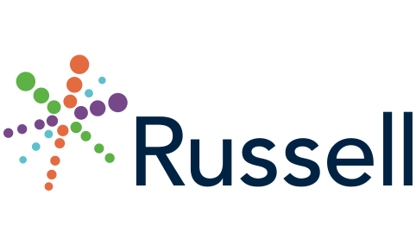
Managing Risk and Opportunities
In a Connected World
A new initiative to support
Strategic Business Strategy in today’s
Interconnected Landscape.
Russell Group Limited
2018
Notes:
jkp

Slide 3
Agenda
Russell Group
What is Connected Risk
Our progress so far
Interactive risk and opportunity workshop
Summary and final questions
This is a workshop - do please ask questions as we go
Notes:
jkp

Slide 4
Workshop Objectives
To understand Connected Risk
To appreciate how risks and opportunities are integral to the business strategy of the company
To learn about and have the opportunity to become involved in an initiative to empower RM/CRO’s with data and information so they can influence and help manage business strategy.
Notes:
jkp

Slide 5
Who are Russell Group – Our Journey
Long-tail liability & Lloyd’s Equitas reserving project
Strong positioning in the liability (re)insurance product classes
Established ALPS multi-class modelling offering for (re)insurers
Our modelling of underlying risk reveals (re)insurance classes are siloed
Thought leadership programme for ‘Connected Risk’ has revealed
  Corporates siloed by function and (re)insurers siloed by product class
  Insurance is just one aspect of risk mitigation
  Opportunity is as important as risk
  Risk and Opportunity needs to be integral to business strategy
Notes:
sb

Slide 6
What is Connected Risk – a Definition
Connected Risk is the systemic exposure of organisations, their partners, suppliers and customers to cumulative and cascading financial, operational and reputational vulnerabilities.
Notes:
sb

Slide 7
How Connected are we?
Connected
Wearables
Connected
Homes
Connected
Cars
Connected
Cities
Connected
Industries
Digitalisation is changing the nature of products, services and relationships on an unprecedented scale.
Notes:
sb

Slide 8
Business Strategy In a Connected World
“To truly execute business strategy, one must understand that we now live in a connected world, in which we, our markets and clients, suppliers and partners operate in interconnected networks. Given that the connected world is a mesh of such interconnected networks, one must observe this landscape first, prior to executing strategies, as otherwise we shall never know the optimal route to market or combination of markets or suppliers. This thinking enables businesses to observe, learn and optimise the true opportunities presented by the business strategy”.
Notes:
Sb/jkp

Slide 9
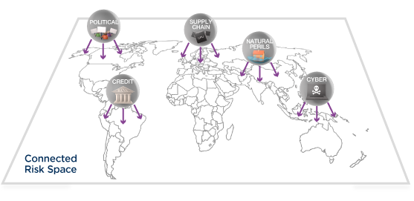
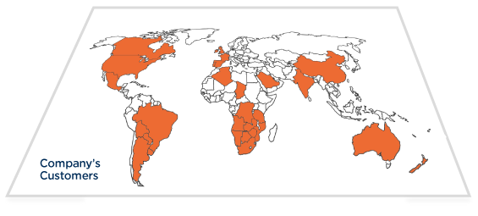
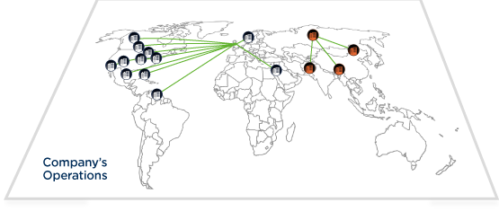
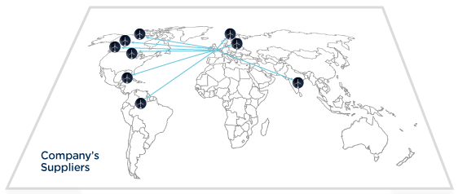
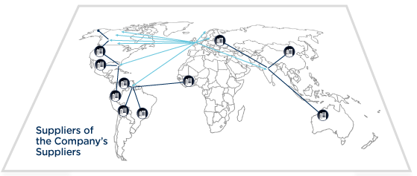
Company’s Customers and Trading environment
An Organisation’s Risk Landscape
Connected Risk Space
Company’s Operations
Company’s Suppliers and Trading Partners
Suppliers and Customers of the Company’s Suppliers and Trading Partners
Notes:
jkp

Slide 10
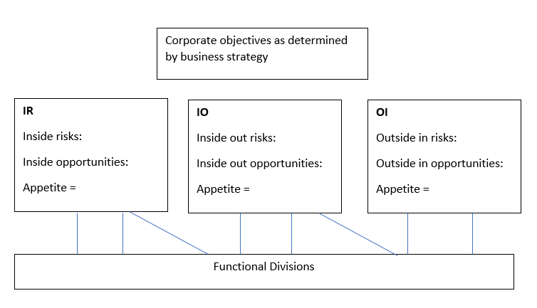
Risk or Opportunity?
Most if not all companies focused on turning risks into opportunities.
CRO’s increasingly need to demonstrate positive value-add.
Hard to move away from inside only or an ‘inside-out’ risk perspective without the availability of a data model that allows an ‘outside-in’ approach.
Notes:
Jkp/sb
The ‘inside-out’ perspective leads to unrealistic risk silos.
An ‘outside-in’ model is required if ‘connected risks’ are to be fully taken into consideration as these embrace the entire trading environment.
Outside-in is moving from horizon scanning to a global satellite view of the whole planet
The counterpoint to heightened risk in a fast-moving, connected digital world is that there is more readily data available to help manage and exploit that risk and opportunity.

Slide 11
Outside In Risks / Opportunities
An Organisation’s Risk Landscape
Internal Risks / Opportunities
Inside Out Risks / Opportunities
Outside In Risks / Opportunities
Notes:
jkp

Slide 12



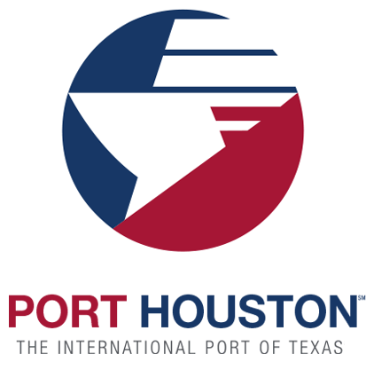





Examples of Connected Risk/Opportunity
Reputational
Cyber
Geopolitical
Nat Cat
Credit
Supply-chain
Digitalisation
Multi-peril events
Notes:
Workshop exercise
Rank the 6 risks as most connected
Then mention combination
Then digitalisation pops up for discussion
Questions
Which one of these risks is the most connected?
Which one of these risks could have the most impact on your company’s business strategy?
Which one of these risks do you feel you do not have a sufficient handle on?
Reputational
HSBC – The bank was accused of money laundering. Mexican drug traffickers deposited hundreds of thousands of dollars each day in HSBC accounts. At least, $881m in drug trafficking money was laundered through the banks accounts. In 2007-8, $7bn was moved from HSBC’s Mexican operations to HSBC’s US operations, the bulk of this being tied to drug money according to a 2012 US senate investigation report. In 2001 and 2007, HSBC US carried out 28,000 undisclosed sensitive transactions between 2001 and 2007 with the vast majority of these transactions – worth $19.7bn involved Iran, who was under US sanctions at the time.
Cyber
ibm
Geopolitical
French energy giant Total pulled out of a billion dollar gas project in Iran due to renewed US sanctions. Allianz and Maersk are also winding down their business in Iran. In 2017, Total signed a contract to develop phase 11 of Iran’s South Pars Gas Field, with an initial planned investment of $1bn (£750m).
Credit
Carillion’s long history of failed investment projects fuelled by cheap credit saw the company owe £2bn to banks in outstanding loans. So, at the time of its collapse in 2017, Carillion owed 30,000 British Businesses a collective sum of £1bn. Meanwhile, Toys R Us was saddled with large amounts of amounts of debts due to its easy access to cheap credit, so that at the time of its Chapter 11 filing, the company debts stood at $5 billion., with $400 million in debt service payments.
NatCat
If Hurricane Harvey had continued on its correct path, it would have knocked out the Port of Houston, which is a vital port for the US economy. The cost would have exceeded the original figure of $125 billion.
Supply Chain
In 2007, Mattel had to recall millions of toys made in China because its main supplier of the toy car products, Early Light Industrial had subcontracted out the painting of the toys to another company, Hong Li Da who used paint supplied by Early Light, instead used paint that contained potentially poisonous lead.
The issue of lead in paint is, according to McDonalds, widespread in China, with the restaurant chain developing a system to monitor paint all the way through the supply chain back to the paint suppliers to try and solve the issue. Mattel’s failure to do likewise had a hugely detrimental impact to its bottom line and brand.
Digitalisation
All of these risks are insurance focused as the industry productises risk. However, the largest risk, which we have not brought up is Digitalisation.. As we discuss in the Roads to Revolution report, digitalisation is both a risk and opportunity. Dyson, for instance are investing £2 million in electric car development., with the aim of launching a new car in 2020. Similarly, Ocado signed a deal with Kroger, the second US retailer to build 20 automated centres in the USA, who now own 5% in the company.
Similarly a combination of these at the same time
External factors are key in driving these risks and opportunities

Slide 13
Connected Risk - Our Progress so far
Mission statement established
Created a working group
Case studies
Broadened our network of interested parties
Answered the opening working group question – what is in it for me?
Notes:
jkp

Slide 14
Our Mission
To build on our experience to create a model of common risks faced by corporates in the ‘most-connected’ sectors.
An understanding of the formation of risks in these sectors will allow us to build a high-level ‘connected risk’ framework, using data that is both in the public domain and commercially available.
Having created that framework, maintain the knowledge base and provide access to the invaluable business intelligence that will result.
Notes:
jkp

Slide 15
What is in it for me?
An information solution that empowers the RM to better understand both internal risks and risks external to the organisation
For market positioning, a model that pre-determines the profile of leading companies representing circa 50% of global company revenue.
A solution that allows the RM to help influence business strategy and better manage corporate risk appetite(s)
The opportunity to add demonstrable value and make risk relevant
Notes:
jkp

Slide 16
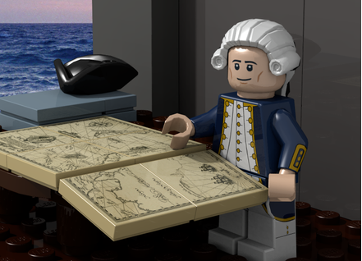
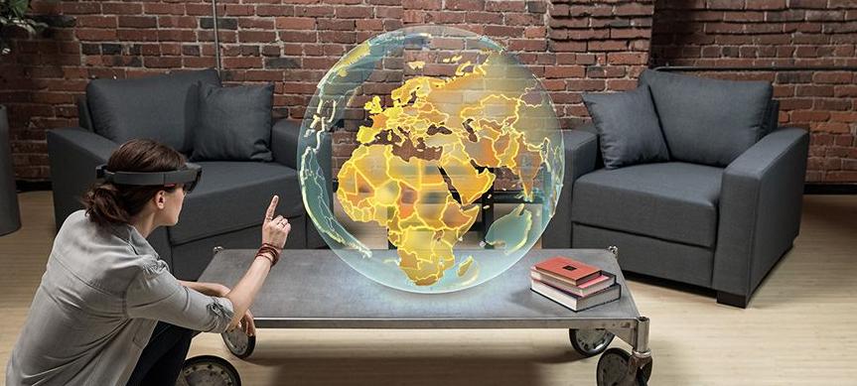
From Horizon Scanning to Globe Scanning

Slide 17
Working Group
Representatives from: Banking, Aerospace, Property Development, Manufacturing, Retail, Energy, Space, Transport, Distribution
When building a strategy, businesses need to regularly quantify risk/opportunity across the business network and measure the effect of current and future strategies on that quantification.
The proposed Russell solution would be positioned for the Board.
Confirmation that the solution should combine risk management with opportunity management.
Notes:
jkp

Slide 18
Risks and Opportunities
Political | Supply Chain (Source & Manage) | Cyber | Balance Sheet Strength | Macroeconomic Changes
Business Interruption | Strategic Delivery | New Technologies | Brand, Trust and Reputation | Market Developments
Theft, Fraud, Corruption | Natural Catastrophe | Product Quality Issues | Legal and Regulatory | Environmental (Climate Change)
Source: FTSE 100 and 10K Corporate reports
Notes:
Jkp – explain how we devised the grid

Slide 19
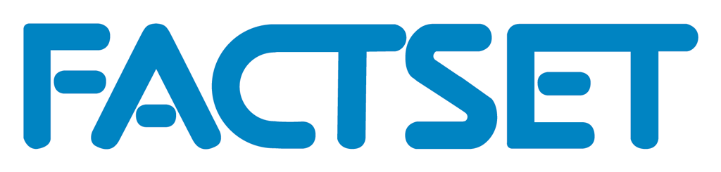




Working Group Case Studies
Space, Energy, Aerospace, Retail
Application of the New Framework
Assessment of Risk Appetites / Risk Tolerance
Integration of Vendor data
Creation of Initial ‘Russell Universe’ database
Notes:
Jkp/sb

Slide 20
Risks and Opportunities – How Connected? 1-10
Political | Supply Chain (Source & Manage) | Cyber | Balance Sheet Strength | Macroeconomic Changes
Business Interruption | Strategic Delivery | New Technologies | Brand, Trust and Reputation | Market Developments
Theft, Fraud, Corruption | Natural Catastrophe | Product Quality Issues | Legal and Regulatory | Environmental (Climate Change)
5
5
5
5
5
5
5
5
5
5
5
5
5
5
5
10 = very connected
Source: FTSE 100 and 10K Corporate reports
Notes:
Workshop – jkp/mb/sb

Slide 21
Summary
“Providing chief risk officers and c-suite decision makers with the information they need to build a winning strategy in the interconnected world where business faces both opportunities and risks.”
Notes:
sb

Slide 22
AIRMIC Workshop Objectives - Revisited
To understand connected risk
To appreciate how risks and opportunities are integral to the business strategy of the company
To learn about and have the opportunity to become involved in an initiative to empower RM/CRO’s with data and information so they can influence and help manage business strategy.
Notes:
jkp

Slide 23
Thank you
Questions
For more information and to join
our interest group please contact:
Suki Basi sbasi@russell.co.uk
Julian Kirkman-Page jkirkmanpage@russell.co.uk

Slide 24
Managing Risk and Opportunities in a Connected World
Notes:
Jkp – conundrum
#Y868

Slide 25
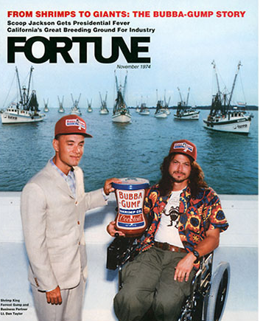
Notes:
Answer to conundrum

