Slide 1



Slide 2
Agenda
What is a standard, who uses standards and what are they for?
The international dimension and standards development process.
The role of standards in risk governance.
Workshop breakout session questions.
37% of UK productivity growth can be attributed to standards
28% of annual UK GDP growth can be attributed to standards, equivalent to £8.2bn (2014 prices)
£6.1 billion of additional UK exports per year can be attributed to standards annually
Source: BSI and Centre for Economics and Business Research (CEBR); ‘How standards benefit businesses and the UK economy’
(‘The Economic Contribution of Standards to the UK Economy Report’; 2015).
GDP: Gross Domestic Product

Slide 3
What is a standard,
who uses standards and
what are they for?

Slide 4
Standards are an agreed way of doing something
They cover broad themes and apply to all sectors and sizes of business
What is a standard?
Voluntary, independent, and consistent agreement.
Guidelines or requirements for recognised good practice.
May relate to a product, managing a process, delivering a service
or supplying materials.
The result of wide-ranging expert collaboration and consensus.
Benefits of standards:
Remove ‘Technical Barriers to Trade’.
Supply chain and fair/equal competition.
Customer relationships, business credentials.
Consumer protection.
Support regulation.
Stimulate innovation.
Manage organisation risk.
Source: BSI

Slide 5
Key standards for risk management
ISO 19600: 2014
Compliance
Management
Systems
ISO 22316: 2017 Security and
Resilience
BS 65000: 2014
Guidance on
Organisational
Resilience
ISO TC 262 Risk management.
New areas:
Legal risks
ISO 31030: Managing travel risks
Product safety risks
[NB PAS 7100 on product recall just released]
Emerging risks
Supply chain risk management
BS 13500: 2013
Code for Delivering Effective Governance of Organisations
BS 31111: 2018 Cyber Risk
and Resilience
ISO 22301: 2012
Business Continuity Management Systems*
ISO TC 292 Security & Resilience.
New areas:
BS 67000 on City Resilience under development
ISO TS 17091 Crisis Management - Strategic issue resolution
ISO 37000: Guidance
for the Governance of Organisations**
ISO 31000: 2018
Risk Management
BS 31100: 2011
Code of Practice
and Guidance on
Implementation of ISO 31000
ISO TC 309 Governance of Organizations.
New areas:
ISO/NP 37002 whistleblowing management systems: guidelines
ISO 37001: 2016
Anti Bribery
Management
Systems
PAS 1998: 2008
Whistleblowing
Code of Practice
ISO 45001: 2018
Occupational Health & Safety Management
*ISO/TS 22317: 2015 - Guidelines for business impact analysis (BIA). Also standards on Emergency Management & Community Resilience.
**Under development
ISO: International Organization for Standardisation. TS: Technical Specification.
Source: BSI

Slide 6
The international
dimension and Standards development process

Slide 7
Types of standards
National and international standards
Type 1 | Type 2 | Type 3
Products | Processes | Principles
Technical specifications | Management systems | Set out values and principles
Better products | Better business processes | Better business potential
International Standards (e.g. ISO IEC)
Corporate Technical Specifications
Private & Consortia Standards
Regional Standards
(e.g. EN)
National Standards
(e.g. British
Standards (BS))
Sponsored Standards
(e.g. BSI PAS)
Professional Codes, Guidance, Best Practice
PAS route to national and international standards
Key
BSI as National Standards Body manages BS, EN & ISO, IEC standards
Private & professional standards codes and guidance
IEC: International Electrotechnical Commission. EN: European Standard. PAS: Publicly Available Specification.
Source: BSI

Slide 8


The international dimension
ISO
(International Organization for Standardization)
164 National Standards Body members globally
CEN
(European Committee for Standardization)
CENELEC
(European Committee for Electrotechnical Standardization)
ISO CASCO
(ISO committee on conformity assessment)
CEN & CENELEC have 34 member countries
(EU ×28, EFTA ×3, FYROM, Turkey, Serbia).
24 countries including the UK have common members of both CEN and CENELEC.
IEC
(International Electrotechnical Commission)
80 members (National Committees) and 80 affiliates globally
ITU
(International Telecommunications Union)
Agency of the UN. Members are national governments and industry
ETSI
(European Telecommunications Standards Institute)
Industry, government and National Standards Body (NSB) members
Source: BSI

Slide 9








Standards development process
If approved, a project is created
Anyone can suggest an idea for a new standard
All ideas for new standards are assessed
Anyone can comment on an existing standard
National, European and ISO standards are reviewed at least every 5 years
Documents are then published online in British Standards Online (BSOL)
The committee drafts the standard
The updated draft is issued for final approval
The draft is then issued for open public consultation
The committee considers the comments
Source: BSI

Slide 10
The role of standards
in risk governance

Slide 11
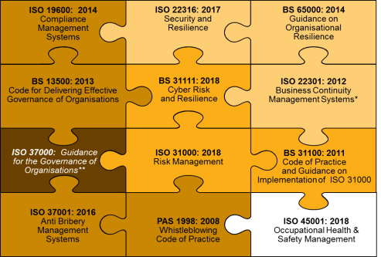
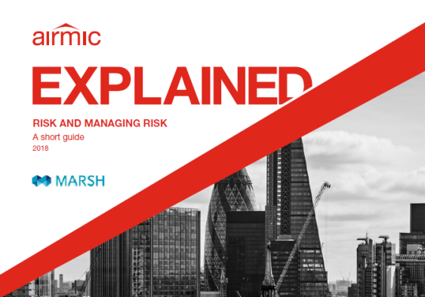
Governance incorporates standards and the risk management framework
Creating and protecting value through integration, oversight and assurance
Governance can be defined as:
“The system by which companies are directed and controlled”
(Ref: Cadbury Committee 1992)
Integration
Design
Improvement
Leadership & Commitment
Key elements for successful governance:
Accountability.
Direction.
Control.
Implementation
Evaluation
Risk management framework
(Ref: ISO31000:2018)
Source: BSI, Airmic and Marsh

Slide 12
Governance focus on risk management
ISO 31000: 2018 Principles
Risk management principles
(Ref: ISO31000:2018;
Airmic Explained, Risk
and Managing Risk, 2018)
Measure, review, reflect and action to facilitate organisational learning
Integral part of the management system and embedded within the organisation’s culture
Create and sustain an effective risk culture which is consistent, transparent, proactive and compliant
Continual Improvement
Integrated
Systematic, structured and timely to identify and address all risk areas
Human and Cultural Factors
Value
Creation
and
Protection
Structured and Comprehensive
Best
Available
Information
Customised
Tailored to the organisational need, context and proportionate to the business environment
Base decisions on reliable and verifiable data
Dynamic
Inclusive
Responsive to internal and external change in a timely manner
Formalised accountabilities and responsibilities including leadership mandate and three lines of defence
Source: BSI, Airmic and Marsh

Slide 13
Workshop breakout
session questions

Slide 14
Workshop breakout session questions
Group A | Group B | Group C
Which risk and resilience standards help inform your organisation’s approach to the management of risk and resilience? | What are they key challenges you face in applying standards within your organisation? | What is your experience of using standards across multiple geographies or organisations e.g. joint ventures and suppliers?
How do you apply these standards and, in particular, measure their effectiveness? | How do you think the standards could be improved as tools for your organization, i.e. how might they evolve, what gaps have you noticed? | How do your customers or partners value your accreditation or adherence to standards?
Source: BSI and Marsh

