Slide 1

The impact of the digital revolution on business models and risk exposure
Airmic Conference 2018 // Workshop B4
James Martin, Client and Distribution Leader
Hélène Stanway, Digital Leader
James Tuplin, Head of Cyber and TMT

Slide 2

Introduction
James Martin
Client and Distribution Leader

Slide 3
Disruptors and examples
Hélène Stanway
Digital Leader

Slide 4



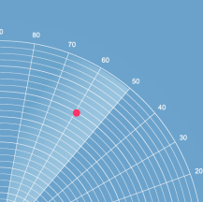









Examples of IoT
Vehicle, asset,
person & pet
monitoring &
controlling
Agriculture
automation
Energy
consumption
Security &
surveillance
Building
management
Everyday
things get connected for a smarter
tomorrow
Logistics,
transport,
supply chain
Vehicle
autonomy
Everyday
things
Smart homes
& cities
Telemedicine &
healthcare
Embedded
mobile

Slide 5
Discussion 1
What disruptors are you currently seeing in your industry?
What changes are these disruptors creating?

Slide 6
What does all this
mean for risk?
James Tuplin
Head of Cyber and TMT

Slide 7




A connected world, connected Insurance
Risks

Slide 8
Discussion 2
How have these changes affected how you
manage your risks?

Slide 9
Review and questions

Slide 10
Conclusion
What will you start, stop or continue doing after this session?

