Slide 1
Practical Tips and Cautionary Tales to support your purchase of D&O Insurance and manage claims better
Stephanie Pestorich Manson, Head of Commercial Institutions – UK
Noona R. A. Barlow, Head of Liabilities & Financial Lines Claims, AEL
12th June 2018

Slide 2
Agenda
Evolving D&O Risks
    Cyber
    Modern Slavery
    Sexual Misconduct
  Buying D&O in a Changing Environment
    Side A
    Multinational
    Do’s & Don'ts

Slide 3
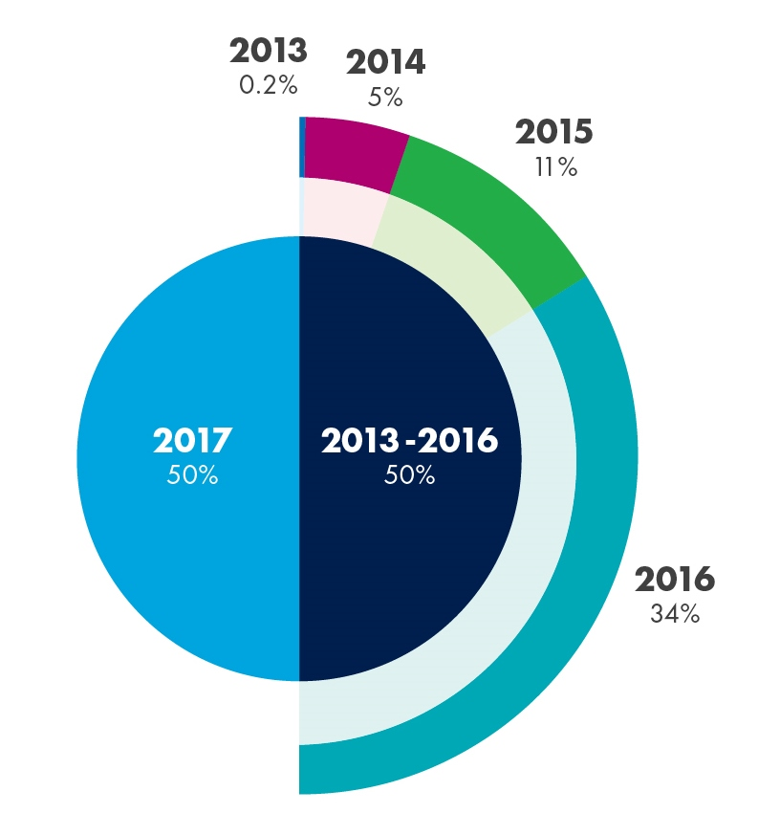
Cyber – European Claims Volumes

Slide 4
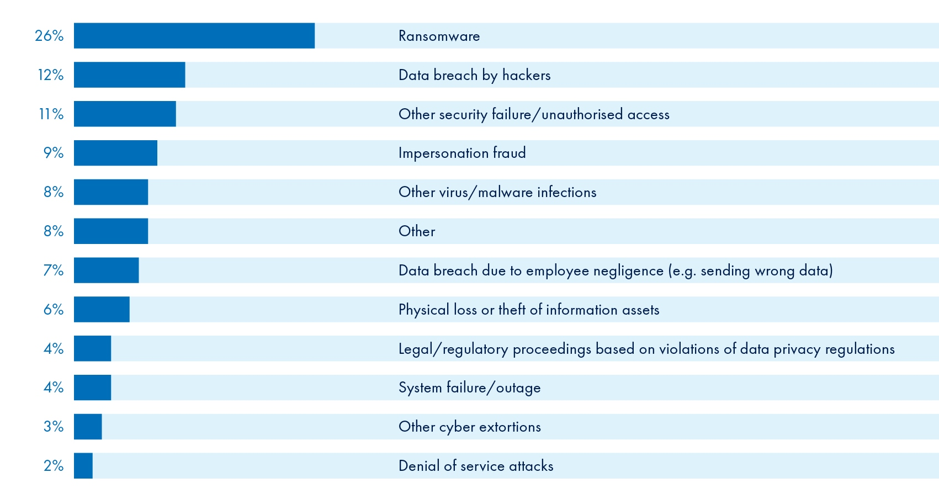
2017 – Cyber Claims by Incident Type

Slide 5
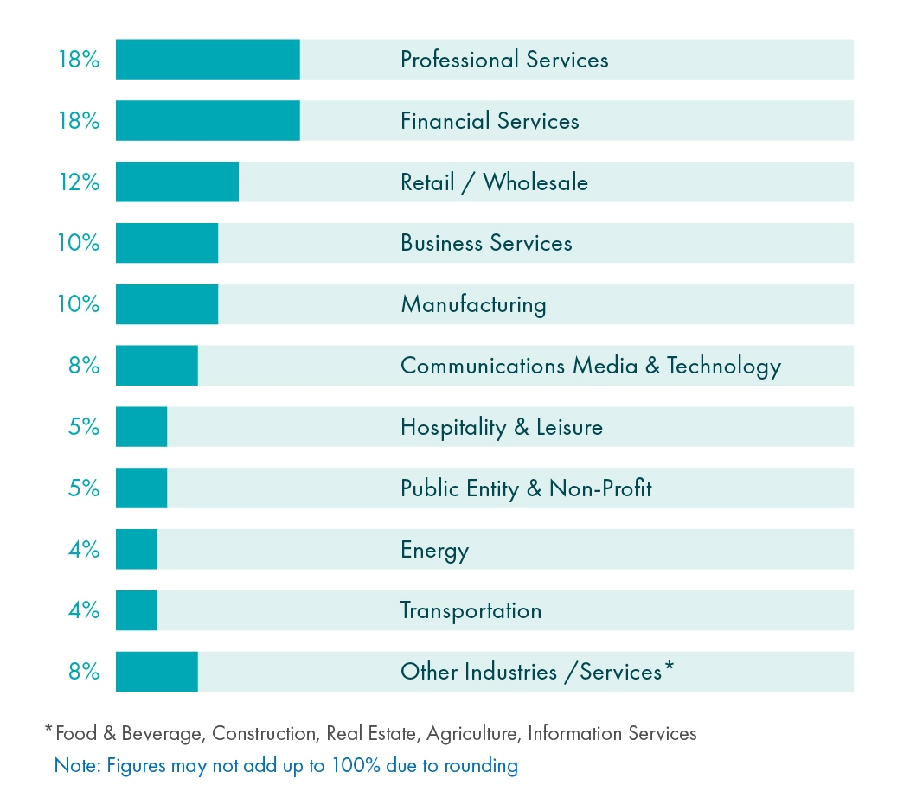
2017 – Cyber Claims by Industry

Slide 6
D&O - Modern Slavery Act
  Modern slavery includes slavery, servitude, forced/compulsory labour and human trafficking
  All organisations with turnover of £36m+
  Statements affirming no slavery in business or supply chain
  Corporations = anti slavery statement must be board approved

Slide 7
D&O + Cyber
  2018 Guidance from SEC
      Updated from previous guidance
      At least one person on board needs cyber experience
      Cyber risk now viewed the same as all other risks
      Focus on CEO and tone from the top

Slide 8
D&O + Cyber
  Yahoo
      Data breach by Russian hackers
      Delay in reporting
      $80m settlement agreed (not yet approved)
      SEC Data Breach Disclosure Enforcement Penalty - $35 million

Slide 9
D&O + Cyber
  Equifax
    143 million users’ personal data
    Discovered in July
    Disclosed in September
    17% stock price drop
    Insider trading?

Slide 10
D&O + Sexual Misconduct
  Weinstein Company
  21th Century Fox
  Signet Jewelers
  Liberty Tax
  Wynn Resorts

Slide 11
D&O + Sexual Misconduct
  Four theories of liability:
    Breach of duty of care and loyalty
    Failure to monitor harassment/see red flags
    Directors turned a blind eye
    Misleading statements about workplace misconduct

Slide 12
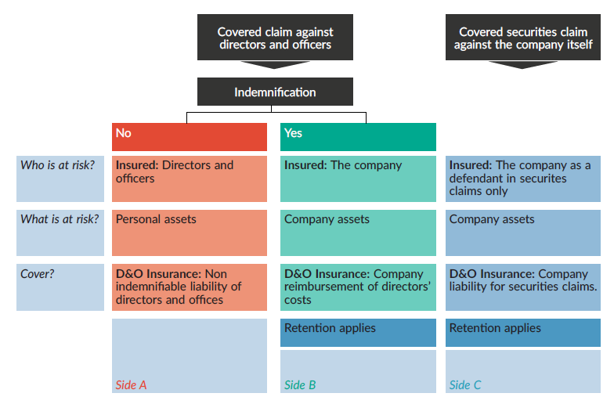
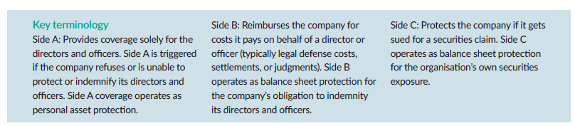
Structure of a primary D&O policy

Slide 13
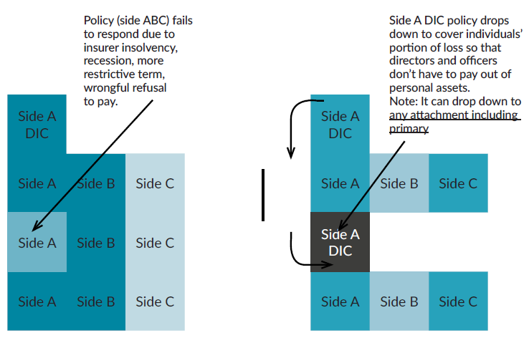

Side A DIC

Slide 14
Side A Claims Examples
Claims by the company
    Current vs former management
  Insolvency
    Piercing the corporate veil after insolvency
    Deepening insolvency
  Derivative claims
    Restatement of accounts
    Event-driven litigation?

Slide 15
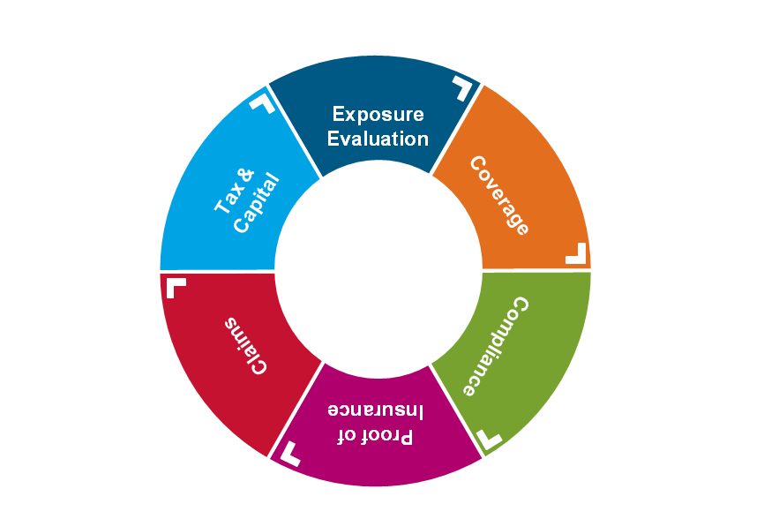
AIG Multinational Philosophy &
Decision Wheel
For D&O – don’t ignore indemnification

Slide 16





Multinational D&O - The Indemnity Trap
A non-indemnifiable claim is made against a Director in a country where non-admitted insurance is not allowed
Global Policy
Multinational Parent
Non Admitted Insurance can attempt to pay loss to local Insured
Indemnification
Foreign Subsidiary
Indemnification

Slide 17
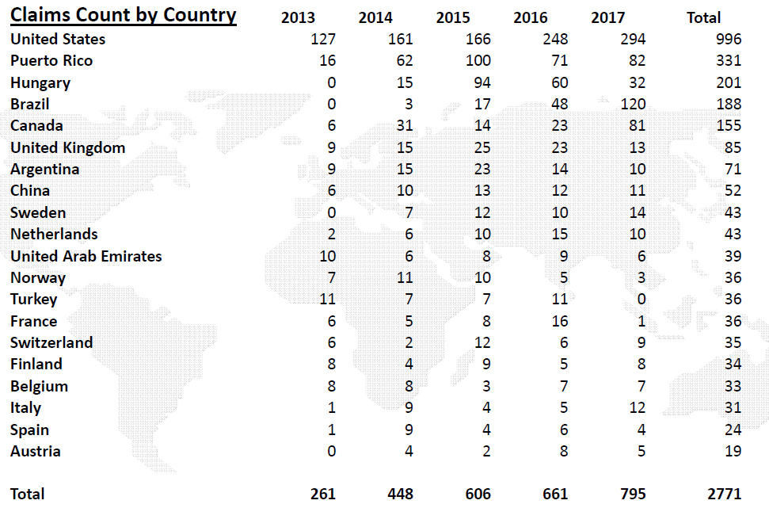
Top 20 countries where financial lines multinational claims noticed

Slide 18
D&O checklist
Do
Prepare for disclosure and Insurance Act obligations
Understand what coverage is available
Review sufficiency of limits
Consider Side A
Check insolvency and investigation protection
Report claims in a timely fashion
Get prior written consent before incurring costs
Communicate frequently and openly with broker and insurer
Talk up front about confidentiality concerns and remember that insurers deal with confidential information every day

Slide 19
D&O checklist
Don’t
Overlook reviewing international indemnification procedures
Ignore how much defence counsel is costing just because it’s covered by insurance – make sure you understand the budget and strategy
Assume your usual solicitor is the right person for your D&O claim
Hide behind confidentiality to avoid sharing information on claims
Settle any matter or admit liability without prior consent

Slide 20







Questions?

Slide 21

American International Group, Inc. (AIG) is a leading international insurance organization serving customers in more than 130 countries and jurisdictions. AIG companies serve commercial, institutional, and individual customers through one of the most extensive worldwide property-casualty networks of any insurer. In addition, AIG companies are leading providers of life insurance and retirement services in the United States. AIG common stock is listed on the New York Stock Exchange and the Tokyo Stock Exchange.
AIG is the marketing name for the worldwide property-casualty, life and retirement, and general insurance operations of American International Group, Inc. Products and services are written or provided by subsidiaries or affiliates of American International Group, Inc. Not all products and services are available in every jurisdiction, and insurance coverage is governed by actual policy language. Certain products and services may be provided by independent third parties. Insurance products may be distributed through affiliated or unaffiliated entities. Certain property-casualty coverages may be provided by a surplus lines insurer. Surplus lines insurers do not generally participate in state guaranty funds and insureds are therefore not protected by such funds.

