Slide 1


WHAT
IS THE CYBER RISK LANGUAGE AND WHAT DOES IT HOLD?
Phillip Rees, Managing Director

Slide 2

WHAT IS THE CYBER RISK LANGUAGE? | PHILLIP REES
CYBER/INFOSEC/DATA GOVERNANCE
INTRODUCTION
The current cyber risk landscape
– Risk Management
GLOSSARY OF CYBER TERMS
Cyber risk insurance structure
BACKGROUND TO STANDARDS
Including; ISOs ( 27001/27002), Legislation (GDPR),
Codes of Practice (IOT – DCMS code)
REGULATORY FINES
Talk Talk, British Airways
RISK MANAGEMENT POLICIES
Best practice structure
INFOSEC/PERSONAL DATA INTERSECTS
GDPR Art 32 security of processing
OTHER DATA ASSETS
Financial data (Credit Card PCI- DSS compliance) / intellectual/property/confidential information
SPECIFIC RISKS
M&A, data sharing, digital advertising
ASSOCIATED POLICIES
e.g. data classification, data handling,
data retention
ACCOUNTABILITIES
(Where Is The Data and Governance)
TRAINING AND AWARENESS
(Formal Training And Comms)
SECURITY
Infrastructure, Application and Retention
THE RIGHTS
(Delete, SARs, Consent)
DEMONSTRATING COMPLIANCE
(3rd Party Monitoring)

Slide 3
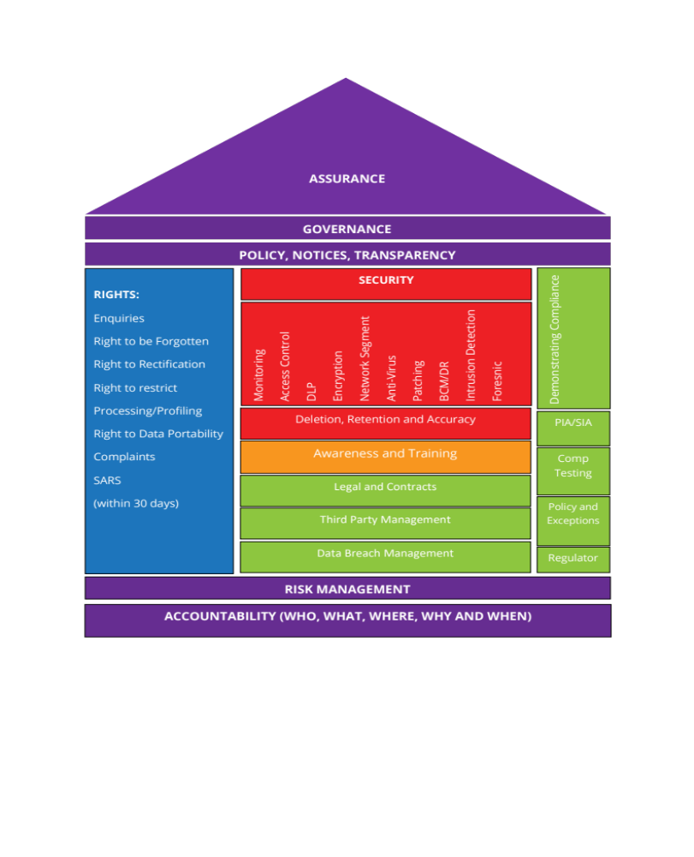
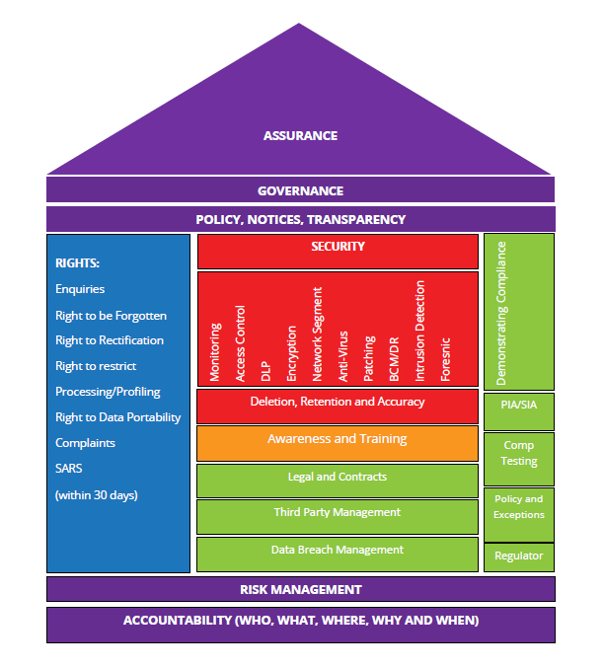
WHAT IS THE CYBER RISK LANGUAGE? | PHILLIP REES
CYBER & DATA RISK MANAGEMENT
PROGRAM PLAN EXAMPLE

Slide 4

WHAT IS THE CYBER RISK LANGUAGE? | PHILLIP REES
WHAT? WHY? & HOW?
Cyber-security is the practice of defending computers, servers, mobile devices, electronic systems, networks, and data from malicious attacks. It's also known as information technology security or electronic information security. The term applies in a variety of contexts, from business to mobile computing, and can be divided into a few common categories.

Slide 5
WHAT IS THE CYBER RISK LANGUAGE? | PHILLIP REES
CYBERSECURITY CATEGORIES FOR RISK MANAGEMENT
Network security is the process of securing a computer network from intruders, whether targeted attackers or opportunistic malware.
Application security focuses on keeping software and devices free of threats. A compromised application could provide access to the data its designed to protect. Successful security begins in the design stage, well before a program or device is deployed.
Information security protects the integrity and privacy of data, both in storage and in transit.
Operational security includes the processes and decisions for handling and protecting data assets. The permissions users have when accessing a network and the procedures that determine how and where data may be stored or shared all fall under this category.
Disaster recovery and business continuity define how an organisation responds to a cyber-security incident or any other event that causes the loss of operations or data. Disaster recovery policies dictate how the organisation restores its operations and information to return to the same operating capacity as before the event. Business continuity is the plan the organisation falls back on while trying to operate without certain resources.
End-user education addresses the most unpredictable cyber-security factor: people. Anyone can accidentally introduce a virus to an otherwise secure system by failing to follow good security practices. Teaching users to delete suspicious email attachments, not plug in unidentified USB drives, and various other important lessons is vital for the security of any organisation.

Slide 6

WHAT IS THE CYBER RISK LANGUAGE? | PHILLIP REES
TYPES OF MALWARE
RANSOMWARE | PHISHING | SPEAR PHISHING | TROJAN VIRUS

Slide 7
WHAT IS THE CYBER RISK LANGUAGE? | PHILLIP REES
CYBER THREATS – EXAMPLE FINANCIAL DATA
TROJAN VIRUSES
Trojan viruses can attack victims’ computers and display a dialogue window or image on each user’s computer. The fake website window will mimic the appearance of the user’s bank’s website – and will ask the user to enter their username and password.
SPAM AND PHISHING
Phishing emails may pretend to be from the victim’s bank – asking for confirmation of the victim’s username and password. To persuade the victim to enter their personal data, the emails often state that users that don’t enter the required information will have access to their account suspended. Spear phishing targets specific individuals asking for personal data.
KEYLOGGER TROJANS
These ‘keyboard spying’ programs will monitor activity on the victim’s computer and wait for the user to connect to an actual banking website. As soon as the user accesses a banking website – that is on the trojan’s list of bank sites – the trojan virus will start to capture the keystrokes that the user types on their keyboard. This enables the cybercriminal to steal data – including login, username and password – which then enables the criminal to access the user’s account… and transfer funds.

Slide 8

WHAT IS THE CYBER RISK LANGUAGE? | PHILLIP REES
CYBER RISK MANAGEMENT
BENEFITS OF CYBERSECURITY
Benefits of utilising cybersecurity include:
Business protection against malware, ransomware,
phishing and social engineering.
Protection for data and networks.
Prevention of unauthorised users.
Improves recovery time
after a breach.
Protection for end-users.
Improved confidence in the product for both developers and customers.

Slide 9
WHAT IS THE CYBER RISK LANGUAGE? | PHILLIP REES
CYBERSECURITY VENDORS
Vendors in cybersecurity fields will typically use endpoint, network and advanced threat protection security as well as data loss prevention. Three commonly known cybersecurity vendors include Cisco, McAfee and Trend Micro.
Cisco tends to focus on networks and allows its customers to utilize firewalls, VPNs and advanced malware protection along with supporting email and endpoint security. Cisco also supports real-time malware blocking.
McAfee makes cybersecurity products for consumers and enterprise users. McAfee supports mobile, enterprise clouds, network, web and server-based security. Data protection and encryption is also offered.
Trend Micro is an anti-malware vendor which offers threat protection for mobile, hybrid clouds, SaaS and the IoT. Trend Micro provides users with endpoint, email and web security.

Slide 10
WHAT IS THE CYBER RISK LANGUAGE? | PHILLIP REES
CYBERSECURITY ROLES / DATA PROTECTION ROLES
Chief information security officer (CISO): implements the security program across the organisation and oversees the IT security department's operations.
Security engineer: protects company assets from threats with a focus on quality control within the IT infrastructure.
Security architect: is responsible for planning, analysing, designing, testing, maintaining and supporting an enterprise's critical infrastructure.
Security analyst: has several responsibilities that include planning security measures and controls, protecting digital files, and conducting both internal and external security audits.
Data protection officer (DPO): performs the mandatory tasks set out in Art 39 GDPR for the protection of personal data.

Slide 11

WHAT IS THE CYBER RISK LANGUAGE? | PHILLIP REES
RISK MANAGEMENT POLICIES – WHAT TO LOOK FOR
Access Controls
Data Loss Prevention
Encryption
Network Segmentation
Anti Virus
Patching/Upgrades
Business Continuity Management
Disaster Recovery
Forensic Capabilities
Privacy Policy
Data Governance
Data Classification
(including IP Protection)
Data Retention
Data Breach/Incident Management

Slide 12
Thank You
phillip.rees@ankura.com

