Slide 1
Crisis Management Team Overview
Nick Powis – Head of Operations EMEA

Slide 2
Outline
CMT Orientation:
  What is a crisis?
  How can YOU prepare for a crisis?
  Types of Crisis
  Crisis Identification Phase
  CMT Structure & Responsibilities
  Incident Management:
    Strategy
    Managing the Incident
    Managing the Media

Slide 3


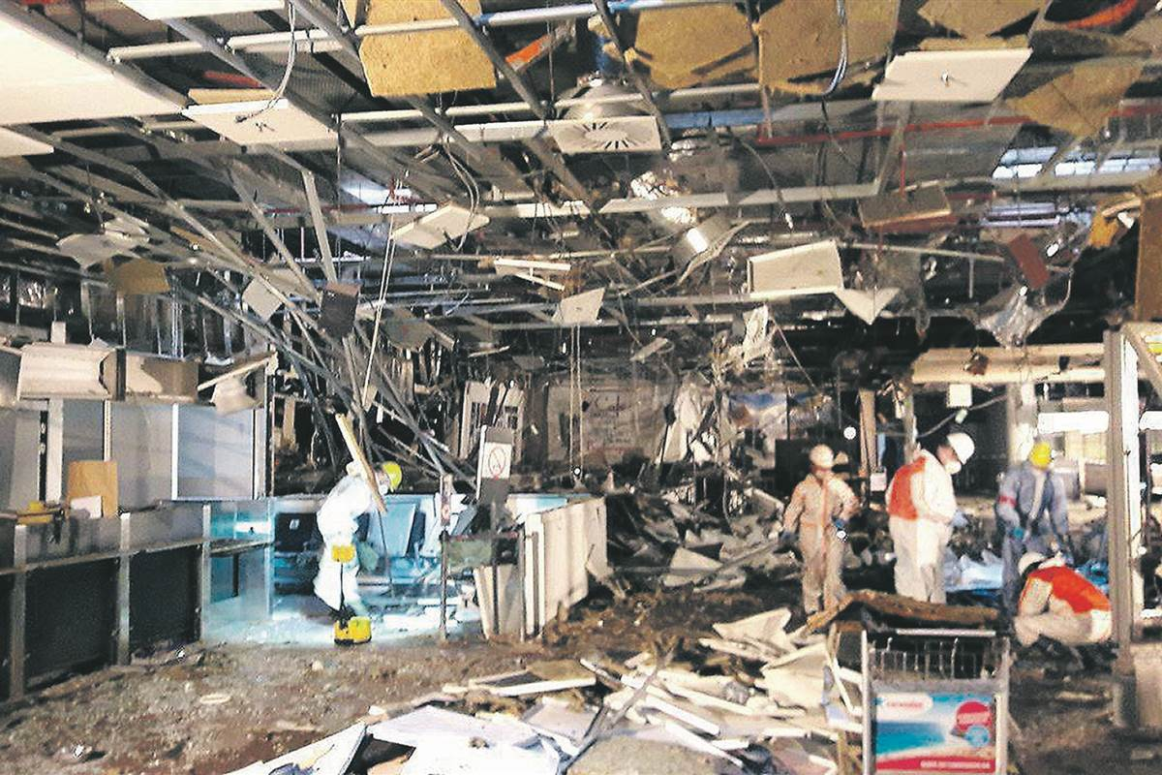
What is a crisis?
Definition
A ‘crisis’ may be defined as an abnormal situation which is beyond the scope of normal business operations and which threatens the immediate safety of core operations or reputation of the institution.

Slide 4
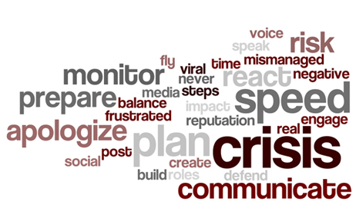
How can YOU prepare for a crisis?
Consider the types of crises that could affect your organisation
Designate a Crisis Management Team (CMT)
Prepare a crisis escalation plan & protocols
Orientation & training of the CMT
Test the plan

Slide 5
Crisis Identification Phase
Part 1
CMT should model 5 x incidents you would consider to be a crisis for your organisation (TVRA):
Part 2
As a CMT rate each incident in terms of:
  Impact
  Probability
High Probability
High Impact
Low Probability
Low Impact

Slide 6
CMT Responsibilities
Members of the CMT play a crucial role:
Single point of contact – clear escalation channels
Minimise impact: Verify + Contain the incident
Coordinate ALL communications channels
Notify other support functions & surge / support partners
Analyse & Approve:
  Strategy
  Priorities
  Contingencies
  Reserved Decisions (for approval above CMT)
Support the IMT (if there is one….)
Legal and regulatory Compliance
Incident/CMT closure protocol
Post-incident review & support

Slide 7
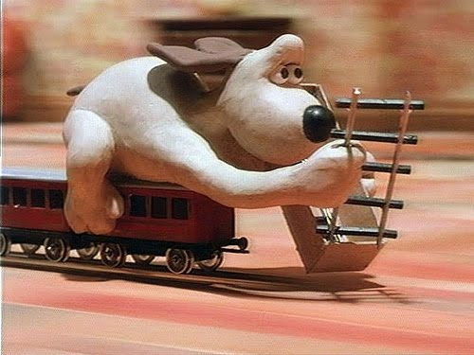
CMT Preparation
Key Points To Consider:
Don’t Learn to Dance on the Evening of the Ball….
Everybody involved in the incident should Travel:
  …….At the same speed
  ………..In the same direction
  …………..To the same destination

Slide 8

Composition of CMT
Factors to consider
Size
Composition
Availability
Authority
Resilience
Objectivity

Slide 9

CMT Roles
Core members:
Surge members:
Chairman
Coordinator(s)
Log-keeper
HR
Legal
Finance
PR Agency
IT Support
3rd party Security Specialist
Diplomatic/Police/Military Liaison

Slide 10
Crisis Strategy
Points to consider:
What is the crisis? VERIFY…!!
Is there a more fundamental problem?....what is actually at stake?
What is the worst case?
What are the stakeholder audiences likely to make of it?
What are the likely time scales?
Which stakeholders/partners should support the CMT?
What is the legal/compliance position? (but avoid paralysis)
Can the spotlight be transferred safely?
Can the crisis be contained?
Notes:
Did it happen over night
Was this something that you should have seen coming. Were there some signs that were missed or ignored?
Now that the crisis has broken are there other things that will come to light, will someone who has recently left make a statement that is harmful?
Plan for the worst but hope for the best. Is someone injured or have they died. Is it a missing person case or is it a kidnap.
What will our sponsors think of this, what will our employees think of it.
How long is this going to last do we have a CM team available will they need to have deputies who can take over if it runs over the weekend
How is this gong to impact on us, financially, reputational issues, emotional issues, shareholders
Did a supplier let you down, has their been a failure in your vetting process or did someone lie
Is there a way to contain it.

Slide 11
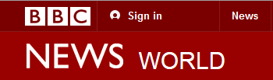
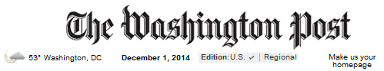
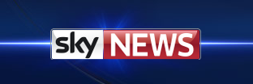
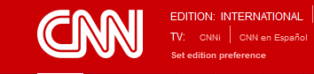
Handling the media
No Comment is not an option
If you don’t talk to the media they will find someone who will
Set the right tone at the outset
Key messages are a life belt
Target Messages effectively
Keep a log of messages sent
Deadlines are real and you must stick to them
Ensure that the spokespeople are trained
Understand the perspective of media/consumers
You will be found out if you lie and later you pay for it

