Slide 1

Brexit and the new political risk
How did we get here and what does it mean?

Slide 2

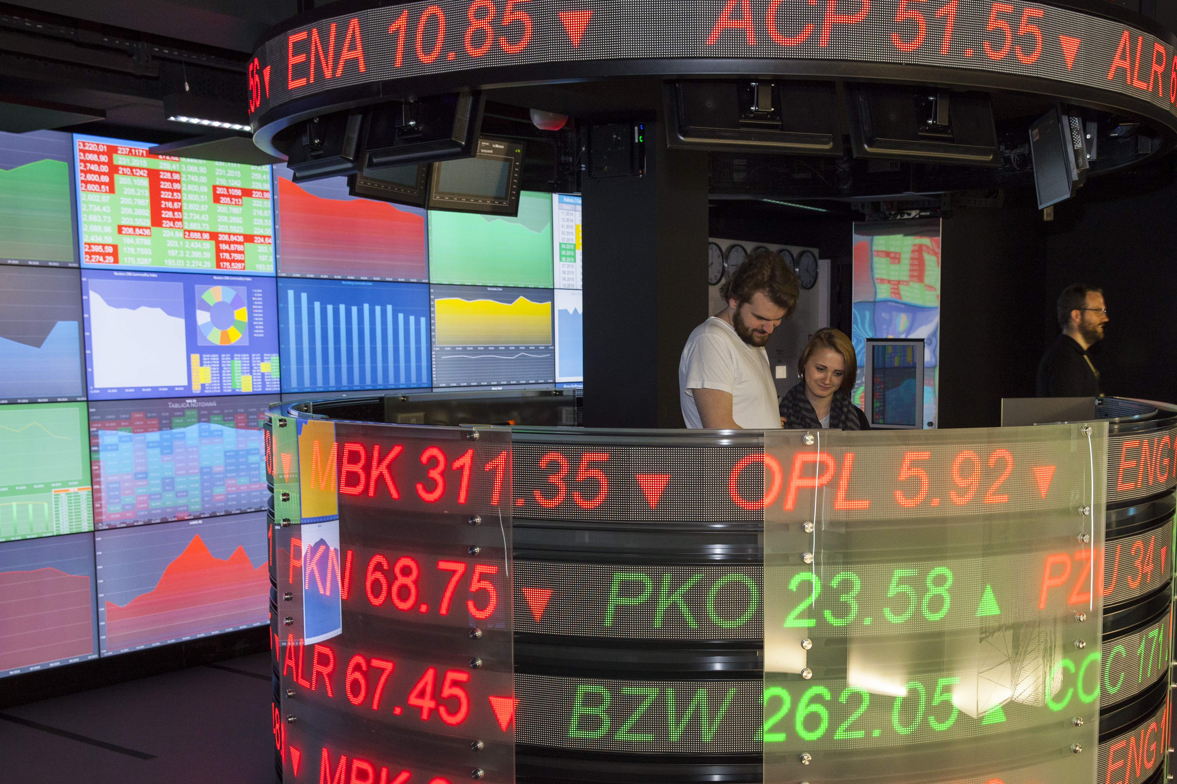
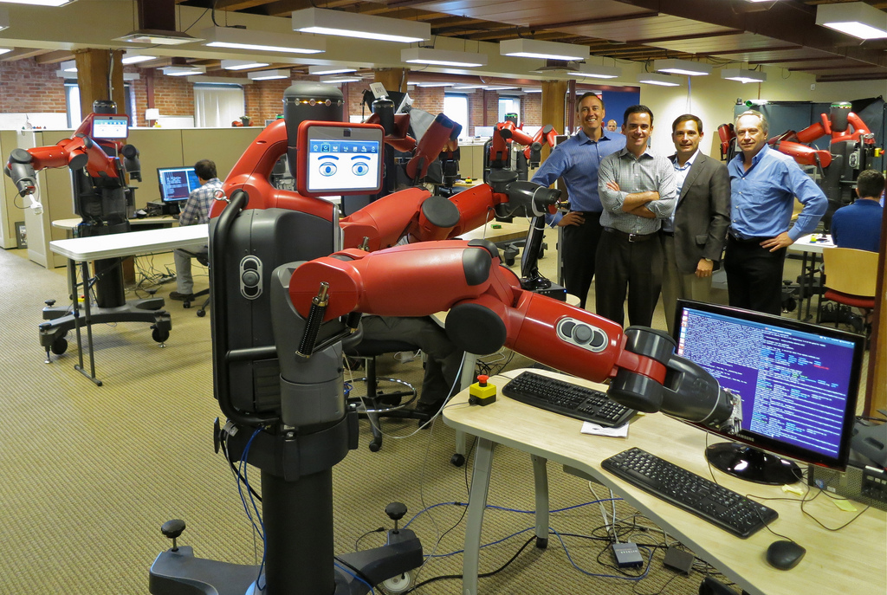

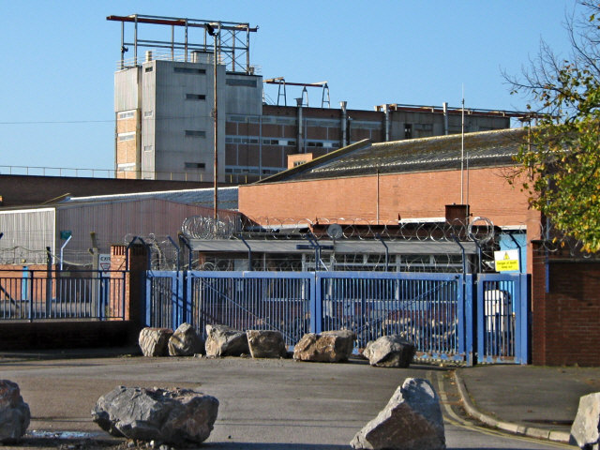
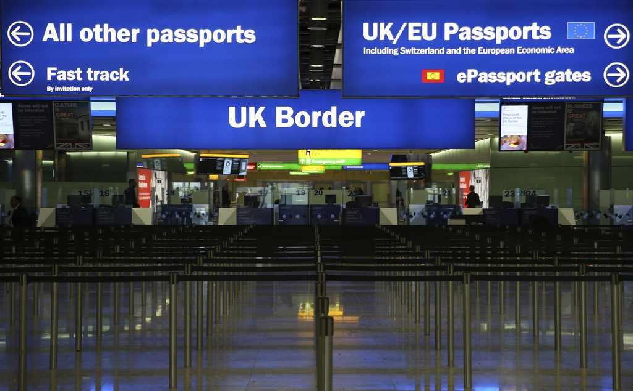
Disruption and volatility

Slide 3


Britain and the EU

Slide 4
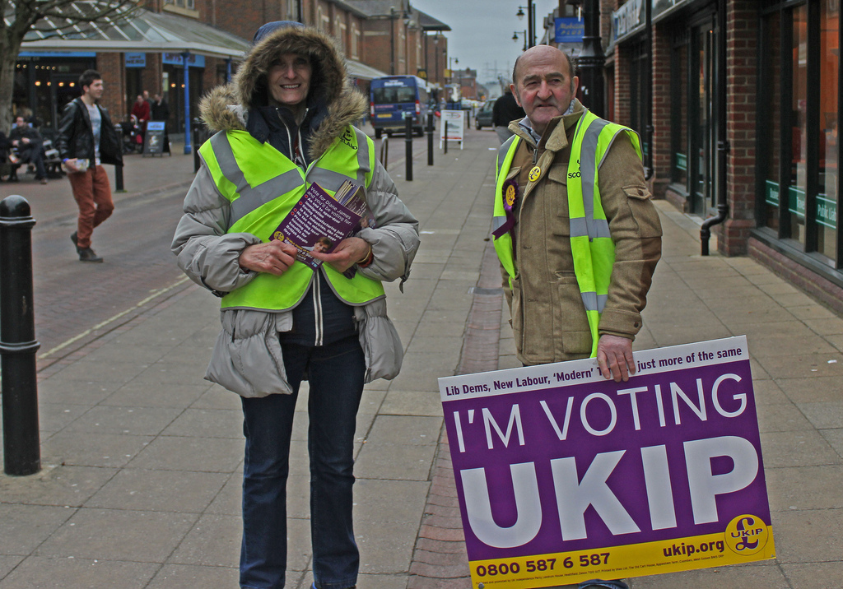


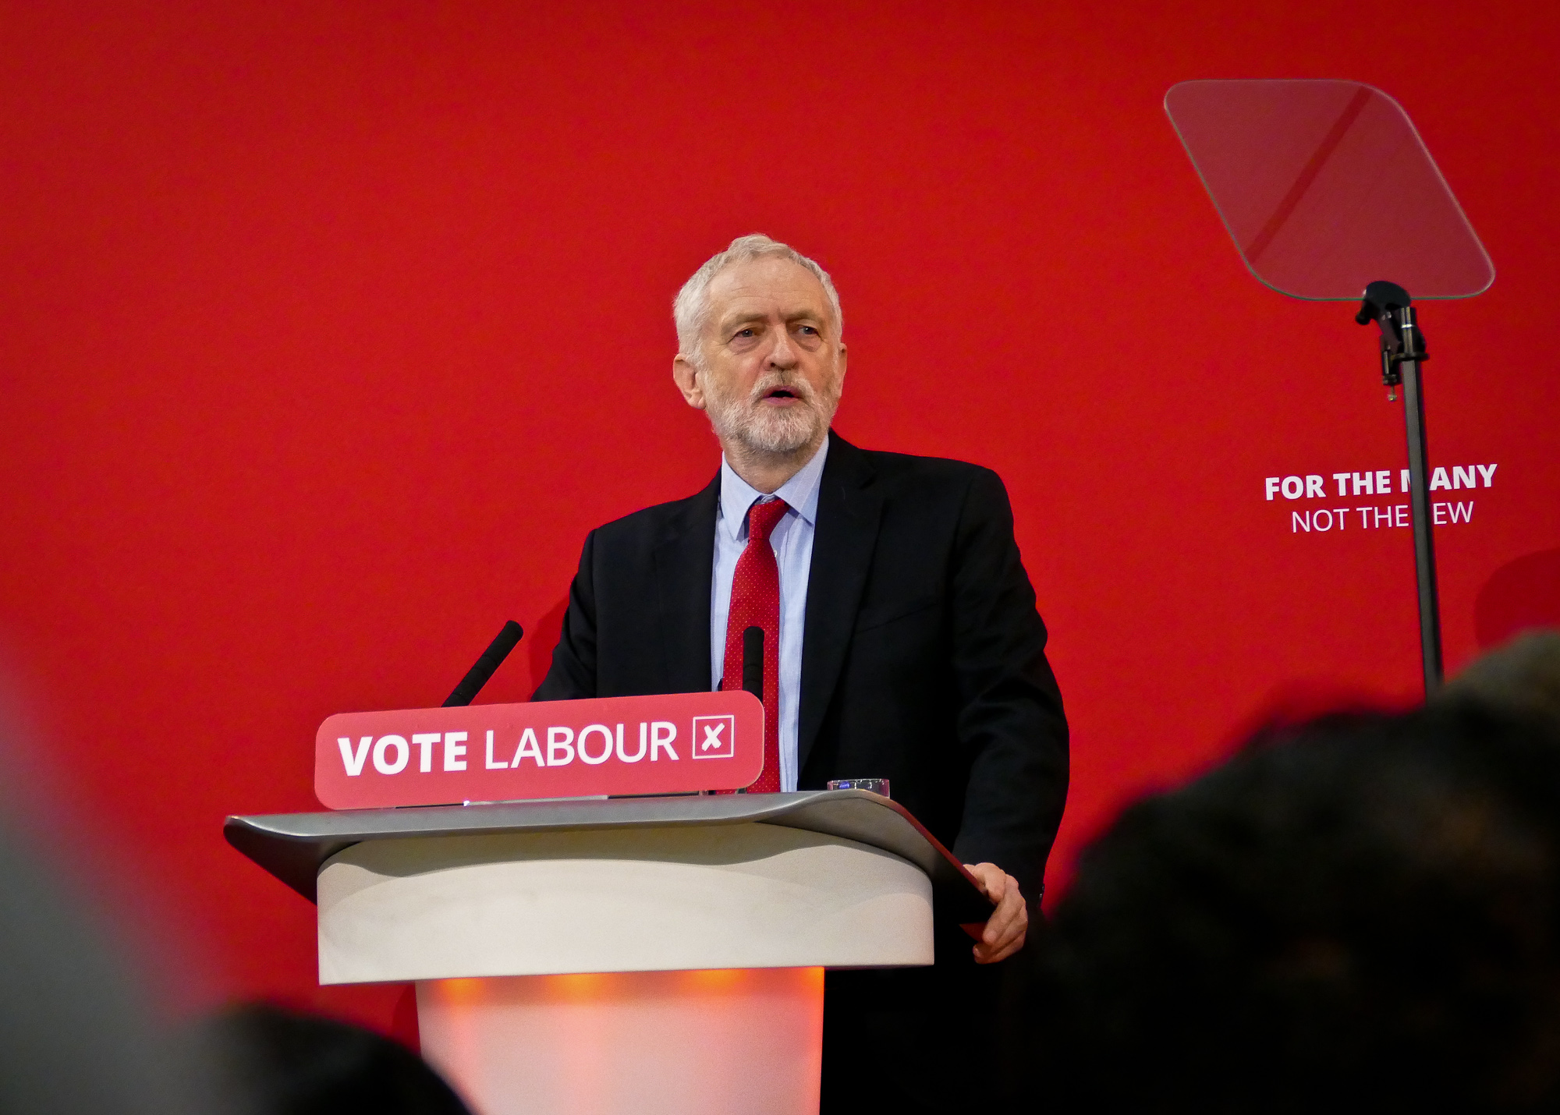
Reshaping Politics

Slide 5

Brexit and our industry

Slide 6

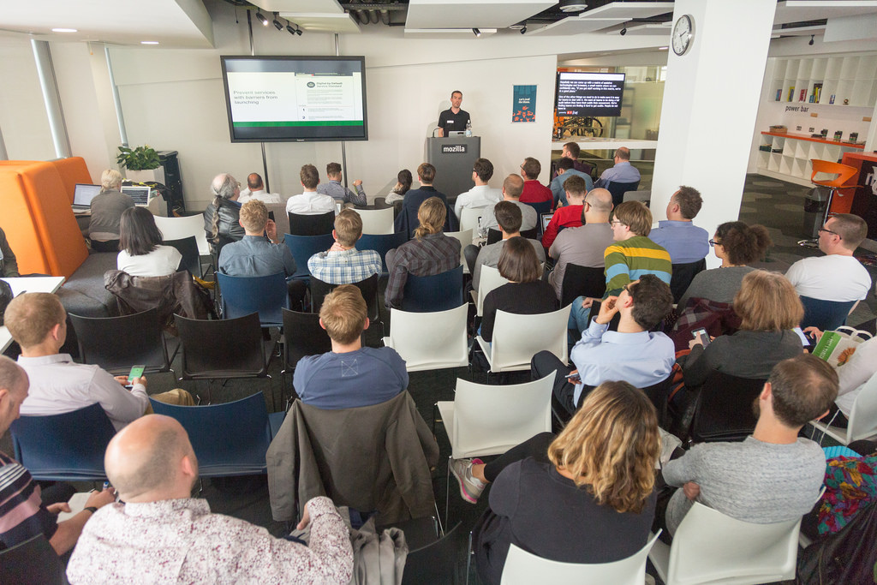
Conclusion

Slide 7

Axco Insurance Information Services
Fifth Floor, 10 Whitechapel High Street, London E1 8QS
Tel: +44 20 7374 5252
Fax: +44 20 7374 5277
Email: axco@axcoinfo.com

