Slide 1
What is Blockchain?
What you need to know
Paul Jones
AIRMIC 2018
Notes:
WARNING: if you try to copy/paste slides from a PPT presentation that doesn’t have this layout, you will probably face some technical issues.
To avoid such thing, you can click on ‘new slide’ in the top menu of this presentation and copy/paste the elements from your former slide onto the new one (but not the slide itself).

Slide 2

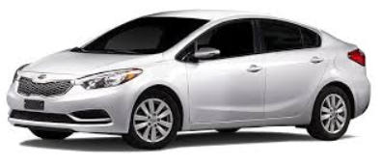

Centralised

Slide 3
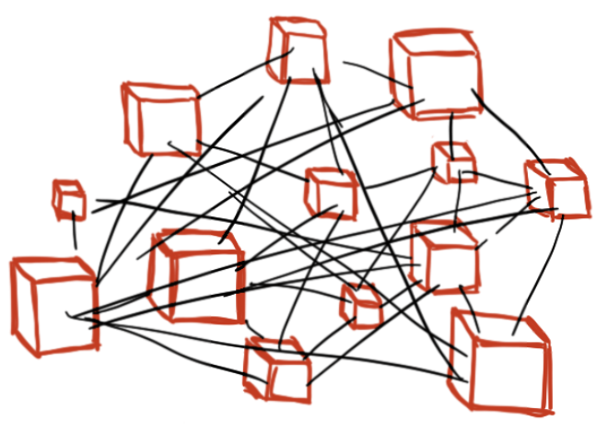
Blockchain is Decentralised

Slide 4
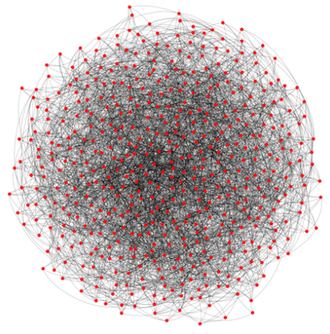
Security

Slide 5



Security
Dkfciovwejrirlejnlicmo203758`903u2gt!£$^%*£%^%$%!££%Yyhyoejbgfio3grfktitg42

Slide 6


Why would you host a blockchain?

Slide 7
How can this benefit Risk Managers?
Notes:
WARNING: if you try to copy/paste slides from a PPT presentation that doesn’t have this layout, you will probably face some technical issues.
To avoid such thing, you can click on ‘new slide’ in the top menu of this presentation and copy/paste the elements from your former slide onto the new one (but not the slide itself).

Slide 8
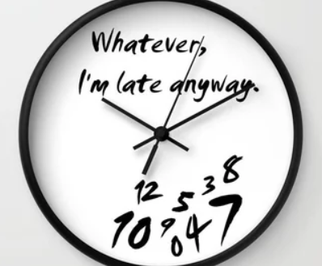
Time

Slide 9
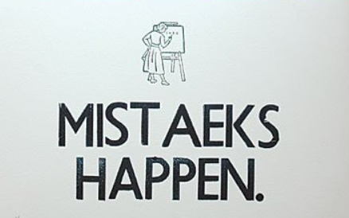
Accuracy

Slide 10
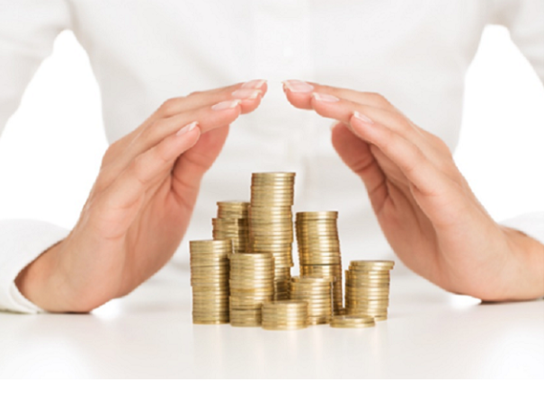
Cost

Slide 11
How can this benefit your business?
Notes:
WARNING: if you try to copy/paste slides from a PPT presentation that doesn’t have this layout, you will probably face some technical issues.
To avoid such thing, you can click on ‘new slide’ in the top menu of this presentation and copy/paste the elements from your former slide onto the new one (but not the slide itself).

Slide 12

Time / Accuracy / Cost… Risks?

Slide 13
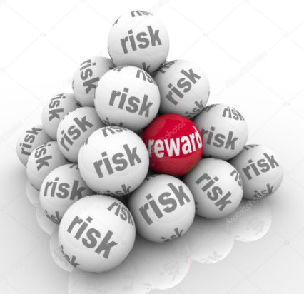
Risk? Embrace vs Ignore

Slide 14
Is the market embracing Blockchain?
Notes:
WARNING: if you try to copy/paste slides from a PPT presentation that doesn’t have this layout, you will probably face some technical issues.
To avoid such thing, you can click on ‘new slide’ in the top menu of this presentation and copy/paste the elements from your former slide onto the new one (but not the slide itself).

Slide 15
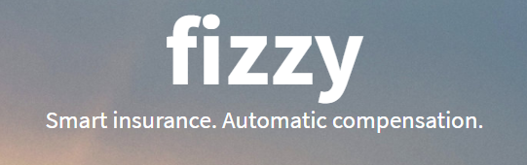
Smart Contracts – Focus on Ethereum
Instant Compensation
No claims reporting
Contract Transparency & Certainty
Terms set in advance of purchase
Use of ‘Oracles’ to corroborate the contract
100% accurate at responding within the contract

Slide 16
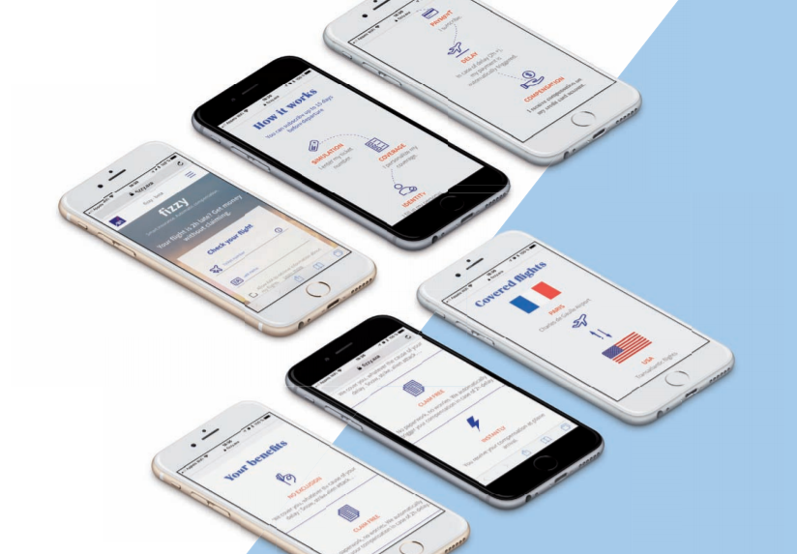
Fizzy

Slide 17
Questions?
Notes:
WARNING: if you try to copy/paste slides from a PPT presentation that doesn’t have this layout, you will probably face some technical issues.
To avoid such thing, you can click on ‘new slide’ in the top menu of this presentation and copy/paste the elements from your former slide onto the new one (but not the slide itself).

Slide 18
Thank you

