Slide 1
AIRMIC HUB | Hot Topic:
Nightmare Claims Come True –
What I did and how I did it
Holly Waszak - Solicitor, Major Loss Claims Adjuster - Financial Lines Claims
Paul Dawson - Major Loss Adjuster - Property/Energy
12th June 2018

Slide 2
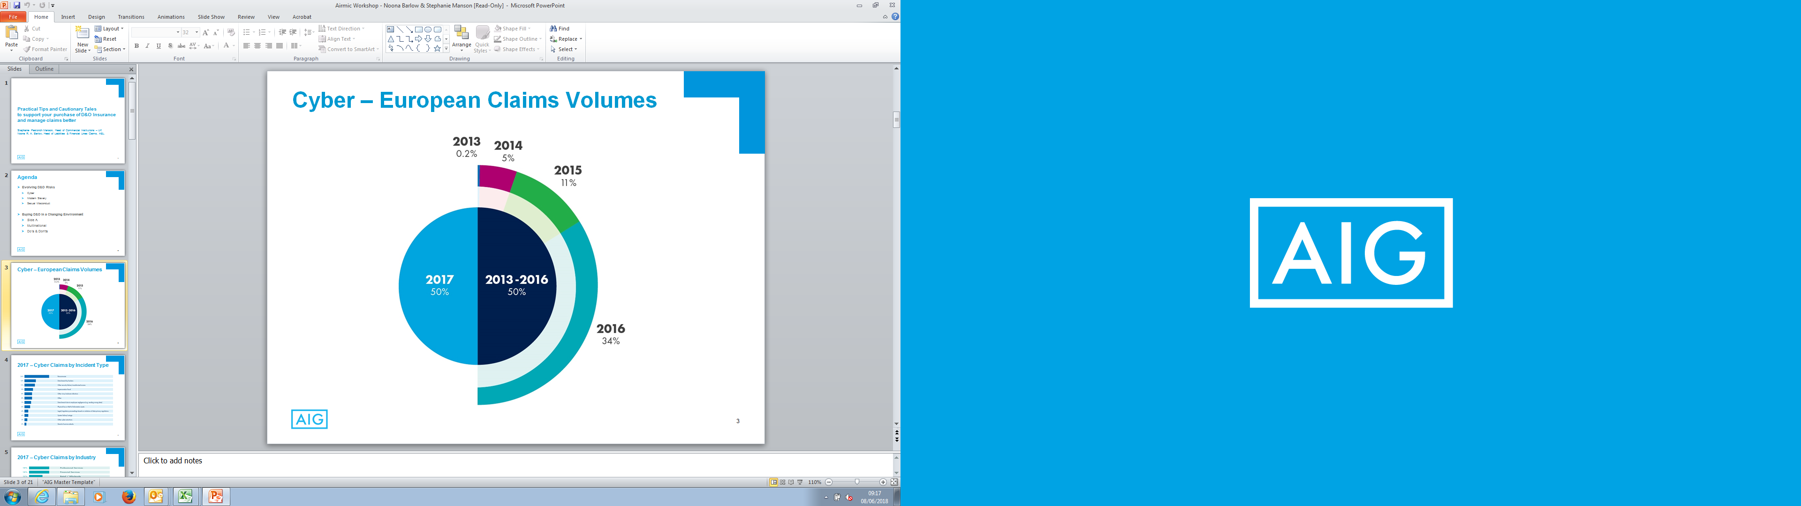
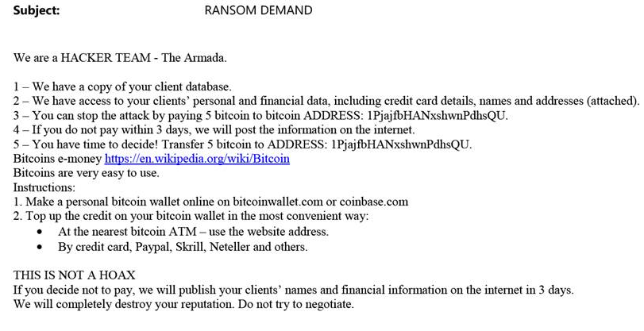

Slide 3
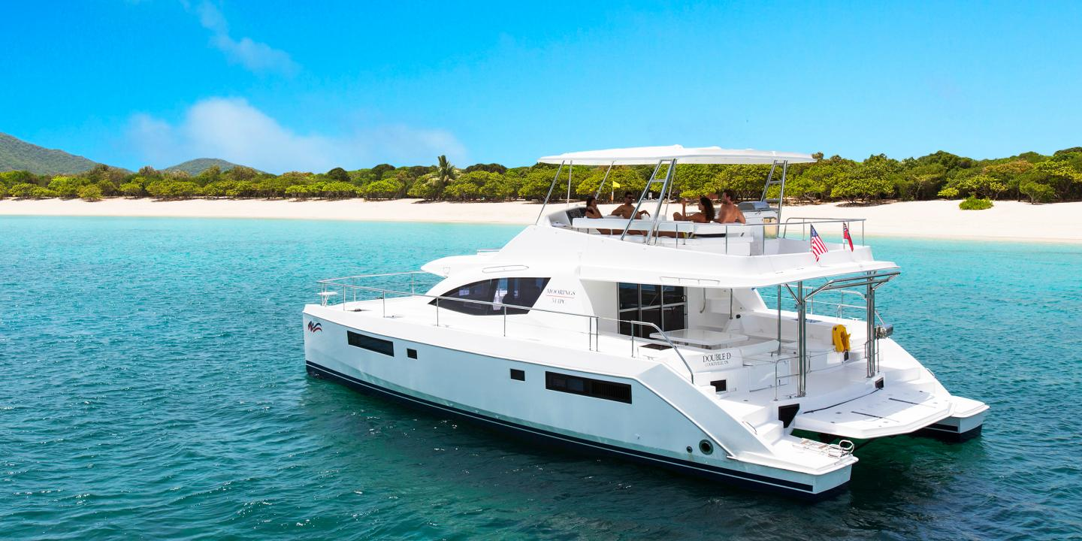


Slide 4
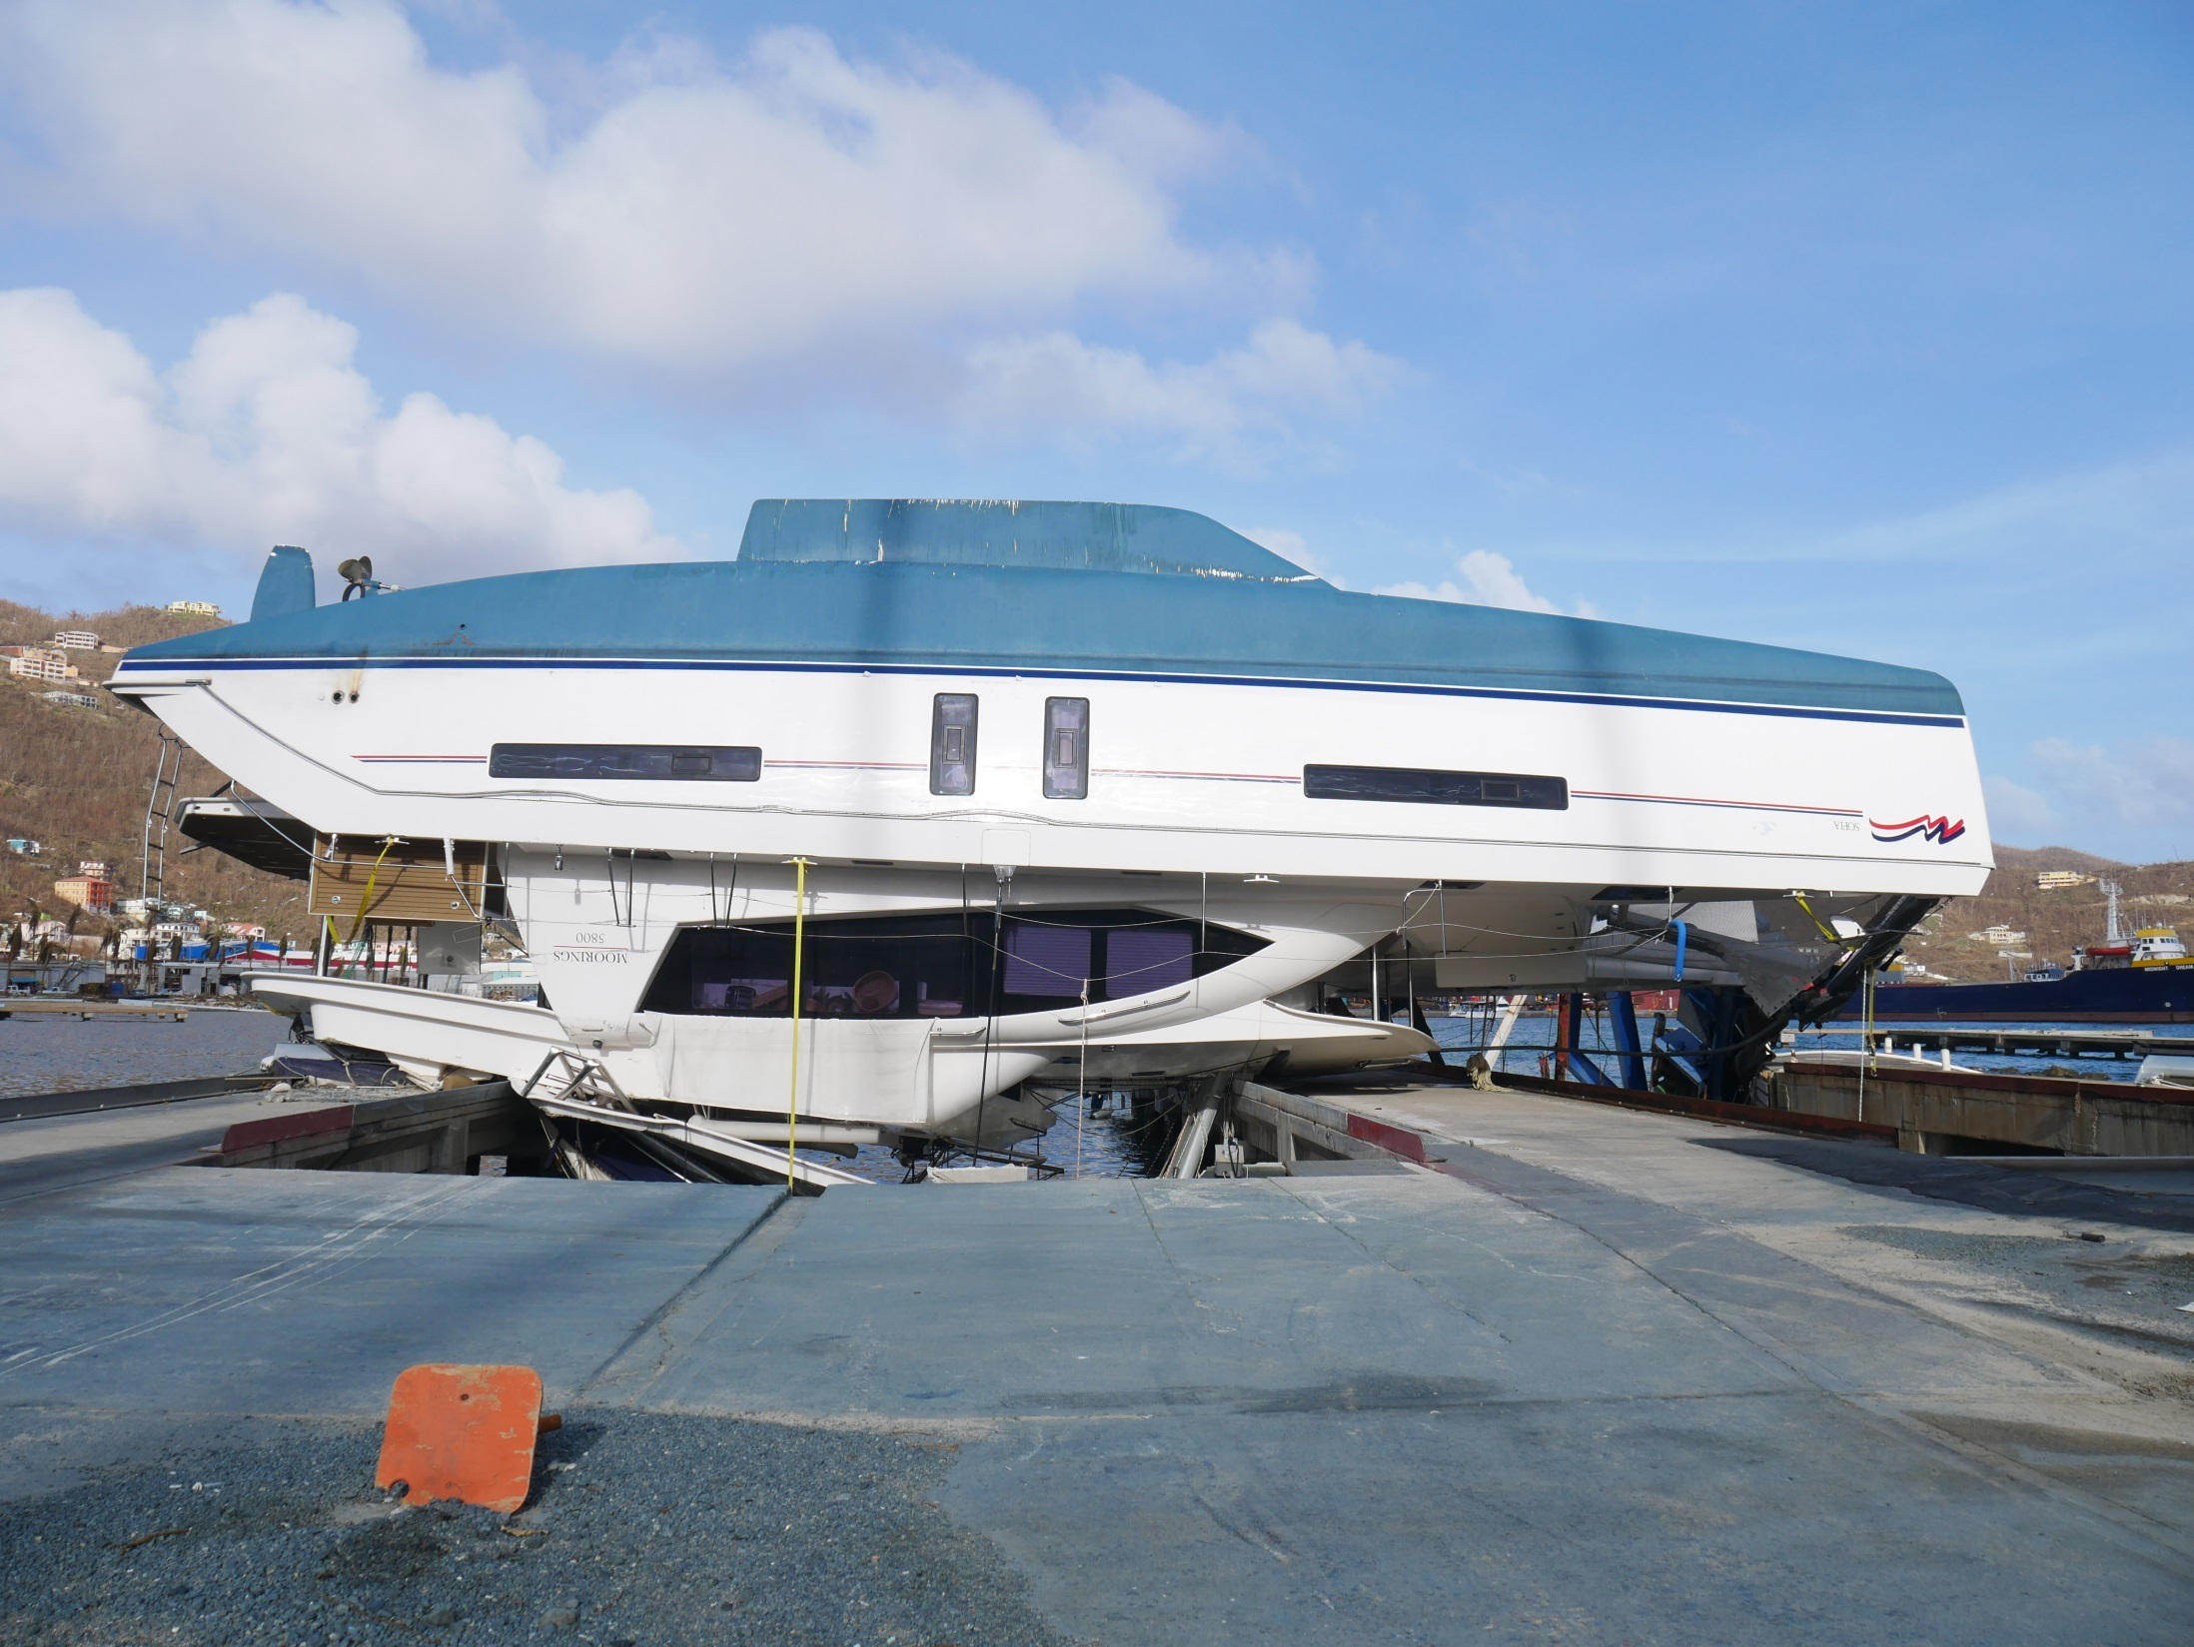

Slide 5
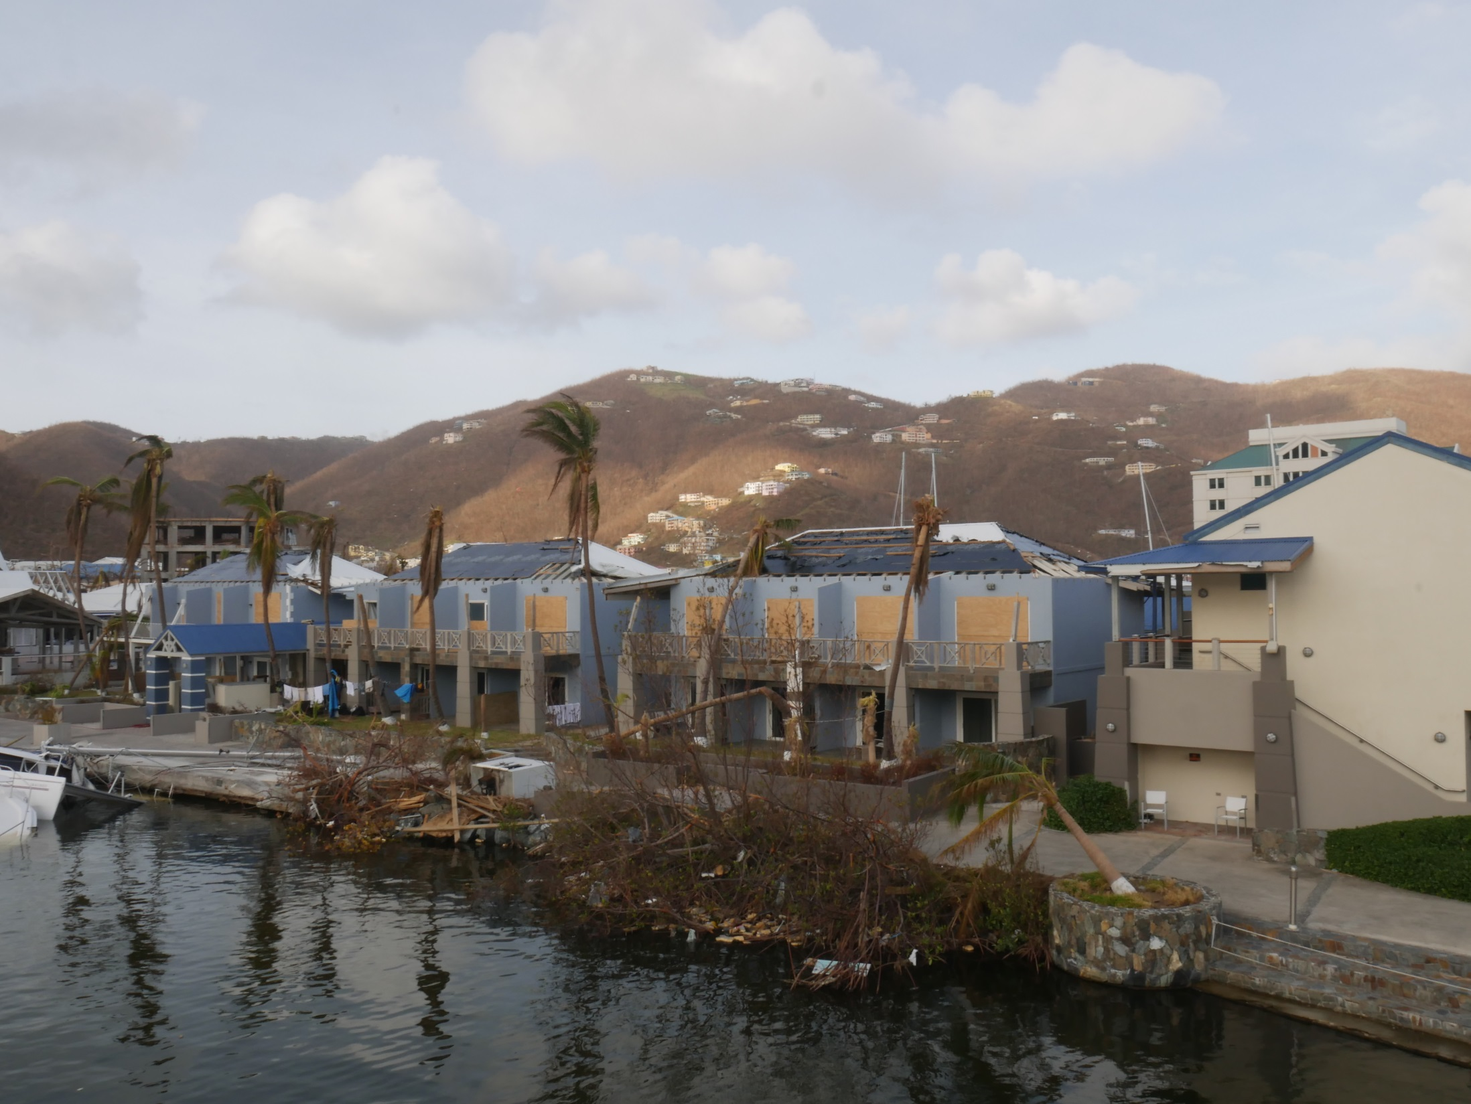

Slide 6
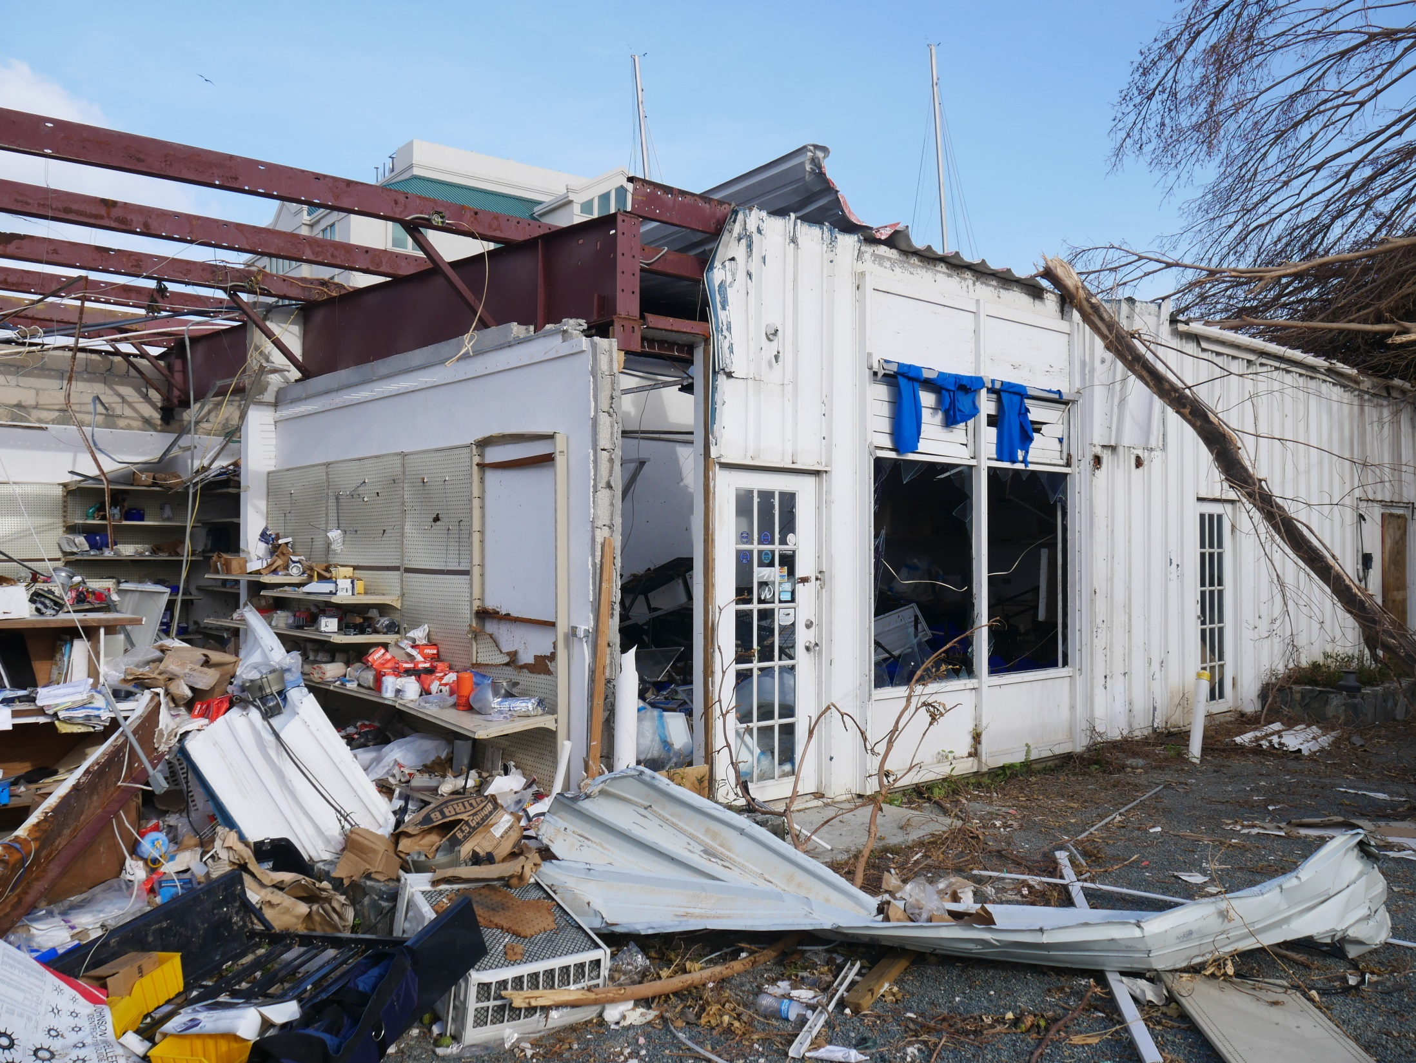

Slide 7
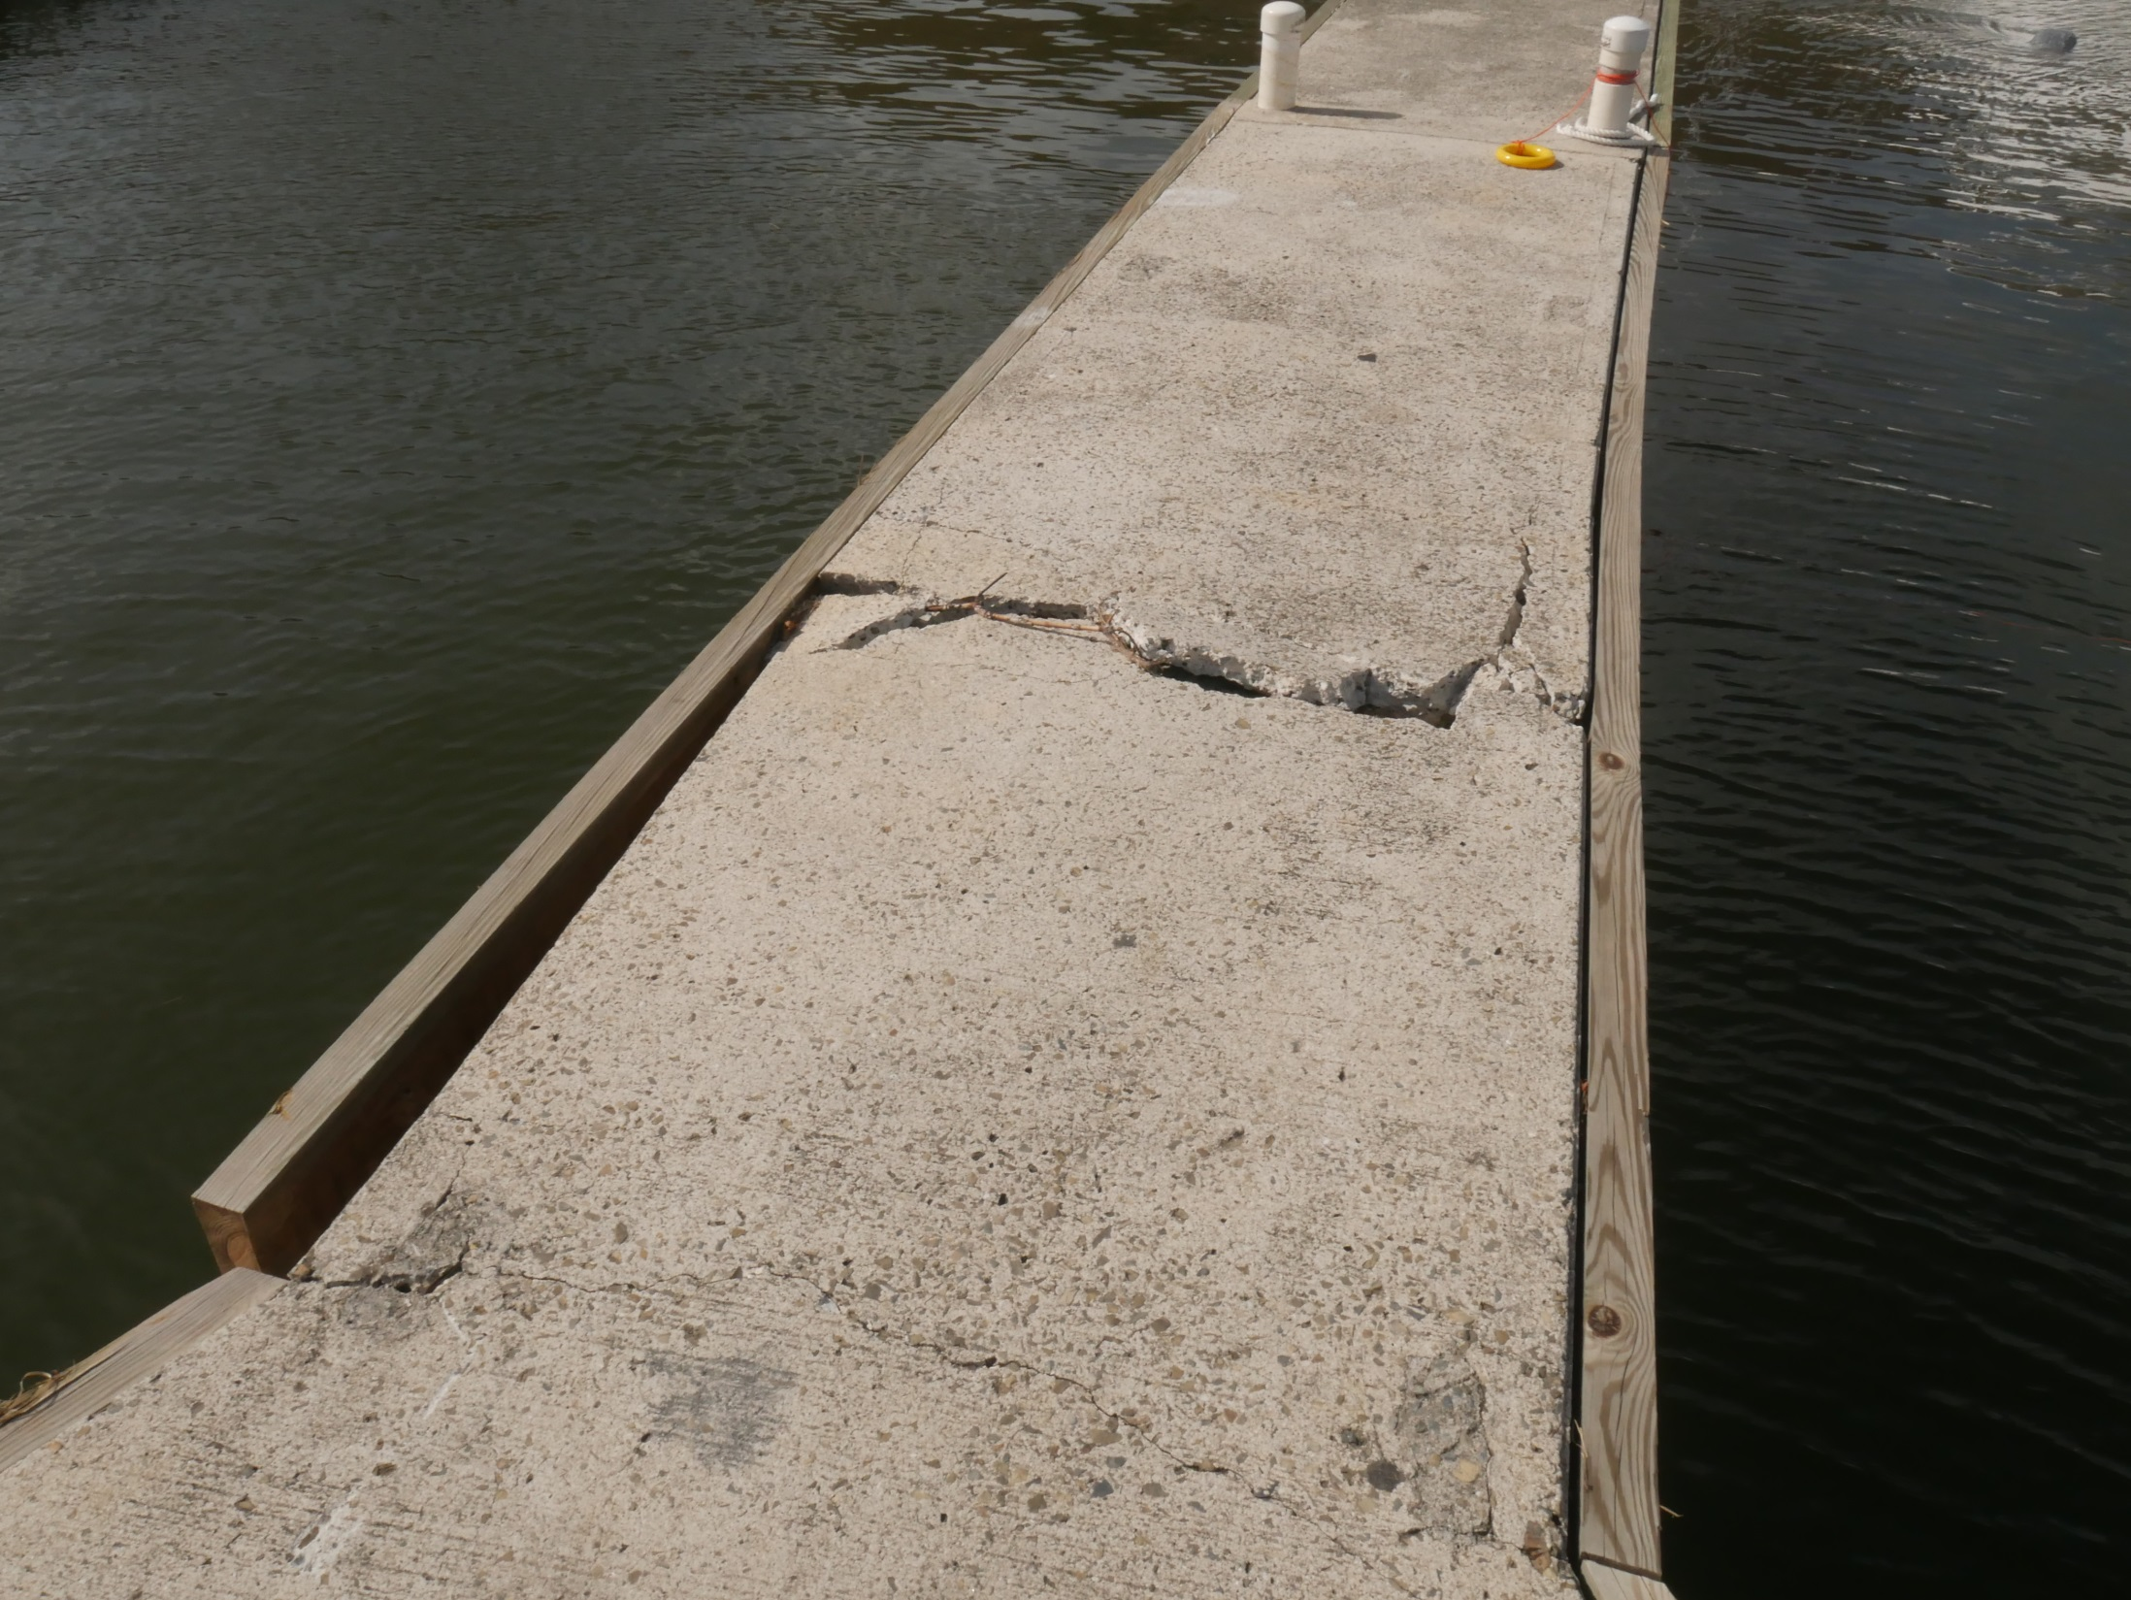

Slide 8
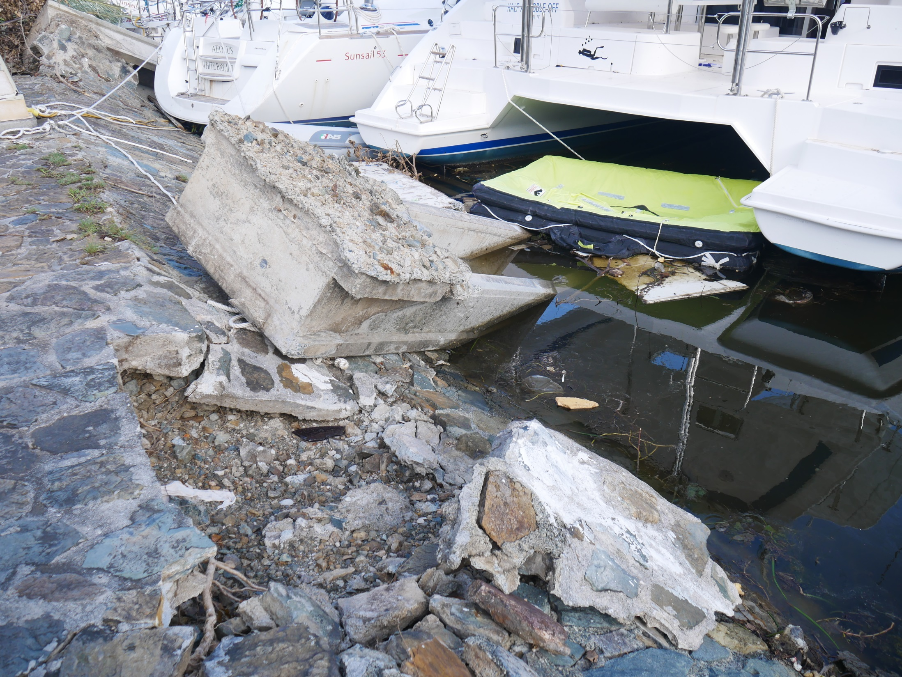

Slide 9
Initial issues
Logistics of getting people to site immediately
  Local airport not operational for 8 – 10 weeks
  Marine transit only viable option from Antigua
  Hurricanes Jose and Maria
Widespread damage and limited local resource
  Power distribution system down for 6 – 8 weeks
  Mini exodus

Slide 10
AIG site visit – November 2017
Primary focus on resort re-opening 9 Dec 2017
Lack of experience for large repair project
Project Manager installed
Interim payment approved

Slide 11
Insurance issues
Local / Master policies
  T&C’s not back-to-back
Underinsurance / Average
No clarity re Basis of Settlement for BI in either policy.
Maximum possible claim sub-limited by Master.

Slide 12
4 months after loss
Loss Limits settlement agreed with the Insured.

Slide 13
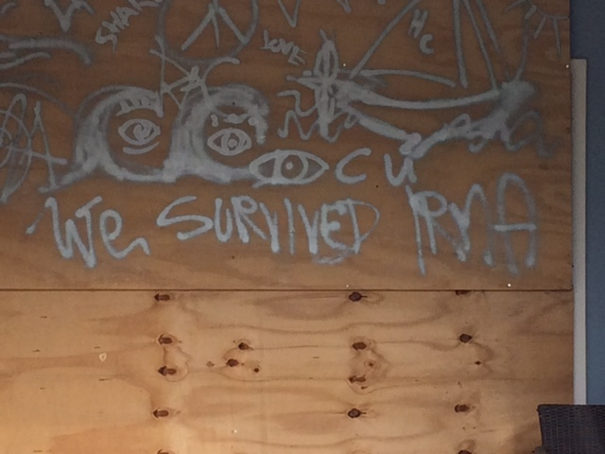

Slide 14

American International Group, Inc. (AIG) is a leading international insurance organization serving customers in more than 130 countries and jurisdictions. AIG companies serve commercial, institutional, and individual customers through one of the most extensive worldwide property-casualty networks of any insurer. In addition, AIG companies are leading providers of life insurance and retirement services in the United States. AIG common stock is listed on the New York Stock Exchange and the Tokyo Stock Exchange.
AIG is the marketing name for the worldwide property-casualty, life and retirement, and general insurance operations of American International Group, Inc. Products and services are written or provided by subsidiaries or affiliates of American International Group, Inc. Not all products and services are available in every jurisdiction, and insurance coverage is governed by actual policy language. Certain products and services may be provided by independent third parties. Insurance products may be distributed through affiliated or unaffiliated entities. Certain property-casualty coverages may be provided by a surplus lines insurer. Surplus lines insurers do not generally participate in state guaranty funds and insureds are therefore not protected by such funds.

