Slide 1


Workshop A8: Parametric solutions – quick payout for faster recovery
Christian Wertli, Martin Hotz

Slide 2
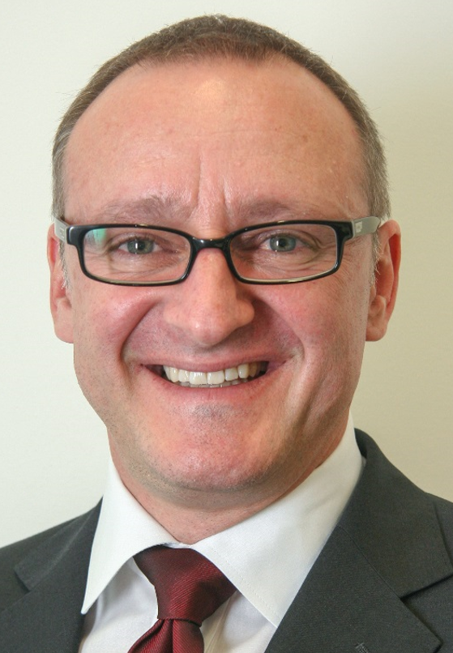
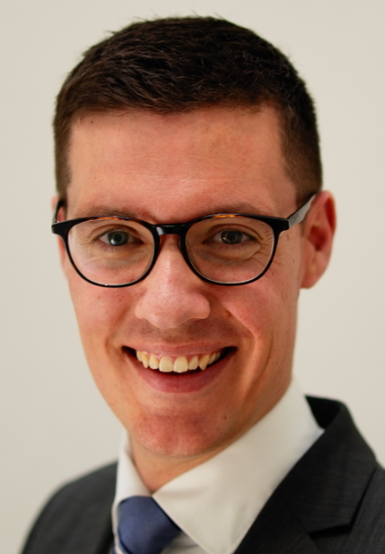
Your Speakers
Christian Wertli
Global Head Innovative Risk Solutions
Martin Hotz
Senior Parametric Nat Cat Underwriter

Slide 3
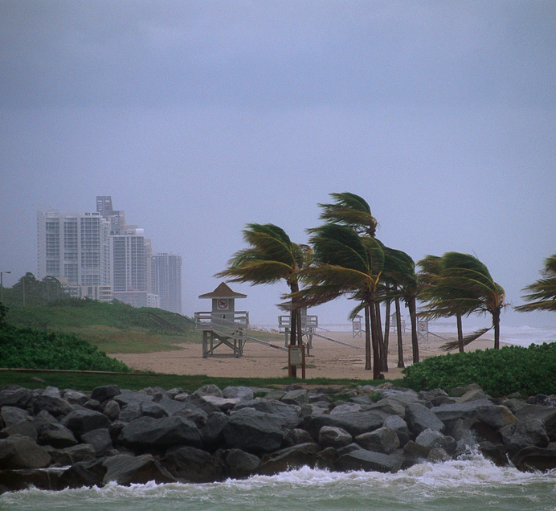
Workshop Objectives
Discuss how parametric solutions work
Provide an overview on what perils and risks can be covered
Provide a real example of a parametric solution in action

Slide 4
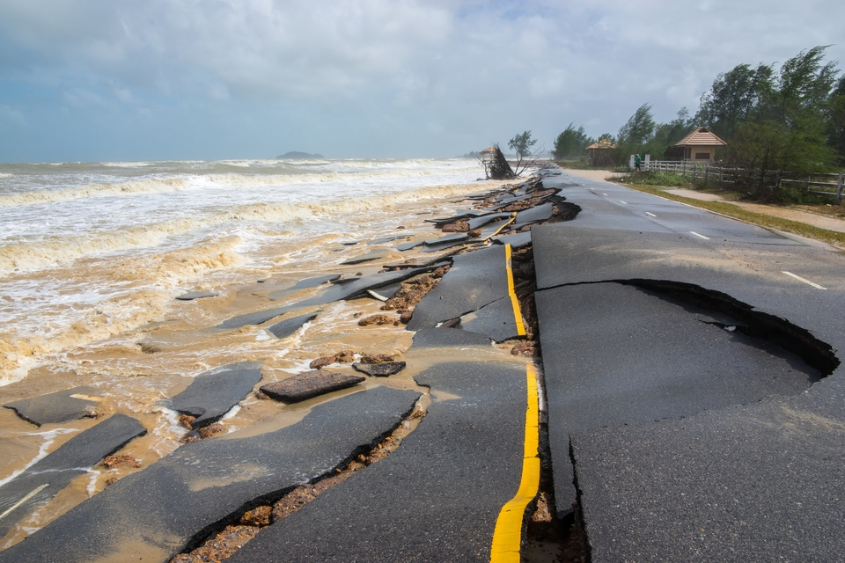
Parametric Solutions
“… pay out on the basis of a pre-determined index …”
Source: The World Bank, Treasury

Slide 5

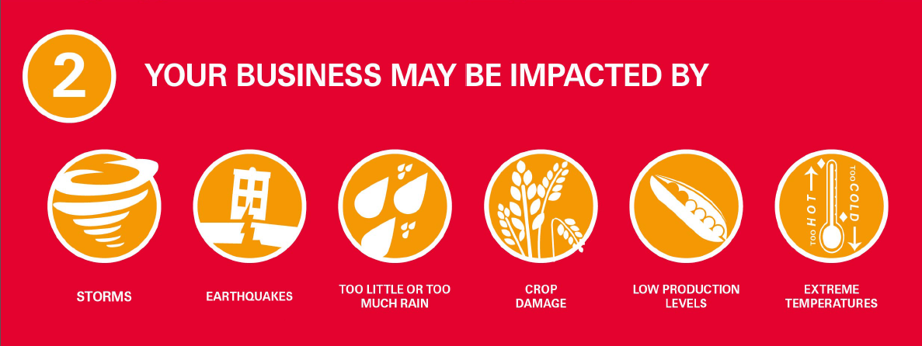

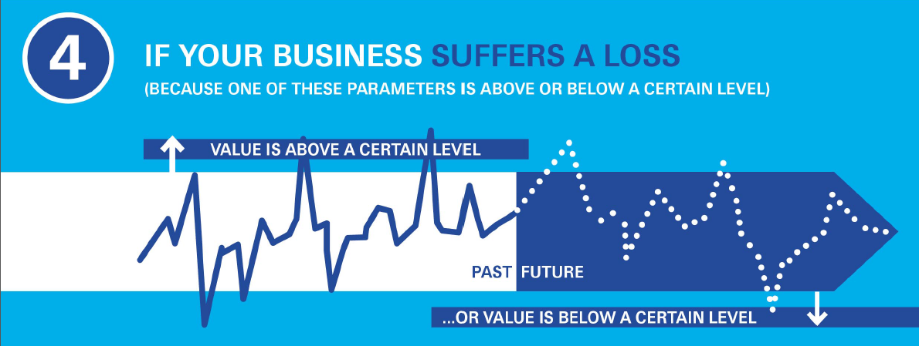

How do they work ?

Slide 6
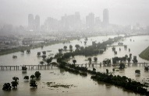
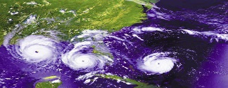


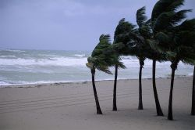

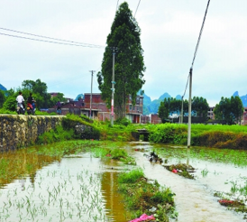
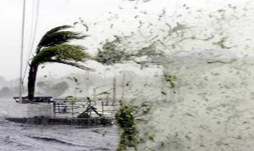


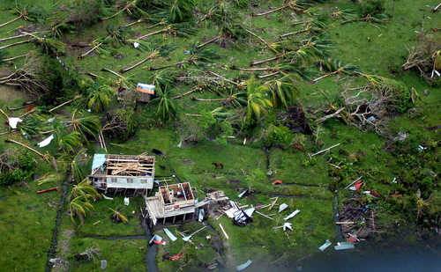

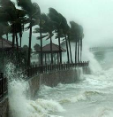





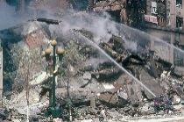

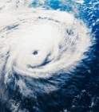



Applications
United States
Flood risk
Louisiana
Hurricane risk
Caribbean
Hurricane,
earthquake and excess rainfall risk
United Kingdom
Flood risk
Bangladesh
Flood insurance
Florida
Hurricane risk
Turkey
Earthquake pool
Heilongjiang
Multiperil disaster risk
California/Utah
Earthquake risk
Beijing
Agricultural risk
Mexico
Earthquake/hurricane
and livestock risk
Guangdong
Typhoon/rainfall
Guatemala
Nat cat business interruption risk
Philippines
Earthquake and
tropical cyclone risk
Vietnam
Agriculture
yield cover
African Risk Capacity
Government drought insurance pool
India
Weather insurance
for farmers
Pacific Alliance
(CHL, COL, MEX, PER)
Earthquake risk
Thailand
Crop insurance
Pacific Islands
Earthquake and tropical cyclone risk
Uruguay
Energy production shortfalls
due to drought
Kenya
Livestock insurance
World Bank
IDA countries
Pandemic outbreak

Slide 7

When it gets too technical …
… join us for an ‘alcohol solution’
on Tuesday @ 4pm

Slide 8

Case study
Our client
Beachfront hotels in South Florida and the Caribbean
Issues
Can not find adequate PD/BI cover for their hotels. High deductibles / low sublimits. PD/BI covers exclude e.g. landscaping, beaches, golf courses etc.
CBI, or wide area damage scenarios not addressed by standard PD/BI policies

Slide 9
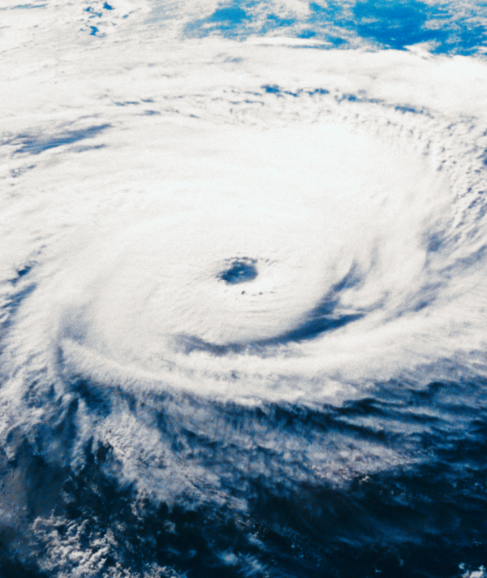
Solution: Swiss Re STORM
Parametric Tropical Cyclone cover
Provides quick formulaic payments when site is impacted by hurricane force winds
Any industry: Hospitality, retail, manufacturing, telecom, utilities, public sector etc.
What is it?
Value Proposition?
Where else can it be applied?
Notes:
On the next slide: Do a step by step

Slide 10
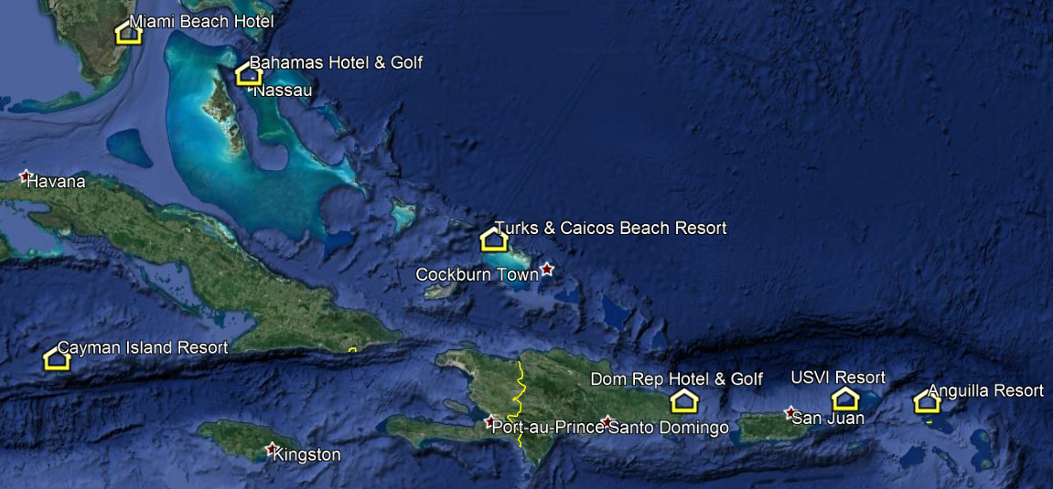
STORM: Step 1 – Define Locations
Notes:
Defined by latitude and longitude
7 locations
The sort of places where as a cat modeller you sit at your desk and think: I should inspect each of these individually

Slide 11
STORM: Step 2 – Define limits per location
Name | Latitude | Longitude | PD/BI TSI (USD) | Limit (USD)
Miami Beach Hotel | 25.779 | -80.130 | 278’000’000 | 14’000’000
Bahamas Hotel & Golf | 24.986 | -77.421 | 118’000’000 | 10’000’000
Turks & Caicos Beach Resort | 21.764 | -72.228 | 78’000’000 | 7’000’000
Dom Rep Hotel & Golf | 18.531 | -68.363 | 93’000’000 | 8’000’000
Cayman Island Resort | 19.306 | -81.384 | 103’000’000 | 5’000’000
USVI Resort | 18.373 | -64.928 | 114’000’000 | 6’000’000
Anguilla Resort | 18.182 | -63.110 | 88’000’000 | 5’000’000
Aggregate limit |  |  | 872’000’000 | 55’000’000

Slide 12
STORM: Step 3 – Define Payout Pattern
Intensity Range (1-min mph) | Payout (% of Site Limit)
< 65 | 0
65 – 74.99 | 20%
75 – 84.99 | 40%
85 – 94.99 | 60%
95 – 104.99 | 80%
≥ 105 | 100%

Slide 13
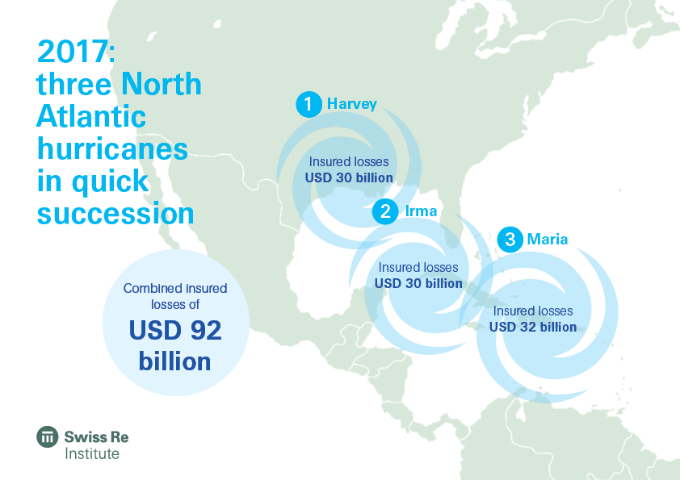
STORM: The Event(s)
The largest insurance loss-event globally in 2017 was Hurricane Maria in the Caribbean and Puerto Rico, which triggered claims of USD 32 billion. Next were Hurricanes Irma and Harvey, each resulting in estimated insured losses of USD 30 billion across the Caribbean and the US.
Swiss Re sigma: Natural catastrophes and
man-made disasters in 2017: a year of record-breaking losses

Slide 14
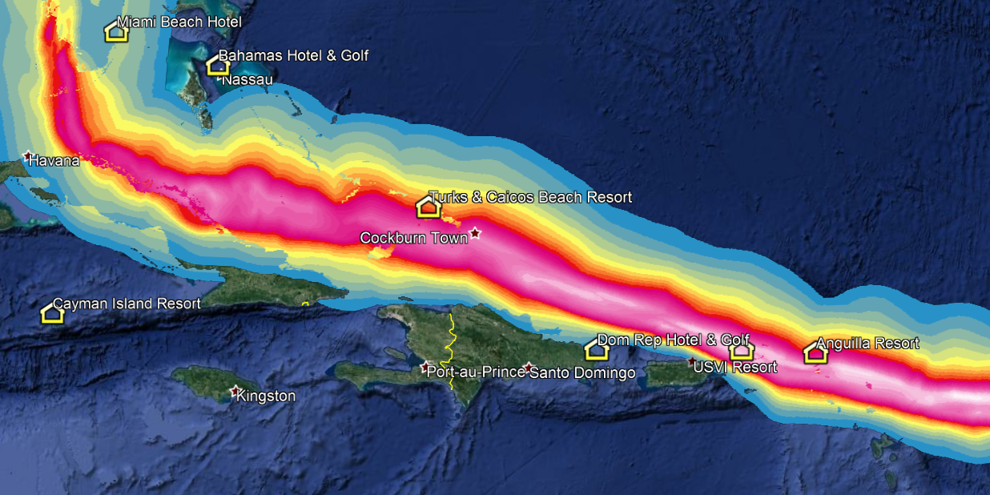
STORM: Step 4 – Event footprint
RMS HWind Event Footprint for 2017 Hurricane Irma
Notes:
RMS HWind. Example: Hurricane Irma. Red spells trouble (red = 100 mph, pink 160 mph and more).
maximum intensity on any point on the map
technology developed by the US government (NOAA, National Oceanic and Atmospheric Administration)
spin off after project was completed
was then acquired by RMS
taps into 40 different networks – airplane, satellite, offshore, onshore
world class science, reliable

Slide 15

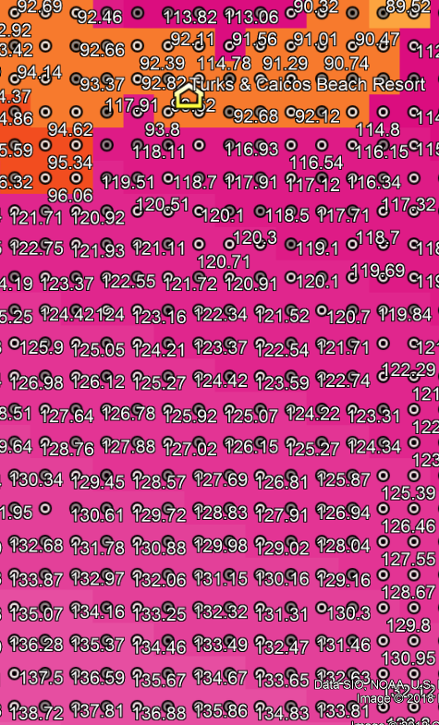
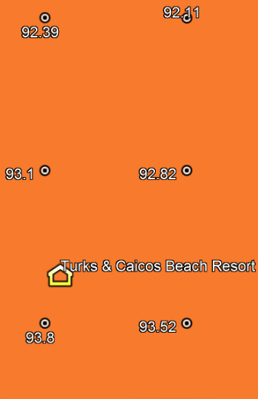
STORM: Step 5 – Intensity lookup
The event footprint
The high resolution grid data behind the footprint (0.01 x 0.01 degrees)
~ 1km x 1km
Look up intensity from nearest grid point
Notes:
grid point = “virtual weather station”
nearest grid point is never more than 0.7 km away (due to 1x1 km resolution)
similar interpolation approach as with numerical weather models

Slide 16
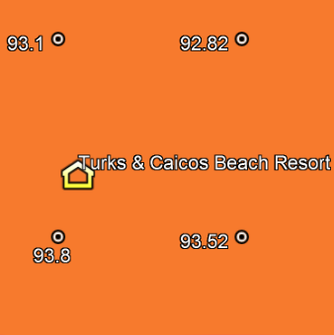
STORM: Step 6 – Payout Calculation
Intensity Range (1-min mph) | Payout (% of Site Limit)
< 60 | 0
60 – 69.99 | 20%
70 – 79.99 | 40%
80 – 89.99 | 60%
90 – 99.99 | 80%
≥ 100 | 100%
Payout for a USD 10’000’000 site limit: 80% of USD 10’000’000 = USD 8’000’000

Slide 17

STORM: Step 7 – Fast Payout!
Swiss Re Corporate Solutions made a claims payment
two weeks after landfall of Hurricane Maria on Puerto Rico
Notes:
while the island was still largely without electricity, scarcity of loss adjusters
theme of this workshop: quick payout for faster recovery

Slide 18
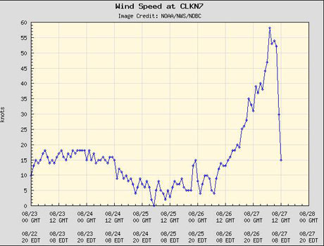
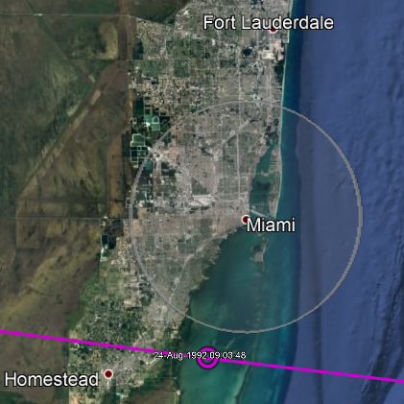
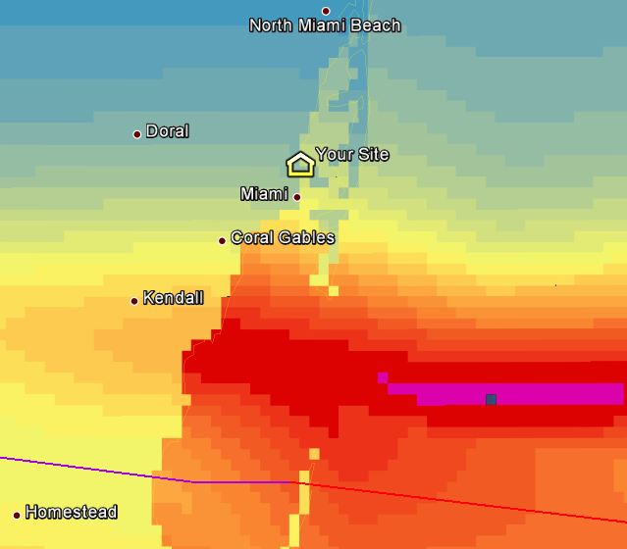
STORM compared to other Parametric Products
Station Measured | Cat-in-the-Circle | STORM
Stations often fail in hurricane conditions Higher basis risk: Stations are often several miles away. 10 miles can mean 40 mph lower wind (Andrew, 1992) … or the station might even be blown away resulting in zero data | Higher basis risk Intense wind at your site may still cause damage even though the named storm is outside the circle | Minimizes basis risk: Site specific, reliable, robust data (uses dozens of sources) Captures every named storm, regardless of distance to your site
Notes:
STORM: cat 3 over the site can be more damaging than Cat 5 30 miles away → in a CIC cover, you likely get more for the Cat 5 that is further away

Slide 19


Slide 20







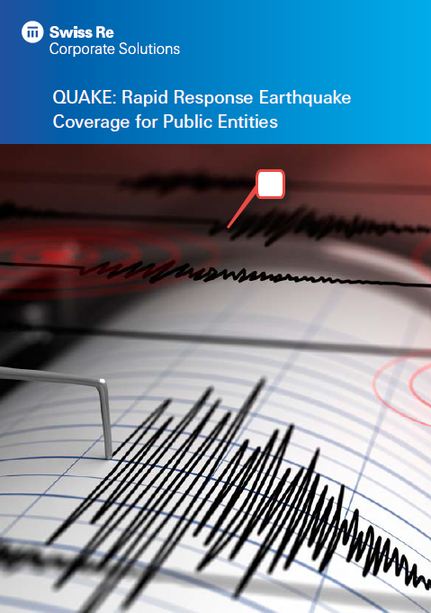
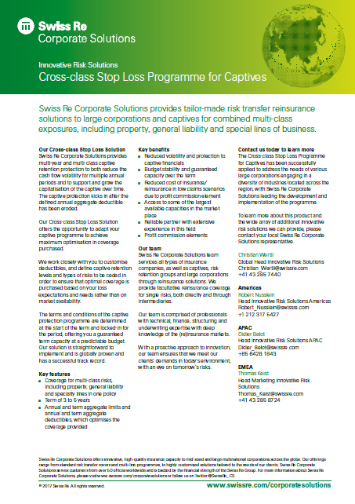

www.corporatesolutions.swissre.com

Slide 21
Innovative Risk Solutions

Slide 22
Legal notice
©2018 Swiss Re. All rights reserved. You are not permitted to create any modifications
or derivative works of this presentation or to use it for commercial or other public purposes
without the prior written permission of Swiss Re.
The information and opinions contained in the presentation are provided as at the date of
the presentation and are subject to change without notice. Although the information used
was taken from reliable sources, Swiss Re does not accept any responsibility for the accuracy
or comprehensiveness of the details given. All liability for the accuracy and completeness
thereof or for any damage or loss resulting from the use of the information contained in this
presentation is expressly excluded. Under no circumstances shall Swiss Re or its Group
companies be liable for any financial or consequential loss relating to this presentation.

