Slide 1




Slide 2

The Learning Journey – Workshop A6
Vanessa Harrison
Julia Graham
Stephen Anderson

Slide 3

Our agenda and approach
The Learning Journey
The Airmic Competency Framework
The Institutes ARM programme
Next steps

Slide 4


COMPETENCIES
ATTRIBUTES
Trusted
Leader
Visionary and Innovator
Ethical and Transparent
Authentic and Empathetic
Patient and Personally Resilient
Plausible Communicator Confident and Courageous
Flexible and Agile
Influencer and Motivator
Coach and Mentor
Facilitator
Curious
MANAGEMENT
SKILLS
Strategic Perspective
Planning
Organisation
Decision Making
Relationship Development
Judgement
Story Telling
Inspiring
Engaging
ORGANISATIONAL
KNOWLEDGE
Internal and External Context
Purpose, Values and Behaviour
Culture
Strategy and Objectives
Business Model
Decision Making Processes
Value Chain
Stakeholders
CORE
COMPETENCIES
Business Insight
Integrity and Ethics
Problem Solving
Consultation
Influencing
Negotiation
Communication
Collaboration
Leadership
TECHNICAL
SKILLS
Governance
Compliance
Research
Data Analytics
Financial Analysis
Technology Application
Statistics
Behavior Modification
Information Systems
Resilience
BUSINESS
ACCUMEN
Global trends
External and Internal Context
Strategic Planning
Business Models
Performance Management
Economics
Laws and Regulations
Functional Areas and Peers
Finance
Technology
People
RISK MANAGEMENT
KNOWLEDGE
Standards and Concepts
Adaptation Approaches
Principles
Frameworks
Processes
Taxonomy
Solutions
Subspecialties

Slide 5
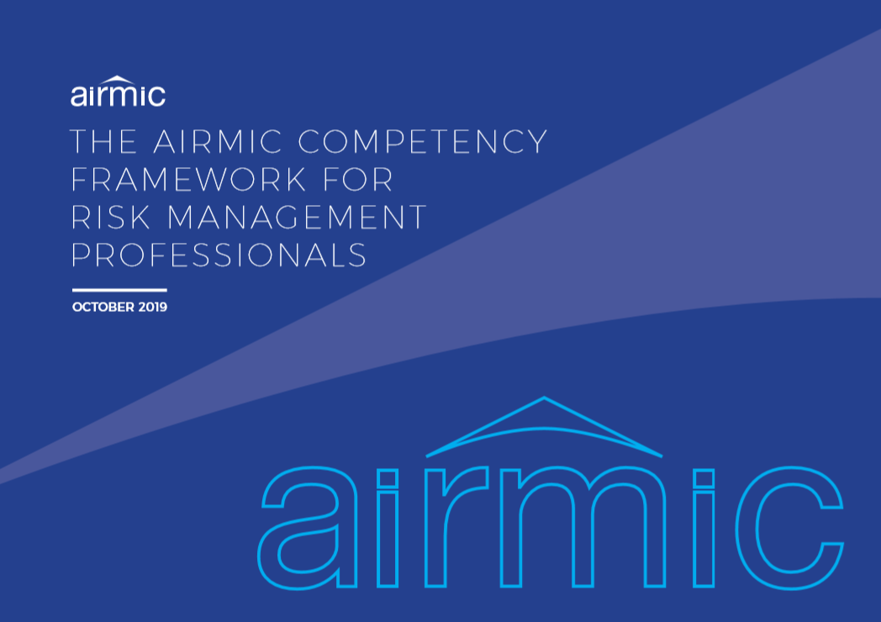

Slide 6
