Slide 1

Crisis management – it’s your reputation at risk
BIA Win Major Loss Case Study
Wednesday 9th October 2019

Slide 2

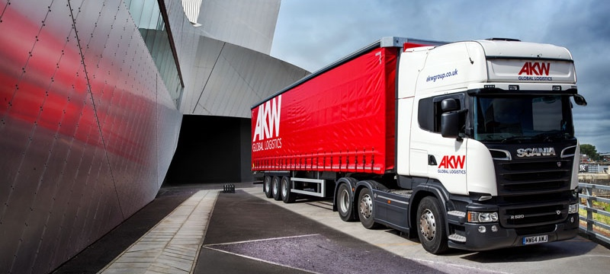
BIA Case Study - AKW Global Logistics

Slide 3
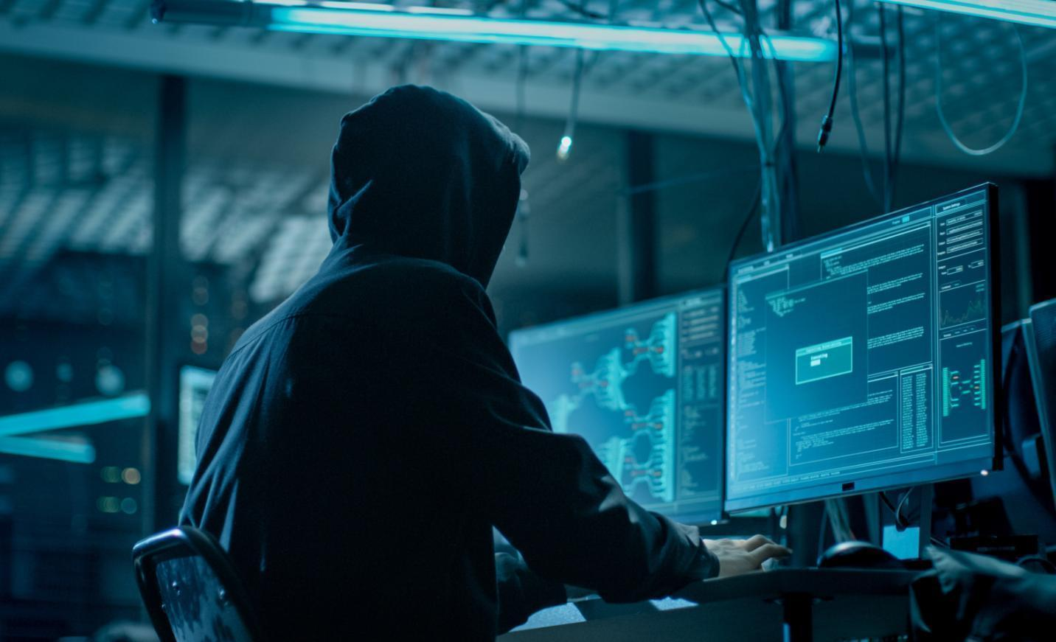
Initial Challenges
All systems are crippled
  VoIP
  Emails
  Stock
  Warehouse
  Logistics
  Payroll
Backups deleted
Criminals had been in network for months
Loss of key clients
Loss of turnover
Board updates
Damage to reputation

Slide 4
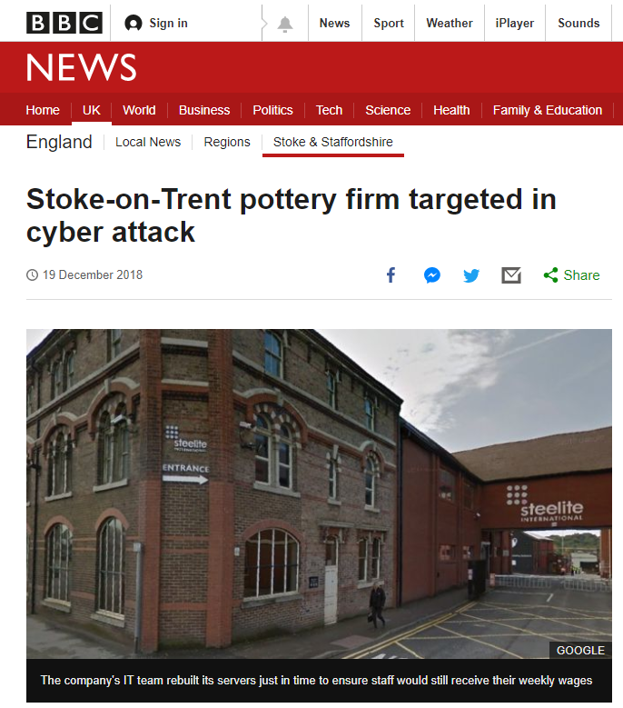
Steelite – System Loss

Slide 5

Breakout Groups

Slide 6
Key factors in rebuilding the network
Forensic accountants – they were able to provide answers to loss of turnover
IT partners – they gave suggestions to the internal team which were not followed resulting in a further encryption – taking us back to square 1
Legal – their involvement was limited as no personal data was exfiltrated.
Communications
Management of client expectations
Post repair meeting to discuss the incident and conclude network audit

Slide 7
Communications
Mark Hawksworth
Sedgwick
IT Partner
Forensic Accountants
Legal
AKW Logistics
AKW Board
Internal IT
Claims Manager
Board
Co-ordinated IT response
Regular updates to the board
Advanced IT planning
Broker updates
Policy Cover
Liability
Payments on account
Ransom payment

Slide 8
Timeline for the rebuild
26 Nov.
AKW Group systems stopped running due to Ransomware
Case conference held to discuss the situation and provide assistance
The initial decision was taken to run with the existing IT contractor with support from our IT partner
28 Nov.
Ryuk “strike again” taking repair efforts back to square 1
Our IT partners attended site and take over project management of repairs
Network secured to prevent further access by Ryuk
Network backups secured and rebuild started
3 Dec.
AKW Group emails working and back office systems accessible
13 Dec.
80% of AKW Group business critical systems back on-line
21 Dec.
AKW fulfilled the majority of customers pre-Christmas orders

Slide 9
What was achieved
Ransom demand of £135,000 was not paid – deterring future attacks
Our IT partners managed
warehouse and logistics systems reinstatement
within a week
80% of the remaining systems reinstated
by 14 days later
AKWG systems reinstated in time for Christmas deliveries
Key clients retained due to management of smaller client expectations
Any damage to reputation was managed, AKWG is now far more resilient to cyber attacks following the repairs and post incident improvements
Successful outcome
for all parties

Slide 10

“The Importance of cyber insurance and pre-incident survey”
✘
✓
15%
78%
  The response from UK businesses who have not suffered from a cyber incident.
  The response from UK businesses who have suffered from a cyber incident.

Slide 11

Questions?

