Slide 1
Employee wellbeing
makes business sense
June 2018
Rosie Hewitt
Adam Shelverton
Rehabilitation and Delegated Claims Manager
Assistant Rehabilitation Manager

Slide 2
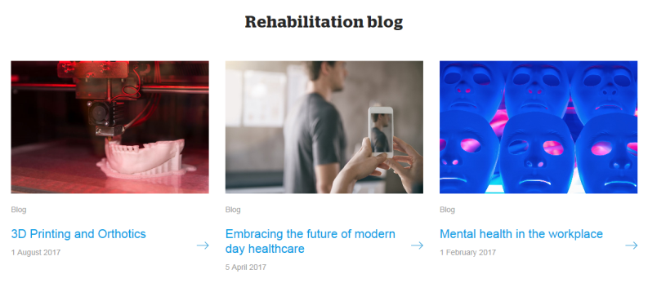
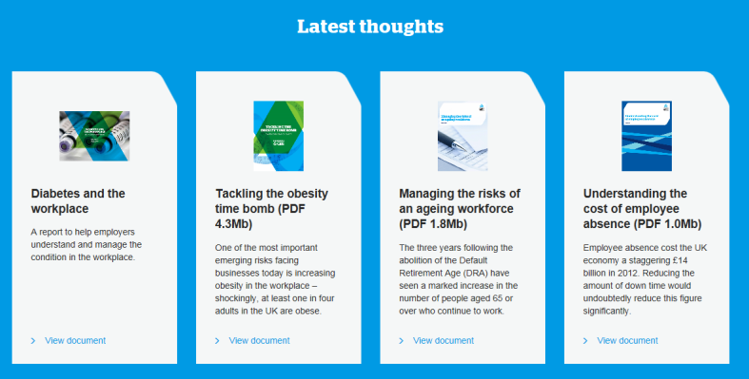
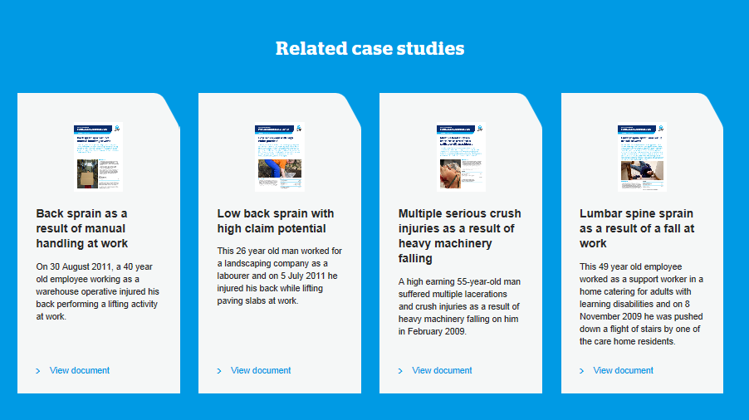
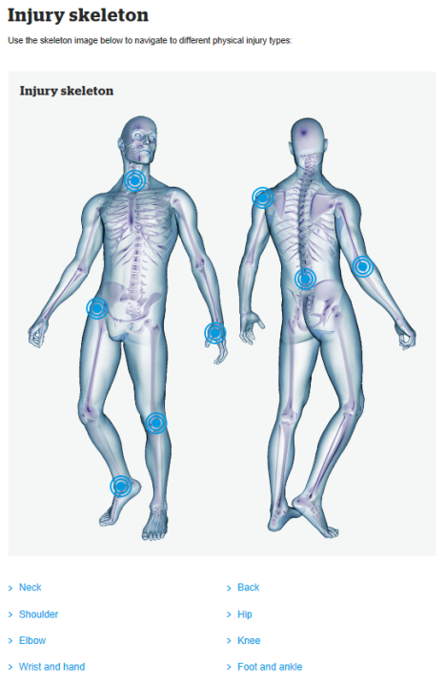
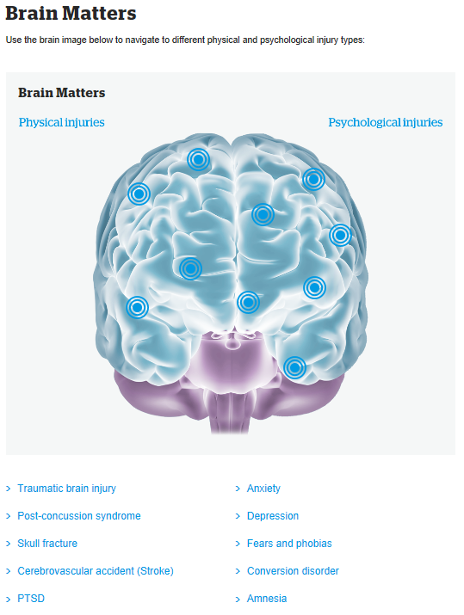
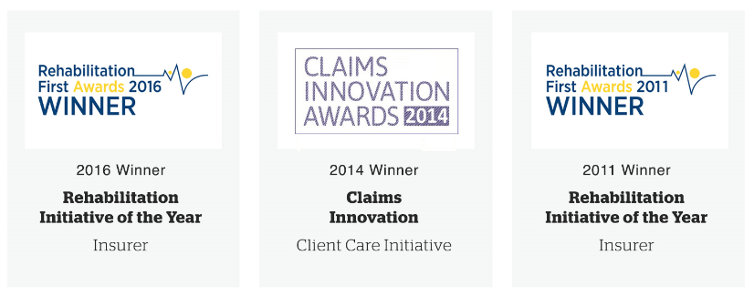
Protecting people and your business
www.qbeeurope.com/rehabilitation
Notes:
RH – 25 years experience, clinical nurse
AS – Physio
Expertise in insurer rehabilition – early intervention is critical to success and awareness of health issues within claims and our customers.
Key challenge is proving its value which we have done and all the brilliant intiatives we take forward

Slide 3
The business case: early intervention
12 months Client MI Summary Data – Transport & Logistics
Number of referrals | 112
Average case duration | 120 days
Percentage of cases RTW achieved | 88%
Average days saved per case compared to MDA* | 21 days
Estimated total days saved over 12 months | 2039 days
Total Direct Net Cost Savings over 12 months** | £390,370
* Footnote to go here
** Footnote to go here

Slide 4
The business case: 2017 in our customers’ industries
Construction
Summary Data | Savings
Referrals | 62
Average case duration | 103 days
% of cases RTW achieved | 86%
Estimated total days saved | 508
Estimated savings based on cost of absence (£71 per day)** | £36,086
Manufacturing
Summary Data | Savings
Referrals | 145
Average case duration | 178 days
% of cases RTW achieved | 93%
Estimated total days saved | 3625
Estimated savings based on cost of absence (£71 per day)** | £257,375
** Footnote to go here
** Footnote to go here

Slide 5

Obesity the ticking timebomb

Slide 6
Obesity: the ticking timebomb
The UK has the highest level of obesity in Western Europe –
26.9% of UK population
Half of Britons will be obese by 2045
In 2017, the strain on the NHS due to conditions caused
by or related to obesity increased by 18%
Since the 1990’s, obesity has increased by 92%*
Health At A Glance Report, 2017, OECD
Notes:
KEY POINTS: Open with the big picture, around UK levels of obesity and their impact on employers. Emphasise this is a major risk for employers that needs to be managed.

Slide 7


Obesity: a costly issue
How many more sick days does the average obese person
take above someone with a recommended BMI?
4 days equates to, on average £284 (avg daily absence cost £71)
additional cost of absence for businesses.
Obesity is the
new smoking
Q:
How much this would equate to your bottom line?
What will you do to assist minimise this risk to your business?
How will you address this sensitive issue?
Or are you and how?
Notes:
KEY POINT: This is a costly health issue, and your challenge is to help employees minimise the impact of their obesity.
4 days on avg. £71 from National Office of Statistics
Unhappy stories here – many multi layers to this issue from health perspective so much so the Government has had to intervene ie sugar tax. Childhood obesity.
On average, obese people take four extra sick days each year*.
Huge problem for NHS – smoking, but next obesity. Simon Stevens chief Executive “Obesity the new Smoking”

Slide 8
Obesity: what can employers do?
Name 3 measures that you should consider to protect obese employees
and cater to their individual needs?
Many ways
Key is Company Culture – non discrimination policies
And to know your employee and adapt accordingly
Notes:
KEY POINT: discussion of measures that employers should consider to lower the risk of accidents, sickness and injury for obese employees.
Company culture.
Making workplace adjustments eg. Chairs, desks, workstations
Improving access to buildings
Providing nearby parking
Allowing additional time off for medical appointments
Ensuring screens and IT equipment are appropriate (Diabetes can effect eyesight). Employer’s may want to fund yearly eye tests.
Providing clean, hygienic spaces for diabetics to take their insulin injections.
Individualised risk assessments
Non-discrimination policies
Workforce engagement

Slide 9
Obesity: EU disability ruling
In 2014, the EU Court of Justice ruled obesity may be considered a disability if it causes:
Physical harm
Mental harm
or
Psychological harm
Regardless of Brexit, organisations need to be aware of the new responsibilities
the ruling raises
34% of companies said that a candidate’s obesity
has influenced their decision to reject them for a role
QBE survey 2016
Notes:
Consequences if they fall foul of these obligations

Slide 10
Obesity: one last question
Hands up whose company currently records obesity levels
for employees involved in workplace accidents?
30%
54%
of employers record
the obesity levels of employees involved
in workplace accidents
of companies
do not monitor
levels of obesity

Slide 11

The ageing workforce

Slide 12
Ageing workforce: Demographic reality
How many companies know how many of their employees are above the state pension age? (show of hands)
In 10 years (2028) the state pension age for both sexes will be 67
Older workers have specific health and safety risks, needing need specific types of support
Q:
Are you ready?
Notes:
Also add:
Between 2011- 2015, the no of workers >65 increased by 30%.
Trajectory set to continue
Subject always in the news – UK families would have to pay an extra £2k per year to fund the NHS due to us living longer.

Slide 13
Ageing workforce: inescapable facts
Ageing affects us all differently and in a number of ways:
Eye sight, lung function, hearing and joints degenerate
However, key elements of cognitive performance i.e intelligence, knowledge and use of language do not show marked decrease until after 70
Little evidence that older workers have an increased risk of occupational accidents v younger workers
BUT, accidents in older workers more likely to result in more serious injuries, permanent disabilities or death
Notes:
Stress how everyone individual is different
Challenge our perceptions
Rehabilitation takes longer, especially if pre-existing or degenerative conditions present – increased absence costs, longer recoveries, work place adaptations

Slide 14
Ageing workforce: So what are we doing?
Q:
Who here conducts specific health and safety risk audits around older employees?
Q:
Who has an OH programme designed for older employees?
Q:
Who trains line managers specifically around age- related employee issues?

Slide 15





Ageing workforce: what can we do?
Risk
Management
Health
Care services
Prevailing attitudes
Manager
training
Working practices

Slide 16

Mental health under pressure

Slide 17
Mental health: disability or not?
Q:
Is a mental health problem legally defined as a disability?
A:
Yes
An estimated 444,000 workers in 2014/5 suffered from stress caused or made worse by their current or past work
(HSE)

Slide 18
Mental health: the impact
Q:
Which of the following is the most likely work-related issue for someone
with mental health problems?
a. difficulty concentrating
b. lack of patience
c. taking longer to complete tasks
d. difficulty in multi-tasking
A:
All

Slide 19





Mental health: the impact
Alternative slide
37%
57%
80%
62%
50%
of mental health sufferers are likely
to get into a conflict with an employee
of mental health sufferers find it difficult to perform multi-tasks
of mental health sufferers find it difficult to concentrate
of mental health sufferers take
longer to do tasks
of mental health suffers are potentially less patient with customers

Slide 20



Mental health: rehabilitation provision
Name three proactive steps you can take to spot and manage mental health issues?
Spotting mental health issues can be problematic. Using below can assist:
Prevention
Identification
Action

Slide 21
To conclude

Slide 22












What our customers say:
I do not know where I would be
had It not been for the help provided
Injured Party – Early Intervention Service
The early intervention service from QBE delivers
significant savings to us, getting our people back to
work swiftly, in many cases avoiding the need for a claim
Major Construction Corporation
The service is seen as a ‘must have’ by the business
and feedback from employees and managers alike, demonstrates how valued the scheme is
Major Distribution Company
Without the guidance and advice of the case manager
and later the counselling I would have struggled to maintain work and put the accident behind me
Injured Party – Early intervention Service

Slide 23

And When Claims Arrive….
Claims Banding | Average Savings Per Band
£0 – 25K | £1,741
£25 – £100K | £8,828
£25 – £100K | £8,828
£100 – 250K | £14,588
£250K+ | Out of scope
2016 Winner:
Insurer Initiative Rehabilitation First Awards
Notes:
So when claims actually happen.
Across our book – motor, EL, and all types of injuries
Actuarial Approved Savings
So we can reduce costs for your business overall – key is early referral and early support

Slide 24
Questions?

Slide 25
Employee wellbeing makes business sense
If we have time – open to debate
Q:
Which out of these 3 areas poses you the most concern as an employer?
a. obesity
b. ageing workforce
c. mental health

