Slide 1



The value of risk management -
Communicating with the C-Suite and the Board

Slide 2




Who are we?
David Thomas
Commercial
Director
30 years insurance market experience underwriting and as a risk manager,
18 years specialising in risk technology
Angus Rhodes
Global Product
Manager
30 years experience in delivering technology solutions,
Leads Ventiv’s global product development team

Slide 3
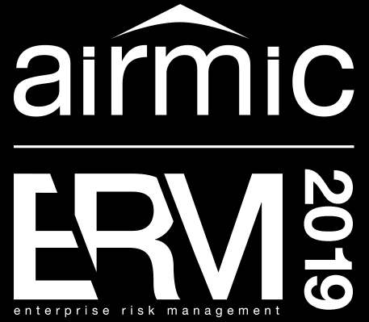
Agenda
Understanding the value of risk management
What communication challenges do you face?
A role for technology?
Ways to improve board communication
The future technological landscape
Wrap-up and questions

Slide 4
WORKSHOP DISCUSSION
Understanding the value of risk management
  Merely a regulatory requirement
  A tool to support and advance organisational strategy
  Or is it more complicated than that?

Slide 5



So what is the value of Risk Management?
Objectives
“Keeping the train on the track”

Slide 6
What is the value of ERM?
Potential Upside With little Downside Risk
 | Advanced ERM Companies | All Other Companies
Better Informed Decisions | 86% | 58%
Greater Management Consensus | 83% | 36%
Increased Management Accountability | 79% | 34%
Smoother government practices | 76% | 39%
Ability to meet strategic goals | 76% | 36%
Better communication to board | 69% | 52%
“The Potential Cost and Value of ERM” The Conference Board
Source: Matteo Tonello, Emerging Governance Practices in Enterprise Risk Management, The Conference Board R-1398-07-WG, February 2007.

Slide 7
What is driving ERM?
Main forces of change raising ERM
Cyber/AI
Expanding risk profiles
Regulatory mandates
Board and C-suite enquiries
Business model disruption
Operational "near misses" increasing
ERM guidance refreshing
ERM frameworks

Slide 8
WORKSHOP DISCUSSION
What challenges do you have in communicating risk management with your board?
  What level of engagement do you have?
  How many risk managers discuss risk with the board?
  How else might you communicate – via another party?
  What are the current constraints?
  What is the frequency of communication?
  What are the potential ways to improve board communication?

Slide 9


The role of technology in communicating risk management.
Who is using spreadsheets to manage their risks?
What other tools do you utilise?
What mechanisms do you have to communicate with the board?

Slide 10

ERM & Technology
So when should technology be considered?
Risk Maturity Progression
High
Maturity
Low
The tail wagging the dog!
Time & Resources
Undeveloped
Developing
Established
Embedded
Optimised
Risk Management in silos
No silos
One Risk View
Ad-hoc
Formal ERM Technology Solution

Slide 11
ERM & Technology
The business risks that will impact the execution of the strategy are not the Governance and the Compliance
The Proportion Of Significant Losses In Market Value Caused By Each Risk Over The Past Decade
Strategic
86%
Operating
9%
Legal and
Compliance
3%
Financial
Reporting
2%
The Proportion Of Time Spent On Each Risk
6%
42%
13%
39%
Source: CEB, and Harvard Business Review July-August 2015

Slide 12
ERM & Technology
Benefits
Improved transparency and insight
Dynamic and effective reporting
Full audit trail and better compliance
Supporting proactive RM
Integrated risk- and insurance reporting

Slide 13
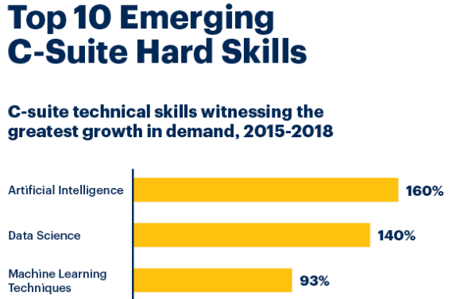
GARTNER 2019 CEO SURVEY
Top 10 Emerging Hard Skills - AI, Data Science, Machine Learning…

Slide 14
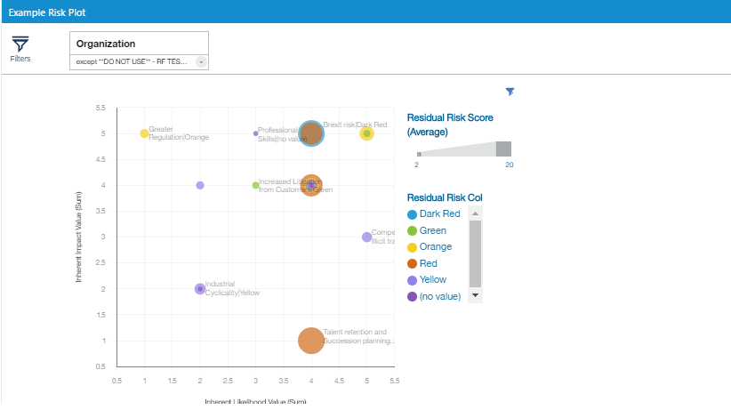
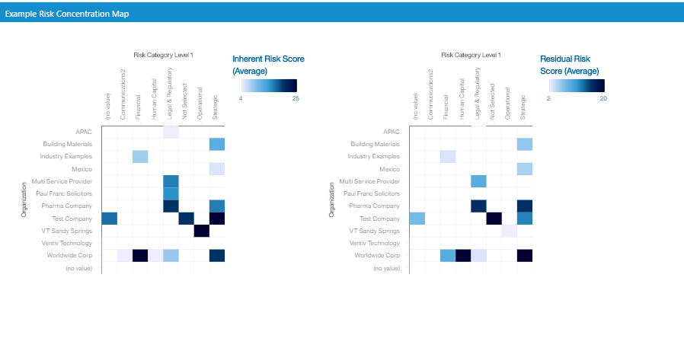
ERM – Communicated by Visualisations
Capable of Interrogation

Slide 15
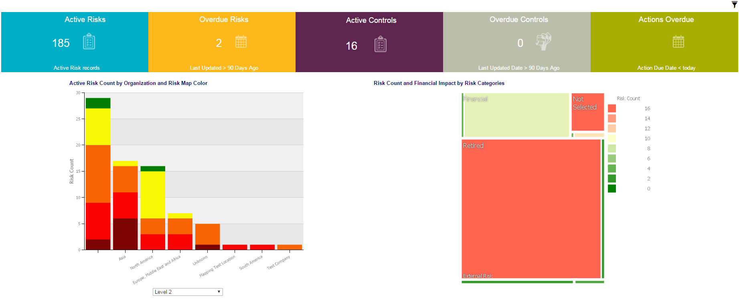
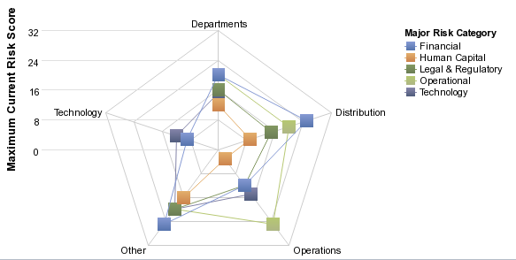
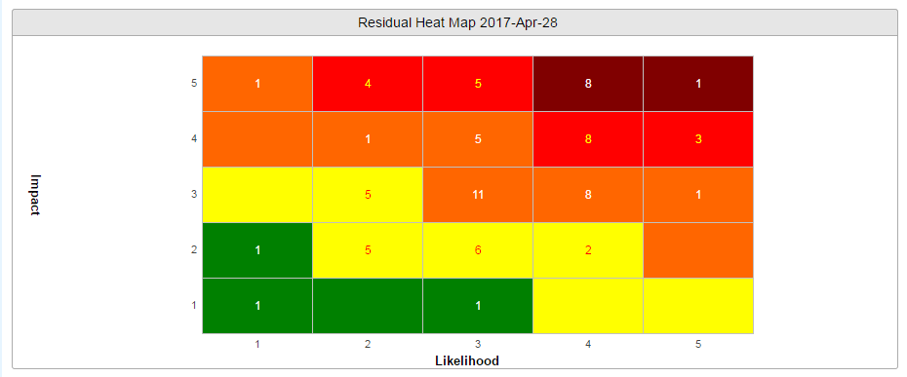
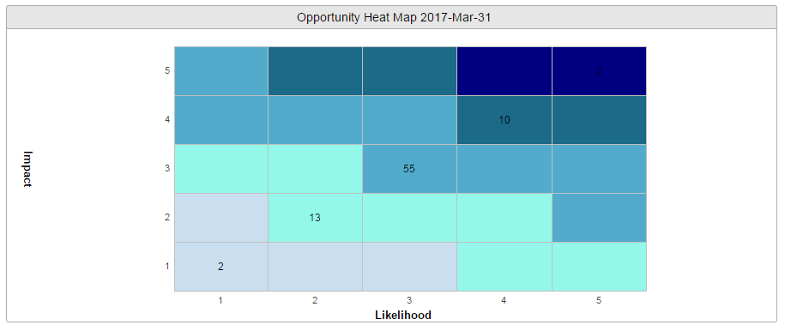
ERM & Technology
Focus Area – Visualise your future risk landscape

Slide 16
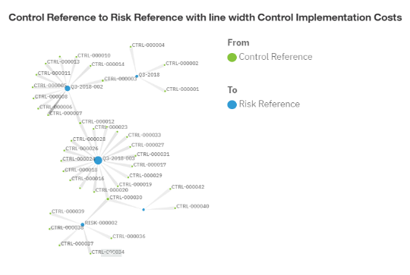
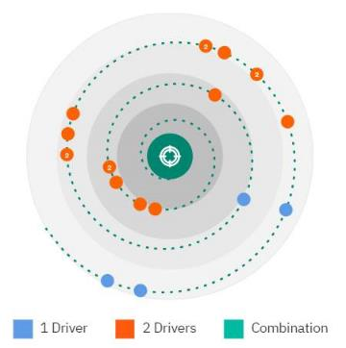
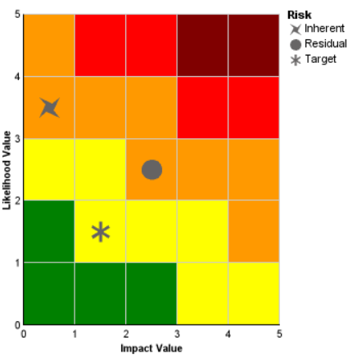
ERM & Technology
Enhanced Reports

Slide 17
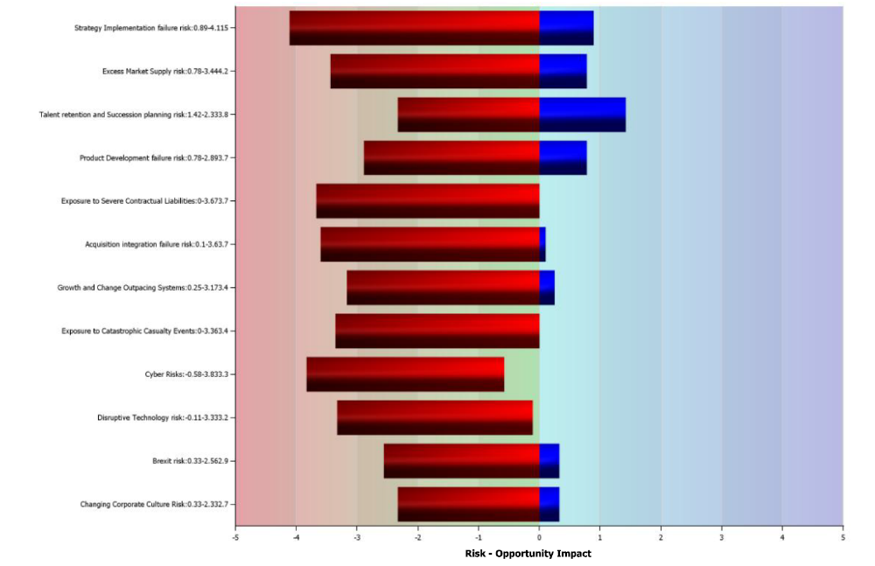
Risk Assessment Results

Slide 18
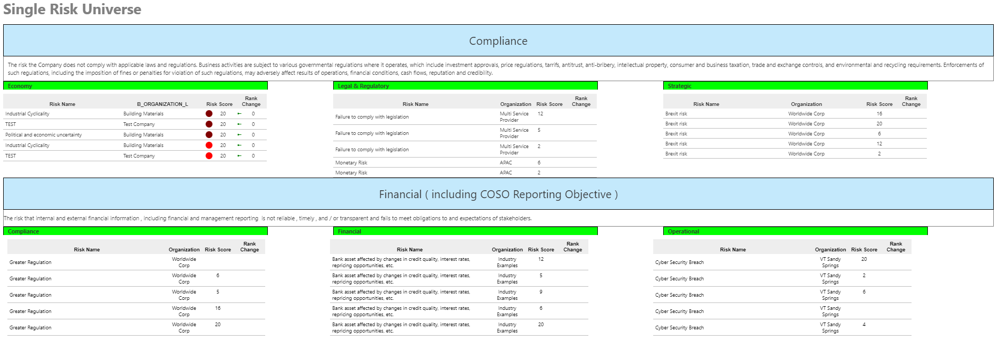
ERM – The Real Time Risk Universe

Slide 19
The future technological landscape

Slide 20
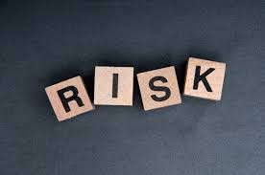


Ever increasing pace of change
Driving the changing risk landscape

Slide 21
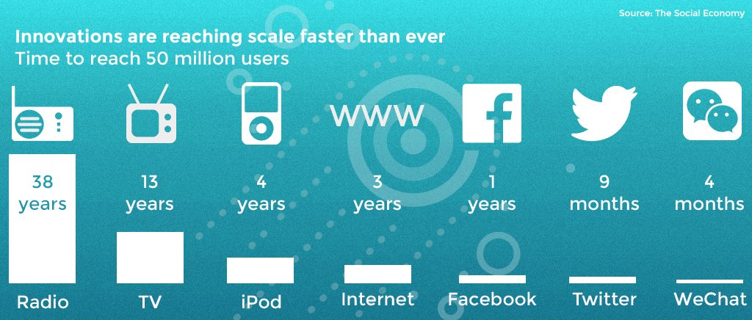
Ever increasing pace of change
Driving the changing risk landscape

Slide 22
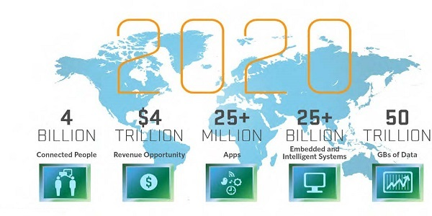
Everything Connected
Driving the changing risk landscape

Slide 23
The Exponential Growth of Data
More than 90 percent of the world’s data has been generated in just the past two years. The accumulation of new data will continue to accelerate as new sources emerge every day. In 2016, the Internet of Things was connecting 5.5 million new devices per day, and according to Gartner, the total number of IoT devices will hit 20.8 billion by 2020. That will equate to roughly 2.5 devices per person on the planet.

Slide 24






The rise of AI - Artificial Intelligence
Driving opportunities and threats
Translating Languages
Write Best
Selling Book
Driving Trucks
2026
2031
2053
2024
2027
2049
High School
Essays
Working
In Retail
Surgery
When Will AI Exceed Human Performance? Evidence from AI Experts, Cornell University Library, 30 May 2017

Slide 25

AI – Application for Insurance & Risk Management
Few use it or appreciate the risks of adoption or non-adoption
15% use AI
40% see role for RM
67% foundational change

Slide 26
The Future of Risk Technology
From these driving changes
Digital
Enhanced Visualisations
Natural Language Processing
The place to do work on the move
Automated Predictive Analytics
Robotic Processing Automation
Visualise the decision or trend
Don’t need to know a technical language
Automatically spot the trends & outliers
Let the bot take on repetitive tasks
Unstructured Text Analysis
Indexing and word analytics

Slide 27
Every company and industry should identify its vulnerabilities and take steps to address them when times are good
Build data analytics, strengthen risk measures and improve transparency
Have the will and means to enact change
Build a strong team
Ruth Porat (former Morgan Stanley CFO, now CFO of Google)

Slide 28
Questions?

