Slide 1



A2. Environmental risk
Understanding the economic impact of natural catastrophes and the effect of climate change.

Slide 2
Economic impact of climate change
IPCC Assessment Report 5 2014:
“For most economic sectors, the impact of climate change will be small relative to the impacts of other drivers (medium evidence, high agreement)
Changes in population, age, income, technology, relative prices, lifestyle, regulation, governance, and many other aspects of socioeconomic development will have an impact on the supply and demand of economic goods and services that is large relative to the impact of climate change.”

Slide 3
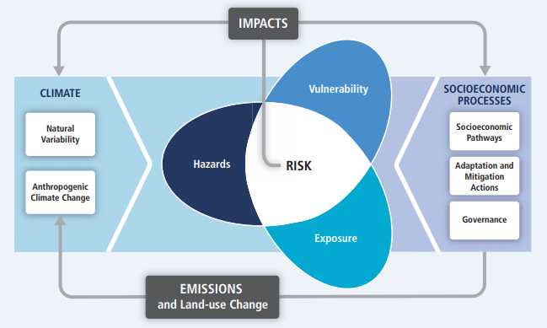
Economic impact of climate change
“For such a fractious discipline, there has been remarkable agreement among economists concerning the first-best climate policy. Ever since the writings of Nordhaus (1977), d’Arge (1979), and Schelling (1992), it has been widely accepted that climate change is, on balance, a negative externality and that greenhouse gas (GHG) emissions should be priced, preferably taxed.”
The Economic Impacts of Climate Change, Tol, R.s.J, 2018
IPCC Assessment Report 5 2014: Summary for Policy Makers

Slide 4
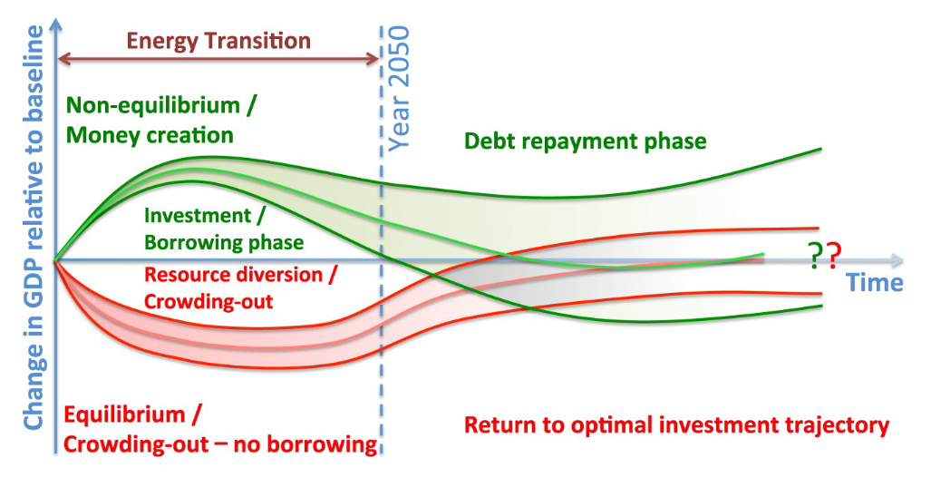
Transitioning to a low carbon economy
“Quantitative models commissioned by policy-makers to assess the macroeconomic impacts of climate policy generate contradictory outcomes and interpretations”
Modelling innovation and the macroeconomics of low-carbon transitions: theory, perspectives and practical use. Mercure, J.F. et al, Climate Policy, June 2019

Slide 5
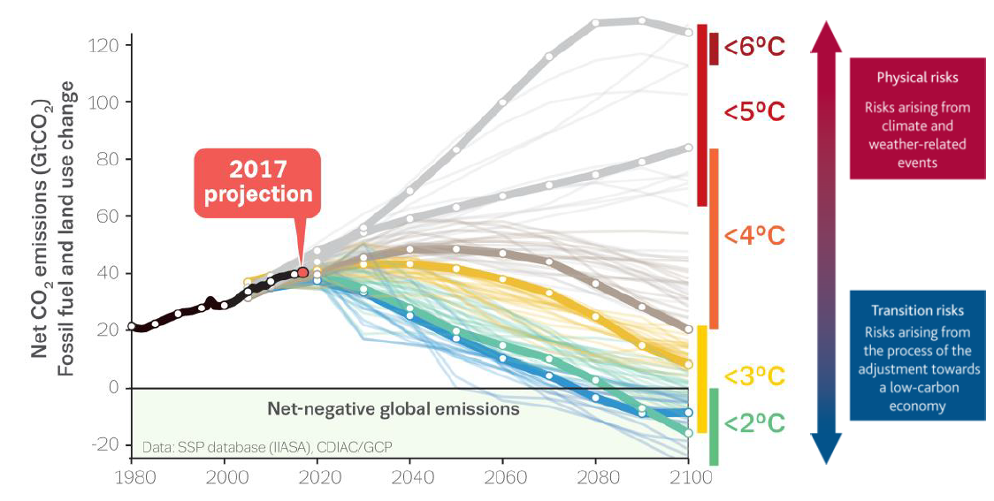

Climate risk scenarios
BoE PRA: Transition in thinking: The impact of climate change on the UK banking sector, Sept 2018

Slide 6
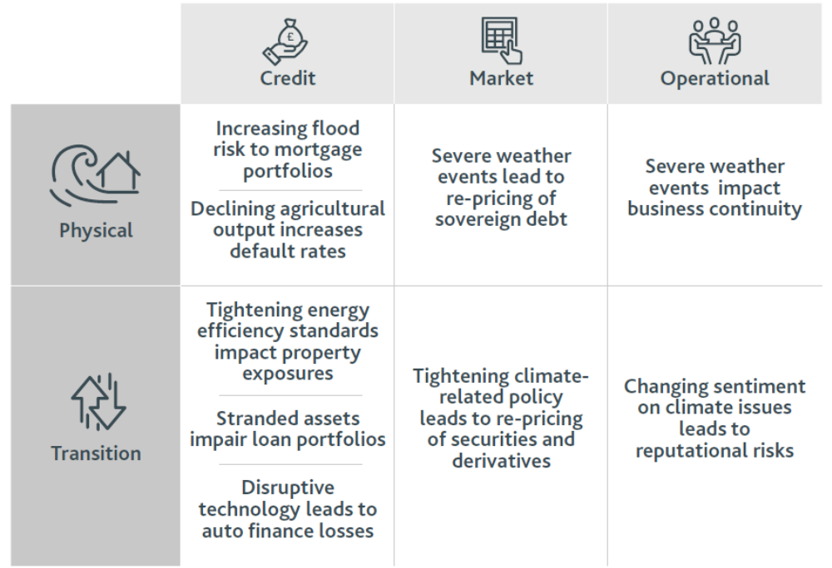
Climate-related financial disclosure
Climate-related Risk
Climate-related Opportunity
Resource efficiency
Energy source
Products & services
Markets
Resilience
Acute Risk
Chronic Risk
Policy & Legal Risks
Technology Risk
Market Risk
Reputation Risk
Recommendations of the Task Force on Climate-related Financial Disclosures

Slide 7
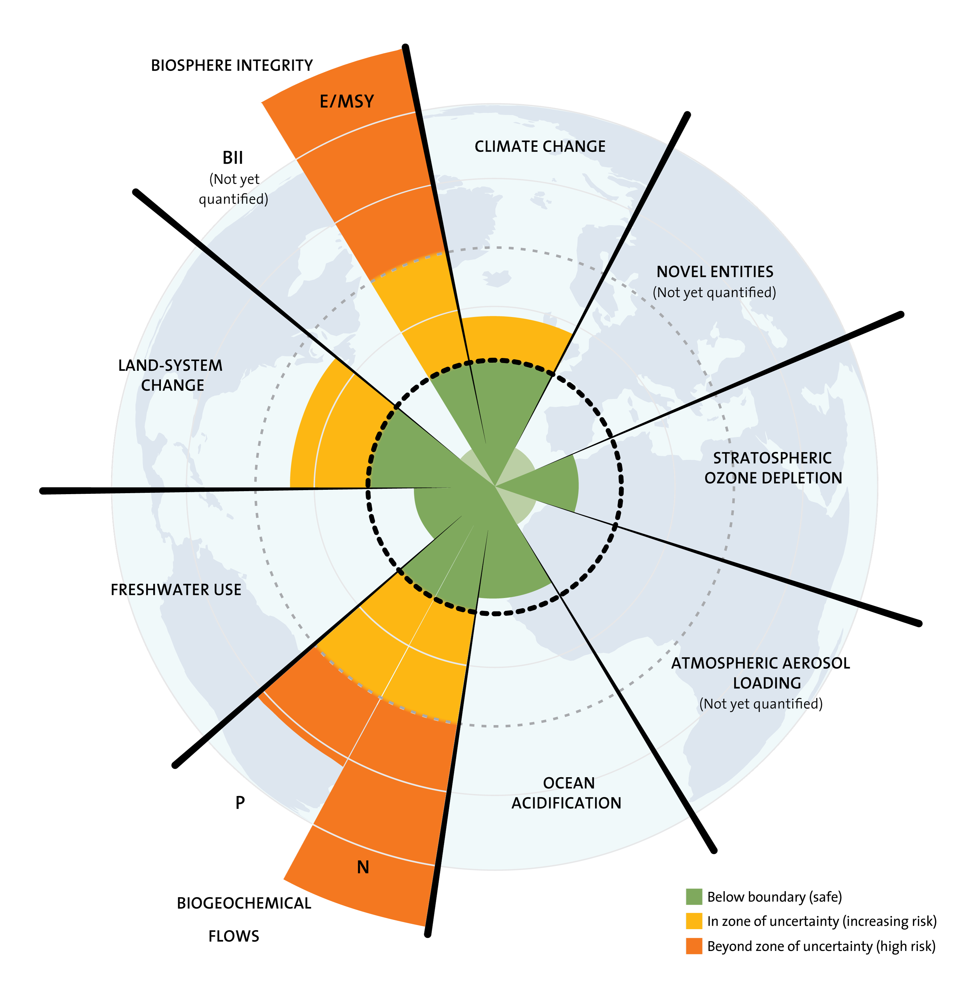
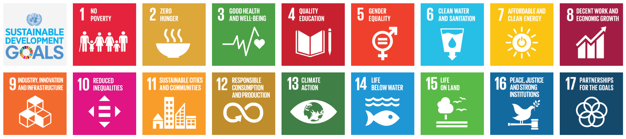
Corporate risk:
Wider than climate change. More than financial risk.
J. Lokrantz/Azote based on Steffen et al. 2015.

Slide 8
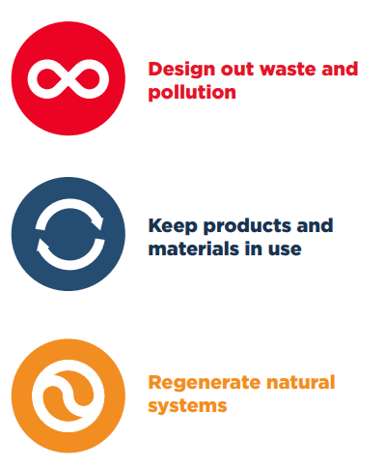
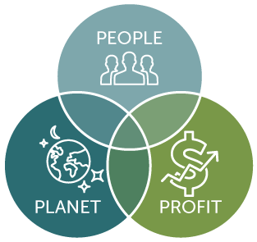
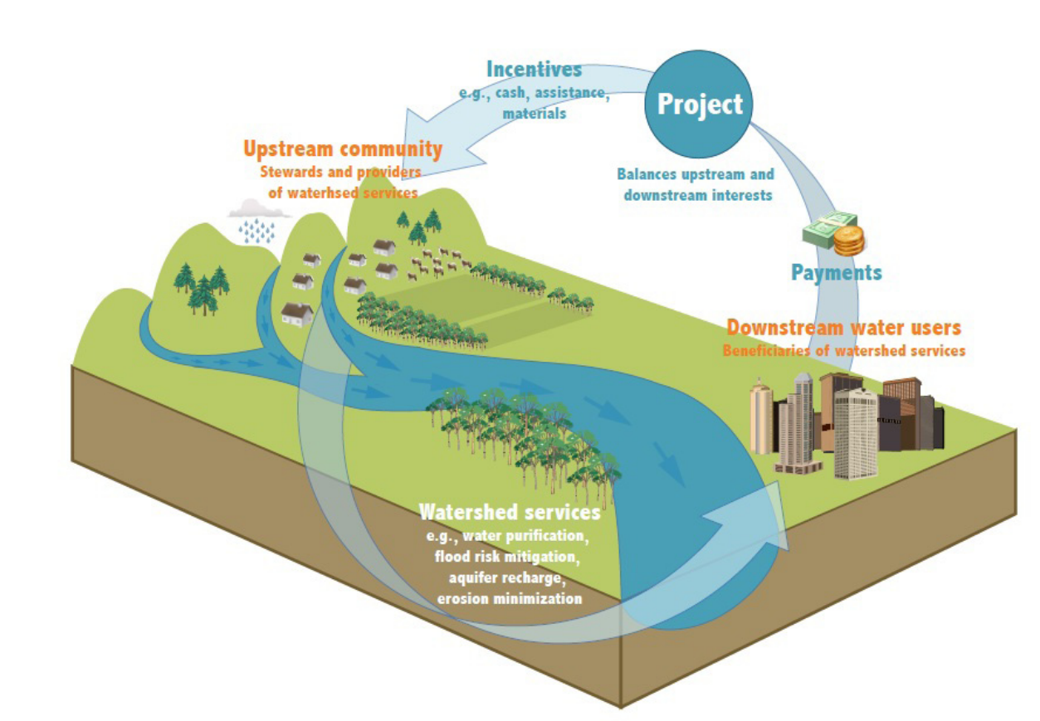
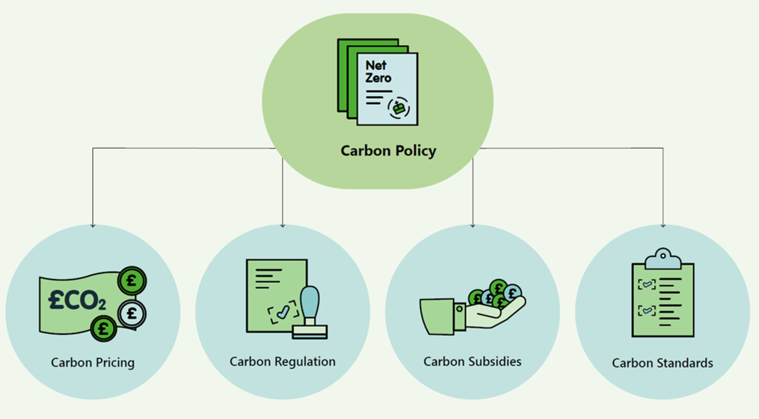
Mitigation and Adaptation….
Circular Economy?
Image: EMF – Completing the picture, how the circular economy tackles climate change
Triple Bottom Line Accounting?
Image: University of Winsconsin
Regulation & policy incentives?
Images: Defra and Energy Catapult

Slide 9
A Re/Insurer’s View

Slide 10
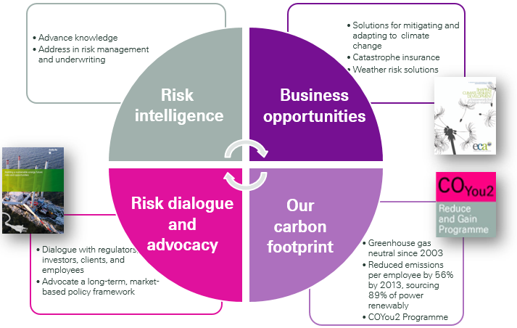
Swiss Re's Group Climate Strategy

Slide 11
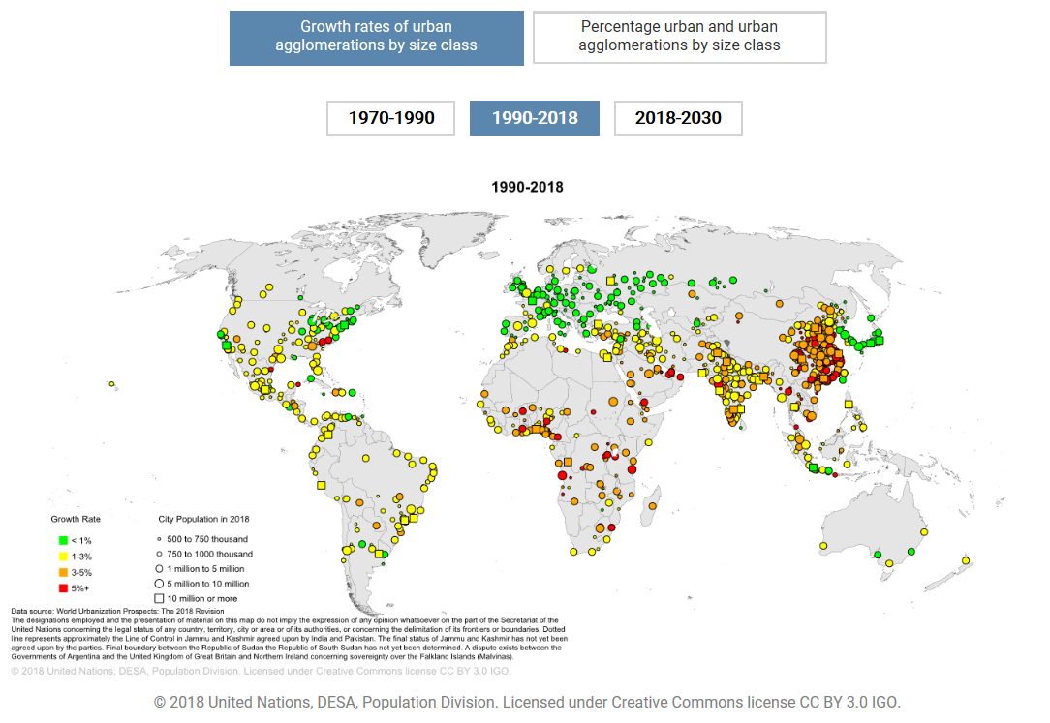
Population Growth & Urbanization
Risk Intelligence
Notes:
In the 1950s approximately 30% of the global population lived in urban areas while today the fraction of people living in cities has grown to more than 50%. These trends are expected to continue and by 2050 almost 70% of the global population will live in urban centres (Figure 4). Urbanization has two main (negative) effects on risk:
Loss of natural buffer zones,
Reduction of geographical diversification (challenge from an insurer’s point of view):
More people living in increasingly exposed places

Slide 12


How to Risk Model Climate Change
Risk Intelligence
Probability
Losses
Change in expected loss premium with climate change
Change in risk-based capital requirements with climate change
Notes:
The insurer’s challenge: Increased expected loss premium and capital requirements
Higher variability → tail value at risk increase outpaces expected loss increase
Higher tail risk also means that companies might have to purchase more cover

Slide 13
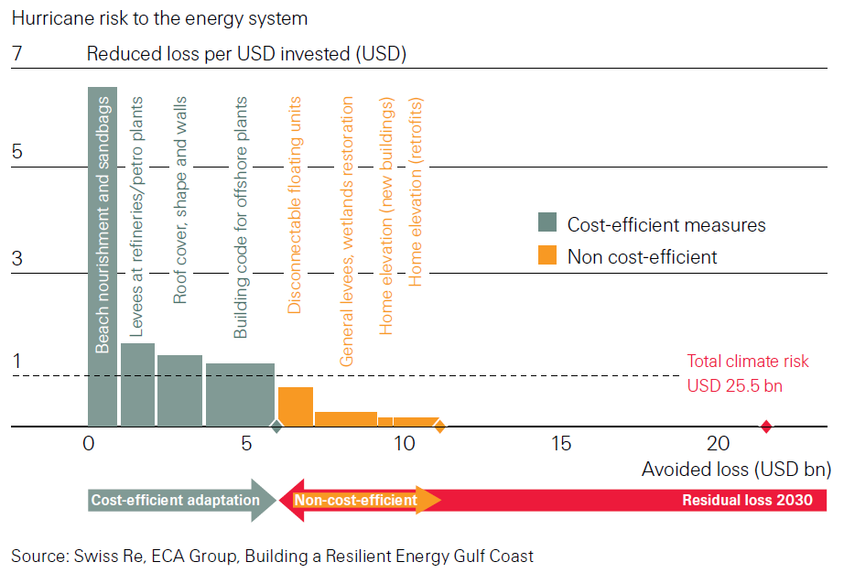
Resilience: Cost-efficient adaptation measures
Risk Dialogue & Advocacy
Notes:
What is more cost efficient:
- invest in own resilience
- at what point is it more efficient to transfer risk & “lend” an insurer’s balance sheet

Slide 14
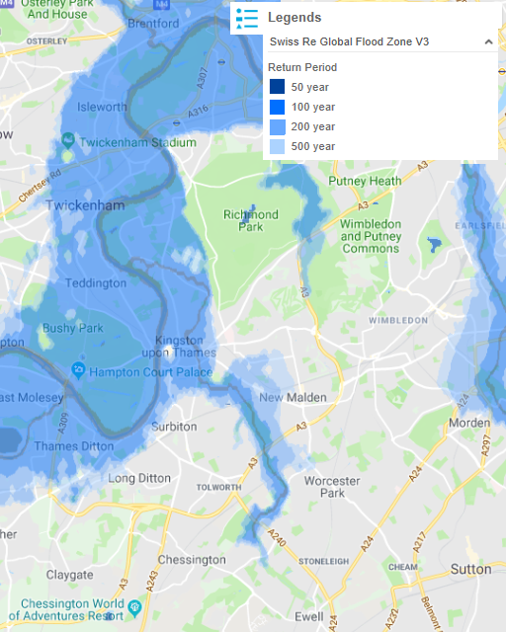
Resilience: Flood Maps in Swiss Re CatNetTM
Risk Dialogue & Advocacy
Check (flood) hazard maps before you build a new plant – and stress test the maps
Swiss Re FLOAT – hyper-detailed local flood maps powered by Airbus Aerial's drone imagery
Protect what is still exposed & be prepared (e.g. BCP)
Control and maintain dikes and other specific protection measures
Risk transfer: Innovation – for example transparent, fast settling parametric solutions to also cover intangible assets

Slide 15
Smarter Together
Science provides foundation for risk awareness
Loss history shows evidence of impact on insurance industry
Risk engineering companies provide advice for efficient adaptation and loss prevention measures
Insurance industry innovates new solutions

Slide 16
Q&A

