Slide 1

What Risk Managers should be doing to travel the Roads to Digital Revolution
David Roberts
Global Relationship Leader
Zurich Commercial Insurance
Claire Combes
Director of Risk & Assurance, intu

Slide 2

Three Key messages to take away from this session
How the digital world is changing and how we are reacting
7 building blocks for risk management – how do you manage risks in a digital age?
How risk management is changing (for business governance, stakeholders management and risk managers). How you may need to adapt your behaviours to maximise the benefit that you provide to your business by ensuring risk management and insurance solutions are fit for purpose and agile

Slide 3
Highlight- Roads to Revolution: Emerging Themes from the AIRMIC report launched today
Seven building blocks for risk management in the digital age
Ownership vs Access
Data Science vs Science on experience
Experimentation vs Stability
Efficiency vs slack
Knowledge Specialisation vs Knowledge Integration
Openness vs Control
Compliance vs legitimacy
Monitoring digital infrastructure availability (business continuity)
Scrutiny of digital logics and data integrity
Monitoring consistency between strategic choices and Organizational metrics
Highlighting areas of "too much" organisational efficiency (risk concentration)
Proposing metrics for measuring and monitoring "merged' risk
Identification and Monitoring of ecosystems "connected' risk (some not directly manageable by the organisation)
Focus on monitoring legitimacy and reputational risks

Slide 4
How the digital world is changing – For Zurich and intu

Slide 5

intu innovation in a digital age

Slide 6
intu digital horizon landscape – 2017 innovations
BotsAndUs creates intelligent robot assistants that guide customers around shopping destinations or stores.
GoInStore uses physical retail spaces to drive up web traffic and orders by creating live in-store video experiences for online customers.
Infraspeak makes building management smart and simple with the use of reactive sensors, user-friendly apps and powerful software.
Percent is an app that helps shoppers raise money for charity as a small portion of their debit or credit card spend is automatically donated by retailers to their chosen charity.
Soza Health offers customers health assessments and tailored recommendations to optimise their health.
Toky Woky is a community live-chat facility where customers browsing an online shop can receive real time advice from fellow shoppers
WoraPay is an app that bypasses in-store queues by allowing customers to order ahead and collect their purchases when ready
Also – building telematics trial with Zurich

Slide 7
intu digital horizon landscape - 2018
CarTap – provides secure access to vehicles to deliver shoppers’ bags straight to their cars
Grid Edge – saves money and reduces carbon emissions by using artificial intelligence to control energy usage
Rhythm – creates multiplayer games for big screens that connect companies with crowds of people
WeFiFo – an online marketplace that connects amateur and professional chefs with paying guests
Greendeck – uses AI to help fashion brands and retailers automatically classify products into categories and attributes
Yosh.Ai – a virtual assistant that provides a personal shopping service
Roialty – hi-tech marketing platform that turns anonymous social media data into valuable customer insight
Even a traditional “property” company is innovating.

Slide 8
Aims of this session - Zurich
Overview of Internet of things (IoT) and Insurance (risk management and risk transfer), Property, Marine, Casualty (GL and EL)
Specific ongoing project Internet of things and commercial buildings
Zurich pilot: “Property telematics”
Notes:
Thank you very much for giving me the opportunity to share our Commercial Insurance IoT project with you.
I work for the business transformation team, focused on Innovation, and specifically, leading the IoT stream.
During this session, I’d like to focus on discussing applications of IoT in commercial insurance. Starting by giving an overview on what is IoT and what’s in it for Insurance, then providing an status update on what is and where we are in our property telematics project and, if we have time, and you are interested, we can further comment on applications of IoT out of property.

Slide 9
Zurich – Setting the overarching group strategy
We are focusing in three key areas:
Focus on our customers – Improve service quality and the overall customer experience – This is focused on a local and global basis. We are deploying robotics and Ai in our service proposition and continuing to invest in our customer portals (MyZurich) and also expanding its functionality to have the ability to provide a API (Application Programme Interface) two way exchange with customers RMS (Risk Management Systems)
Simplify – A more efficient, agile and responsive organisation – We wish to learn from our investment in API to explore emerging new technologies such as Blockchain which will drive efficiency gains and also allow us to explore far more timely responsive insurance solutions.
Innovate – better products, services and customer care – We have a well publicised strategy around innovation investment (from our innovation foundries and Tech Hubs in Spain, recent acquisitions in tech solutions (Covermore, Fitsense, Brightbox, Laka) and the creation of Zurich Mobile Solutions

Slide 10


Internet of Things in Zurich Commercial Insurance
Starting a journey to transform the complex ecosystem and full value chain
3
Change
Combination of incremental and disruptive change
2
Collaboration
Reorganisation of roles and players. Partnership across the ecosystem to respond to new customer challenges
1
Customer focus
Continuous engagement to understand customer challenges and apply technology to develop suitable solutions
IoT building block:
Impact:
1
Loss: reduce cost, improve prevention
A
Remote sensing
2
Risk: improve risk management and safety
B
Real time, continuous monitoring
3
Underwriting: improve accuracy
C
Learn from data: identify patterns & trends
4
Pricing: enhance and improve accuracy
D
Learn from data: analyse behaviours
Claims: minimize frequency, severity, reduce fraud
5
Notes:
Beginning of a journey
Understand what the customer wants, out of skillset, collaboration. Transformation in the way we work. Combining incremental and disruptive change.
From building blocks to insurance
Real impact: this is something that we need to validate during the pilot

Slide 11
IoT and commercial buildings
Notes:
This is work in progress, but we are not there yet
The story started last year.

Slide 12
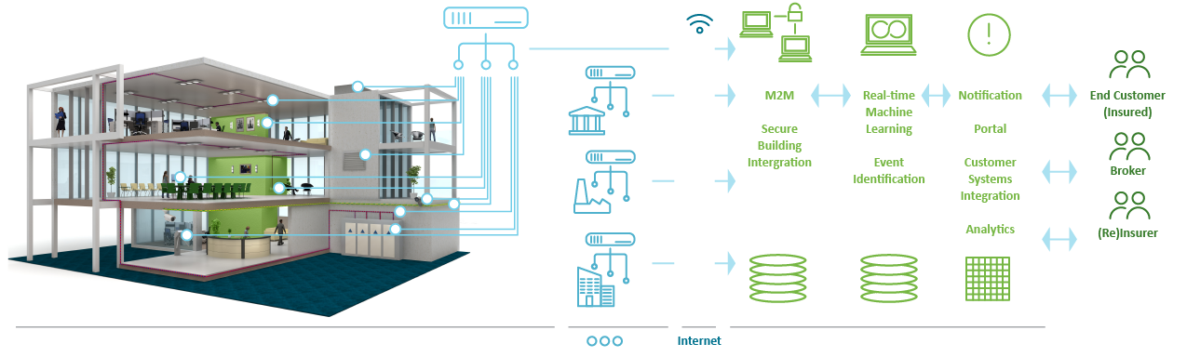
We are running fast pilots to develop a building telematics solution together with customers in an iterative way
EXAMPLE: Commercial BUILDING Telematics prototype
ZURICH
INTELLIGENT BUILDING
Data capture from internal building
infrastructure networks
Connecting Insured
Commercial Buildings
Notification service to reduce claim risk and improve health & safety
Periodic reports to improve maintenance and underwriting
Sophisticated pricing rewarding well managed buildings
Early loss detection/ prevention
Advanced risk selection
Risk engineering insights to customer
Notes:
Intelligence to automatically calibrate to each building and recognize insurance relevant activity, plus a notification service to inform clients and customers in real-time of significant insurance relevant activity.
Periodic reports with insights to improve building maintenance. Provides a complete view of event and time-based information on the operating conditions of insured buildings.

Slide 13
Future trends- Other lines of risk transfer

Slide 14





The foundation of our digital agenda is the commitment to leverage technology to get closer to our customers
    Digital Agenda CI International Progr.
Aspiration
Dimensions
Value drivers
Digital Agenda
B2B
Inter-actions -API
Robotics
(RPA)
Block-chain
Artificial Intelli-gence
(AI)
Digitize interactions
Efficiency
Increase business productivity
Quality
Connect the ecosystem
Retention
MARINE
PROPERTY
LIABILITY
Notes:
Committed to leverage technology in order to get closer to our customers (and brokers)
We are part of an ecosystem where one cannot move on its own driving digital transformation
Co-design, co-creation is the key to move forward and make a difference

Slide 15
Questions?

Slide 16
Strategic trade Offs

Slide 17
Roads to Revolution: Emerging Themes from the AIRMIC report launched today
Seven building blocks for risk management in the digital age
Ownership vs Access
Data Science vs Science on experience
Experimentation vs Stability
Efficiency vs slack
Knowledge Specialisation vs Knowledge Integration
Openness vs Control
Compliance vs legitimacy
Monitoring digital infrastructure availability (business continuity)
Scrutiny of digital logics and data integrity
Monitoring consistency between strategic choices and Organizational metrics
Highlighting areas of "too much" organisational efficiency (risk concentration)
Proposing metrics for measuring and monitoring "merged' risk
Identification and Monitoring of ecosystems "connected' risk (some not directly manageable by the organisation)
Focus on monitoring legitimacy and reputational risks

Slide 18

OWNERSHIP | ACCESS
SUMMARY
The research shows that digital technologies, differently from previous information technologies, are becoming increasingly core in a business, not just a support function. It is a key point that the digital world is more open and there are advantages to that. However, it is true that this then prompts questions about who owns the data, who owns changes to data, are they consistent and who is monitoring it?
intu
Zurich trial; we have to be open to Zurich knowing a lot more about us (monitoring our systems) to get the benefits (limited renewal, flagging to us where there may be issues)
Previously had tried to do this offline by sharing information with insurers throughout the year; telling them about all changes, holding an intu insurance family day.
Zurich
New risk owners are emerging within your business, how do you build a quick and relevant relationship with them ? and the align that with your group risk strategy and the efficacy of the current risk transfer solutions that exist.

Slide 19
DATA SCIENCE | SCIENCE ON EXPERIENCE
SUMMARY
Digital technologies facilitate decision-making based on big data. Are there opportunities to enhance “red flags” over data; like the Zurich monitoring of intu systems. This could flag issues early and prevent loss for all parties.
intu
Are we as businesses adequately investing in data science to maximise opportunities and reduce risks? There are many opportunities for better use of data analytics in the risk and insurance industries.
Zurich
How do we evaluate risk that is truly new with no history or actuarial modelling?

Slide 20
EXPERIMENTATION | STABILITY
SUMMARY
Companies are struggling in defining their core business and hence driving execution accordingly. There is an increase in experimentation which can throw out the standard stability that helps manage risk.
intu
The way that intu develop their customer facing systems is more experimental i.e. try something, if it doesn’t work with the customers then change it and try something else. Whilst we still follow controls in systems development, it is harder to manage the risks around this sort of approach.
Zurich
Innovation is always fast paced and subject to usual business rules of success and failure before they flourish and unfold in the future business model how do you stay close to that environment whether it be contractual with Third Parties (NDA’s or Supply Chain exposure)? The enterprise risk still needs assessing from ideation, development to production.

Slide 21
EFFICIENCY | SLACK
SUMMARY
While digital technologies enable a drive towards optimisation, optimisation often becomes over-optimisation and this has side effects. By making processes more efficient, we have eliminated any slack, which means that there is no available spare time to manage risks when they materialise.
intu
As with other companies, there has been a drive to reduce costs which eliminates slack. This means that when things don’t go to plan, resource to manage this needs to be created; usually by reprioritising “essential” tasks to “non-essential” tasks.
Zurich
We have invested in Robotics and AI to enhance our global international systems and to also drive out claims fraud

Slide 22
KNOWLEDGE SPECIALISATION | KNOWLEDGE INTEGRATION
SUMMARY
There is a tension between knowledge specialisation that provides a specialised solution to a specific customer need and knowledge integration that provides integrative solutions to a wider set of customer needs.
intu
Knowledge is power is not necessarily the appropriate mantra in the new connected world.
We share a lot more data internally than we have done previously. We have a Data Committee, Senior Strategy Group, ICT Steering Group, Operational Board, Insurance Quarterly etc. Where do we discuss certain risks such as cyber; it is pervasive and needs to be discussed on all of these committees. We need to become experts in a wider range of things and need to change our attitude to the “power of information”. Not sharing means your information gets out of date.
Zurich
Data, its existing use and future use needs to be handled against many back drops, especially with the new GDPR rules. Brand reputation can be quickly eroded or in some instances destroyed by the miss use of Data.

Slide 23
OPENNESS | CONTROL
SUMMARY
Digital transformation requires a new type of relationship with “the outside world”. Business rules have changed due to digital ‘disintermediation’. Industry boundaries have become fluid.
intu
Believe that interdependence between ecosystems does generate opportunities and new risks. E.g. Zurich telematics trial at our centres – great opportunities, but what are the downsides, such as hacking?
Like other companies, we have been subject to digital ‘disintermediation’. intu are a shopping centre company, but have virtual shopping centres and provide a wide raft of services to our customers (e.g. electrical car charging, Wi-Fi, fashion shows, click & collect etc.) Are we somewhere that people go shopping, or are we something different; a provider of entertainment and services?
Zurich
Post GDPR all openness needs to be on a permissible basis, with a clear and agreed use of such data sources with measurable outcomes that bring benefit to both the provider and user of the data.

Slide 24
COMPLIANCE | LEGITIMACY
SUMMARY
Does compliance exist in an environment where data is openly shared. Does this increase the importance of culture? How is culture monitored and issues addressed?
intu
Regulation cannot keep up with the pace of business change e.g. when vaping came in, was it legal or illegal to smoke in confined public spaces like pubs? Organisations have to make their own decisions. Where we are introducing new risks through innovation, we need to make sure that we are self-regulating, not relying on legislation.
The culture of the organisation becomes vitally important here;
  Carillion failure , VW emissions
  Google content
Zurich
Facebook vs Cambridge Analytics: The original contract content was executed correctly the onward use of data was never envisaged but still supplied and by then the normal rules of compliance and legitimacy become broken.

Slide 25

ACHIEVING THE RESILLIENCE AND TRANSFORMATION PRINCIPLES
Eight key areas of focus
1
RISK RADAR
2
RESOURCE AND ASSETS
3
RELATIONSHIP AND NETWORKS
RAPID RESPONSE
4
Resilient organisations have exceptional risk radar. Transformational organisations additionally require that the risk radar capabilities are specifically focused on emerging risks.
Resilient organisations have the capability to ensure decisive and rapid response. Transformational organisations additionally require that communication barriers within the organisation are removed.
Resilient organisations have resources and assets that are flexible and diversified. Transformational organisations additionally need to strengthen resource where they are insufficient to take full advantage of developments in technology.
Resilient organisations value and build strong relationships and networks. Transformational organisations additionally examine the need to extend the existing relationships and networks.
REVIEW AND ADAPT
REDESIGN PROCESSES
RETAIN STAKEHOLDERS
REINVENT PURPOSE
5
6
7
8
Resilient organisations review and adapt to changes and adverse events. Transformational organisations additionally require specific focus on protection and enhancement of the reputation the organisation.
Revolutionary organisations can also successfully redesign processes. This requires a forward-looking culture that successfully embraces new technologies to ensure business process improvement.
Revolutionary organisations retain stakeholders during the transformation. The ability to retain stakeholders is essential for successful digital transformation and this relies on analysis of customer-based big data.
Revolutionary organisations have the ability to reinvent purpose. Reinventing purpose is based on opportunity awareness, the active commitment of stakeholders and the availability of necessary people capabilities.

Slide 26

HOW RISK MANAGEMENT IS CHANGING AND HOW YOU MAY NEED TO ADAPT YOUR BEHAVIOURS TO MAXIMISE THE BENEFIT THAT YOU PROVIDE
In this session we wish to address three key areas: Your role as the risk manager and your changing interaction with your stakeholders and your business. Taking the content of the workshop so far we have some suggested themes and questions around the role of the risk manager highlighted below, and we have some mics in the audience so we can socialise comments and start a debate as time permits.
Risk Managers
More horizon scanning
What has gone wrong elsewhere?
How may this affect us?
Look externally
More conversations to get a feel for what is happening
Wider range of people
Internal and external
More scenario based considerations –
how may this happen?
Could it happen to us?
what would the impact be?
importance of culture and independent assessment of culture
are employees and decision makers motivated to do the right thing?
How are we measuring that?
What happens when people do the wrong thing.
Stakeholders
Are new risk owners emerging in your organisation?
Business
New Emerging Risks & Opportunities ?

Slide 27
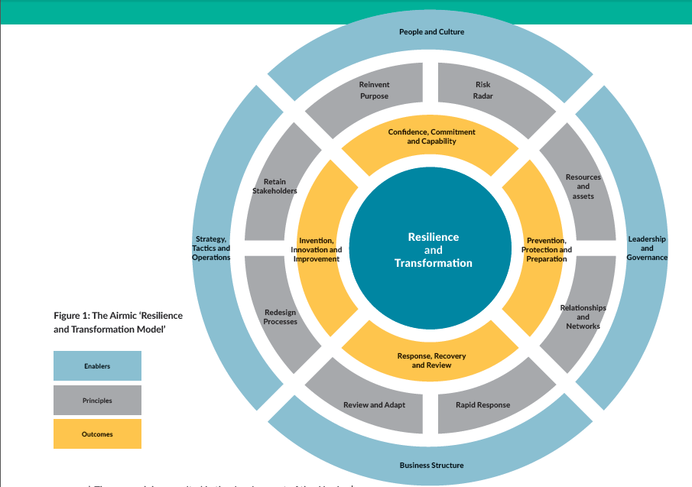
*originally published in Airmic ‘Roads to Revolution’ executive summary- all rights reserved

Slide 28
Questions?
Thank you for your time today

Slide 29


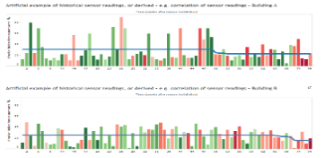
Internet of Things enhances Property insurance
By providing an accurate picture of exposures, risks and hazards
By sensing:
Impact on Insurance:
Marine
RFID sensors
Assess inventory value
Anti-counterfeiting
Real time monitoring: HVAC, boilers, water leaks, pressure, potential for freezing
Reduce loss costs
Aviation
Health monitoring engines
Smart baggage
Operational efficiency: delays?
Generate alerts of abnormal equipment operation
Preventive maintenance, reduce claims (frequency and severity)
Property
Buildings
Oil and gas
Ground (sinkhole)
Leverage information to gain understanding of the building
Improve underwriting and pricing accuracy
Liabi-lity
Slip and fall claims
Product recalls
Food recall claims
Ensure equipment functioning at optimum level
Reduce business interruption
Auto
Recording behavioral data
Driverless vehicles
Car diagnosis
Continuous monitoring of building
Enhanced risk insights, capacity of analysing root cause of claims
Workers
Compen-
sation
Smart equipment
Wearables
In vehicle telematics
Notes:
In this session we will be focusing on Property, basically on buildings.
What we are doing is to collect information from sensors that are already in place to track heating, ventilation and air conditioning, boilers, chillers, water pipes etc ; continuous monitoring the building to get an understanding of the building by identifying patterns of behavior and use this information to reduce loss cost, preventive maintenance, avoid business interruption or doing post mortem analysis after a claim

Slide 30
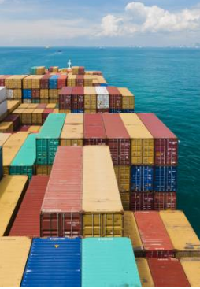
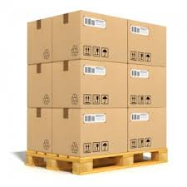
Internet of Things examples- Marine
More accurate picture of exposures, risks and hazards
By sensing:
Impact on Insurance:
Marine
RFID sensors
Assess inventory value
Anti-counterfeiting
Movement and quality of transport conditions detection
Accurate pricing
Aviation
Health monitoring engines
Smart baggage
Operational efficiency: delays?
Sensors info may include value of goods. Goods in transport value permanently assessed
Accurate estimation of claim payout
Property
Buildings
Oil and gas
Ground (sinkhole)
High value tagged goods securely identified
Claims fraud reduction
Liabi-lity
Slip and fall claims
Product recalls
Food recall claims
Real time contractors equipment monitoring
Effective underwriting and pricing of equipment risk
Auto
Recording behavioral data
Driverless vehicles
Car diagnosis
In ship monitor information: consumptions, location, cargo status
Workers
Comp
Improve loss control measures
Smart equipment
Wearables
In vehicle telematics
Build robust models from collected info
Effective pricing

Slide 31
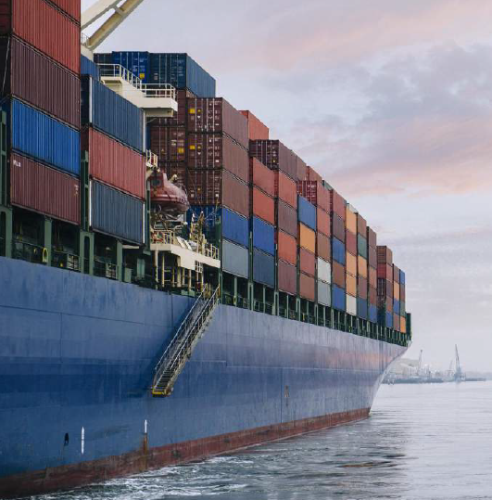
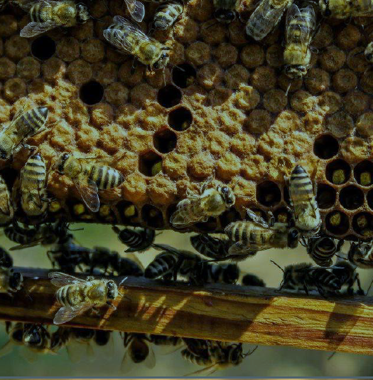
Internet of Things examples- Marine
More accurate picture of exposures, risks and hazards
Marine
RFID sensors
Assess inventory value
Anti-counterfeiting
Aviation
Health monitoring engines
Smart baggage
Operational efficiency: delays?
Property
Buildings
Oil and gas
Ground (sinkhole)
Liabi-lity
Slip and fall claims
Product recalls
Food recall claims
Auto
Recording behavioral data
Driverless vehicles
Car diagnosis
Workers
Comp
Smart equipment
Wearables
In vehicle telematics
Port of Amsterdam: optimizing port usage with life occupancy heat maps
Mooring post monitoring anticipates maintenance needs
Bejo Zaden: ensuring safe transport conditions for living cargo

Slide 32

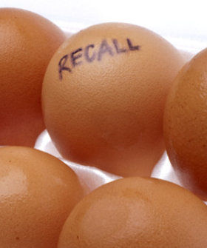
Internet of Things examples- General Liability
More accurate picture of exposures, risks and hazards
By sensing:
Impact on Insurance:
Marine
RFID sensors
Assess inventory value
Anti-counterfeiting
Alerts could be generated when floor conditions drop below a threshold
Improvement of safety, better control of risk
Aviation
Health monitoring engines
Smart baggage
Operational efficiency: delays?
Condition of vehicles, machinery and equipment tracked, early detection, over the air fixes
Improve prevention, reduction of loss
Property
Buildings
Oil and gas
Ground (sinkhole)
Monitoring result in assessment of quality issues and exposure
Liabi-lity
Slip and fall claims
Product recalls
Food recall claims
Enhanced pricing
Auto
Real time contractors equipment monitoring
Effective underwriting and pricing of equipment risk
Recording behavioral data
Driverless vehicles
Car diagnosis
Workers
Comp
On food real time monitoring temperature, moisture, light exposure, hand off
Prevention and accurate assessment of potential claims
Smart equipment
Wearables
In vehicle telematics

Slide 33
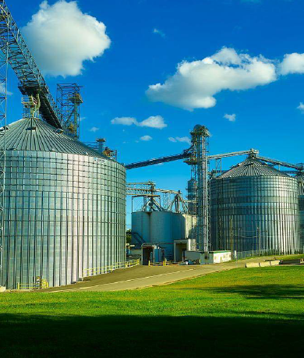
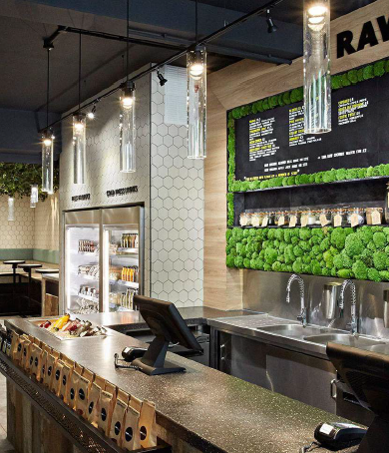
Internet of Things examples- General Liability
More accurate picture of exposures, risks and hazards
Marine
RFID sensors
Assess inventory value
Anti-counterfeiting
Aviation
Health monitoring engines
Smart baggage
Operational efficiency: delays?
Property
Buildings
Oil and gas
Ground (sinkhole)
Liabi-lity
Slip and fall claims
Product recalls
Food recall claims
Auto
Recording behavioral data
Driverless vehicles
Car diagnosis
Workers
Comp
Smart equipment
Wearables
In vehicle telematics
Cacao commodity trader: Monitoring warehouse and silo conditions to prevent loss and show-case high standards
Rawligion: Using sensors to monitor stock inventory and kitchen preparation conditions

Slide 34
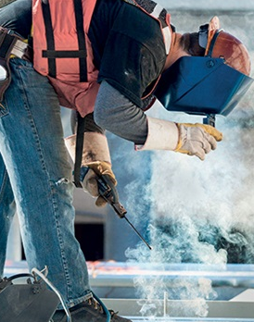
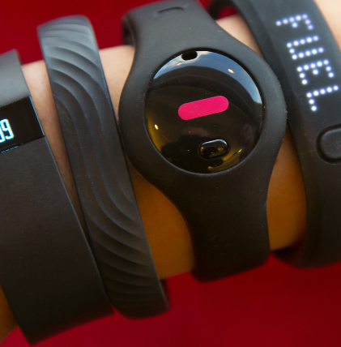
Internet of Things examples- Employers Liability
More accurate picture of exposures, risks and hazards
By sensing:
Impact on Insurance:
Marine
RFID sensors
Assess inventory value
Anti-counterfeiting
Detection of hazard, location, slip and fall, gas levels
Prevention, minimize claim frequency and severity
Aviation
Health monitoring engines
Smart baggage
Operational efficiency: delays?
Health monitoring to timely track patient evolution and rehabilitation
Minimize claim payout
Property
Buildings
Oil and gas
Ground (sinkhole)
In vehicle telematics, driver behavior, detection of fatigue
Reduce frequency and severity of claims
Liabi-lity
Slip and fall claims
Product recalls
Food recall claims
Wearables that assess risk in dangerous manufacturing e.g. worker fatigue, fitness
Improve risk management and safety, reduce frequency and severity of claims
Auto
Recording behavioral data
Driverless vehicles
Car diagnosis
Workers
Comp
Smart equipment
Wearables
In vehicle telematics
Wearables to assess situations that result in injuries in the food and agricultural
Improve risk management and safety

