Slide 1


Bridging the gap between technical safety risks and strategic business decisions
ERM FORUM
October 2019

Slide 2
Bridging the gap between technical safety risks and strategic business decisions
“If you think safety is expensive, try having an accident”

Slide 3
“Small” accident = large business impact
Bridging the gap between technical safety risks and strategic business decisions
Example: Parcel wagon falls off platform onto railway line
TOTAL COST
£20,000
£180,000
DIRECT COSTS
Repair to Track
Repair to Tractor
£200,000
INDIRECT COSTS
Management Time
Compensation Claims
Insurance
Business Interruption
Loss of Good Will
Revenue to
Cover Costs
£4m
PROFIT MARGIN
5%
How easily can your business generate this extra revenue?
£200,000 Extra Costs

Slide 4

“Broken Windows Theory” has proven to be effective
Bridging the gap between technical safety risks and strategic business decisions
Broken Windows Theory
  If a window is broken and left unrepaired, people walking by will conclude that no one cares and no one is in charge
  Soon more windows will be broken, and a sense on anarchy will spread
  In a city, relatively minor problems (such as graffiti and public order) are the equivalent of ‘broken windows’ – invitations to more serious crimes
  Tackling these ‘broken windows’ was part of the approach used to rebuild the New York subway system (graffiti was ruthlessly tackled before reliability) and later ‘Zero Tolerance’ policing in New York
Source: The Tipping Point, Malcolm Gladwell

Slide 5

How can “broken windows” link low level technical safety issues to important business decisions
Bridging the gap between technical safety risks and strategic business decisions
Q
  How does “broken windows” apply to risk?
  As a leader what should you do?
  Think of some examples and discuss

Slide 6
How many safety controls are enough?
Bridging the gap between technical safety risks and strategic business decisions
Total Costs
Business Cost
Cost of Safety
Controls
Optimum
Cost Position
Cost of
Accidents
Increasing Safety Effort

Slide 7
The mantra of “weak signals – strong action” has been part of many “Zero” campaigns in the last ten years
Bridging the gap between technical safety risks and strategic business decisions
  Detection of “weak signals”
  Signal shows
    minor non-compliance
    slight deterioration in performance
    less engaged workforce
  No waiting to see if “weak signals” are part of long-term trend
  No attempt to build business case
  Leadership takes “strong action” (visible and decisive) based on “intuition”

Slide 8
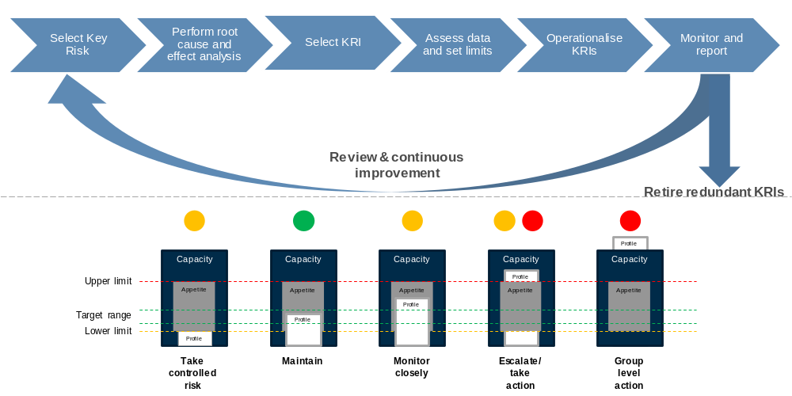
Defining and implementing Key Risk Indicators (KRIs) to improve the monitoring of established and emerging risks
Bridging the gap between technical safety risks and strategic business decisions

Slide 9
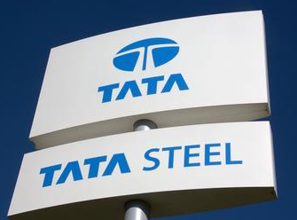
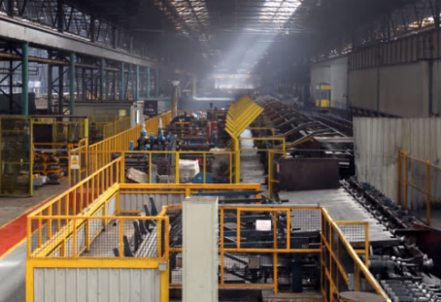
Failure to provide basic safety controls not only causes harm, but costs business
Bridging the gap between technical safety risks and strategic business decisions
  Tata Steel was sentenced after two workers were seriously injured in separate incidents in Corby, Northamptonshire
    A 26 year old employee lost more than two third of his hand while clearing a blockage on a manufacturing line
    A 52 year old worker was injured in a separate incident. The employee’s hand was caught in a turning lathe during refresher training
  In both incidents the HSE concluded that Tata Steel had not fitted appropriate guards to protect from dangerous parts of the machinery, despite a warning after the first incident
    Fine: £1.9 million + costs of £22,500
    The fine was reduced on appeal to £1.5 million after the company was able to argue successfully that the likelihood of harm was lower than that established at the trial

Slide 10

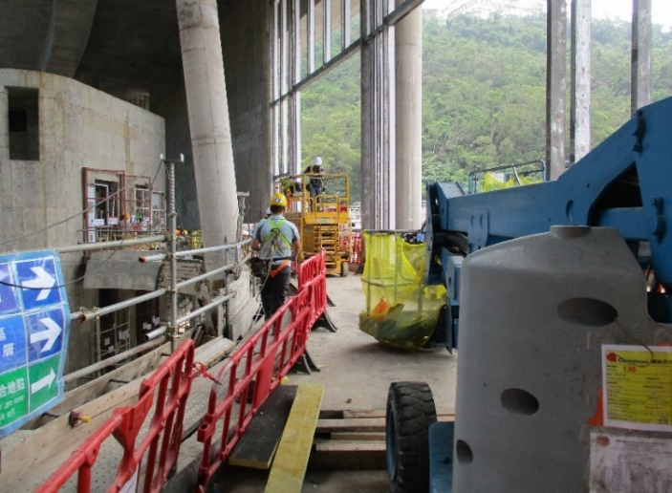
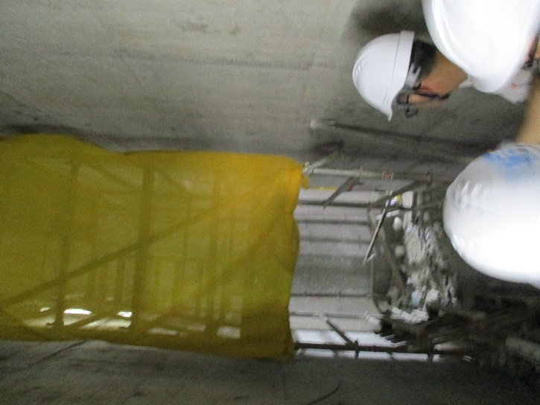
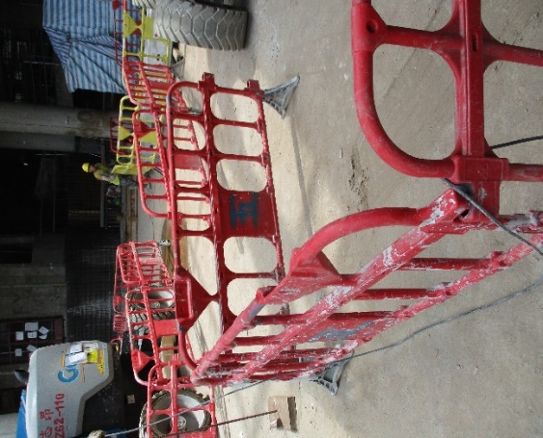
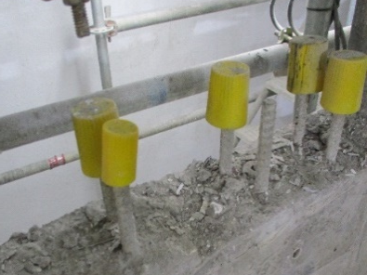
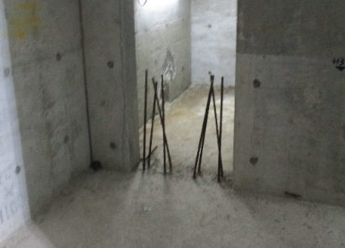
A review of a Asian subsidiary of a global construction company
Bridging the gap between technical safety risks and strategic business decisions
Following two separate fatal accidents the leadership team of Asian subsidiary focussed on safety
After a two months, an independent review identified many poor visible practices across multiple sites
Fundamental improvements in the leadership of safety, starting from the top, were agreed

Slide 11
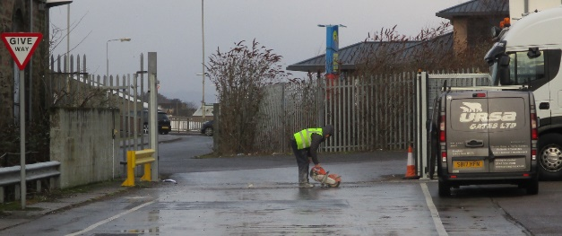
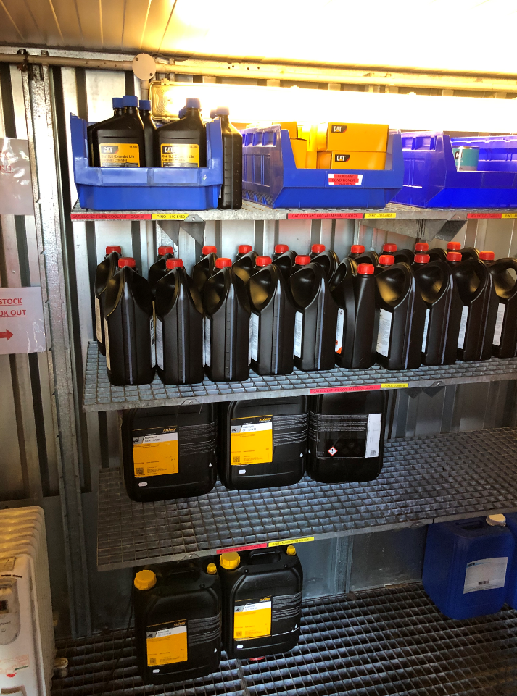
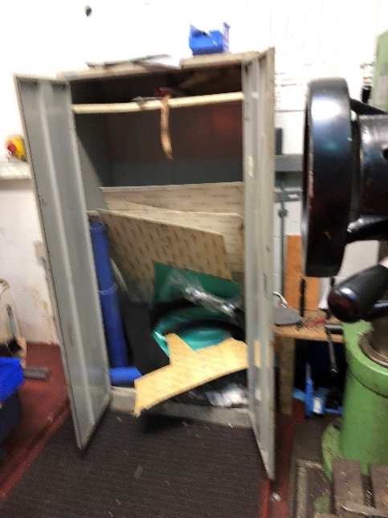
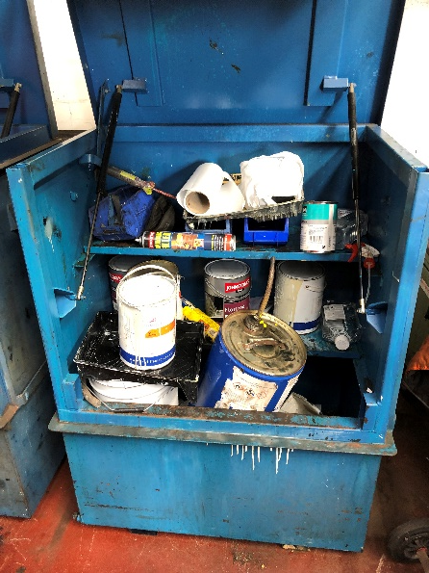
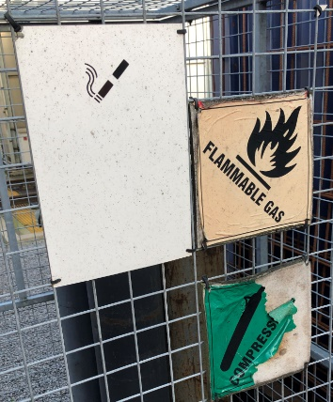
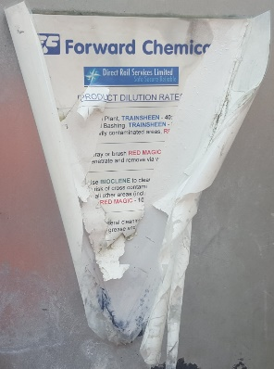
An award winning logistics company was concerned about one division
Bridging the gap between technical safety risks and strategic business decisions
Walking round the engineering depots the independent reviewers were able to identify multiple non-compliances with basic H&S legislation – that no body in the organisation had seen (or wanted to see)
These findings were used to develop an organisation-wide safety improvement plan to get back into legal compliance and support retaining external ISO accreditations required for important customers

Slide 12
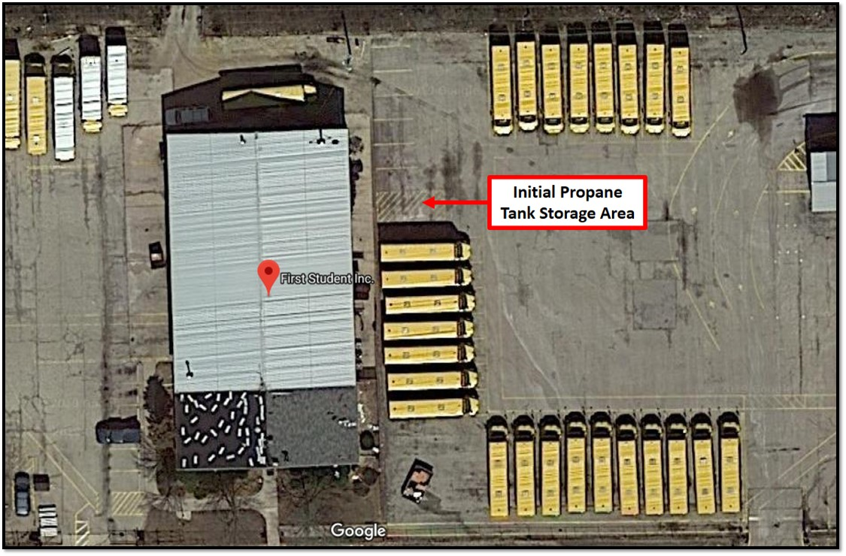
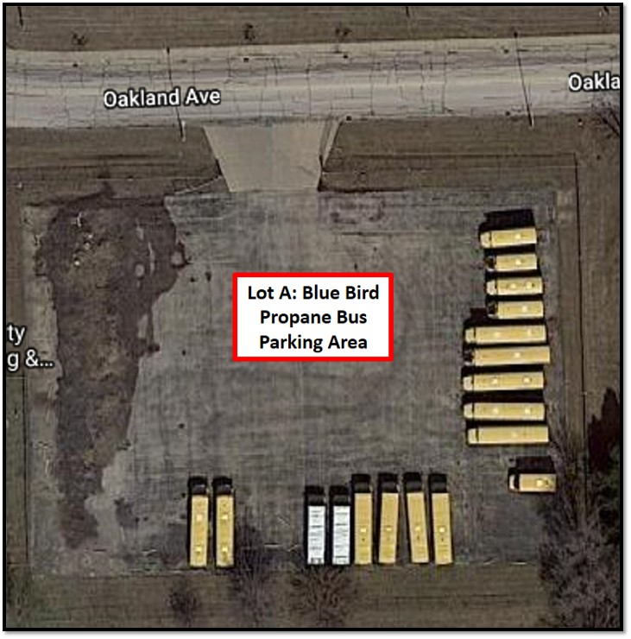
A bus company was getting a new fleet of propane fuelled school buses
Bridging the gap between technical safety risks and strategic business decisions
An Exec on a safety tour found a portable propane tank next to the staff building and maintenance shop
This was a high traffic area and adjacent to pressurized commercial vehicle tires. Evidence of smoking
The tank was the relocated to a low-traffic area to reduce the chance of a serious incident occurring

Slide 13

Bridging the gap between technical safety risks and strategic business decisions
1
Failure to provide basic safety controls can cost business big
It is a business decision to decide how much to spend to comply with the law and optimise cost
2
3
Low level – broken windows
Measuring accidents is too late…. Key Risk Indicators can provide real foresight
4

Slide 14
Arthur D. Little has been at the forefront of innovation since 1886. We are an acknowledged thought leader in linking strategy, innovation and transformation in technology-intensive and converging industries.
We navigate our clients through changing business ecosystems to uncover new growth opportunities. We enable our clients to build innovation capabilities and transform their organizations.
Our consultants have strong practical industry experience combined with excellent knowledge of key trends and dynamics. Arthur D. Little is present in the most important business centers around the world. We are proud to serve most of the Fortune 1000 companies, in addition to other leading firms and public sector organizations.
For further information please visit www.adlittle.com.
Copyright © Arthur D. Little 2019. All rights reserved.
Contact:
Marcus Beard beard.marcus@adlittle.com
Stephen Watson
watson.stephen@adlittle.com
Arthur D. Little Limited
Merlin Place
Milton Road
Cambridge
CB4 0DP
United Kingdom
www.adlittle.com/risk

