Slide 1
Property Losses
Spread of fire in high rise buildings

Slide 2




Agenda
Spread of fire in high rise building
  A loss adjusters perspective
    Andrew King, Head of FAS Global (EMEA)
  Practicalities of Fire Spread
    Andrew Moncrieff, Managing Director, Hawkins
  Legislation – then and now
    Iain Corbett, Partner, Kennedys
  Underwriting considerations
    Evan Moore, REI Underwriting Manager , Zurich

Slide 3


A loss adjusters perspective
Presenter: Andrew King

Slide 4
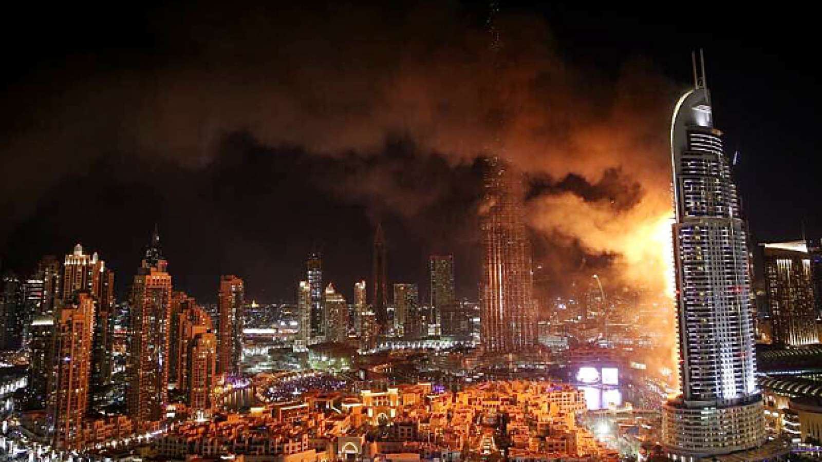
Action Plan – immediate thoughts
Causation – ignition, third party involvement.
Why did the fire spread – design, materials used, quality of the construction, building management and maintenance.
What additional damage has been caused by the spread to the subject matter of the policy and possibly to third party property
After discovery was anything done or not done that caused the blaze to spread.
Subrogation matters – designers, architects, engineers, construction firms, building management and maintenance organisations, contractual relationship with owners, applicable law and regulations.

Slide 5
Action Plan – immediate thoughts
Insured parties
The Business insured
The Premises
  History
  Power, services, systems
  Maintenance and management
Certification and inspection
Risk assessments and management
Risk control regime
Does the policy contain the correct details and accurately reflect what business activity had been taking place?
Does the broker’s underwriting presentation fully reflect the actualite??
What questions were asked at the underwriting presentation itself???

Slide 6
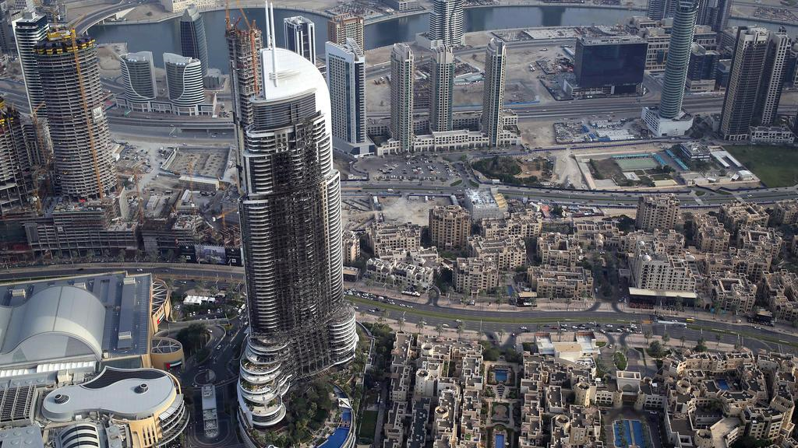
Address Downtown Dubai

Slide 7
Practicalities of
Fire Spread
Presenter: Andrew Montcrieff

Slide 8
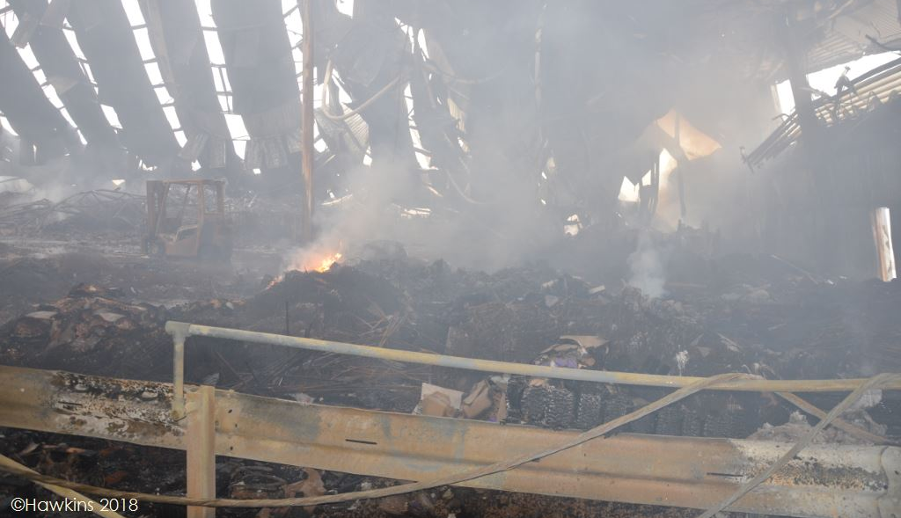
We discover why…

Slide 9
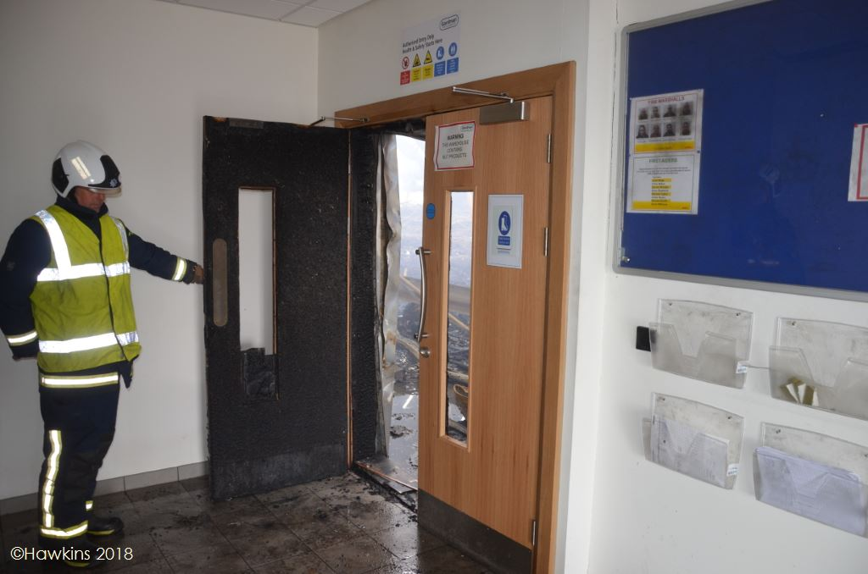
We discover why…

Slide 10
Radiation
Conduction
Convection

Slide 11
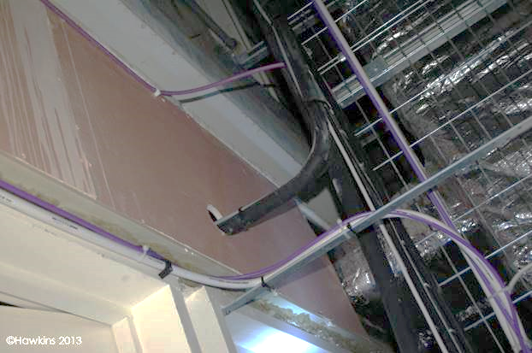
We discover why…

Slide 12
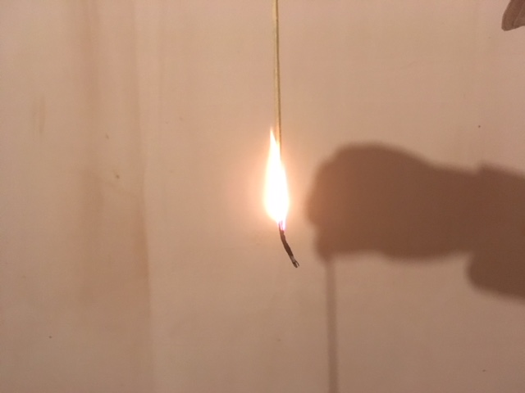
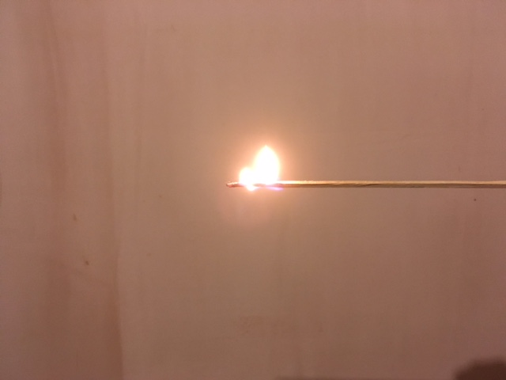
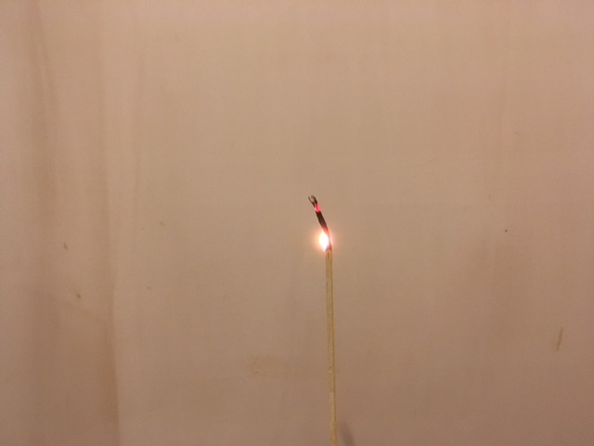
We discover why…

Slide 13
We discover why
Fire spread is dominantly upwards
Design, build and maintenance must be correct
There must be continuity of management and responsibility
Testing must be realistic for materials and systems
Desktop extrapolation must be constrained

Slide 14
Legislation
then and now
Presenter: Iain Corbett

Slide 15
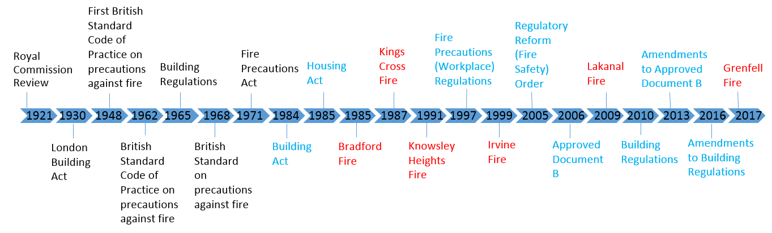
The Landscape of legislation- and how it has changed

Slide 16
Building Regulations
B1. Means of warning and escape
The building shall be designed and constructed so that there are appropriate
provisions for the early warning of fire, and appropriate means of escape in
case of fire from the building to a place of safety outside the building capable
of being safely and effectively used at all material times.
B2. Internal fire spread (linings)
(1) To inhibit the spread of fire within the building the internal linings shall—
(a)adequately resist the spread of flame over their surfaces; and
(b)have, if ignited, either a rate of heat release or a rate of fire growth which is reasonable in the circumstances.
(2) In this paragraph “internal linings” mean the materials or products used in lining any partition, wall, ceiling or other internal structure.

Slide 17
Building Regulations
B3. Internal fire spread (structure)
(1) The building shall be designed and constructed so that, in the event of fire, its stability will be maintained for a reasonable period.
(2) A wall common to two or more buildings shall be designed and constructed so that it adequately resists the spread of fire between those buildings. For the purposes of this sub-paragraph a house in a terrace and a semi-detached house are each to be treated as a separate building.
(3) To inhibit the spread of fire within the building, measures shall be taken to an appropriate extent to the size and intended use of the building comprising either or both of the following- sub-divided with fire-resisting construction or installation of suitable fire suppression systems
(4) The building shall be designed and constructed so that the unseen spread of fire and smoke within concealed spaces in its structure and fabric is inhibited.

Slide 18
Building Regulations
B4. External fire spread
(1) The external walls of the building shall adequately resist the spread of fire over the walls and from one building to another, having regard to the height, use and position of the building.
(2) The roof of the building shall adequately resist the spread of fire over the roof and from one building to another, having regard to the use and position of the building.
B5. Access and facilities for the fire service
(1) The building shall be designed and constructed so as to provide reasonable facilities to assist fire fighters in the protection of life.
(2) Reasonable provision shall be made within the site of the building to enable fire appliances to gain access to the building.

Slide 19
Approved Documents
Building Act 1984- Section 7 Compliance or non-compliance with approved documents:
(1) A failure on the part of a person to comply with an approved document does not of itself render him liable to any civil or criminal proceedings; but if, in any proceedings whether civil or criminal, it is alleged that a person has at any time contravened a provision of building regulations—
(a) A failure to comply with a document that at that time was approved for the purposes of that provision may be relied upon as tending to establish liability, and
(b) Proof of compliance with such a document may be relied on as tending to negative liability.
“The Approved Documents are intended to provide guidance for some of the more common building situations. However, there may well be alternative ways of complying with the requirements. There is no obligation to adopt any particular solution contained in an Approved Document if you prefer to meet the relevant requirement in some other way.”- from the introduction of Approved Document B

Slide 20
Approved Documents – high rise buildings
Insulation: the test for insulation in buildings above 18m in height is that of “limited combustibility”
Cladding/ external surfaces: any building or part of a building above 18m in height should have an external surface with a Class 0 test of external fire spread
Minimum period of fire spread increases at 18m in height to between 60- 120 minutes depending on use (90 minutes for residential property)
Minimum period of fire resistance increases again at 30m in height to 120m regardless of use
All buildings above 30m in height MUST be fitted with a sprinkler system

Slide 21
Legislation elsewhere...
Scotland:
Fire (Scotland) Act 2005 (instead of FSO)
Fire Safety (Scotland) Regulations 2006
Fire Sprinklers in Residential Premises (Scotland) Bill
Technical Handbooks rather than Approved Documents
Wales:
Domestic Fire Safety (Wales) Measure 2011
Its own (different) Approved docs since 2014
Strictest fire safety laws in the UK

Slide 22
Comparisons
Dubai
  15 high rise fires between 2012 and 2016 e.g. Torch Tower (2015 and 2017) and the Address Hotel on New Year’s Eve 2015- all or most had ACM cladding
  Interiors are generally safe as Dubai has strict fire codes and mandatory sprinklers
  New code in January 2017 made retrofitting non-combustible cladding mandatory
Shanghai
  Latest fire was in Summer 2017- 30 Toh Guan Road
  In 2014, new regulations were introduced on fire prevention and control
  2017 saw in new regulations on fire safety management in residential buildings- duties of this scheme were allocated to property Management Company or owners. It also made sprinklers in some old buildings mandatory
Europe
  Most countries have prescriptive rules
  Germany has national code Musterbauordnung with federal laws on top, parts of Germany banned ACM in 1970
  France suffered severe fires in the 70s, since 1977 all construction materials should be non-combustible
  Sweden’s cladding must be non-combustible or pass a strict test

Slide 23
Underwriting Considerations
Presenter: Evan Moore

Slide 24
So what does it all mean for our Industry?
Pre-Grenfell attitudes in Underwriting
Globally known – but
priorities elsewhere
Local markets disconnected
with Global on UW appetite
Competition and soft
markets playing a part
Information was so infrequently available
Location underwriting – Insurers taken a more portfolio view
Building materials easily deceive the untrained eye
Attitudes
Information

Slide 25

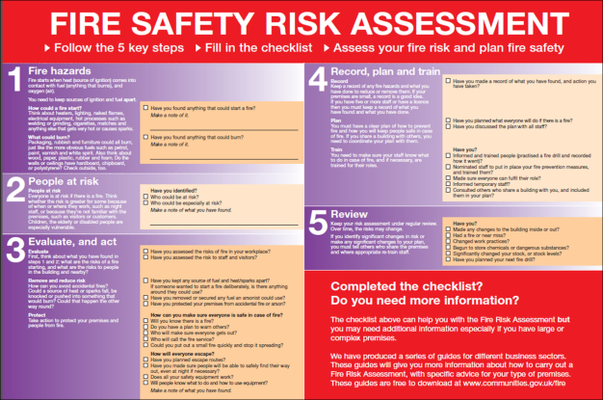
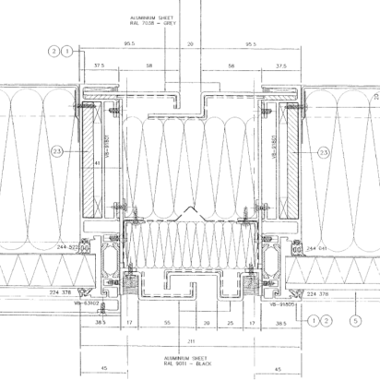
The Change…. Underwriting Information
June 2017 marked a watershed moment for local councils and housing providers, inspiring a renewed focus on fire risk.
Insurers worked closely with customers providing risk management and where appropriate improving fire safety of their property portfolio.
We now obtain far more underwriting information. The challenge remains tough… Typically its very complex – so how do UWs go about assessment?

Slide 26
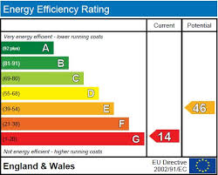
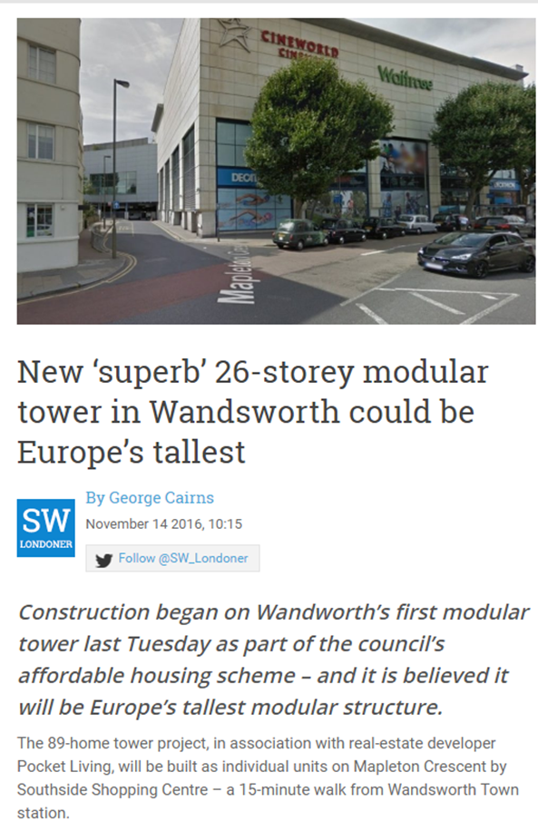
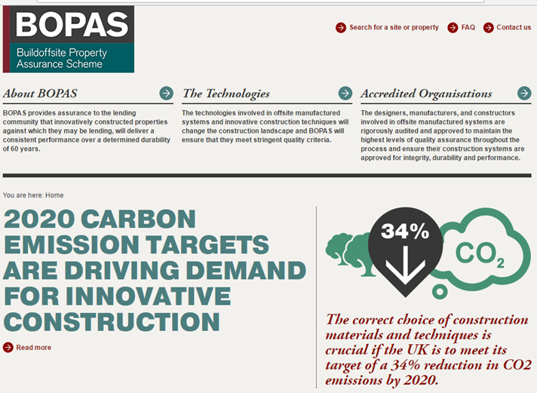
Construction
Notes:
In addition, building methods are changing at a break net pace. Modular, MMC, Offsite consruction, all collective names for the myriad of new construction methods.
(see pick of CLT high rise as they can now build over 7 floors) Aided by a government white paper pushing builders to meet new home targets and the green agenda pushing for energy efficiency. What is yet to be established is the performance of these products over time and Their durability to the Great British weather!
BOPAS is their association and are there to influence both mortgage lenders and insurers amongst others that their products are suitable. But remember, it is a lobbying group, they do not provide a guarantee/latent defects product to support their statements, like NHBC, so be interesting to see whether their involvement brings over time.

Slide 27
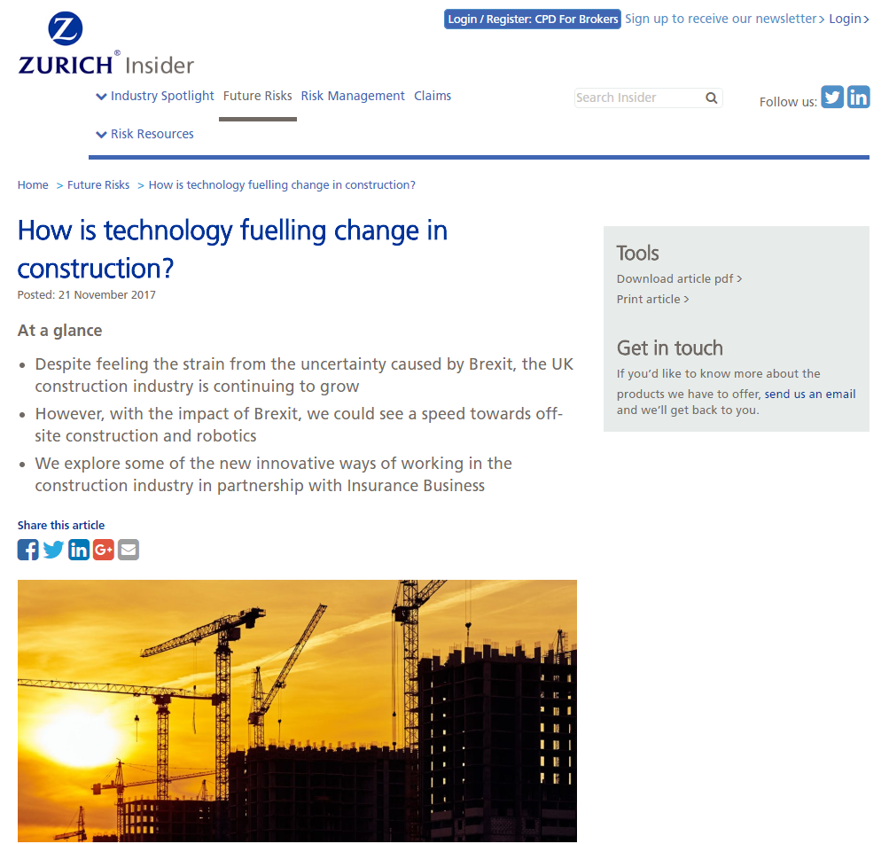
Modifications
Notes:
However, building modifications, refurbishment and improvements to tower blocks such as installation of central heating, new kitchens and bathrooms, fire detection and replacement windows while raising the standard of the property can have a detrimental effect on the building’s performance in the event of a fire. Control of contractors and quality assurance of the work can be critical.
What JCT conditions has the contract been awarded under? That will denote who the employer is, who needs to take out insurance, what needs covered and whether joint names with the contractor is required and make it clear
Who is responsible for their part of the construction to enable recoveries to be made in the event of a loss.
Extreme method of modificiation – we’ve done building down in to basements, now we build up in to airspace which can make a building in to a high rise and change our view on the building as a whole.
And are buildings “as built” or was the specification adjusted by the contractors

Slide 28
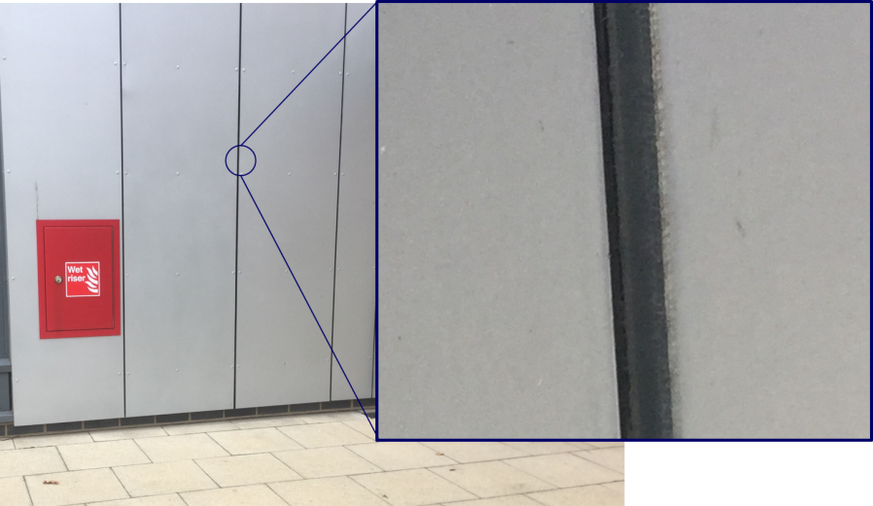
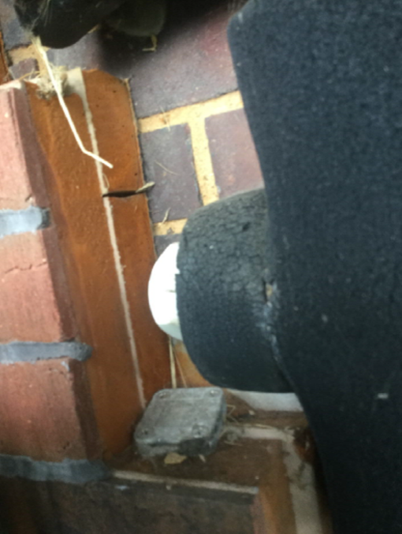
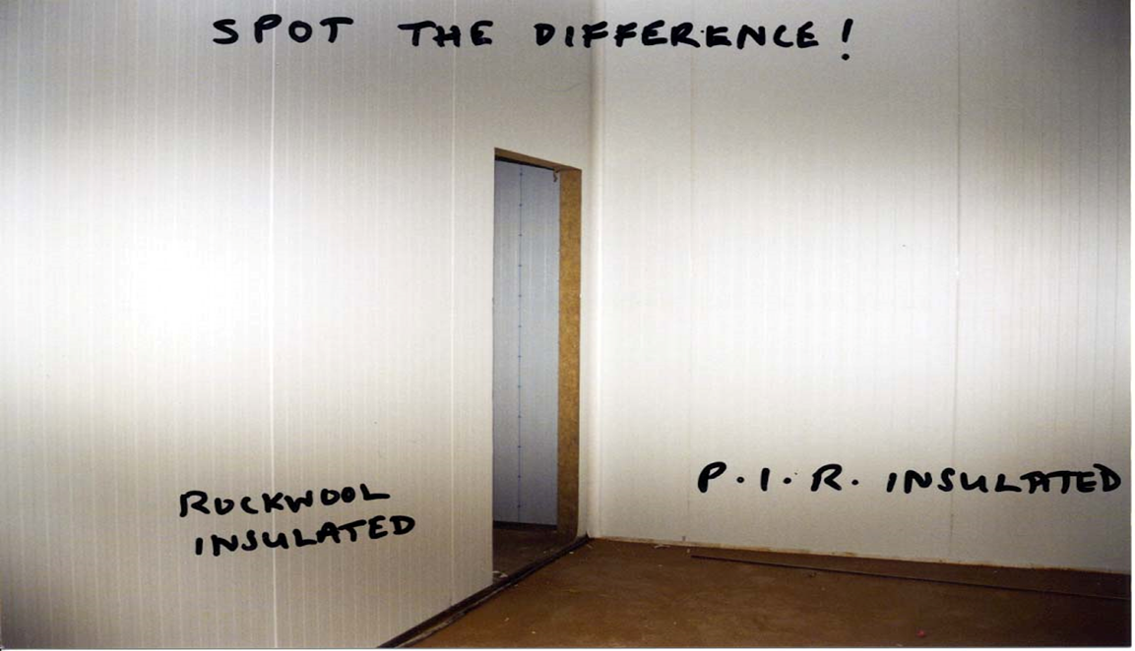
Identification
Notes:
Its very difficult…. But our view hasn’t materially changed irrespective of Grenfell
Identification is extremely difficult, and will continue to be so. The industry is aware of some of these dangers and UWs are becoming accustomed to asking further questions even when on the surface everything seems non-combustible.
Will be an area of potential challenge In future re FPOR and Insurance Act. No one wants to be asking these questions post loss. We need to ask before and will need granular construction detail.

Slide 29


Mitigation
Maintenance
Housekeeping
Fire Protection
Lightning Protection
Waste storage
Fire Risk Assessments
Contractor Controls
Notes:
But its not all bad news, risks can be mitigated.
Maintenance
Heating and ventilation systems should be maintained regularly, particularly where they serve the common parts or are common to more than one flat.
Fixed electrical installations should be subject to periodic inspection and test at intervals determined by a competent person, no greater than every five years in the case of the common parts and every ten years for installations within each flat.
Regular inspections on cladding with immediate Remedial action. Inspection where possible, height restriction on cladding for arson risk. Know the % of cladding and fire breaks compartmentation crucially important for safe evac and
To the fire brigade.
Also licence or monitoring of tenant upgrades to flat entrance doors to preserve fire resistance
Housekeeping, regular reviews of common areas, with a robust maintenance regime. Smoking? What is the policy? Completely sterile and zero tolerance or managed use?
You Remove opportunities for arson, through denial of fuel, good security.
Sprinklers – are the current protection of choice and are no doubt the pinnacle of protection. However, they are expensive to retro fit and not the only choice that will work for fire protection. Do not ignore physical onsite
Management of the risk.
Fire wardens (waking watch)
Fire Alarms and ensuring action after false alarms to ensure fire brigade attendance
Evacuation Procedures – review and current
Any lightning protection systems should be subject to regular maintenance.
Remove or prevent the use of waste chutes by sealing the hatches. Provision of suitable waste areas and regular removal will control against opportunistic fire raising
Fire Risk Assesments need to be up to date and regular.
Cold/Hot works – Contractor Procedures – we have issued a good insider on the subject

Slide 30
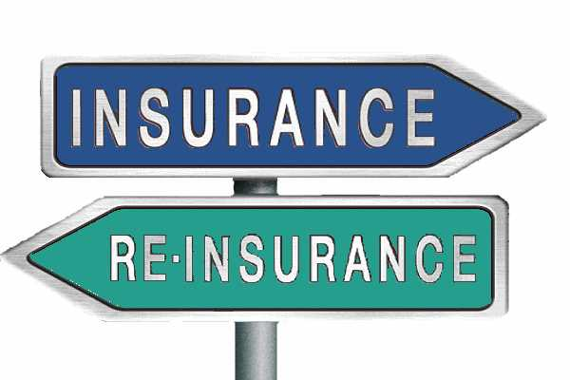
Reinsurance markets will...
  Now decline this type of business
  Manage exposures and reduce overall capacity
All increase the costs of High rise property
  Attaching at higher retentions
Capitalize on hard market, in pockets
Find customers not often aware of dynamics

Slide 31
What does this all mean?
For Insurers
No knee jerk reactions
Insurers to identify key exposures
In-depth discussions at NB & RNL
Brokers work towards FPOR
Underinsurance
Capacity Considerations
Increasing FAC reinsurance costs
Customers open RIA guidance
Tightening UW controls
Evaluating our EML Adequacy
For You
Risk Assessments – proactive as possible
Patience with our questions, it may take longer than last year…
Valuation Programmes and Loss Limits
Tenants may see premium increases
Risk Improvement Actions– requirements to be completed
Insurer partners – the whole proposition is important
Notes:
1 Insurers likely to support their customers – these issues are affecting local authorities and individual customers and they need our help and support
2 additional requirement for insurers to understand what is on their books and provide updated and comprehensive information to UW’s
3 Where buildings are known to contain construction materials that present negative insurance risks and where steps are not being taken to rectify this, it may be necessary for us to reflect this in price, terms offered, a combination of both and in extreme cases refusal of cover.
4Values at risk maybe incorrect, Underinsurance is a perennial problem– and this will only exacerbate concerns on overall exposure - you might see loss limits due to this.
5 what was out of fashion is back In vogue, Scheduling risk is likely to be more common. Its not the size of an insurers capacity, its their insight and willingness to put it down.
6 FAC reinsurance increases leading to premium challenges in a continuing soft market but insurers need to hedge their bets
7 Customers more likely to listen to insurers – getting some traction on risk improvements and an ability for Insurers to provide thought leadership
8 FPOR is critical going forward. Brokers and insurers need to be on the same page. All insurers do not have the same response under the insurance act and we don’t want to get in to technical arguments after the event if we can help it. No one wins in these situations
9 Insurers have put more focus on UW topic, each underwriter will have a different view, but markedly the industry has tightened controls in this sector
EML Adequacy – that we know our exposures and can balance these risks on our book.

Slide 32


THANK YOU - QUESTIONS

